Slide 1



















































Page 01
B1229040 B1229042 B1229052 B1229057
Presented by B1229057 Author by B1229042
GitHub repo: https://github.com/Hanson0901/meeting-assistance

Slide 2

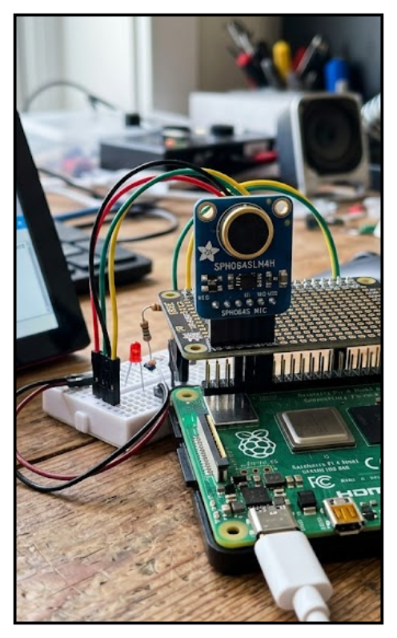

































WHAT OUR ASSISTANCE DOES
Page 02
ASR

Slide 3


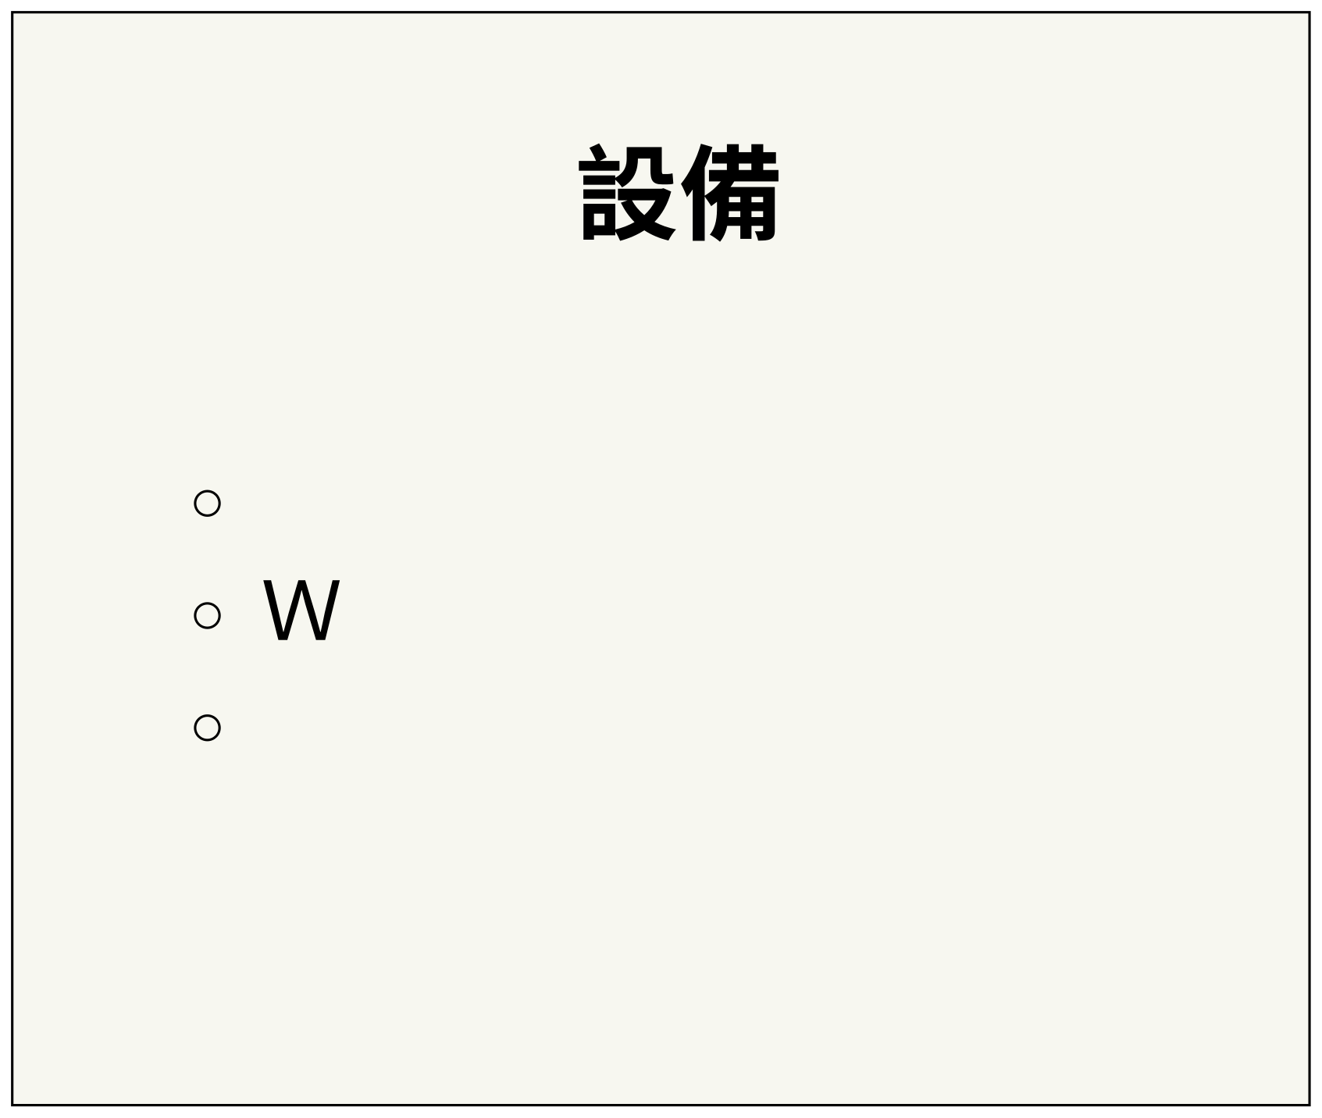
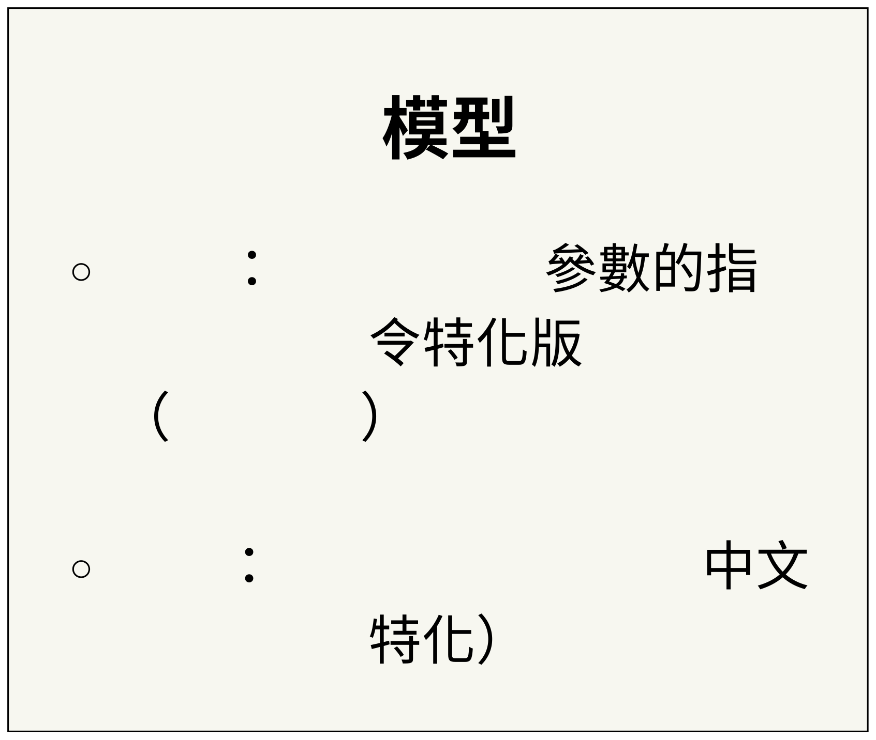
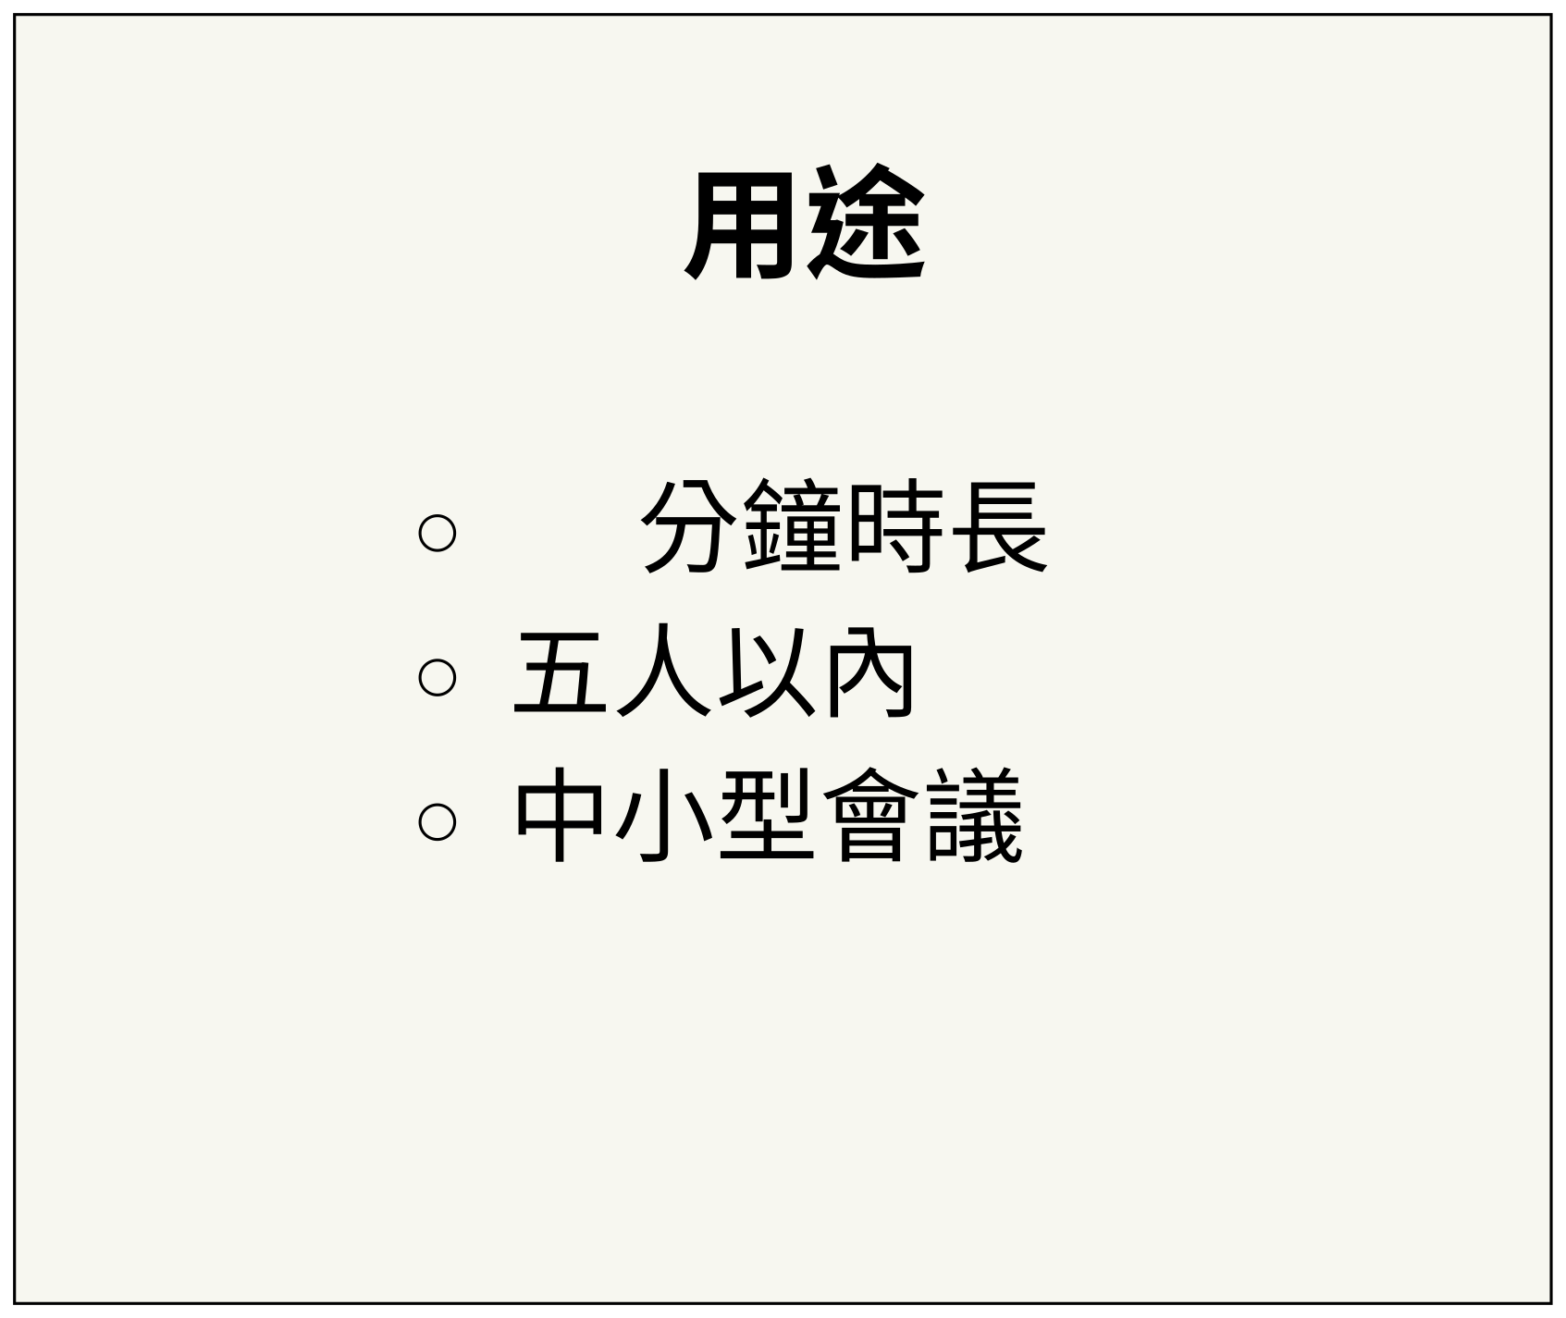
Page 03
WHAT INCLUDED
LLM qwen3-4B
30
Raspberry Pi 5 16GB
ebcam Microphone
Instruct
Bluetooth Transceiver
ASR FunASR(Whisper

Slide 4













































































































































Page 04
TARGET OF PROJECT
Portable
Decentralized
Automatic

Slide 5



























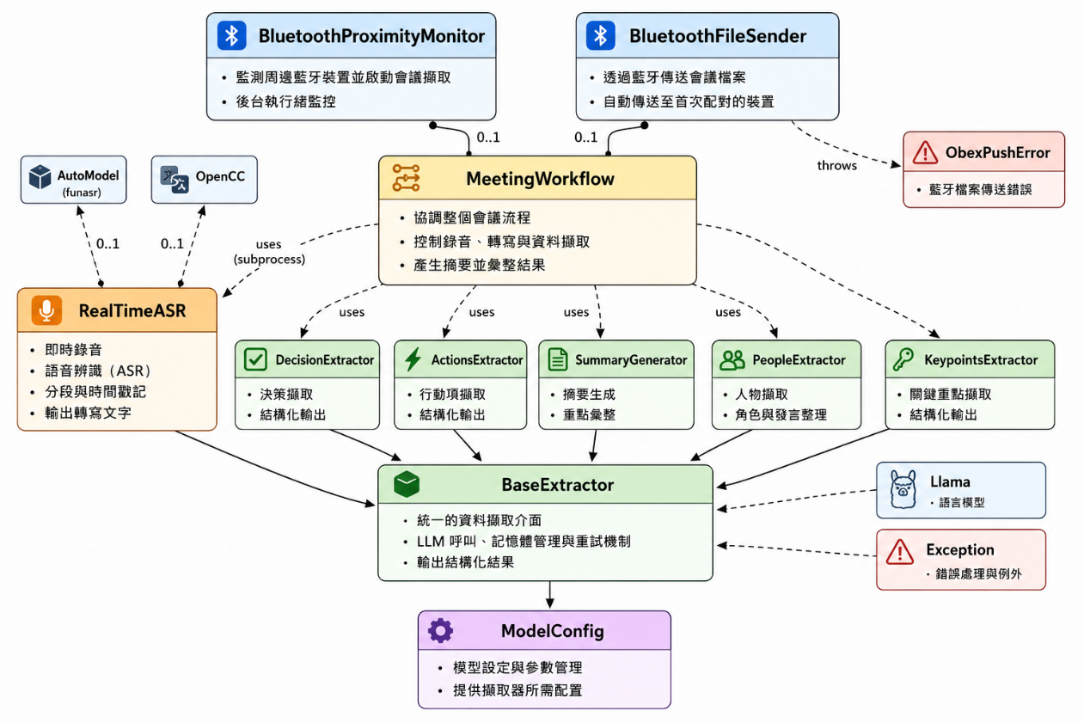
Fradel and Spies
prompt
Page 05
ACR&Tokenization
ASR
(Jieba)
LLM Procedure
prompt
Transmitt

Slide 6
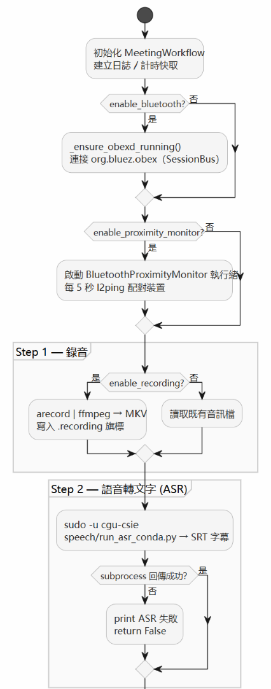







Page 06
ASR &
TOKENIZATION
Paraformer-zhCT-Punc
FSMN-VAD
CAM++

Slide 7





































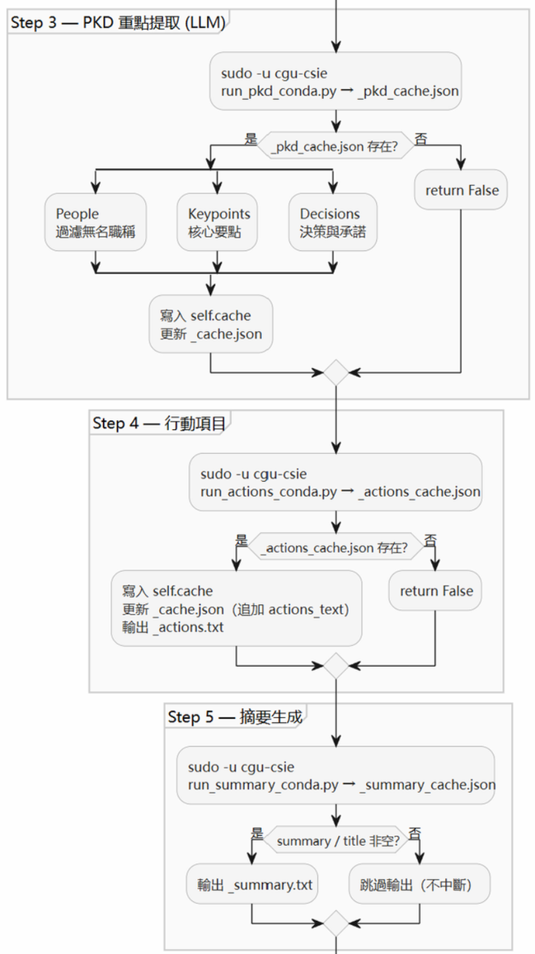














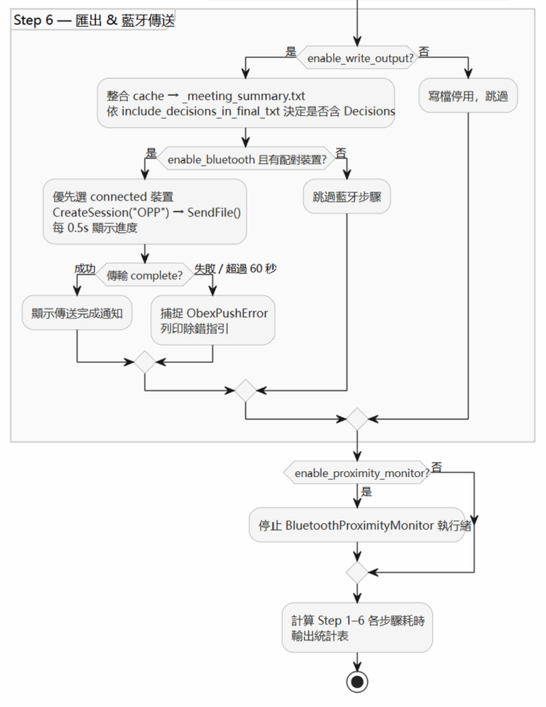
















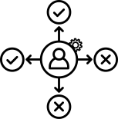














































































LLM PROCEDURE
prompt
Page 07
People
Json
Json
Keypoint
Context
Json
Decision
Context
Json
Action
People
Keypoint
Decision
Json
Summary
txt
markdown

Slide 8










































































































































































Page 08
Memory Management
Log Tracking
10GB
log
KV cache
Debug
POGRESS &DETAIL
Model Loader
Model Parameter
CPU
llama.cpp,
Method
'temperature':0.7,'top_p': 0.8, 'top_k': 20
Model Limit
Expection Restart
context window
8192 tokens
1500
Voiceprint Dynamic ALGO
CAM++
192
0.7
“alpha=0.2ˮ
50

