Slide 1
SMART DUMBBELL
FOR HOME EXERCISE
CCCARE participants exercising independently at home
Following prescribed targets and recording completed activity
Group 57 | ECE 198
Hanson He, Julia Zhang, Zoe Wang, Eric Zhu
Notes:
SLIDE 1 - TARGET 45 SECONDS
Our project focuses on remote, at-home exercise for CCCARE participants. We are targeting program graduates and other participants who can independently perform prescribed dumbbell exercises. At home, they do not have the same immediate support as in a supervised session. We want to help them follow assigned repetition targets and record completed activity. We are comparing a guided exercise station with a smart dumbbell. Both support an existing exercise plan, and neither requires the user to own a smartwatch.
SOURCES AND PRODUCTION NOTES - NOT SPOKEN
F26 ECE 198 Project Overview.pdf, Sub Problem 3. LEARN pitch: https://learn.uwaterloo.ca/d2l/le/content/1318281/viewContent/6736419/View
Status: proposed design and performance targets, not tested results. AI assistance must be reviewed and acknowledged according to the course requirements.

Slide 2
TWO CONCEPT SOLUTIONS
CONCEPT A
Guided exercise station
CONCEPT B
Smart dumbbell
Screen shows exercise and target
Buttons confirm completion
R4 Minima; USB record transfer
Simple setup; self-reported activity
Sensor measures movement
On-device model supports counting
Nano ESP32; local Wi-Fi records
Measured activity; more validation
Current preference: smart dumbbell, to reduce manual recording.
Notes:
SLIDE 2 - TARGET 50 SECONDS
Concept A is a tabletop exercise station. An Arduino R4 Minima would show the assigned exercise and target on an OLED. Buttons let the user start, pause, and confirm completion, with records transferred to a computer by USB. This is relatively simple, but completion is self-reported. Concept B is a smart dumbbell that measures movement and automatically counts repetitions. Its Nano ESP32 would process the sensor data and send records over local Wi-Fi. We currently prefer the dumbbell because it could reduce manual recording. It also requires more development and testing, especially for reliable sensing.
SOURCES AND PRODUCTION NOTES - NOT SPOKEN
Local ECE 198 Remote Care Research and Design Ideas and team concept comparison. Two concepts require team review; neither has been built or tested.
Status: proposed design and performance targets, not tested results. AI assistance must be reviewed and acknowledged according to the course requirements.

Slide 3
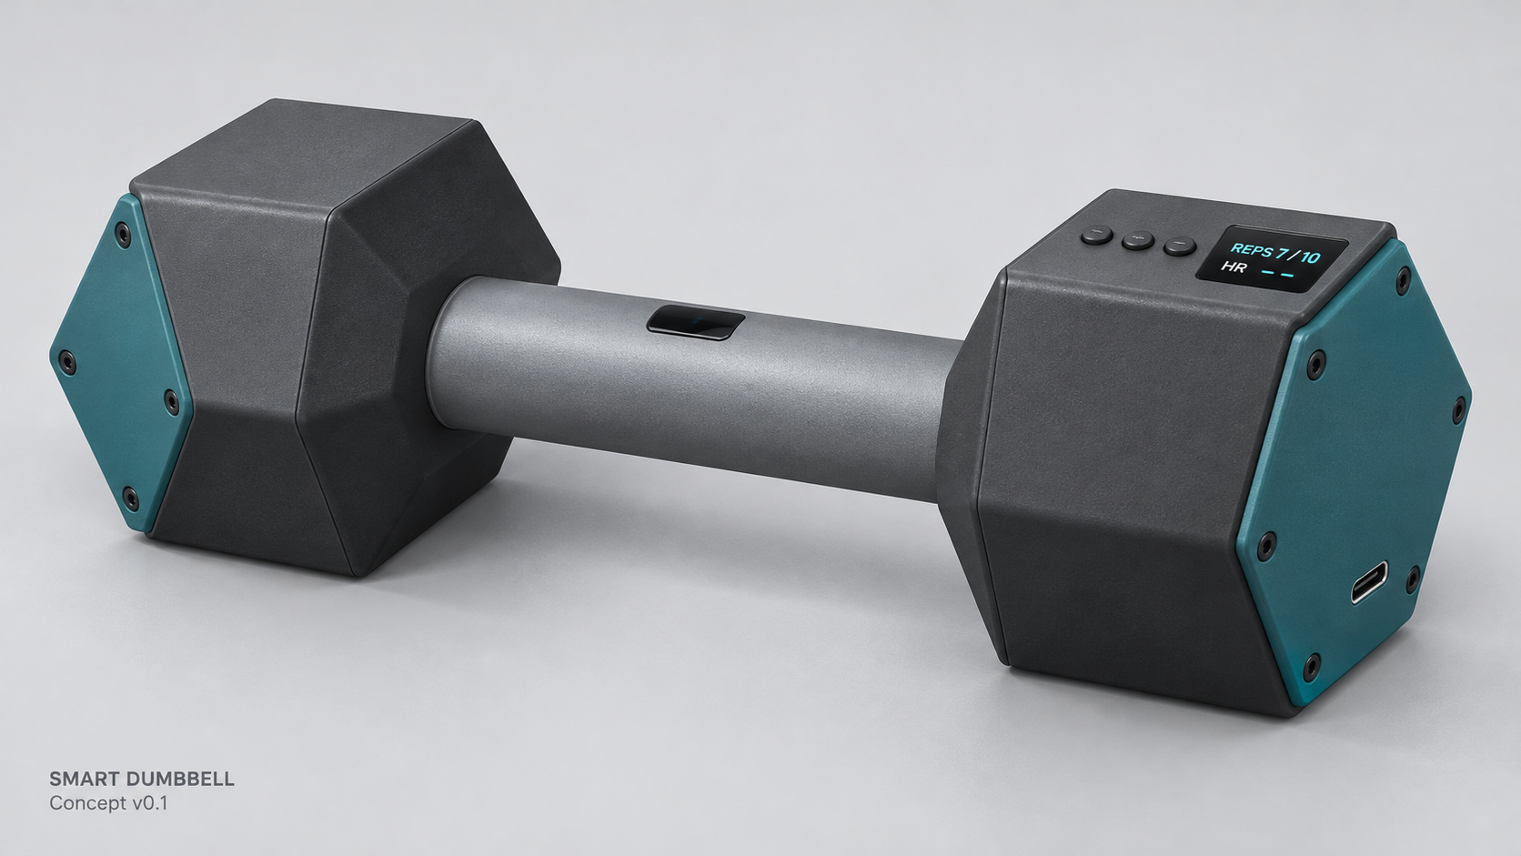
SMART DUMBBELL CONCEPT
One exercise: bicep curl
Model classes: curl, idle, other
Complete movement cycles count as repetitions
OLED shows progress toward the target
Heart rate during movement: to be validated
AI-generated concept image; component fit is not yet verified.
Notes:
SLIDE 3 - TARGET 60 SECONDS
Our first dumbbell prototype would support one exercise: the bicep curl. A fixed accelerometer would provide movement data to a small model running on the controller. The model would distinguish curls, stationary periods, and other movements. Separate logic would count a repetition only after a complete outward and return cycle. The screen would show progress, such as seven out of ten repetitions. We also plan to measure heart rate during movement through an optical sensor at the grip. This remains unverified. Poor contact and movement can interfere with readings, so the device must indicate when its signal is unreliable. The image illustrates the concept, not a completed prototype.
SOURCES AND PRODUCTION NOTES - NOT SPOKEN
Arduino Nano ESP32: https://docs.arduino.cc/hardware/nano-esp32/
ADXL335: https://wiki.seeedstudio.com/Grove-3-Axis_Analog_Accelerometer/
MAX30102: https://www.analog.com/en/products/max30102.html
Image: Smart_Dumbbell_Concept_Render_v01.png, AI-generated concept visualization. It is not a CAD-accurate manufacturing drawing. The 80 mm head-width revision is only a candidate and is not shown as final.
Status: proposed design and performance targets, not tested results. AI assistance must be reviewed and acknowledged according to the course requirements.

Slide 4
HARDWARE AND BUDGET
Item | Qty. | Source and purpose
R4 Minima | 1 | Course kit; guided-station concept
Nano ESP32 | 1 | Purchase; dumbbell control, ML and Wi-Fi
ADXL335 + GY-MAX30102 | 1 each | Course loans; motion and optical pulse sensing
OLED + pushbuttons | 1 + 3 | Course kit; feedback and session controls
Power, enclosure and mounts | 1 set | Reuse or purchase; secure portable assembly
Computer | 1 | Existing; training, setup and records
Smart-dumbbell purchase target: CAD 100 including tax and shipping
Assumes sensor loans, an existing computer and affordable enclosure fabrication.
Notes:
SLIDE 4 - TARGET 55 SECONDS
The guided station would mainly use the supplied kit. For the dumbbell, we propose purchasing a Nano ESP32 and borrowing the ADXL335 accelerometer, MAX30102 module, OLED, and three buttons. We would also need a portable power supply and a custom hollow enclosure with secure mounts. The R4 Minima could support bench development, but we would not put both controllers inside the dumbbell. Our additional spending target is one hundred Canadian dollars, including taxes and shipping. This assumes that the loan components are available and that fabrication stays within budget. Actual module dimensions must be checked before finalizing the enclosure.
SOURCES AND PRODUCTION NOTES - NOT SPOKEN
ECE 198 Project Parts List.pdf. Smart Dumbbell Preliminary Specification v0.1. Budget is a target, not a purchase quotation. Nano ESP32: https://docs.arduino.cc/hardware/nano-esp32/
Status: proposed design and performance targets, not tested results. AI assistance must be reviewed and acknowledged according to the course requirements.

Slide 5
INDEPENDENT OPERATION AND RECORDS
ON THE DUMBBELL
ON THE COMPUTER
Internal power supply
Motion inference and repetition count
Heart-rate processing and display
Start, pause and end controls
Train and install the model
Set the prescribed repetition target
Receive data over local Wi-Fi
Save session records for review
Local counting continues if Wi-Fi disconnects. No personal smartwatch is required.
Notes:
SLIDE 5 - TARGET 45 SECONDS
The dumbbell would run its motion model, counting logic, and heart-rate processing locally using internal power. The computer would be used to train and install the model, set the target, and save records. A local Wi-Fi connection would transfer data without relying on campus internet or a cloud service. If the connection drops, counting and the display would continue, while the computer record would mark the missing interval. Complete offline history storage is not yet part of this version.
SOURCES AND PRODUCTION NOTES - NOT SPOKEN
Smart Dumbbell Preliminary Specification v0.1, FR-01 and FR-04 through FR-13. Local setting changes, persistent offline history and later synchronization are possible future additions, not completed functions.
Status: proposed design and performance targets, not tested results. AI assistance must be reviewed and acknowledged according to the course requirements.

Slide 6
VALIDATION AND NEXT STEPS
PROPOSED TEST TARGETS
NEXT BUILD STEPS
Count: within 1 repetition in at least 18 of 20 ten-repetition sets
Heart rate during motion: at least 90% valid readings; mean absolute error no more than 10 bpm
Test on recordings not used for training
Confirm modules and measure their dimensions
Test counting and grip heart-rate signals on the bench
Integrate the electronics before final enclosure printing
Main feasibility risk: maintaining a reliable optical signal while gripping and moving.
Notes:
SLIDE 6 - TARGET 45 SECONDS
We will compare automatic counts with manual observation. Our proposed target is an error within one repetition in at least eighteen of twenty sets of ten. For heart rate during movement, we propose at least ninety percent valid readings and a mean absolute error within ten beats per minute against a reference device. These are targets, not results. We will confirm the components, test sensing on the bench, and integrate the electronics before printing the final enclosure. Reliable grip-based heart-rate measurement is our main feasibility risk.
SOURCES AND PRODUCTION NOTES - NOT SPOKEN
Smart Dumbbell Preliminary Specification v0.1, AT-02, AT-04 and AT-05. Heart-rate testing includes five participants and synchronized reference records; targets apply after initial stabilization. Optical interference: https://www.analog.com/en/resources/design-notes/how-common-noise-and-error-sources-affect-optical-biosensing.html
Status: proposed design and performance targets, not tested results. AI assistance must be reviewed and acknowledged according to the course requirements.

Slide 7
REFERENCES AND AI USE
Course sources
F26 ECE 198 Project Overview and LEARN pitch instructions
ECE 198 Project Parts List
Technical sources
Arduino Nano ESP32 and Seeed Grove ADXL335 documentation
Analog Devices MAX30102 and optical-sensing error guidance
AI disclosure
ChatGPT assisted with drafting and slide preparation.
OpenAI Imagegen produced the labelled concept image.
Team review is required. No prototype results are claimed.
Notes:
BACKUP ONLY - HIDDEN FROM NORMAL SLIDE SHOW
F26 ECE 198 Project Overview.pdf, Sub Problem 3. LEARN pitch: https://learn.uwaterloo.ca/d2l/le/content/1318281/viewContent/6736419/View
Local ECE 198 Remote Care Research and Design Ideas and team concept comparison. Two concepts require team review; neither has been built or tested.
Arduino Nano ESP32: https://docs.arduino.cc/hardware/nano-esp32/
ADXL335: https://wiki.seeedstudio.com/Grove-3-Axis_Analog_Accelerometer/
MAX30102: https://www.analog.com/en/products/max30102.html
Image: Smart_Dumbbell_Concept_Render_v01.png, AI-generated concept visualization. It is not a CAD-accurate manufacturing drawing. The 80 mm head-width revision is only a candidate and is not shown as final.
ECE 198 Project Parts List.pdf. Smart Dumbbell Preliminary Specification v0.1. Budget is a target, not a purchase quotation. Nano ESP32: https://docs.arduino.cc/hardware/nano-esp32/
Smart Dumbbell Preliminary Specification v0.1, FR-01 and FR-04 through FR-13. Local setting changes, persistent offline history and later synchronization are possible future additions, not completed functions.
Smart Dumbbell Preliminary Specification v0.1, AT-02, AT-04 and AT-05. Heart-rate testing includes five participants and synchronized reference records; targets apply after initial stabilization. Optical interference: https://www.analog.com/en/resources/design-notes/how-common-noise-and-error-sources-affect-optical-biosensing.html
AI disclosure: ChatGPT assisted with content organization, speaker notes and file generation. OpenAI Imagegen generated the concept render. Team review and source checking are required before submission. No participant data or successful prototype measurements are claimed.

