Slide 1
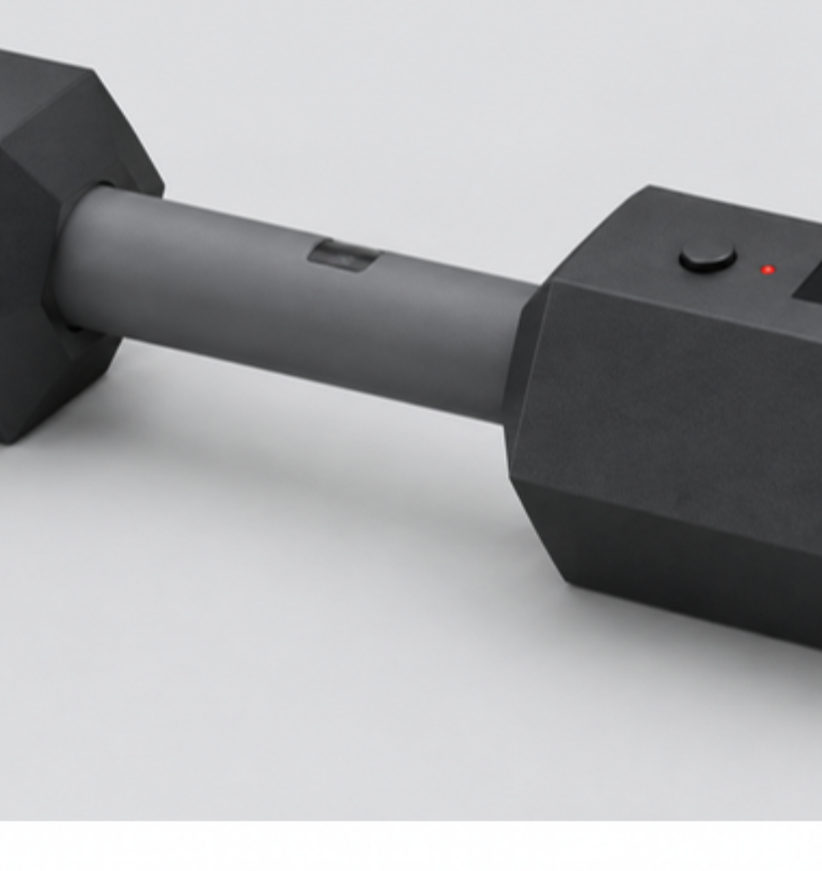
SMART DUMBBELL
Project update, 10 November 2026
ECE 198 Group 57: Hanson He, Eric Zhu, Zoe Wang, Julia Zhang
Counts bicep curls on the device, reads heart rate at the grip, logs every set to a laptop
Notes:
开场 20 秒。一句话说清：给 CCCARE 居家康复用户的智能哑铃，哑铃自己识别并数弯举，握把测心率，数据发到电脑。右边是概念渲染图，不是实物，说清楚。

Slide 2
THREE WEEKS IN: EVERY MODULE RUNS, THE SYSTEM IS HALF INTEGRATED
WORKS ON THE BENCH
IN PROGRESS THIS WEEK
NOT STARTED
Nano ESP32 + IMU + pulse sensor + OLED on one I2C bus, 4 devices, no conflicts
IMU streams 6 axes at 104 Hz, axes verified against the silkscreen
Wi-Fi access point answers HTTP from a phone
Integrated firmware v0: one button, display, 100 Hz pulse sampling, on-device model call
Laptop logger prototype with CSV export (on a mock server)
Schematic v2 drawn in EasyEDA, reviewed; Bluetooth web dashboard merged
Rewiring the bench onto a half-size breadboard after the first board failed
Rep counter and heart-rate detector are placeholders in the integrated app; both need real-motion tuning
Recording rig and protocol ready; first 3 people this week
Enclosure layout v0.2 drawn; first print this week
Model trained on real recordings (pipeline tested on synthetic data only)
Device-side Bluetooth service for the dashboard; logger against real firmware
Any of the ten acceptance tests
Printed enclosure
Parts arrived 3 Nov · bring-up records in tests/results · integrated firmware first run 6 Nov
Smart Dumbbell | Project update | 10 November 2026
PAGE 2
Notes:
40 秒。三栏按能跑 / 在做 / 没开始分，只说仓库 main 上有的东西。重点：四个模块一条总线通了，整合固件上板跑过一次，原理图有了，Zoe 的蓝牙仪表盘合进去了。坦白：计数器和心率是占位实现，真人数据为零，验收测试为零，壳没打印。台架接好的话这页讲完举起来按一下。

Slide 3
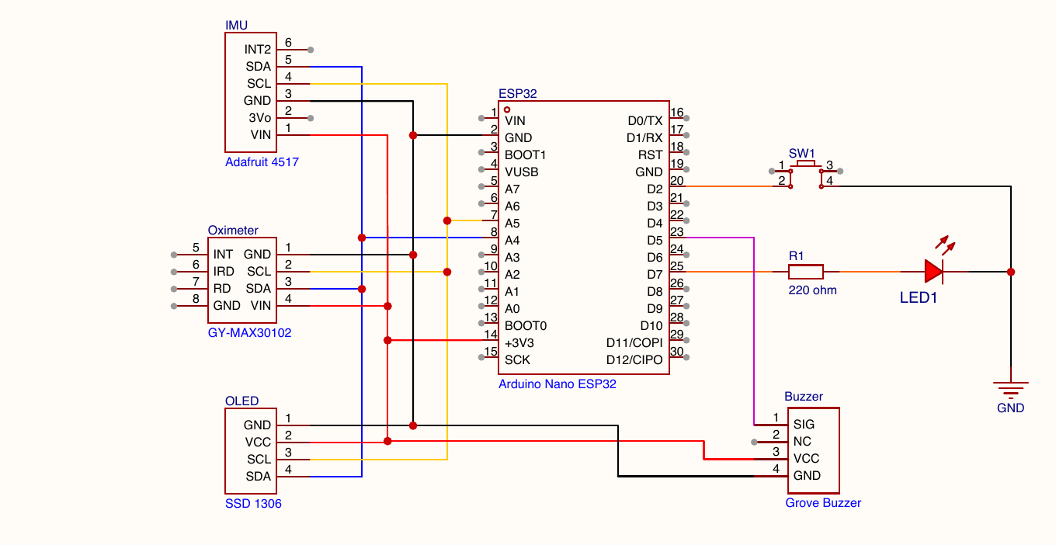
THE BENCH PROTOTYPE, MEASURED ON 3 AND 6 NOVEMBER
Check | Result | Status
I2C devices found | 4 of 4 | pass
IMU sample rate | 104.0 Hz | pass
Samples lost with display on | 0 in 20 s | pass
Pulse sampling | 100 Hz | pass
Model inference on device | 2.3 ms | pass
Button start / pause / end | events logged | pass
Rep count on a real curl | — | not tested
Heart-rate value | 9–14 bpm high | open
Found and fixed: the display library dropped the bus to 100 kHz and a full-frame refresh delayed IMU samples; the frame is now sent in 64-byte chunks between samples.
Schematic v2 (EasyEDA, 8 Nov) · one button on D2 · all modules on the Nano 3V3 rail · records: tests/results, 3 Nov and 6 Nov
Smart Dumbbell | Project update | 10 November 2026
PAGE 3
Notes:
45 秒。左边原理图，右边串口实测表。强调数字是串口读出来的。讲一个踩过的坑：显示库把总线降到 100 kHz、整帧刷屏拖慢 IMU，改成分块发送。最后两行明确说没测和未解决。

Slide 4
COUNTING CURLS: A CLASSIFIER GATES A SIMPLE COUNTER
IMU 104 Hz
2 s window, 31 features
Classifier on the Nano
Counter (placeholder)
3-axis accel + 3-axis gyro, X axis along the grip
mean, spread, range, zero crossings per axis; one result per second
logistic regression: curl / idle / other with confidence; trained on the laptop, exported as a C header
gyro rate crosses +60 then -60 deg/s and settles, 0.6-5 s per rep; gate on the curl label once the model is real
WHY TWO PARTS
WHERE IT STANDS
The counter alone counts any swing. The classifier alone cannot tell one rep from two. Together: a half rep, a pause or picking the dumbbell up does not count (FR-05, FR-06).
Training pipeline and on-device inference agree to 1e-6, but only on synthetic data. The counter thresholds are guesses and have not been tested on a real curl. Real recordings start this week; evaluation is split by person, never by random windows. Target: macro-F1 ≥ 0.85, count within ±1 on 18 of 20 sets.
ml/workplan.md · classification: Hanson · counting and integration: Julia
Smart Dumbbell | Project update | 10 November 2026
PAGE 4
Notes:
45 秒。为什么分两条线：计数器单独会把晃动也数进去，分类器单独分不清一次和两次。现状：流程在合成数据上通了，真人数据这周开始录，按人划分评估。目标数字是提议值，未验证。

Slide 5
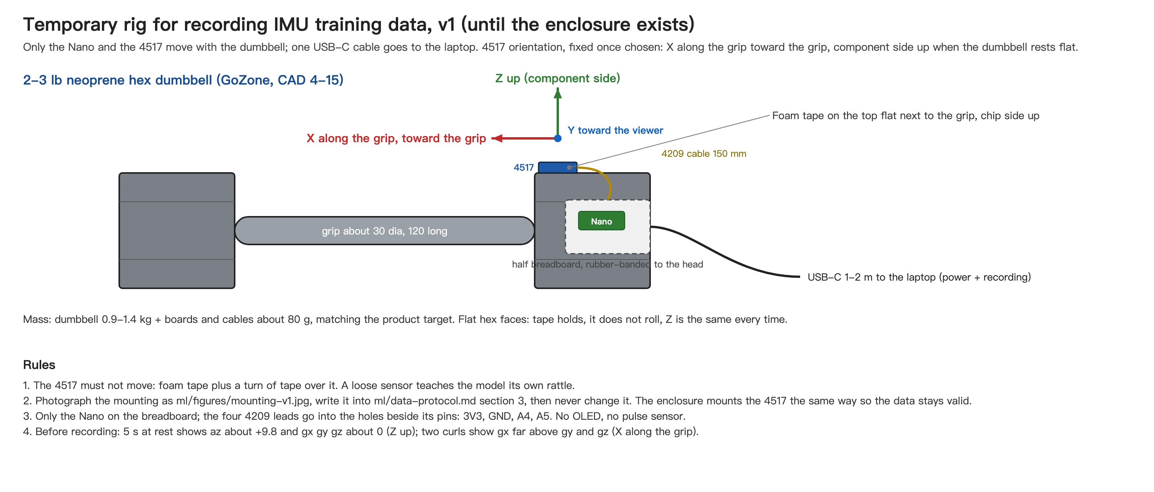
TRAINING DATA STARTS THIS WEEK, BEFORE THE ENCLOSURE EXISTS
RIG
IMU taped to a 3 lb hex dumbbell, X axis along the grip, orientation photographed and frozen; the same mounting goes into the printed head.
PROTOCOL
6 people, anonymous IDs. Per person: curls slow / normal / fast, three kinds of idle, two minutes of other movements, one minute of half reps. 104 Hz CSV over USB.
WEIGHT
Main recordings at 1.4 kg, checks at 0.9 and 2.3 kg. Product target 1.5 kg, washer ballast adjustable 1–3 kg: senior strength classes use 1–3 lb, early cardiac rehab 1–5 lb.
ml/data-protocol.md · evaluation split by person, never by random windows · 0 recordings as of 8 Nov
Smart Dumbbell | Project update | 10 November 2026
PAGE 5
Notes:
35 秒。老师最可能问数据从哪来，这页先答。三点：临时台架（IMU 贴在 3 lb 六角哑铃上，朝向定死，壳里照搬）、录制协议（6 人、匿名、三种速度弯举加 idle、other、半次）、重量依据（老年课 1–3 lb、心脏康复 1–5 lb，所以成品 1.5 kg、可调 1–3 kg）。诚实说：到 8 号为止 0 条录音。

Slide 6
HEART RATE AT THE GRIP IS OUR BIGGEST OPEN RISK
0.1–0.4 %
+9 to +14
NEXT TWO WEEKS
Replace the detector with band-pass filtering and peak picking
Borrow a reference device and run the 60 s synchronized comparison (AT-04)
Decide before the method freeze: keep valid heart rate during motion, or report it only when signal quality allows and guarantee it between sets
pulse amplitude relative to DC, finger still, at rest
bpm error of our best offline estimate vs a watch reading 86, at rest
Sensor, bus and finger detection work; the library beat detector does not. A band-pass plus peak-picking replacement is planned, not yet on the board.
A curl is about 1 Hz, in the same band as heart rate, so motion will make this worse.
Firmware already follows FR-08: no finger, too few beats or stale data shows HR -- and logs invalid, never an old value.
We would like your view on that spec change today.
Measurements 3 Nov, tests/results/2026-11-03_bringup-05-max30102.md · outcome recorded as inconclusive
Smart Dumbbell | Project update | 10 November 2026
PAGE 6
Notes:
45 秒。最诚实的一页。两个大数字：脉搏幅度只有直流的千分之一到千分之四，静止时最好的估计也高 9 到 14。运动 1 Hz 和心率同频带，运动中更差。然后把问题抛给老师：规格里运动中心率能不能改。这是 Q&A 第一个问题。

Slide 7
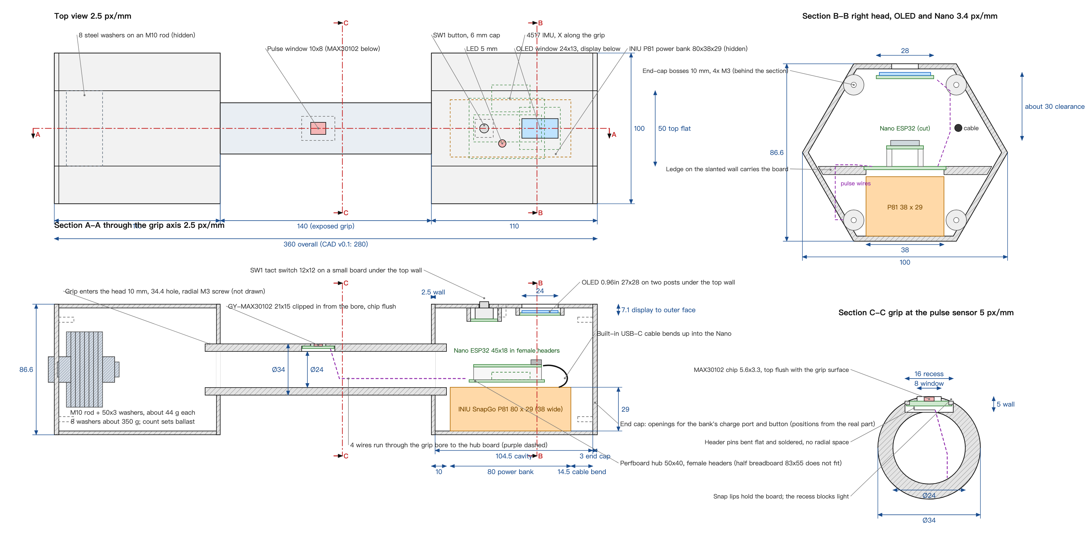
ENCLOSURE, THE ROAD TO 25 NOVEMBER, AND THREE QUESTIONS
Week | Milestone
10–16 Nov | Recordings from 4+ people; first real model; counter tuned offline; printed head fit check; logger talks to the real firmware
17–21 Nov | Model on device gating the counter; assembled dumbbell; count, interference, 10 min and reconnect tests on the device
22–24 Nov | Freeze, spare board flashed, three rehearsals of the 90 s demo
25 Nov | Symposium: start, 10 counted curls, swing not counted, grip heart rate, set logged on the laptop
QUESTIONS FOR YOU
Layout v0.2: electronics and the 5000 mAh power bank in one hex head, steel-washer ballast in the other, pulse sensor flush in the grip. Target 1.5 kg, adjustable 1–3 kg by washer count. First print this week.
1. May we restate the in-motion heart-rate requirement as above?
2. Symposium format: table, power, how long per visitor?
3. We are at CAD 120 of our own money; is a 200 ceiling reasonable?
Enclosure: Eric · electronics and heart rate: Zoe · classification: Hanson · counting, integration, logger: Julia
Smart Dumbbell | Project update | 10 November 2026
PAGE 7
Notes:
40 秒。左边布局图只说三点：电路和充电宝在一头、配重在另一头、心率在握把。右边时间表快速过，落点是 11-25 要演示的那 90 秒。最后三个问题直接念，留给 Q&A。

Slide 8
QUESTIONS?
WHAT WE WOULD LIKE YOUR VIEW ON
1. Heart rate during motion: keep FR-07 as written, or report it only when signal quality allows and guarantee it between sets?
2. Symposium on 25 November: table, power, time per visitor?
3. Budget: CAD 120 of our own money spent; is a 200 ceiling reasonable?
Repository: github.com/juliazhang1015/smart-dumbbell
Smart Dumbbell | Project update | 10 November 2026
PAGE 8
Notes:
问答时停在这页。先把三个问题念一遍让老师先答，再接老师的问题。问答预案见 docs/update-presentation-2026-11-10.md 第 3 节。

