Slide 1
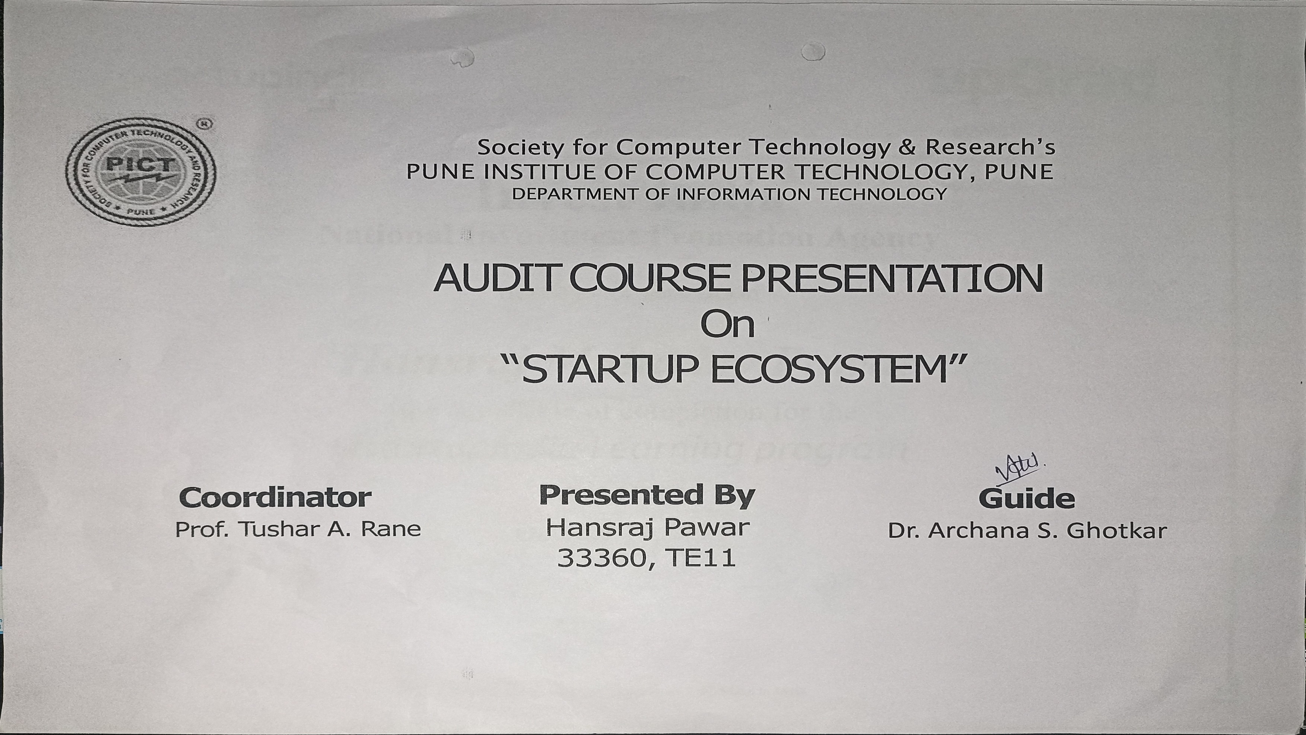

Slide 2
Unlocking the Power of Startup Ecosystems 🚀
Discover the fundamental components, role of stakeholders, funding opportunities, and challenges that shape the vibrant world of startup ecosystems.

Slide 3

Definition of Startup Ecosystem
1 2
3
A Thriving Network
A dynamic system of interdependent actors, resources, and conditions that nurture the growth of startups and entrepreneurship.
Enabling
Co llaborat ion
A melting pot where passionate entrepreneurs, investors, mentors, and support organizations come together to foster innovation.
Driving Economic
Growth
An engine that generates job opportunities, attracts investments, and transforms cities into innovation hubs.

Slide 4
Key Components of a Startup Ecosystem
Dedicated Physical Spaces
Catalyzing innovation, co-working spaces and incubators provide entrepreneurs with a collaborative environment to learn, network, and grow.
Access to Talented Individuals
A pool of skilled professionals, mentors, and advisors empowers startups with knowledge, expertise, and guidance.
Solid Support Infrastructure
Strong networks of legal, financial, and marketing services offer startups the essential resources for success.
Vibrant Culture of Entrepreneurship
Communities that celebrate risk-taking, embrace failures, and encourage creativity foster a culture of innovation.

Slide 5
Role of Government & Supporting Ins titutions
Government
Policies, tax incentives, and regulatory frameworks create an enabling environment and provide crucial support for startups to thrive in.
Academic Ins titutions
Collaboration between universities and startups encourages knowledge transfer, research, and development.
Investors
Venture capitalists, angel investors, and crowdfunding platforms contribute essential funding for early-stage startups.

Slide 6
Importance of Talent & Skill Development
1
Skills for Success
Equipping entrepreneurs with business acumen, leadership skills, and technological expertise empowers them to overcome challenges.
2
Education & Training Programs
Startup-specific educational initiatives develop entrepreneurial mindsets and provide practical knowledge.
3
Mentorship & Networking
Experienced mentors and networking events facilitate learning, growth, and valuable connections.

Slide 7


Access to Funding & Investment Opportunities
Venture Capital
Critical funding from financial institutions fuels innovative ideas and propels startups forwa rd.
Angel Investors
Individuals with financial resources and industry expertise provide early-stage startups with capital and guida nc e .
C rowdfunding
A novel way to secure funds by engaging the community, showcasing ideas, and building a loyal customer base.

Slide 8
Success Stories from Startup Ecosystems
1 2
3
Silicon Valley
The birthplace of groundbreaking tech companies like Google, Apple, and Facebook, Silicon Valley showcases the power of innovation and collaboration.
Tel Aviv
From the "Start-Up Nation," Tel Aviv boasts a thriving ecosystem known for its cybersecurity, fintech, and artificial intelligence breakthroughs.
Bengaluru
India's Silicon Valley is a testament to the potential of a local ecosystem, nurturing globally recognized startups in IT, biotech, and e-commerce.

Slide 9
Challenges & Future Prospects of Startup Ecosystems
1
Capital Gap
Access to early-stage funding remains a challenge, limiting the growth of startups in certain regions.
Talent Retention
Creating an environment that encourages skilled individuals to stay and contribute to the ecosystem is
c ruc ia l.
2
3
Diversity & Inclusion
Ensuring equal opportunities for
underrepresented groups fosters a
more resilient and innovative startup
ecosystem.

Slide 10

Conclusion: Embracing the Startup Journey
As we conclude our exploration of startup ecosystems, we emphasize the importance of collaboration,
innovation, and adaptability. By nurturing talent, fostering supportive environments, and addressing
challenges, we can unlock the full potential of startup ecosystems and create a thriving landscape for
e ntre pre ne urs hip.

