Slide 1
Cardiovascular Risk Prediction
CAPSTONE PROJECT
Presented By:
HANS RAJ
ALLIANCE COLLEGE OF ENGINEERING AND DESIGN
BTECH-CSE

Slide 2
OUTLINE
Problem Statement (Should not include solution)
Proposed System/Solution
System Development Approach (Technology Used)
Algorithm & Deployment
Result
Conclusion
Future Scope
References

Slide 3
Problem Statement
Current Healthcare Challenge
High Cardiovascular Disease Rates: Cardiovascular diseases remain a leading cause of mortality globally, imposing significant healthcare burdens.
Limited Early Detection Tools: Current methods for identifying at-risk individuals often lack precision, leading to missed opportunities for early intervention.
Data Complexity: Healthcare data, encompassing diverse demographic and health parameters, poses challenges for accurate risk assessment.
Inefficient Risk Assessment: Existing tools may not effectively leverage the breadth of available data to predict cardiovascular risks accurately.
Delayed Diagnosis: Late identification of high-risk individuals hampers timely interventions and preventive measures.
Healthcare Resource Strain: High disease prevalence strains healthcare resources, highlighting the need for proactive and targeted healthcare strategies.

Slide 4
Proposed Solution
Prediction of Cardiovascular Risk: Develop a robust predictive model to assess the risk of cardiovascular diseases based on demographic, behavioral, and medical data.
Approach
Data Collection: Gather comprehensive datasets from the Framingham cardiovascular study and other relevant sources.
Data Preprocessing: Cleanse, preprocess, and standardize the data to ensure consistency and accuracy.
Feature Selection: Identify key predictors through statistical analysis and domain knowledge.
Model Development: Implement machine learning algorithms like Gradient Boosting, Random Forest, and Logistic Regression for risk prediction.
Model Evaluation: Assess model performance using metrics such as accuracy, precision, recall, and F1 score.
Expected Outcomes
Accurate Risk Assessment: Provide clinicians with reliable predictions to identify individuals at high risk of cardiovascular diseases.
Early Intervention: Enable proactive healthcare interventions tailored to individual risk profiles.
Improved Patient Outcomes: Contribute to better patient management and reduced incidence of cardiovascular events through timely interventions.

Slide 5
System Approach
Python Libraries : Scikit-learn: For machine learning algorithms like Gradient Boosting, Random Forest, and Logistic Regression.
Pandas and NumPy: For data manipulation and preprocessing tasks.
Matplotlib and Seaborn: For data visualization and model performance analysis.
XGBoost or LightGBM: Optional for boosting algorithms if not included in Scikit-learn.
Development Environment
IDE: Jupyter Notebooks
Version Control: Utilize Git for version control to track changes and collaborate effectively.

Slide 6
Algorithm & Deployment
Algorithm Selection
Discuss the choice of algorithms used: Logistic Regression, Random Forest, and Gradient Boosting.
Mention their suitability for the cardiovascular risk prediction task based on initial experimentation and evaluation metrics.
Model Performance
Present key performance metrics (Accuracy, Precision, Recall, F1 Score) for each algorithm.
Highlight the strengths and weaknesses observed in each model's performance.
Deployment Strategy
Integration into Healthcare Systems:
Collaborate with healthcare providers to integrate the model into existing diagnostic workflows.
Ensure compatibility with electronic health records (EHR) systems for seamless implementation.
Real-time Prediction Capability:
Deploy as a web service or API for real-time heart disease risk assessment.
Enable clinicians to make timely and informed decisions based on patient data.

Slide 7
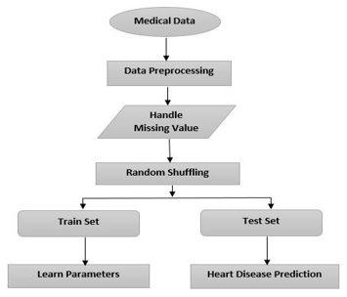
DEsign

Slide 8
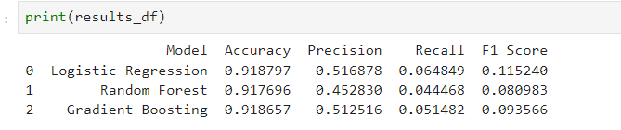
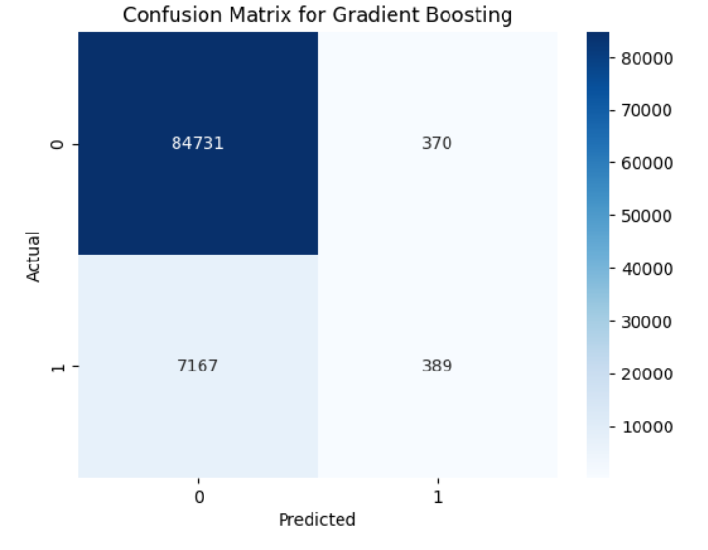
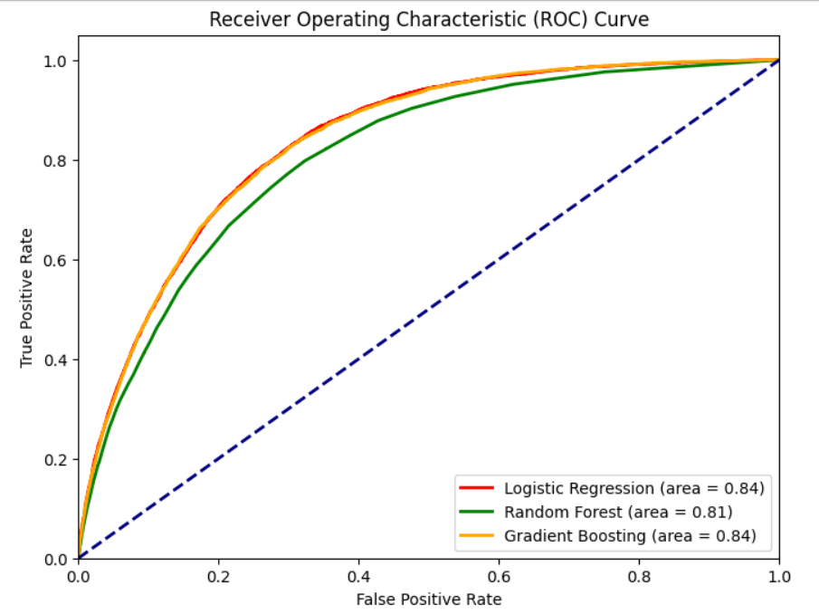
Result

Slide 9
Conclusion
Successful Model Evaluation: We evaluated multiple machine learning models—Logistic Regression, Random Forest, Gradient Boosting, and SVM—on predicting heart disease using data from the Framingham cardiovascular study.
Best Performing Model: Logistic Regression emerged as the top performer with an accuracy of 91% and an F1 score of 0.86, indicating its robustness in predicting heart disease based on our dataset.
Key Predictive Features: BMI, Age Category, Smoking History, and Alcohol Consumption were identified as the most influential factors contributing to heart disease predictions.
Recommendations
Implementation Strategy: Implement Gradient Boosting as the primary model for heart disease prediction due to its superior performance metrics.
Health Interventions: Develop targeted health programs aimed at reducing BMI, managing smoking habits, and moderating alcohol consumption to mitigate heart disease risks among at-risk populations.
Continuous Improvement: Continuously monitor and refine the model with new data to enhance prediction accuracy and relevance in clinical settings.
Next Steps
Deployment: Deploy the model in healthcare settings to assist in early detection and personalized intervention planning for heart disease.
Research Expansion: Explore additional datasets and conduct further research to validate and expand the model's applicability across different demographic and geographic contexts.

Slide 10
Future scope
Continuous Improvement
Data Enrichment: Expand dataset with additional health parameters and demographics to improve model robustness.
Advanced Techniques: Explore ensemble methods or deep learning architectures for enhanced predictive accuracy.
Extended Applications
Risk Prediction Tools: Develop similar models for predicting other cardiovascular diseases or health conditions.
Personalized Medicine: Integrate predictive models with genetic and lifestyle data for personalized treatment plans.
Research and Collaboration
Clinical Trials: Partner with research institutions for validating model predictions in clinical trials.
Global Health Impact: Adapt model for diverse populations and geographic regions to address global health disparities.
Community Engagement
Public Health Initiatives: Support community health programs with data-driven insights to promote preventive care.
Education and Awareness: Educate the public and healthcare providers on the benefits and limitations of predictive models in healthcare.
Regulatory Compliance
Adherence to Standards: Ensure model deployment complies with healthcare regulations (e.g., FDA approvals, ethical guidelines).
Ethical Considerations: Address bias mitigation and fairness in predictive algorithms to uphold patient trust and transparency.

Slide 11
References
M. Saq1ain, W. Hussain, N. A. Saqib and M. A. Khan, "Identification of heart failure by using unstructured data of cardiac patients", 2016 45th International Conference on Parallel Processing Workshops (ICPPW), pp. 426-431, 2016..​
S. Palaniappan and R. Awang, "Intelligent heart disease prediction system using data mining techniques", 2008 IEEE/ACS International Conference on Computer Systems and Applications, pp. 108-115, 2008..​
M. Hertzong and B Poezehl, "Cluster analysis of symptom occurence to identify subgroups of heart failure patients: A pilot study", Journal of Cardiovascular Nursing, vol. 25, pp. 273-283, July/August 2010.​
. Kwon, H. Hwang, H. Kang, K. G. Woo and K. Shim, "A remote cardiac monitoring system for preventive care", 2013 IEEE International Conference on Consumer Electronics (ICCE), pp. 197-200, 2013..​
Y Wei, T Liu, R Valdez, M Gwinn and M.J Khoury, "Application of support vector machine modeling for prediction of common diseases: the case of diabetes and pre-diabetes", BMC Medical Informatics and Decision Making, vol. 10, 2010..​

Slide 12
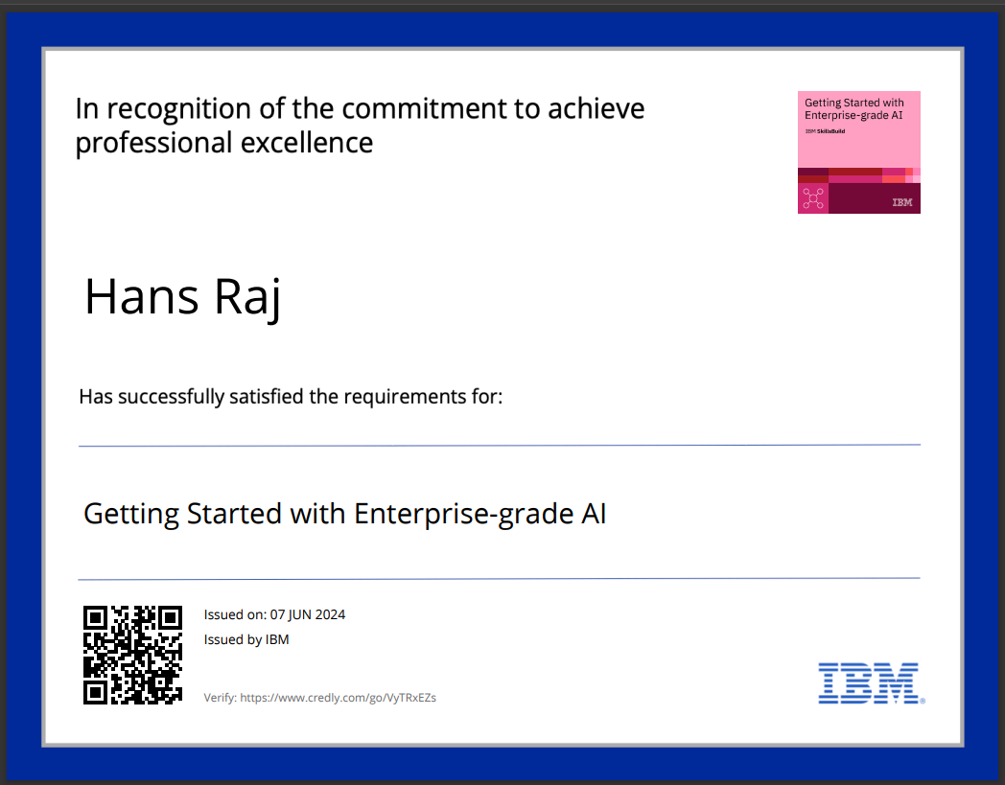
course certificate 1

Slide 13
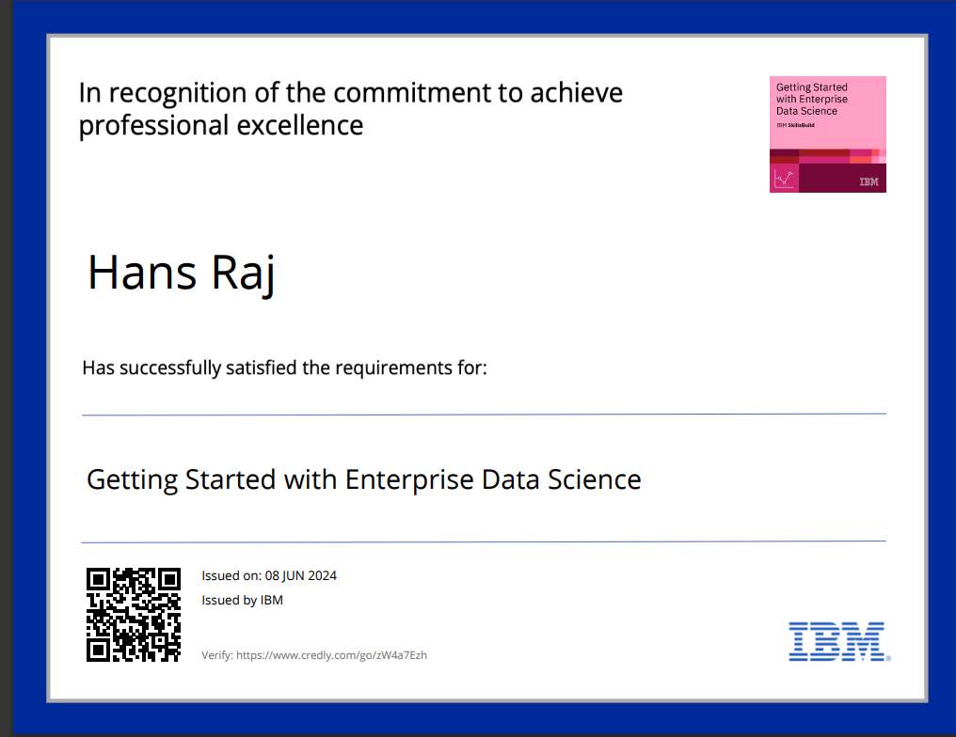
course certificate 2

Slide 14
THANK YOU

