Slide 1
Swami Keshvanand Institute of Technology, Management & Gramothan, Jaipur
“An Autonomous Institute Affiliated to Rajasthan Technical University, Kota”
Department of Information Technology
Industrial Training Presentation
On
Pathik: A Trip Planner for India
Submitted To: Submitted By:
Ms Shalini Singhal Student name
Assistant Professor IT University Roll. No.
Session 2026-27

Slide 2
Outline
1
Company Profile
8
User Workflow & Modules
2
About Training
9
Screenshots: Page Walkthrough
3
Problem Statement
10
Development Methodology
4
Stakeholders
11
Challenges Faced
5
Project Overview
12
Learning Outcomes
6
Technologies Used
13
Future Scope & Conclusion
7
System Architecture
14
Acknowledgement
Pathik · Industrial Training Presentation · Session 2026-27
2

Slide 3



Company Profile
ABOUT THE ORGANISATION
[Company Name]
My role
[Web Development Intern]
Team: [team or department]
[One line on what the company does]
Domain
[e.g. IT services, web and app development]
Founded
[Year]
Location
[City, State]
Mentor
[Mentor name]
[Designation]
Website
[www.company.com]
Clients / products
[Two or three examples]
Text in [brackets] is a placeholder to fill in.
Pathik · Industrial Training Presentation · Session 2026-27
3

Slide 4







About Training & Objectives
THE TRAINING
Training objectives
Training details
Duration
[dd Mon 2026 to dd Mon 2026], [N] weeks
Mode
[Onsite / Remote / Hybrid]
Understand industrial work culture
Enhance technical knowledge
Hours
[e.g. 6 hours a day, Mon to Fri]
Topics covered
Develop practical programming skills
Improve communication skills
HTML5 and accessibility
CSS grid, flexbox, responsive layout
JavaScript, DOM and browser storage
3D graphics with Three.js
Maps with Leaflet
Learn project management
Experience teamwork
UX research and testing
Git and GitHub
Pathik · Industrial Training Presentation · Session 2026-27
4

Slide 5





Trip planning is still a research project
PROBLEM STATEMENT
Where travellers get stuck
141
5 hours
Finding a place
Inspiration is spread across Instagram, blogs and booking sites.
pages of travel content read before booking
spent reading that content (303 minutes)
Knowing about it
Season, routes, real costs and scams sit in old forum threads.
Expedia Group, Path to Purchase study
Expedia Group
Making an itinerary
Copied plans put stops 900 km apart or in the wrong season.
44%
1 in 5
Planning the budget
Package prices hide transfers, tickets and GST.
of travellers worry most about overspending
run into out-of-date information
Enquiring with agents
The same trip retyped to five agents on WhatsApp.
Go City survey, 2024
TripAdvisor data
Booking
Prices 'on request', vague inclusions, full payment upfront.
Pathik · Industrial Training Presentation · Session 2026-27
5

Slide 6






Who is affected
STAKEHOLDERS
Independent traveller
Family traveller
First-time visitor
Travel agent
Wants Cheap, flexible trips
Wants Safe, fully arranged trips
Wants Trustworthy local help
Wants Leads with complete details
Pain Hidden costs, too many tabs
Pain Unclear package inclusions
Pain Scams, unregistered agents
Pain Vague enquiries, lost leads
Hotels and transport
Local guides
Tourism boards
Project team
Wants Bookings across the season
Wants Fair income from tourism
Wants Visitors spread across regions
Wants A working end-to-end product
Pain Peak crowding, empty off-season
Pain Middlemen take the margin
Pain Overcrowded icons, complaints
Pain No backend, static hosting
Pathik · Industrial Training Presentation · Session 2026-27
6

Slide 7
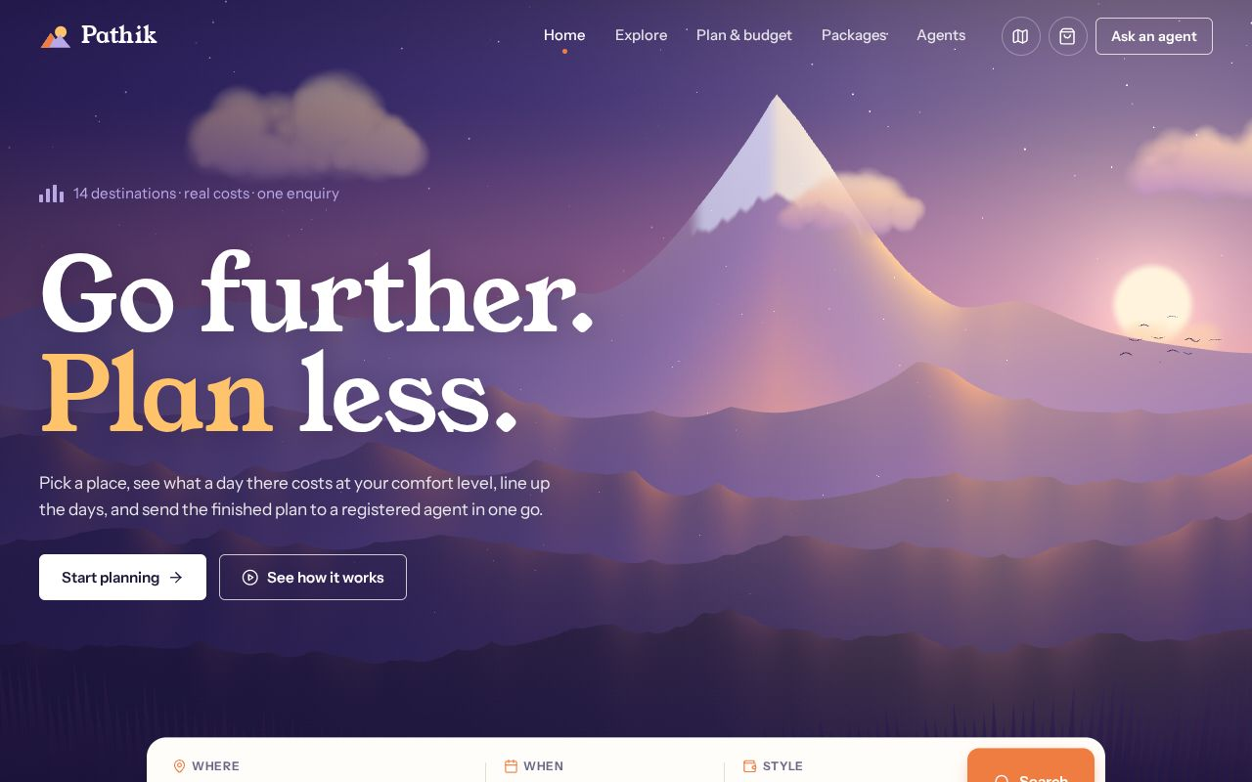
Project Overview
PATHIK (पथिक), 'WAYFARER'
PROJECT TITLE
pathik / home
Pathik: A Trip Planner for India
PROBLEM STATEMENT
Travellers jump between dozens of sites to choose a place, learn about it, plan the days, estimate the cost and reach a trustworthy agent. Costs are hidden and enquiries get lost.
PROPOSED SOLUTION
One website that covers all six steps: discover, learn, plan, budget, enquire and book, with real costs shown before anyone pays.
SCOPE
Domestic and inbound travellers planning trips in India. 14 destinations, 8 packages, 7 sample agents. Runs fully in the browser; prices are estimates.
Pathik · Industrial Training Presentation · Session 2026-27
7

Slide 8




Technologies Used
TECH STACK
Programming languages
Web technologies
Data and storage
HTML5 (semantic, accessible markup)
CSS3 (grid, flexbox, custom properties)
JavaScript ES2019+ (no framework)
Three.js r169: 3D hero with custom shaders
Leaflet 1.9: interactive maps
Lucide icons, Google Fonts
localStorage: trip, cart, enquiries, bookings
JSON data module: 14 places, 8 packages, 7 agents
No server database needed
Tools
Services
Node.js, npm, esbuild (bundling)
Playwright (automated UI tests)
Git and GitHub (pull requests)
Wikimedia Commons (licensed photos)
Esri / OpenStreetMap map tiles
Google Fonts CDN
Pathik · Industrial Training Presentation · Session 2026-27
8

Slide 9



System Architecture
HOW THE PIECES FIT
BUILD STEP
Browser · desktop and mobile
EXTERNAL
src/pages + partials
Wikimedia Commons
→ build.mjs
Home
Explore
Plan & budget
Packages
Agents
photos, CC licences
→ 5 HTML pages
5 HTML pages, each with its own script (home.js, explore.js, planner.js, packages.js, agents.js)
Lucide SVGs
Esri / OSM tiles
→ build.mjs
data.js
store.js
budget.js
ui.js
map background
→ icons.js (58 icons)
Destinations, packages, agents, photos
Shared state in localStorage, change events
Cost model and day-by-day plan
Header, cart, modals, maps, carousels
hero-scene.js
Google Fonts
→ esbuild
Young Serif, Instrument Sans
→ 3D bundle
localStorage · persists across pages and tabs
No server. Every page loads the shared modules first, then its own script. Leaflet and the Three.js bundle load only when needed, so nothing blocks the first paint. The site also opens straight from a file.
Pathik · Industrial Training Presentation · Session 2026-27
9

Slide 10



User Workflow
FROM IDEA TO BOOKING
1
2
3
4
5
6
Discover
Learn
Plan
Budget
Enquire
Book
Home
Explore
Plan & budget
Plan & budget
Agents
Packages
Search, trip types, in-season picks
Season, routes, daily cost, scams, map
Add stops, reorder, set nights and dates
Live breakdown, target meter, warnings
Send the trip to one agent, track the quote
Cart with GST, reserve with 20%
Shortcut: like a fixed package? Book it directly
Shared state: the trip, cart, enquiries and bookings are saved in the browser, so the header counters and every page stay in sync, even across tabs.
Pathik · Industrial Training Presentation · Session 2026-27
10

Slide 11
Modules
REQUIREMENTS F1 TO F6
F1
F2
F3
Discover
Learn
Itinerary
Search with suggestions
Filters: month, region, type, daily budget
Filters saved in the URL
Best months strip
Getting there by air, rail, road
Tips, scams and a location map
Add, remove, reorder stops
Nights per stop, start date
Dated day-by-day plan, season warnings
F4
F5
F6
Budget
Enquire
Book
Stay, food, transport, sights, travel
Rooms split by group size, 10% buffer
Target budget with advice
7 registered agents to choose from
Trip attached to the enquiry
Tracker: sent, seen, quote ready
Inclusions and exclusions listed
Cart with 5% GST line
Reserve with 20%, reference number
Pathik · Industrial Training Presentation · Session 2026-27
11

Slide 12
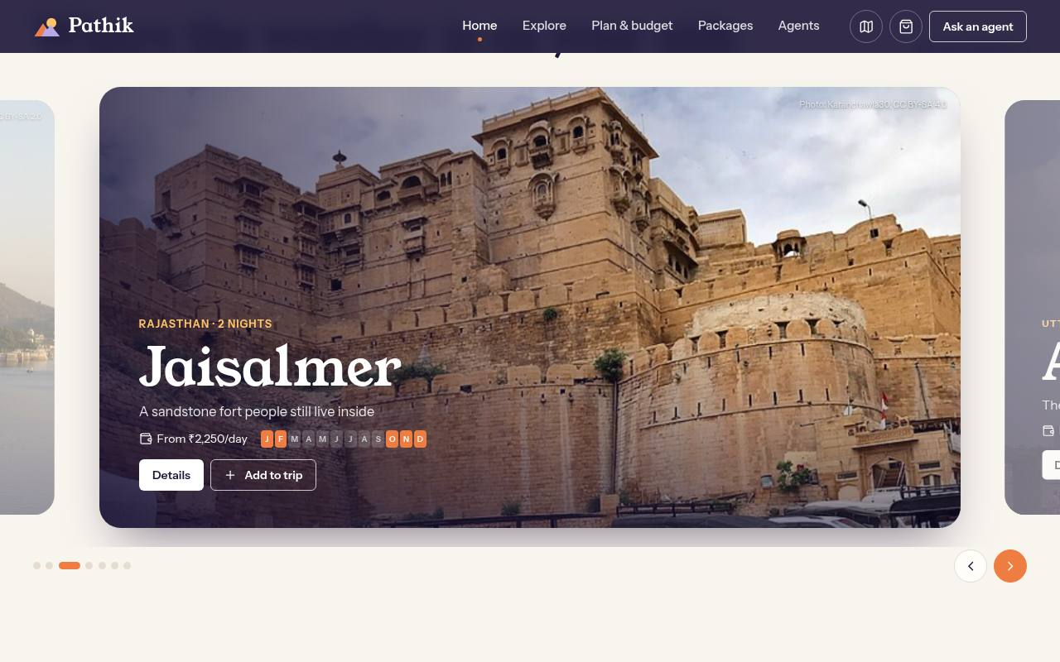
Home: start from a mood or a search
SCREENSHOTS · INDEX.HTML
pathik / home
What it does
3D hero built with Three.js. Loads after the page is ready and pauses when off-screen.
Search bar with suggestions. Sends place, month and style straight into Explore.
Trip types and an in-season carousel picked for the current month.
Fixed-price offers, reviews and travel notes in a reader.
in-season carousel
Pathik · Industrial Training Presentation · Session 2026-27
12

Slide 13
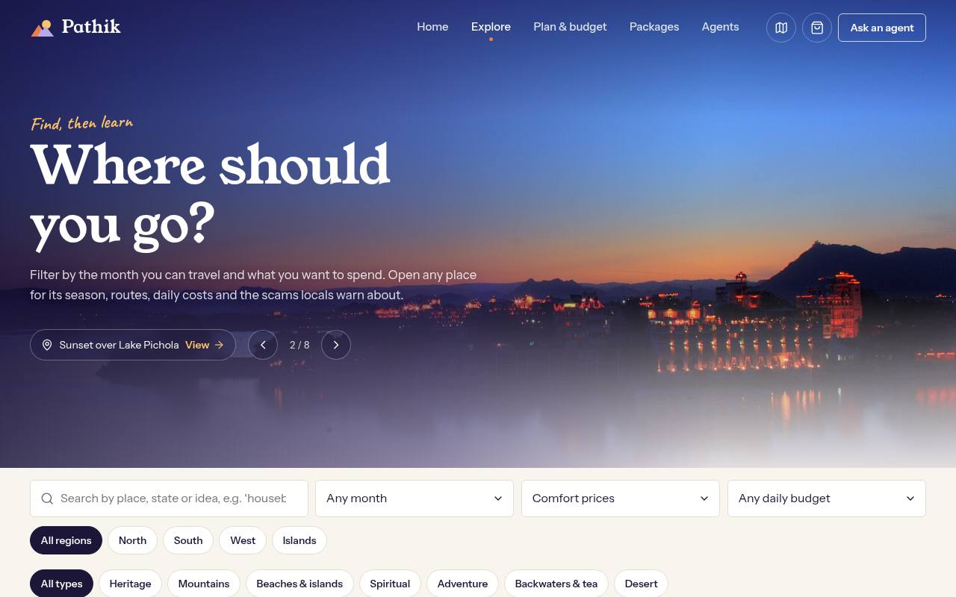
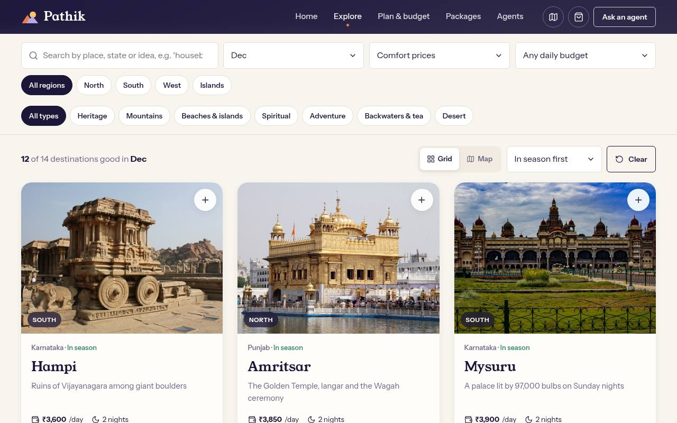



Explore: filter by month and money
SCREENSHOTS · EXPLORE.HTML
pathik / explore
explore?month=12
Filters that stack
Season first
Real photos
Text, month, style, daily budget, region and type. Results update as you type and the URL keeps the state.
Places in season for the chosen month sort to the top and get an 'In season' tag and a month strip.
A slideshow of 8 Commons photos up top, each linking to its destination.
Pathik · Industrial Training Presentation · Session 2026-27
13

Slide 14
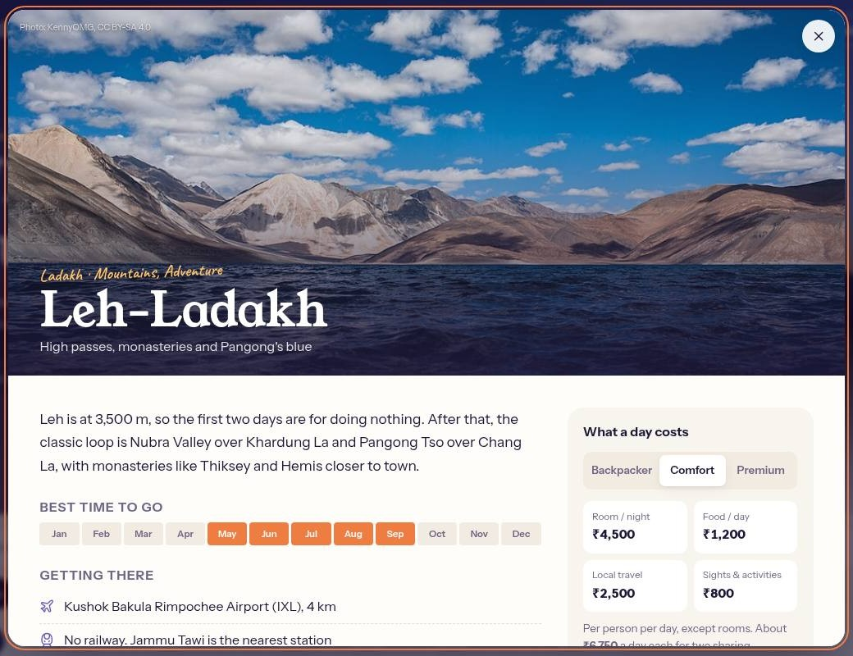
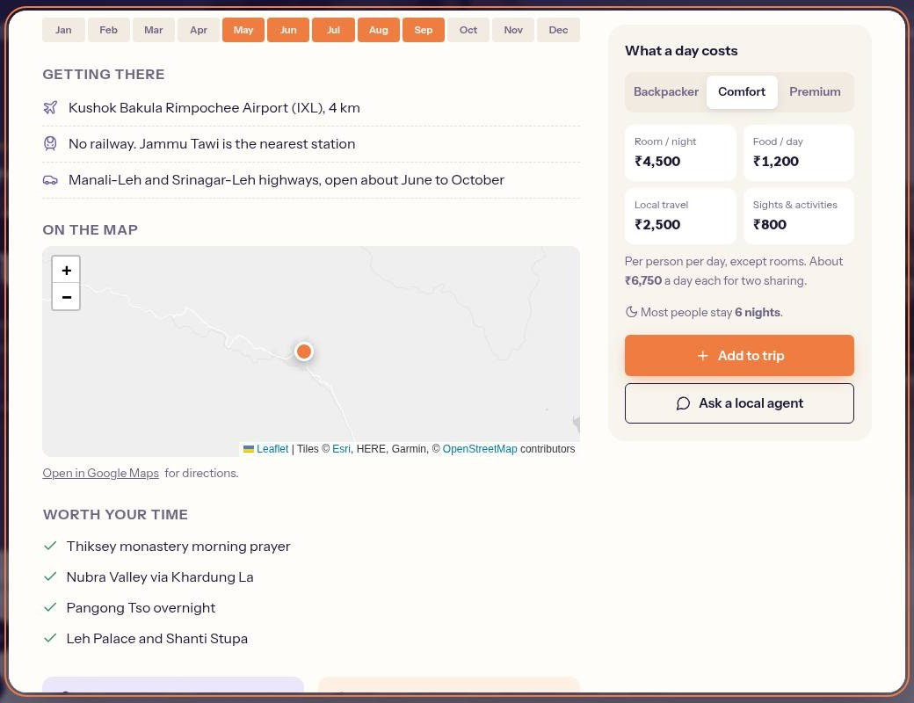
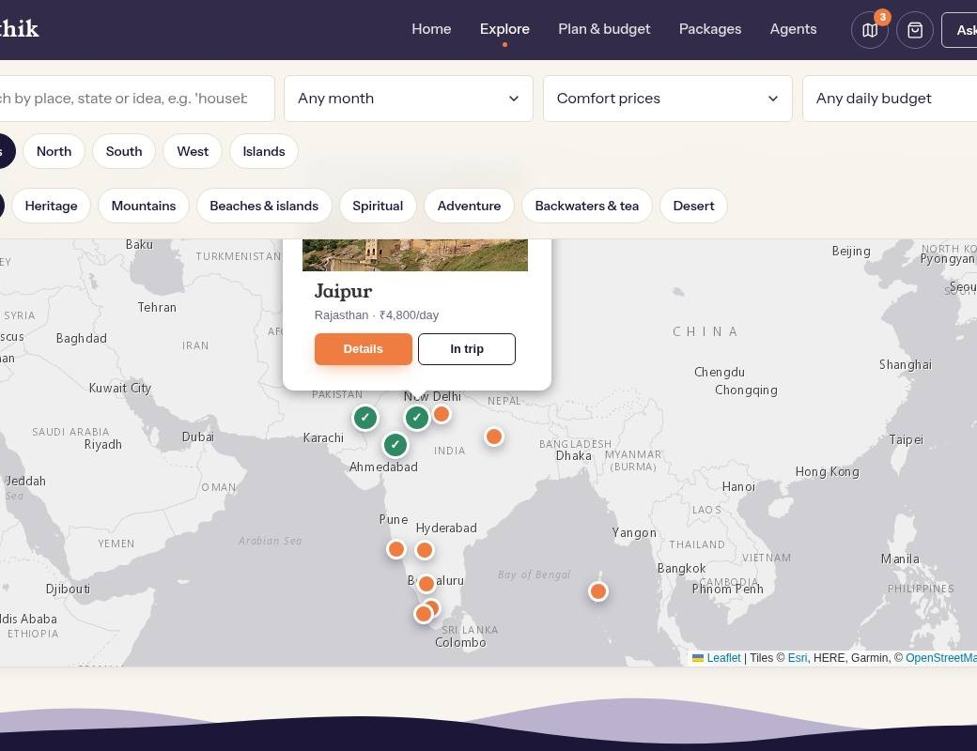
Destination details and maps
SCREENSHOTS · EXPLORE.HTML
explore#leh
explore#leh
explore?view=map
1
Detail view
2
Know before you go
3
Map view
Overview, best months and what a day costs at three comfort levels.
Getting there, a location map, Google Maps link, tips and scams.
Every match as a pin. Popups open details or add the place to the trip.
Example, Leh-Ladakh: best May to Sep, rest 36 to 48 hours for altitude, Inner Line Permit for Nubra and Pangong, carry a postpaid SIM.
Pathik · Industrial Training Presentation · Session 2026-27
14

Slide 15
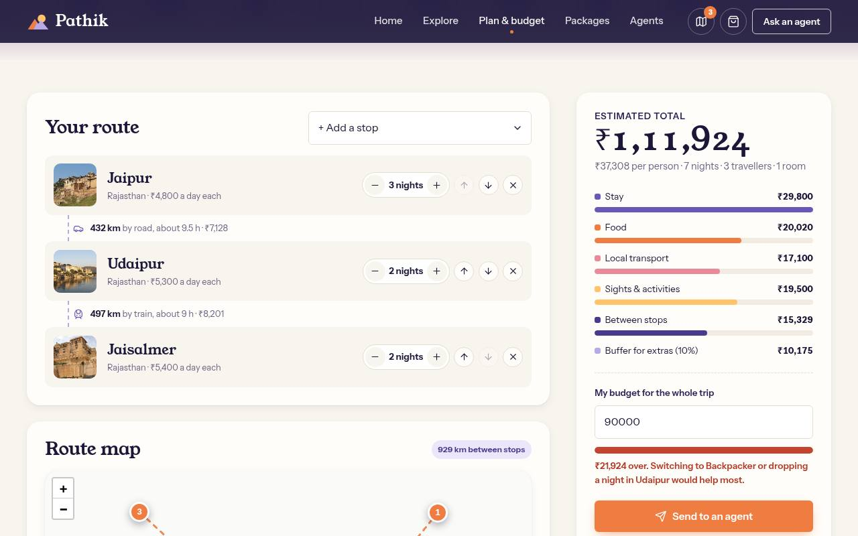
Plan & budget: the route and the money
SCREENSHOTS · PLANNER.HTML
pathik / planner
How the estimate is calculated
Stay
room rate × rooms × nights (2 adults per room)
Food, sights
daily rate × (adults + 0.6 × children)
Local transport
daily rate × travellers
Between stops
distance × 1.3 road factor × rate per km
Buffer
+10% for tips, tickets, SIM, laundry
Target budget: enter a limit and the meter turns red when you go over, with a hint such as 'drop a night in Udaipur'.
Pathik · Industrial Training Presentation · Session 2026-27
15

Slide 16
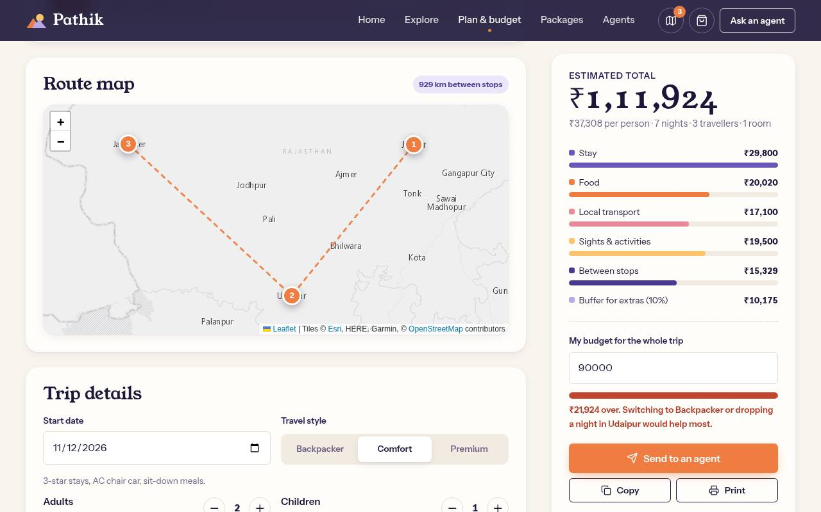
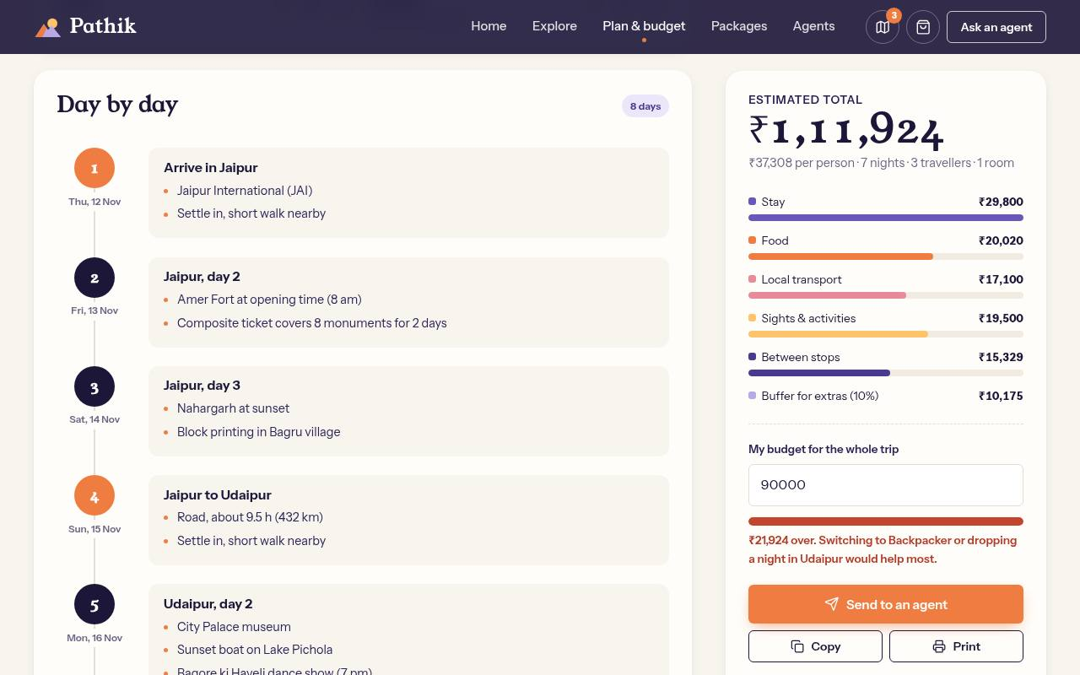



Plan & budget: route map and day-by-day plan
SCREENSHOTS · PLANNER.HTML
planner · route map
planner · day by day
Numbered route
Dated days
Season warnings
Share it
Stops in order on a Leaflet map, with total kilometres between stops.
Sights spread across the nights; travel days show mode, hours and distance.
Flags a stop that falls outside its best months on those dates.
Print, copy a text summary, or send the plan to an agent.
Pathik · Industrial Training Presentation · Session 2026-27
16

Slide 17
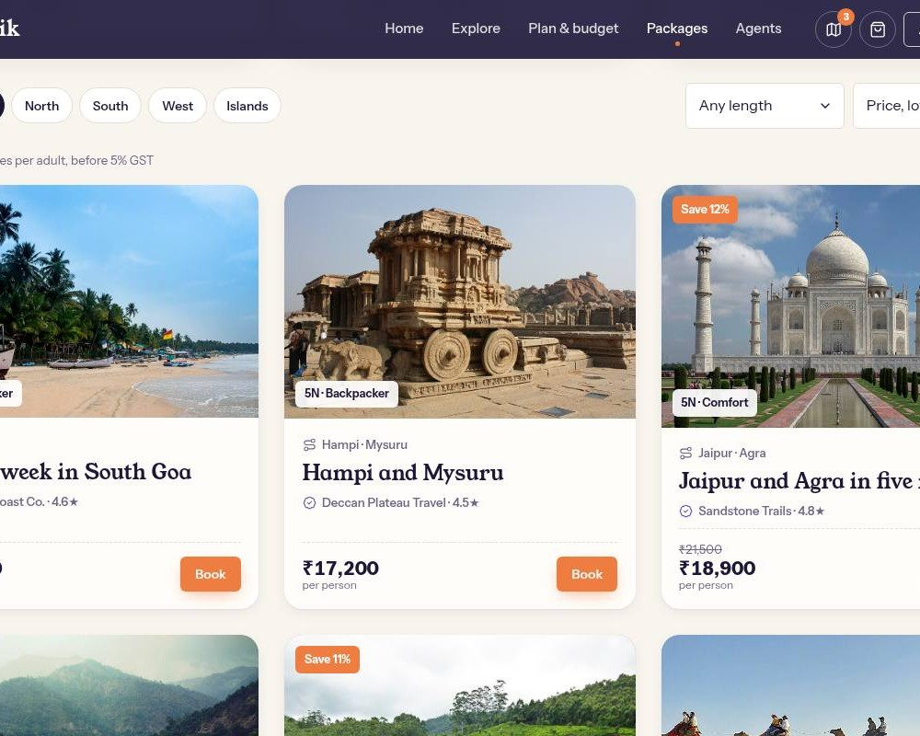
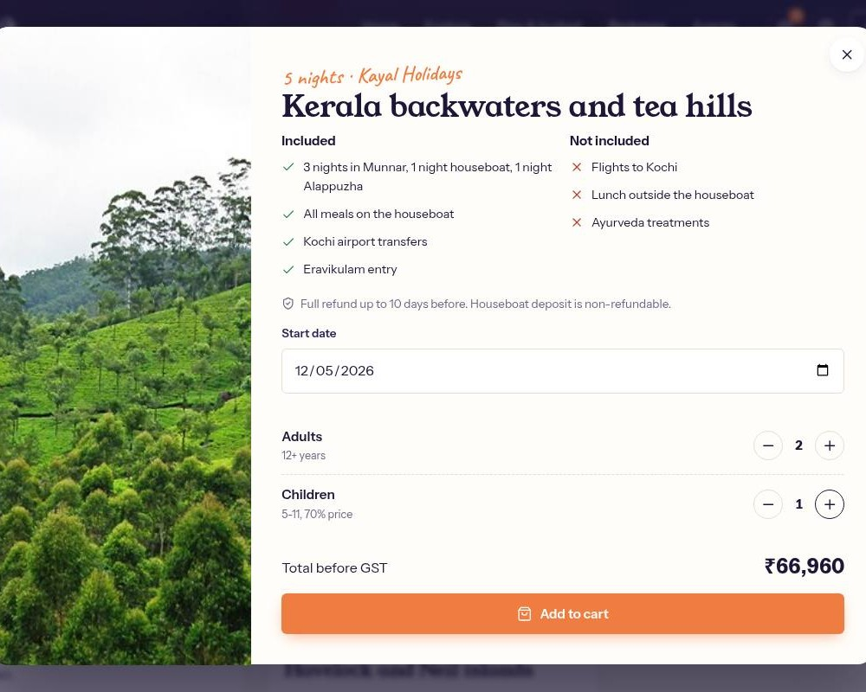
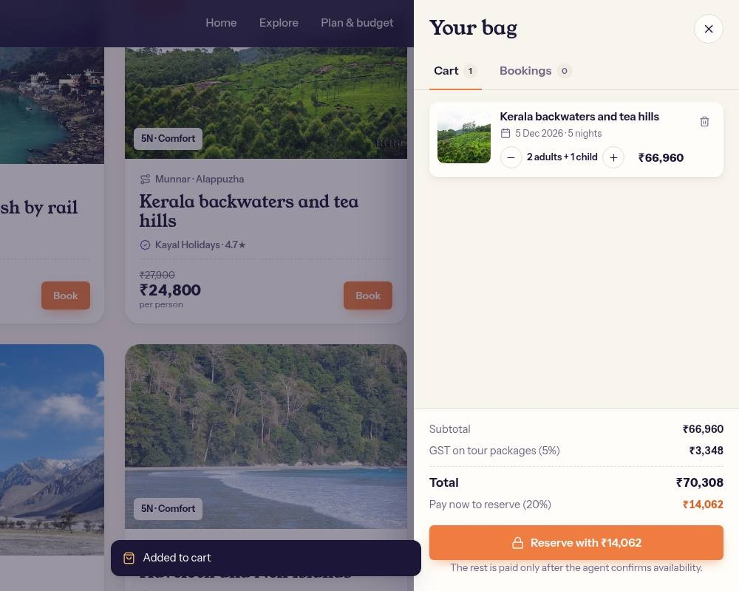
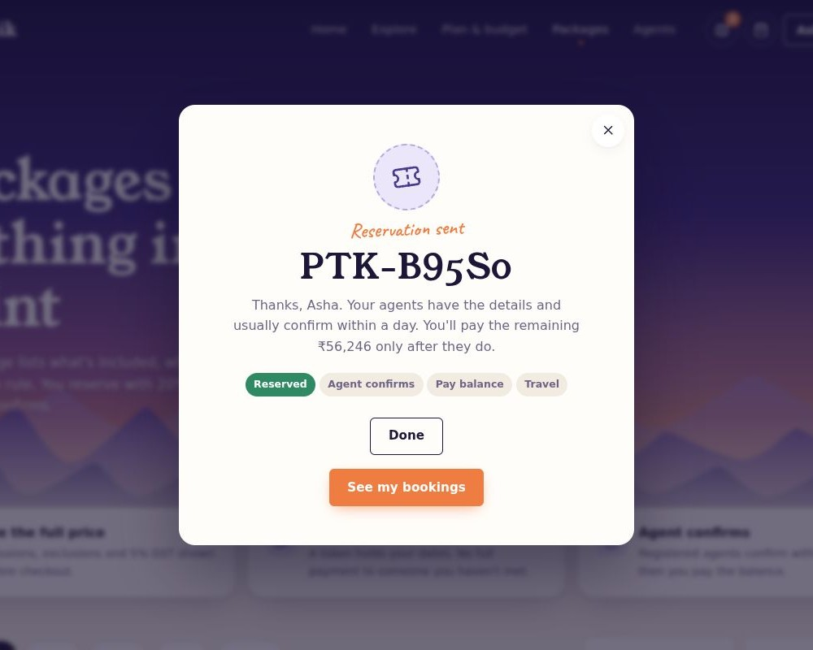

Packages: book with every rupee listed
SCREENSHOTS · PACKAGES.HTML
packages
booking
cart
reserved
1
Choose
2
Pick date and travellers
3
Review the cart
4
Reserve
8 packages with saving, nights and agent rating.
Included and not included, cancellation rule, live total.
Subtotal, 5% GST line, total and the 20% due now.
Validated form, then a reference number like PTK-B95S0.
No full payment upfront. Children pay 70%, GST is a visible line, and the balance is due only after the agent confirms.
Pathik · Industrial Training Presentation · Session 2026-27
17

Slide 18
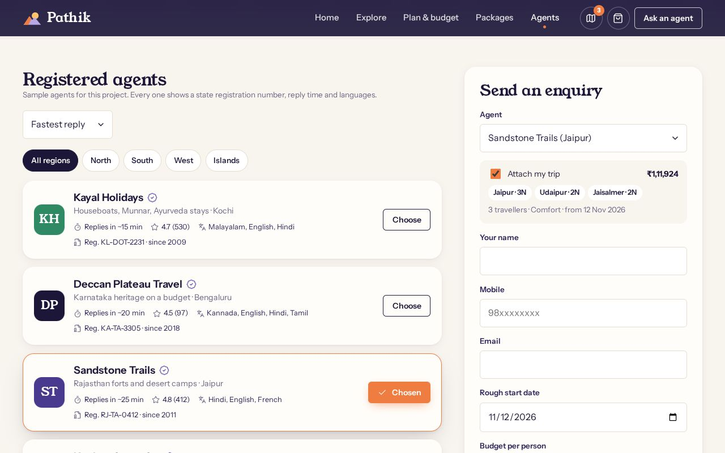
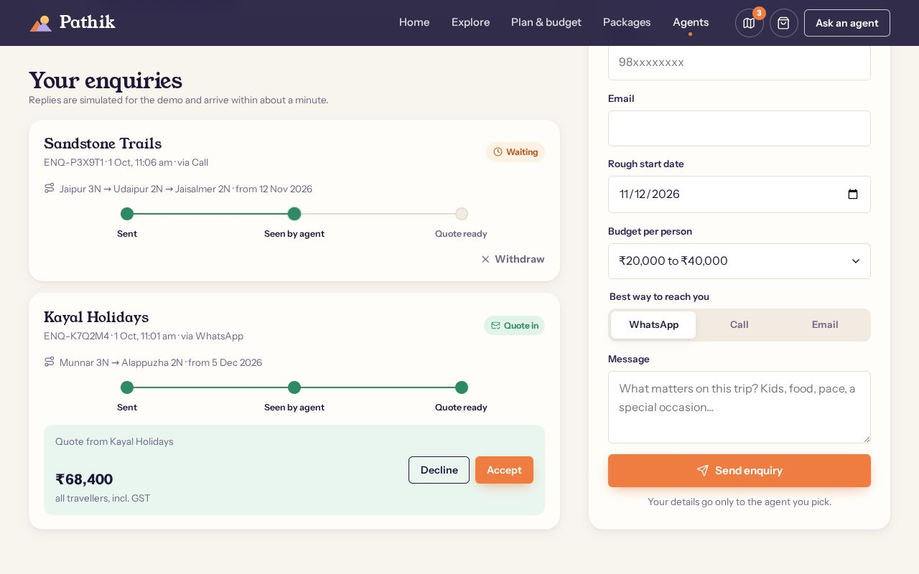



Agents: one enquiry, tracked to a quote
SCREENSHOTS · AGENTS.HTML
pathik / agents
agents · your enquiries
Registered agents
Trip attached
Checked form
Quote tracker
Registration number, reply time, rating and languages. Best match picked from the trip.
Stops, nights, travellers and the estimate go with the enquiry. No retyping.
Name, 10-digit Indian mobile and email checked before sending.
Sent, seen, quote ready. Accept or decline the quote.
Pathik · Industrial Training Presentation · Session 2026-27
18

Slide 19
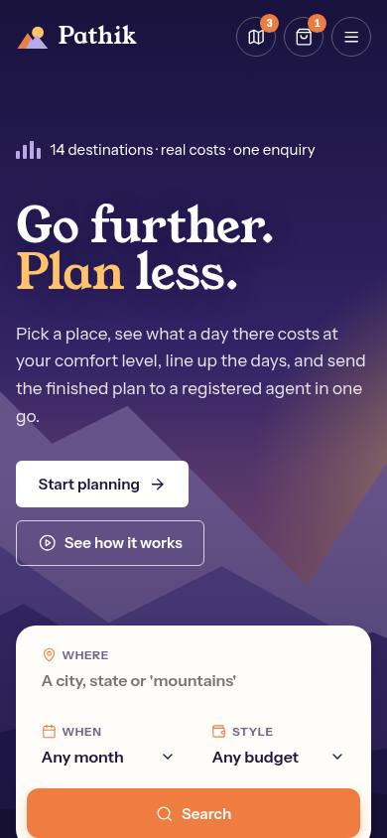
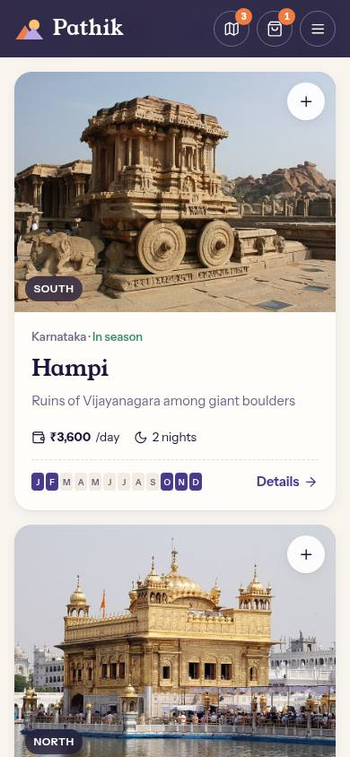




Works on every screen, loads fast
SCREENSHOTS · MOBILE AND QUALITY
Responsive
From 360 px phones to wide desktops. Menu, finder and carousels reflow; no sideways scrolling.
Performance
No render-blocking scripts. Lazy images in the right size. 3D and maps load only when needed.
Accessible
Keyboard friendly, visible focus, labelled fields, reduced-motion support.
Tested
Playwright scripts click through every flow on desktop and mobile and check for console errors.
Pathik · Industrial Training Presentation · Session 2026-27
19

Slide 20

Development Methodology
ITERATIVE, FEEDBACK-DRIVEN
01
02
03
04
05
06
Research
Requirements
Design
Build
Test
Review & improve
Published studies, traveller pain points, stakeholders
F1 to F6 functions plus speed, access and offline goals
Layout from agency sites, colours and type from a dusk illustration
5 pages, shared modules, build script, 3D scene
Playwright flows, mobile widths, file:// check
Feedback round: search fix, carousels, maps, new photos
Version control: each round was a branch and a pull request on GitHub, reviewed and merged into main.
Each change was checked before merging: build, automated click-through tests, mobile layout and screenshots.
Pathik · Industrial Training Presentation · Session 2026-27
20

Slide 21


Challenges Faced
PROBLEMS AND FIXES
Search bar ignored clicks
Map tiles stopped loading
Streaky 3D lighting
Fix The section below overlapped it. Raised the hero's stacking order and added a click test.
Fix The tile provider started requiring an API key. Switched to Esri tiles that need none.
Fix Per-vertex colours left stripes. Rewrote shading per pixel for a soft sun, snow and haze.
Licensed photos of real places
No backend
Speed with 3D and maps
Fix Used Wikimedia Commons with author and licence credits in the site.
Fix One store in localStorage with change events keeps every page and tab in sync.
Fix 3D loads after the page is usable and pauses off-screen; Leaflet loads on demand.
Pathik · Industrial Training Presentation · Session 2026-27
21

Slide 22

Learning Outcomes
WHAT I LEARNED
Technical skills
Professional skills
Semantic, accessible HTML and responsive CSS
State management in plain JavaScript
Turning research into requirements
Designing from reference sites
3D graphics and GLSL shaders with Three.js
Interactive maps with Leaflet
Debugging from user feedback
Form validation and user feedback patterns
Build tooling: npm scripts and esbuild
Writing clear documentation
Automated UI testing with Playwright
Git branches and pull requests
Planning work in short iterations
Pathik · Industrial Training Presentation · Session 2026-27
22

Slide 23



Future Scope & Conclusion
WHERE IT GOES NEXT
Future enhancements
Summary
Backend and accounts
Save trips across devices; real agent logins.
Pathik turns six separate tasks into one flow: find a place, learn about it, plan the days, see the cost, ask one registered agent, and book with nothing hidden.
Live prices and payments
Hotel and train availability; UPI payments.
Hindi and regional languages
Reach travellers beyond English.
5
14
Installable offline app
pages
destinations
Itinerary and tickets without signal.
6
0
More destinations
North-east, hill stations, and user reviews.
modules
servers needed
Pathik · Industrial Training Presentation · Session 2026-27
23

Slide 24
Acknowledgement
I would like to thank Ms Shalini Singhal, Assistant Professor, Department of Information Technology, for her guidance throughout this training.
I am grateful to [Company Name] and my mentor [Mentor Name] for the opportunity and their feedback on the project.
I also thank the Department of Information Technology, Swami Keshvanand Institute of Technology, Management & Gramothan, Jaipur, and my family and friends for their support.
[Student Name] · [University Roll No.]
Pathik · Industrial Training Presentation · Session 2026-27
24

Slide 25

Thank You
Any questions?
pathik / home
Pathik: a trip planner for India. Find, learn, plan, budget, enquire, book.
github.com/Hanu2908/intership_project
Pathik · Industrial Training Presentation · Session 2026-27
25

