Slide 1
Swami Keshvanand Institute of Technology, Management & Gramothan, Jaipur
“An Autonomous Institute Affiliated to Rajasthan Technical University, Kota”
Department of Information Technology
Industrial Training Presentation
On
Pathik: A Trip Planner for India
Submitted To: Submitted By:
Ms Shalini Singhal Student name
Assistant Professor IT University Roll. No.
Session 2026-27

Slide 2
Agenda
WHAT WE'LL COVER
01
Project Introduction
02
Problem & Objectives
What Pathik is and who it is for
Why the project exists and its goals
03
Key Features
04
Website Walkthrough
Six things the site does for a traveller
A screenshot tour of every page
05
Tech Stack
06
User Journey
Languages, libraries and tools used
How a visitor moves from idea to booking
07
Future Scope
08
Conclusion
What comes next
Summary and questions
Pathik · Industrial Training Presentation · Session 2026-27
2

Slide 3
What is Pathik?
INTRODUCTION
Pathik (पथिक, 'wayfarer') is a trip planner for India. It puts the whole journey of planning a trip in one website: finding a place, learning what it is really like, planning the days, seeing the cost, asking a registered agent and booking.
It runs entirely in the browser with HTML, CSS and JavaScript. Two Three.js scenes (the home hero and the Season map), maps that draw India's official outline, and real photos from Wikimedia Commons sit on top of a small shared data and state layer. Trips, carts and enquiries are saved in the browser, so nothing needs a server.
Every page works on phones, tablets and desktops, and opens straight from a file as well as from a web server.
6
MAIN PAGES
23
DESTINATIONS WITH REAL COSTS
₹0
SERVER COST, RUNS IN THE BROWSER
Pathik · Industrial Training Presentation · Session 2026-27
3

Slide 4


Why build this project?
PROBLEM & OBJECTIVES
THE PROBLEM
OUR OBJECTIVES
Planning a trip is still a research project
What Pathik delivers
Inspiration is spread across Instagram, blogs and booking sites
Season, routes, real costs and scams sit in old forum threads
Copied plans put stops 900 km apart or in the wrong season
Package prices hide transfers, tickets and GST
The same trip is retyped to five agents on WhatsApp
Find a destination by month, region, type and daily budget
Know each place: season, routes, costs, tips and scams
Plan dated days with a live, itemised budget
Send one enquiry, with the trip attached, to a registered agent
Book packages with every inclusion and GST shown upfront
141
pages of travel content read before booking (Expedia Group)
5 hours
spent reading it (303 minutes, Expedia Group)
44%
worry most about overspending (Go City, 2024)
Pathik · Industrial Training Presentation · Session 2026-27
4

Slide 5






Six core capabilities
KEY FEATURES
Discover
Learn
Plan
A Season map lights up places by month, budget and crowd. Search and filters kept in the URL.
Best months, getting there by air, rail and road, daily costs, tips, scams and a map.
Add, reorder and size stops; dated day-by-day plan with season warnings.
Budget
Enquire
Book
Stay, food, transport, sights and travel between stops, with a 10% buffer and a target meter.
Send the trip to one of 11 registered agents, or share it as a link.
Packages with inclusions listed, a cart with GST, and a 20% reservation.
Pathik · Industrial Training Presentation · Session 2026-27
5

Slide 6
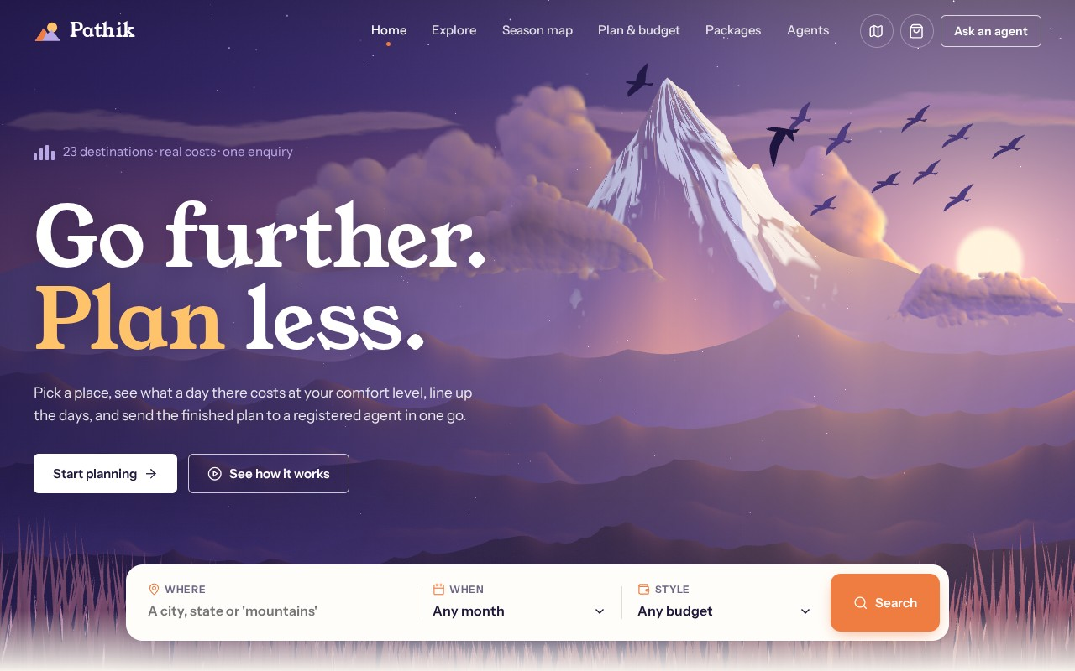

The landing experience
WEBSITE WALKTHROUGH · PAGE 01 · HOME
The home page opens on a 3D dusk scene built in Three.js: a snow peak, towering clouds and birds in flight. Then it gets straight to work with a search bar, trip types, places in season and offers.
pathik / index.html
Search box visible on first load
Search sends place, month and style to Explore
In-season carousel for the current month
Offers, reviews and travel notes
Home page with the Three.js hero and the search bar
Pathik · Industrial Training Presentation · Session 2026-27
6

Slide 7







Inside the 3D hero
WEBSITE WALKTHROUGH · PAGE 01 · HOME · THREE.JS SCENE
Snow peak
Cumulus clouds
Birds in flight
Ridges fan out from the summit. Snow fills the gullies and runs down in fingers; steep flanks stay bare rock, lit warm on the sun side.
Billowing towers behind the peak and two clouds drifting in front. Each is painted once on the GPU and lit from the sun's position.
3D gulls whose wings bend at the elbow as they flap, then glide. A distant flock and a closer pair give depth.
Built for speed: loads after the page is usable, draws only while visible, and keeps a still frame for reduced-motion users.
Pathik · Industrial Training Presentation · Session 2026-27
7

Slide 8
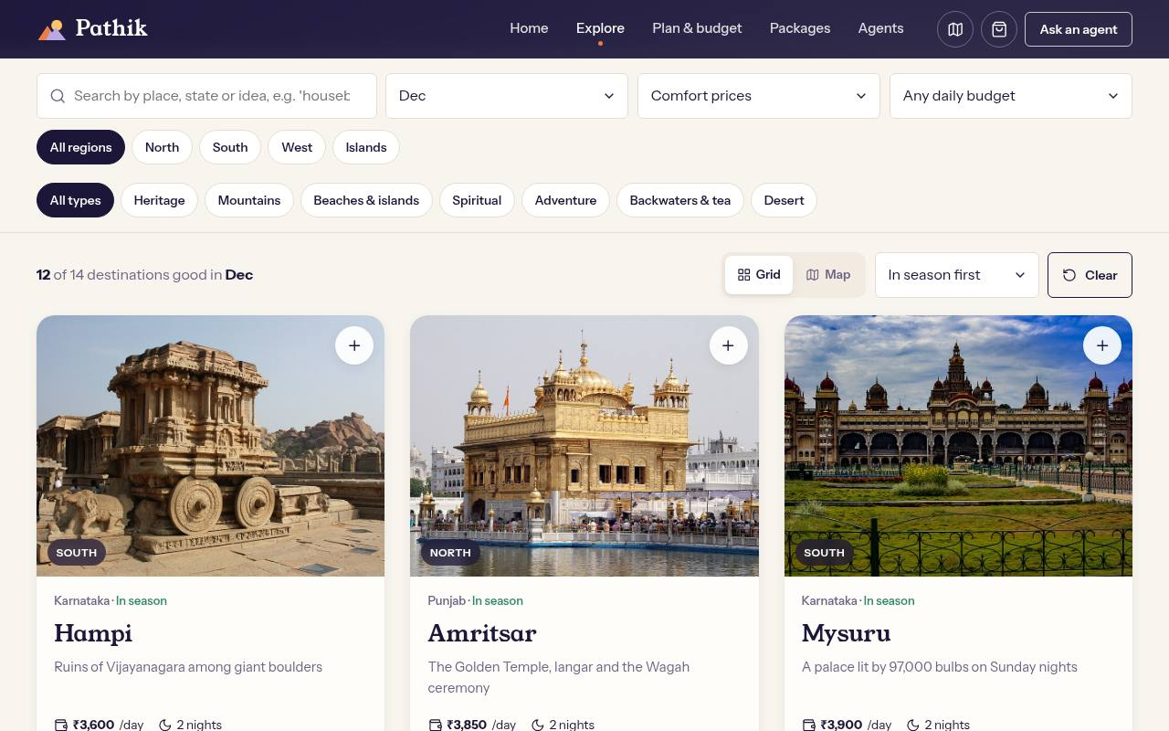
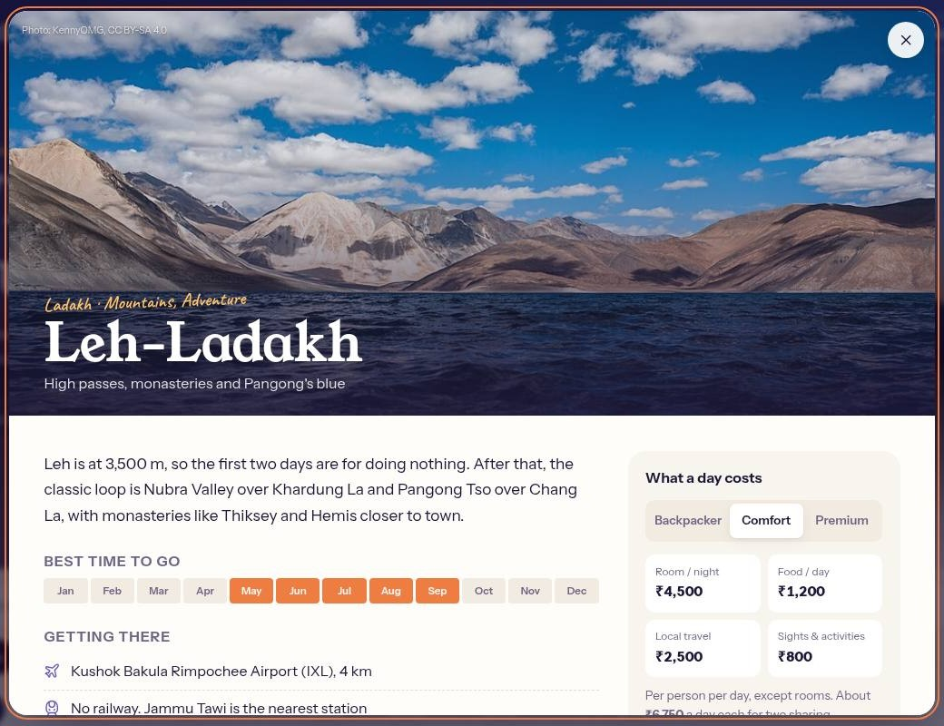
Find the right place
WEBSITE WALKTHROUGH · PAGE 02 · EXPLORE
pathik / explore.html?month=12
pathik / explore.html#leh
Filters that stack
Everything about a place
Month, style, daily budget, region and type. Places in season sort first.
Best months, getting there, a day's cost at three comfort levels, tips, scams and a Google map.
Pathik · Industrial Training Presentation · Session 2026-27
8

Slide 9
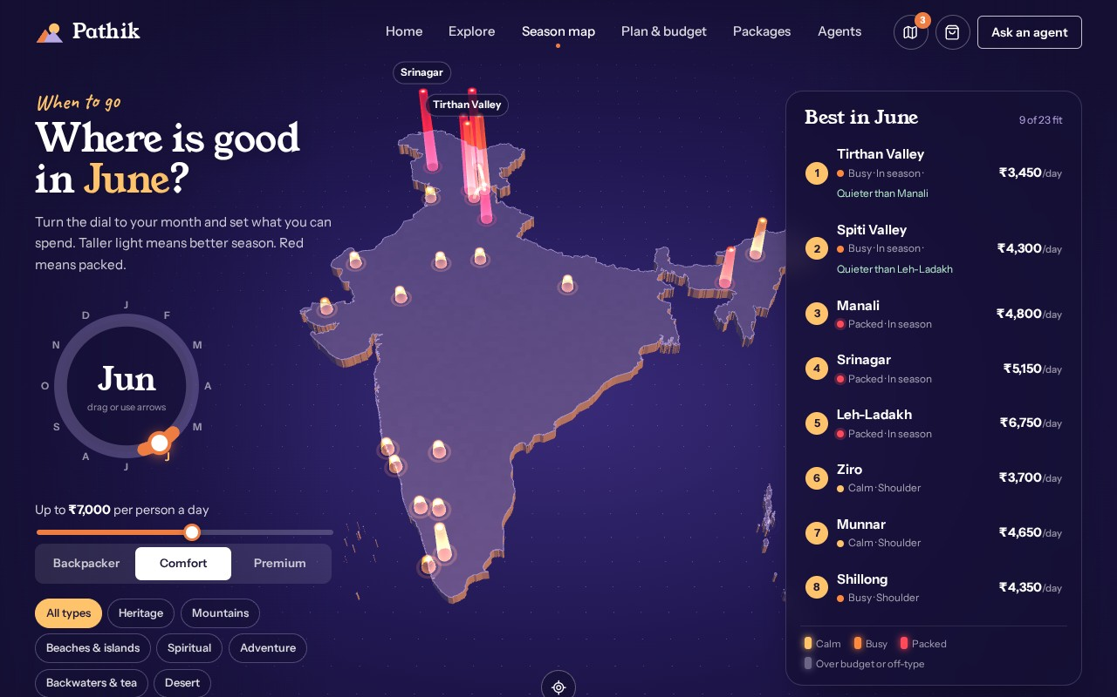
Where is good this month?
WEBSITE WALKTHROUGH · PAGE 03 · SEASON MAP
pathik / season.html?m=6
Turn a dial to your month and set a daily budget. A 3D map of India lights up every place: taller light means better season, colour shows how crowded it is.
Calm
Busy
Packed
Over budget
Ranked list updates as you turn the dial
Season, budget and crowd in one score
Click a pillar: the camera flies to it
Trip stops joined by glowing arcs
June with a ₹7,000 a day budget: the Himalaya is in season; Manali, Srinagar and Leh are packed
Pathik · Industrial Training Presentation · Session 2026-27
9

Slide 10
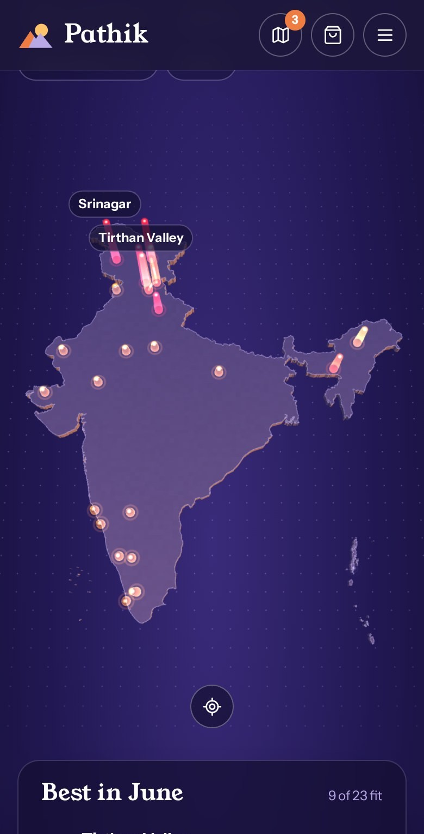
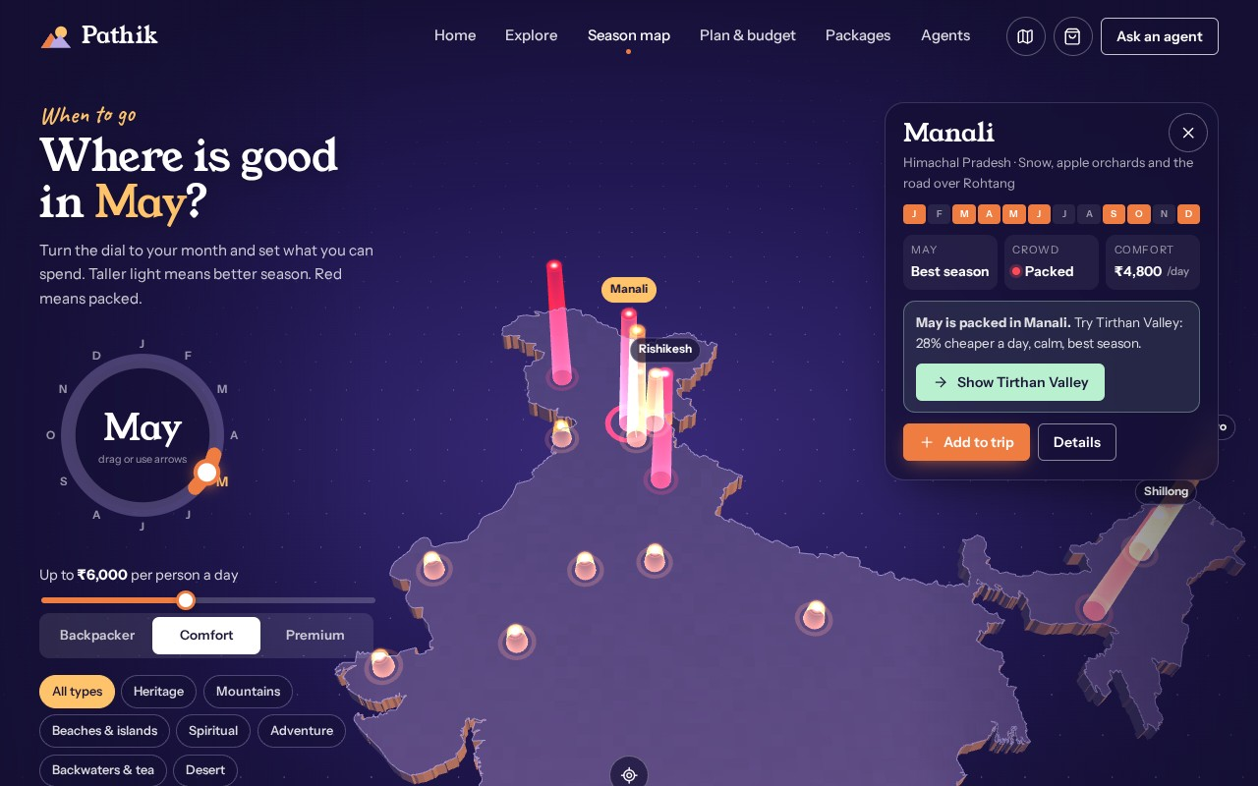



Quieter places and shareable trips
WEBSITE WALKTHROUGH · PAGE 03 · SEASON MAP IN ACTION
pathik / season.html?m=5&d=manali
Quieter twin
Manali is packed in May, so the card suggests Tirthan Valley: 28% cheaper a day, calm, in season.
Share as a link
The whole trip fits in one link. Friends or an agent open it and see the same plan.
On phones
A near top-down map, with the dial and the list stacked below.
A packed place points to a calmer alternative
Pathik · Industrial Training Presentation · Session 2026-27
10

Slide 11
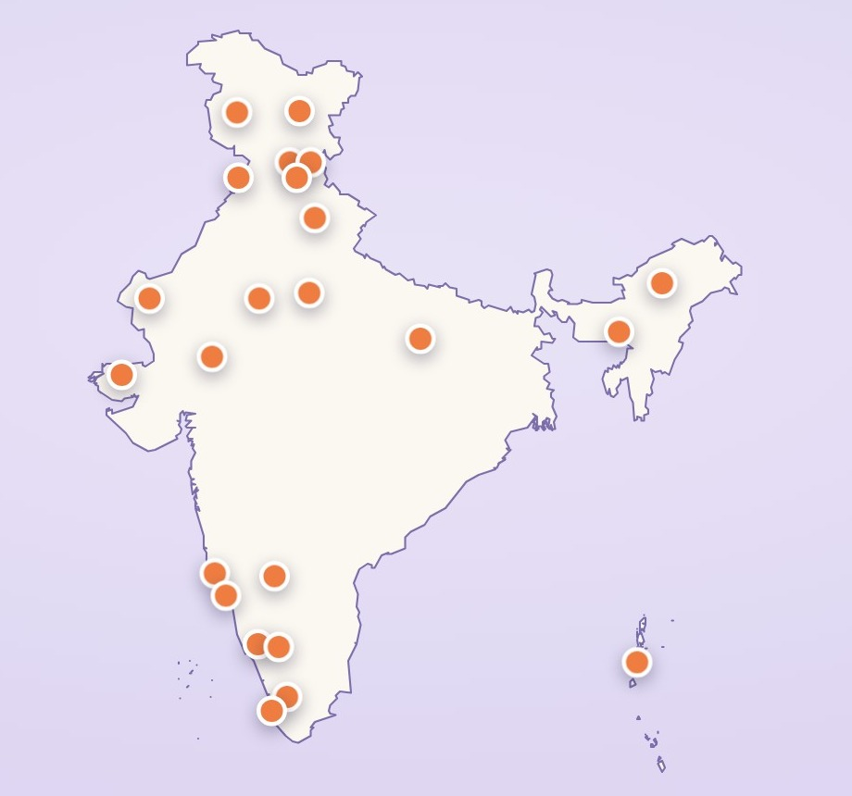



One correct map of India
MAPS
pathik / explore.html (map view)
World map services draw India's borders the way international maps show them. Pathik draws India's official outline itself, as published by the Survey of India, on every map on the site.
Official boundary
All of Jammu & Kashmir and Ladakh, Arunachal Pradesh, the Andaman & Nicobar and Lakshadweep islands.
Open data
Simplified from DataMeet's India boundaries (CC BY 4.0) to a 37 KB file, credited on every map.
Used everywhere
The Season map's 3D slab, the Explore map and the planner's route map share the same outline.
Pathik · Industrial Training Presentation · Session 2026-27
11

Slide 12
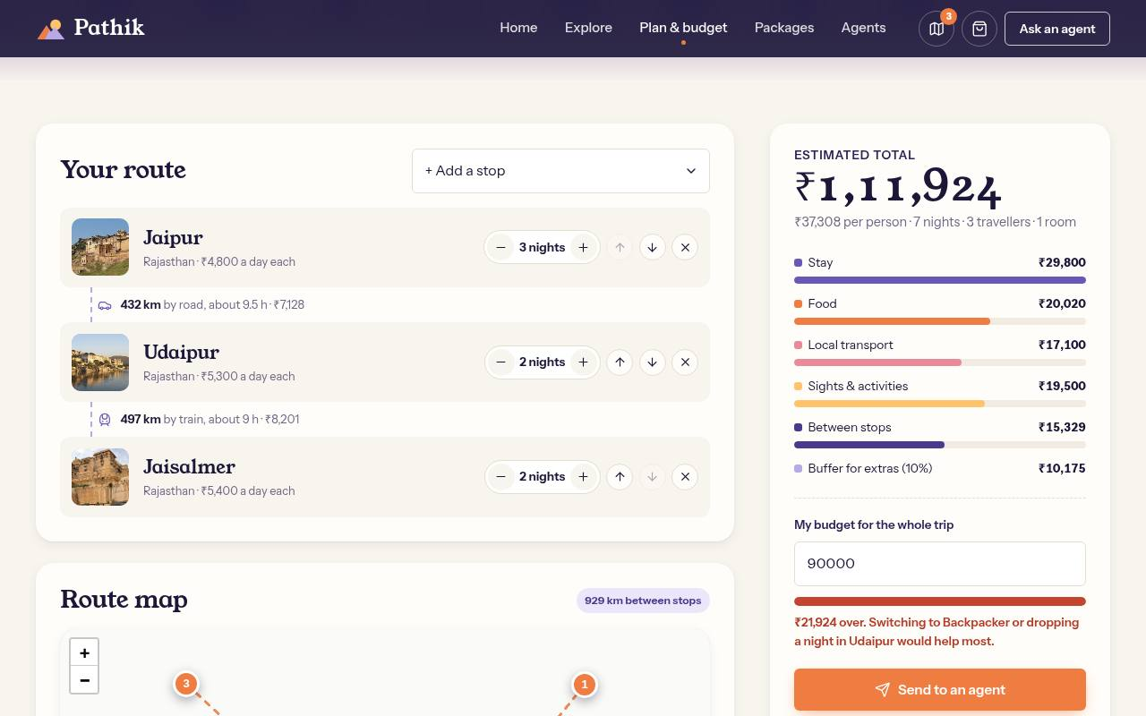
Plan the days, see the cost
WEBSITE WALKTHROUGH · PAGE 04 · PLAN & BUDGET
pathik / planner.html
How the estimate is calculated
Stay
room rate × rooms × nights (2 adults per room)
Food, sights
daily rate × (adults + 0.6 × children)
Local transport
daily rate × travellers
Between stops
distance × 1.3 road factor × rate per km
Buffer
+10% for tips, tickets, SIM, laundry
Route map, dated days, season warnings
Target budget meter with advice
Pathik · Industrial Training Presentation · Session 2026-27
12

Slide 13
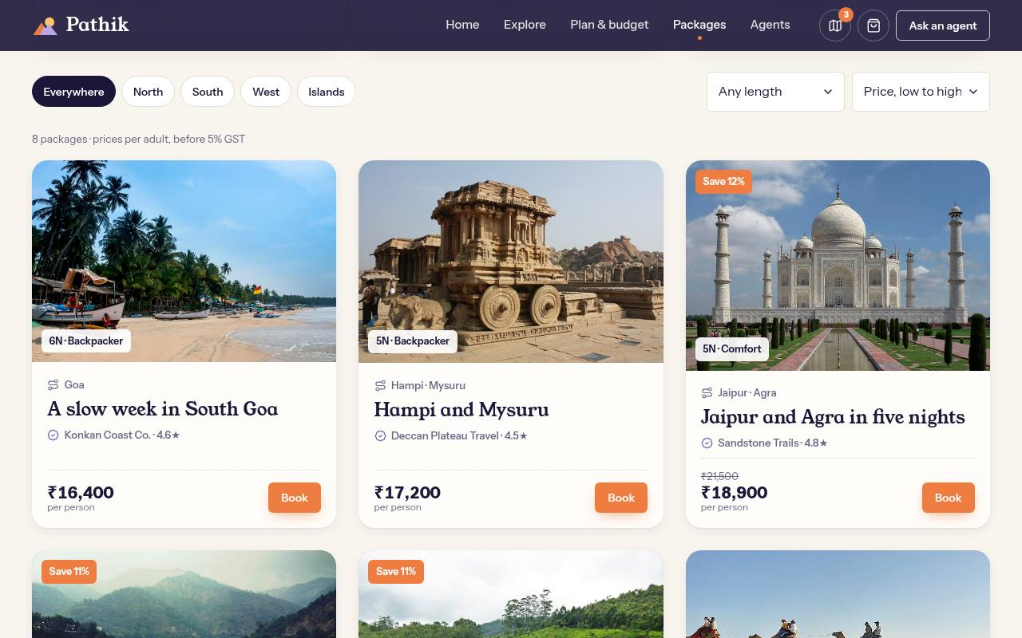
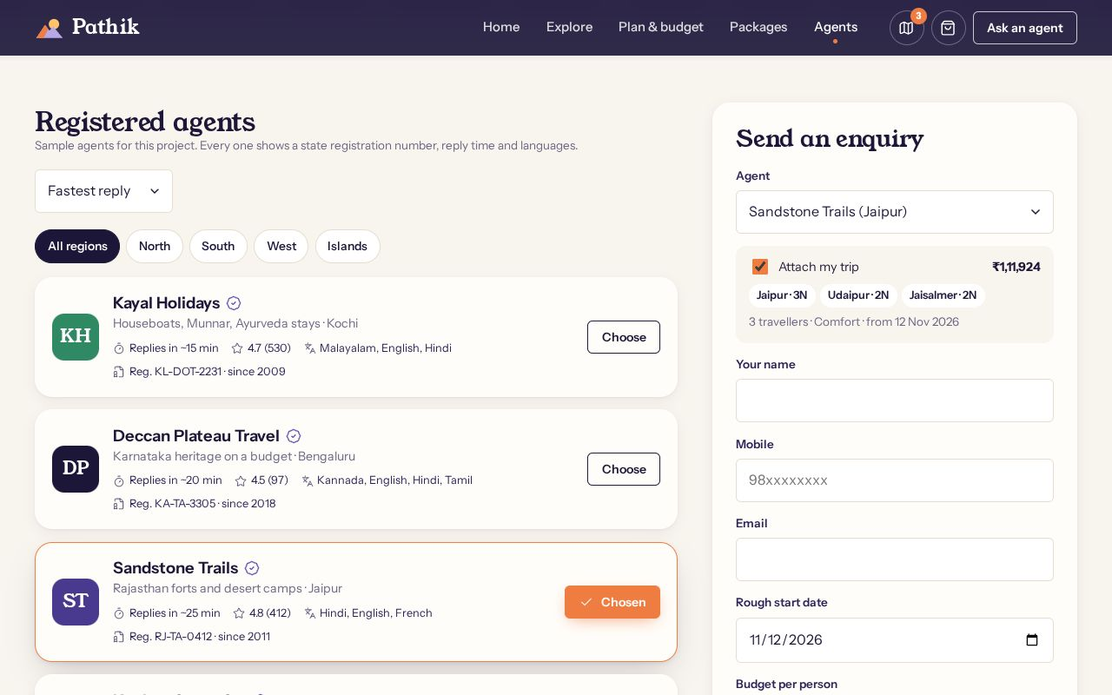
Fixed-price trips and registered agents
WEBSITE WALKTHROUGH · PAGES 05 & 06
pathik / packages.html
pathik / agents.html
PACKAGES
AGENTS
8 trips with nights, agent rating and any saving. Every card lists what is and isn't included.
11 registered agents with reply time, rating and languages. The enquiry form attaches your planned trip.
Pathik · Industrial Training Presentation · Session 2026-27
13

Slide 14
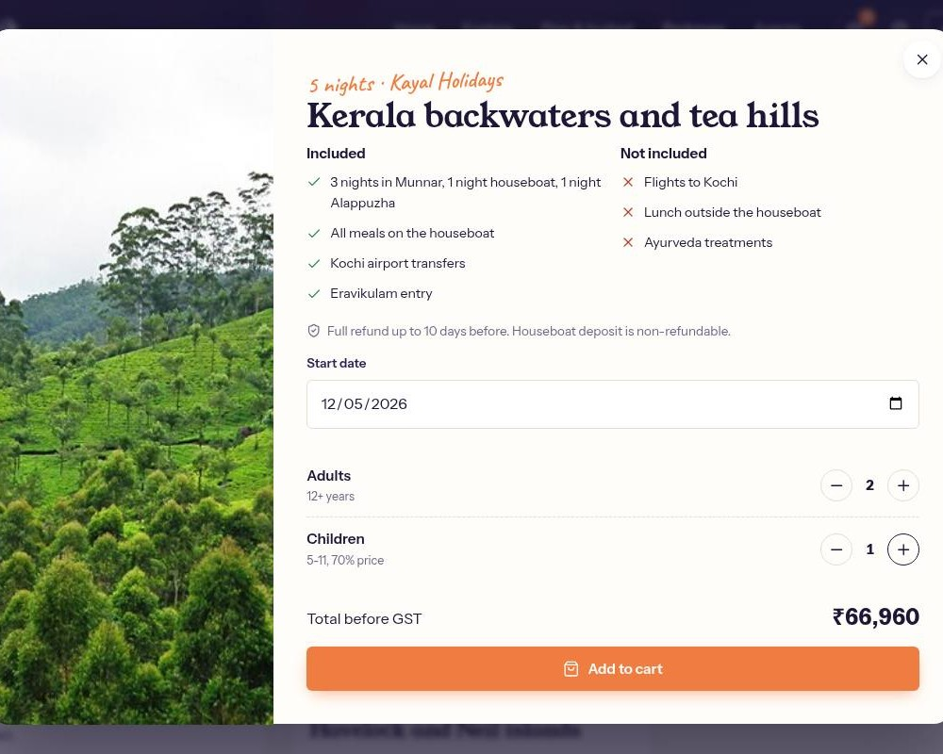
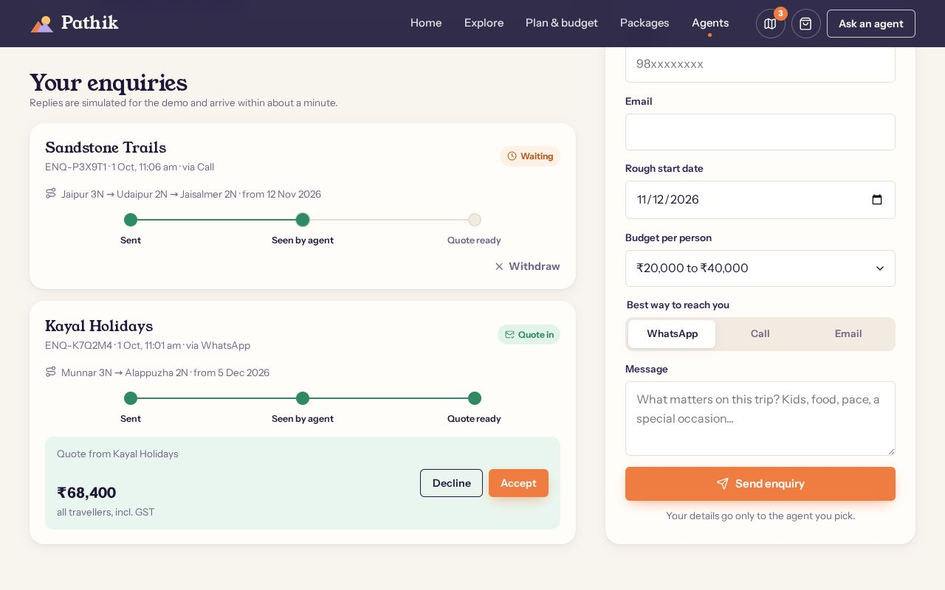
Booking and enquiry in action
WEBSITE WALKTHROUGH · PAGES 05 & 06 · INTERACTIVE FLOW
packages.html · Book
agents.html · Your enquiries
Quick book
Enquiry tracker
Pick a start date and travellers; total updates live
Name, 10-digit mobile and email checked before sending
Cart shows a 5% GST line and the 20% due now
Status moves from sent to seen to quote ready
Checkout form is validated; you get a reference
Accept or decline the agent's quote
Pathik · Industrial Training Presentation · Session 2026-27
14

Slide 15




Built with the web fundamentals
TECH STACK
Programming languages
Libraries
Data and storage
HTML5 (semantic, accessible markup)
CSS3 (grid, flexbox, custom properties)
JavaScript ES2019+ (no framework)
Three.js r169: 3D hero and Season map
Leaflet 1.9 with India's official outline
Lucide icons, Google Fonts
localStorage: trip, cart, enquiries, bookings
JSON data: 23 places, 8 packages, 11 agents
Trips shared as links, no server needed
Tools
Services
Node.js, npm and esbuild (bundling)
Playwright (automated UI tests)
Git and GitHub (pull requests)
Wikimedia Commons (licensed photos)
DataMeet open map data (Survey of India)
Google Maps embed, Google Fonts
Pathik · Industrial Training Presentation · Session 2026-27
15

Slide 16

How a visitor uses the site
USER JOURNEY
1
2
3
4
5
6
Discover
Learn
Plan
Budget
Enquire
Book
Season map
Explore
Plan & budget
Plan & budget
Agents
Packages
Pick a month and budget, see what fits
Season, routes, daily cost, scams, map
Add stops, reorder, set nights and dates
Live breakdown, target meter, warnings
Send or share the trip, track the quote
Cart with GST, reserve with 20%
Shortcut: like a fixed package? Book it directly
Shared state: the trip, cart, enquiries and bookings are saved in the browser, so every page and tab stays in sync.
Pathik · Industrial Training Presentation · Session 2026-27
16

Slide 17



Where this project goes next
FUTURE SCOPE
Phase 1
Phase 1
Phase 1
Backend and accounts
Online payments
Live availability
Save trips across devices; real agent logins.
UPI and card payments for the 20% reservation.
Hotel and train availability on chosen dates.
Phase 2
Phase 2
Phase 2
Hindi and regional languages
Installable offline app
Live crowd and weather data
Reach travellers beyond English.
Itinerary and tickets without signal.
Replace crowd estimates with real visitor and weather feeds.
Phase 1
Next: build the foundation
Phase 2
Later: grow the reach
Pathik · Industrial Training Presentation · Session 2026-27
17

Slide 18

Conclusion
SUMMARY AND QUESTIONS
Summary
Thank you
Pathik turns six separate tasks into one flow: find a place, learn about it, plan the days, see the cost, ask one registered agent, and book with nothing hidden.
Any questions?
pathik / home
6
23
pages
destinations
6
0
core features
servers needed
github.com/Hanu2908/intership_project
Pathik · Industrial Training Presentation · Session 2026-27
18

