Slide 1

Readypick.ai
Know every candidate
before you meet them.
AI-assisted profile discovery, evidence-led assessment and one decision-ready PFI report.
Executive Search Inspired Profiles
Readypick.ai • The candidate is yours, rest is on us!
01
Notes:
[Sources]
- Internal product specification: new-killer-spec.docx
- PickReady product implementation and locally captured product UI

Slide 2
Readypick.ai
More activity does not create a better decision.
01
Disconnected evidence
Resumes, assessments and interview notes live in different places.
02
Opaque ranking
A score without a reason gives the panel nothing useful to verify.
03
Administrative drag
Teams repeat drafting, screening and follow-up work for every role.
Readypick.ai • The candidate is yours, rest is on us!
02
Notes:
[Sources]
- Internal product specification: new-killer-spec.docx
- PickReady product implementation and locally captured product UI

Slide 3
Readypick.ai
One evidence trail, from role to decision.
The system carries the work. Your team keeps the judgment.
01
02
03
04
05
06
Define
Discover
Match
Assess
Understand
Decide
Role brief
Applied, sourced, databank
Evidence against the job
Role-shaped questions
PFI report
Human call, clear trail
Readypick.ai • The candidate is yours, rest is on us!
03
Notes:
[Sources]
- Internal product specification: new-killer-spec.docx
- PickReady product implementation and locally captured product UI

Slide 4
Readypick.ai
PFI turns signals into a profile people can use.
PickReady Fit Intelligence connects four kinds of evidence without hiding the decision behind a number.
Role match
Behaviour
Technical depth
Validation
Skills, experience, role alignment and education against the live job.
Structured signals in clear rating bands with readable remarks.
Questions generated from the role and assessed with evidence.
Team remarks, prior-employer inputs and focused interview probes.
Plain-language ratings • Evidence-linked remarks • Suggested probes • Human-controlled outcomes
Readypick.ai • The candidate is yours, rest is on us!
04
Notes:
[Sources]
- Internal product specification: new-killer-spec.docx
- PickReady product implementation and locally captured product UI

Slide 5
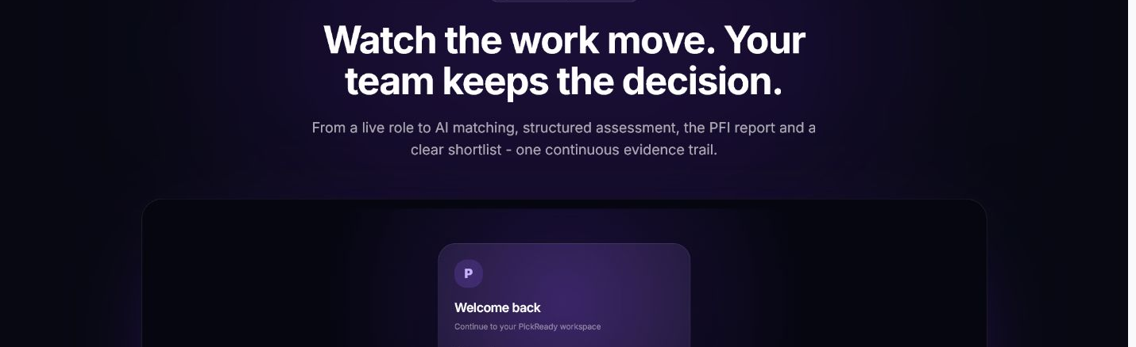
Readypick.ai
The workflow is visible, not mysterious.
Nine connected moments move from secure access to a communicated decision.
Readypick.ai • The candidate is yours, rest is on us!
05
Notes:
[Sources]
- Internal product specification: new-killer-spec.docx
- PickReady product implementation and locally captured product UI

Slide 6
Readypick.ai
Trust is part of the operating model.
Consent with context
Workspace isolation
Candidates see why data is needed, where it is used and how to withdraw.
Customer information remains separated by tenant and role-based access.
A visible audit trail
Messages stay human
Material actions, edits and sends remain attributable.
AI drafts. A person reviews before candidate communication is sent.
Readypick.ai • The candidate is yours, rest is on us!
06
Notes:
[Sources]
- Internal product specification: new-killer-spec.docx
- PickReady product implementation and locally captured product UI

Slide 7
Readypick.ai
Start with one role.
See what a better profile changes.
Hyderabad • Visakhapatnam • Bengaluru • Chennai
manjuchro@gmail.com
A Hanulisa Technologies LLP product
Readypick.ai • The candidate is yours, rest is on us!
07
Notes:
[Sources]
- Internal product specification: new-killer-spec.docx
- PickReady product implementation and locally captured product UI

