Slide 1

Analyzing Wikipedia Talk Network with GraphX
Under the supervision of
--Dr. Animesh Chaturvedi

Slide 2



1. Introduction
Objective
Dataset
Algorithm
Demo
Results
Conclusion
Contents

Slide 3





Introduction
To increase scalability and our understanding of social dynamics, we use Apache Spark's GraphX to find communities in the Wikipedia Talk Network.
By using the Connected Components method, we get knowledge with broader applications, including social network analysis, anomaly detection, and recommendation systems.

Slide 4



Objective
The primary objective of this project is to leverage Apache Spark's GraphX library to analyze the Wikipedia Talk Network and identify connected components within the network. This analysis aims to uncover the underlying community structure, influential contributors, and collaboration patterns within the Wikipedia Talk Network, facilitating a deeper understanding of online knowledge-sharing dynamics.

Slide 5
Dataset
Wikipedia talk Network
Directed graph (each unordered pair of nodes is saved once): Wiki-Talk.txt.gz Communication network of Wikipedia (till January 2008). Directed edge A->B means user A edited talk page of B.
Nodes: 2394385 Edges: 5021410

Slide 6

WorkFlow
2
1
Load the Graph:
3
Component Size Calculation:
We determine the number of nodes in each connected component by mapping each node's ID to '1' and then summing up the nodes within that component.
Connected Component Identification:
We apply the 'connected components' algorithm to our network graph, grouping nodes connected through interactions. Each group is assigned a unique identifier.
We start by importing necessary libraries and loading our Wikipedia Talk Network data.
In this network, nodes represent Wikipedia users, and edges denote various interactions or connections.

Slide 7
Algorithm
4
Sorting by Size:
5
Printing Results
To identify the largest connected components, we sort them in descending order based on their sizes
In this we are printing only top 50 connected components

Slide 8








Slide 9

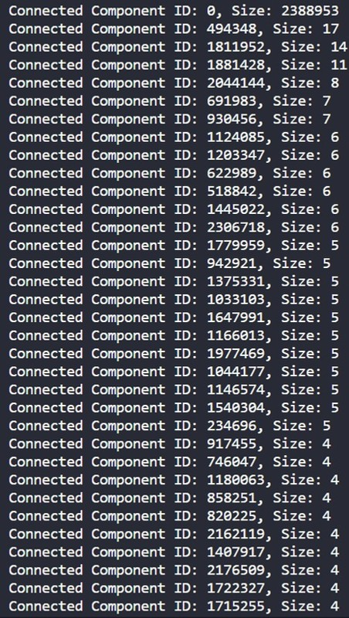
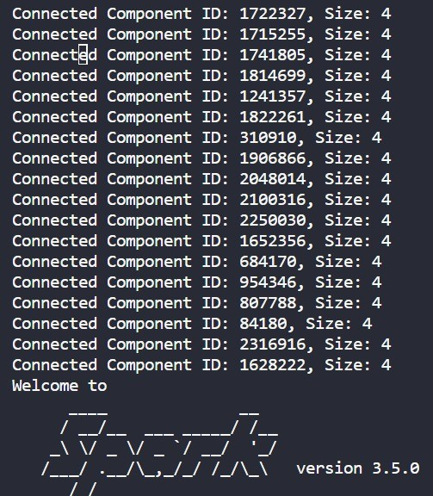
RESULTS
Largest connected component Id= 0, Size = 2388953
Containing approximately 99. 8% of all users
These results provides insights into how Wikipedia users form
communication clusters and
communities, revealing patterns of interaction and collaboration.
I t sheds l ight on the dynamics of
knowledge exchange and collaboration within the Wikipedia platform,
highlighting both the larger Wikipedia community and smaller, specialized
discussion groups.

Slide 10











CONCLUSION
Our project effectively utilized Apache Spark's GraphX to identify unique communities in the Wikipedia Talk Network, overcoming scalability issues with the Connected Components algorithm.
Optimization techniques enhanced performance and accuracy, showcasing the versatility of Spark and GraphX for graph-based analytics with broader applications in anomaly detection, recommendation systems, and social network analysis.

Slide 11




Team Memebers
Allu Hanuma Reddy--20bcs008
Kotha Balaji--20bcs073
Erigi Vaishnavi--20bcs044
Golla Anjaiah--20bcs048

Slide 12






THANK YOU

