Slide 1
Complaints Classification
Models, Procedure and Results

Slide 2
Models
Random
Forest
RNN
RoBerta
Logistic Regression
XG
Boost
LSTM

Slide 3
Procedure
Generated the case_study_data.csv file by utilizing the provided datasets and Python code.
Explored the data using Pandas DataFrames and visualized it with Matplotlib charts.
Cleaned and preprocessed the complaints text using regular expressions (reg-ex).
Applied TfidfVectorizer to vectorize the complaints text for model training and evaluation.
Implemented various classification algorithms, including Logistic Regression, Random Forest, and XGBoost to assess performance.
Experimented with Recurrent Neural Networks (RNN) and Long Short-Term Memory (LSTM) models, achieving moderate results.
Attempted to utilize the RoBERTa model for improved performance; however, a GPU was required for successful implementation, and the attempt was unsuccessful without it.

Slide 4
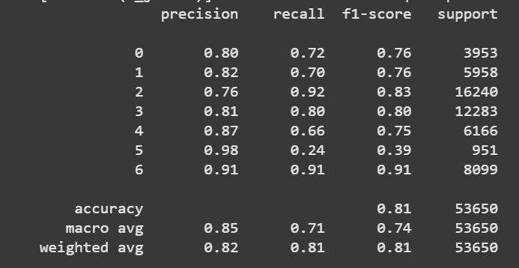
Logistic Regression

Slide 5
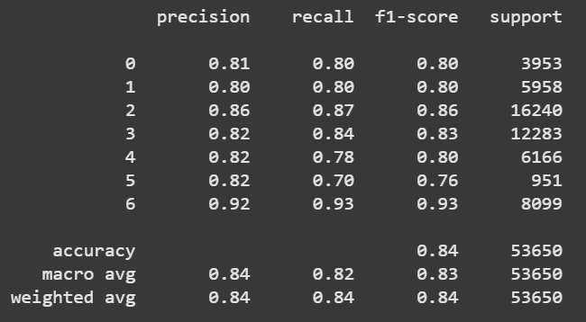
Random Forest

Slide 6
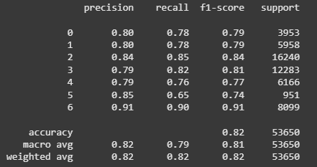
XG Boost

Slide 7
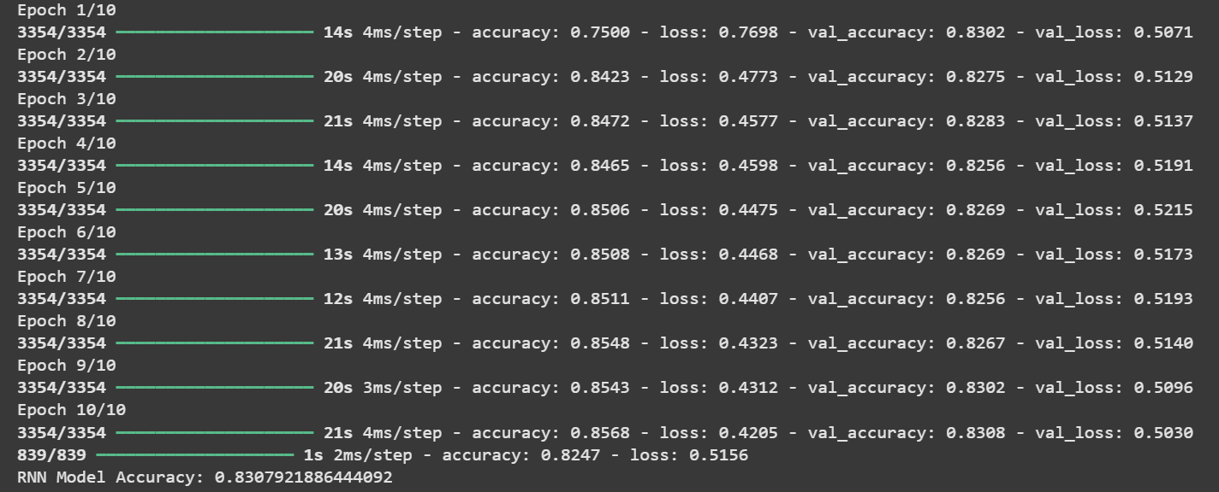
RNN

Slide 8
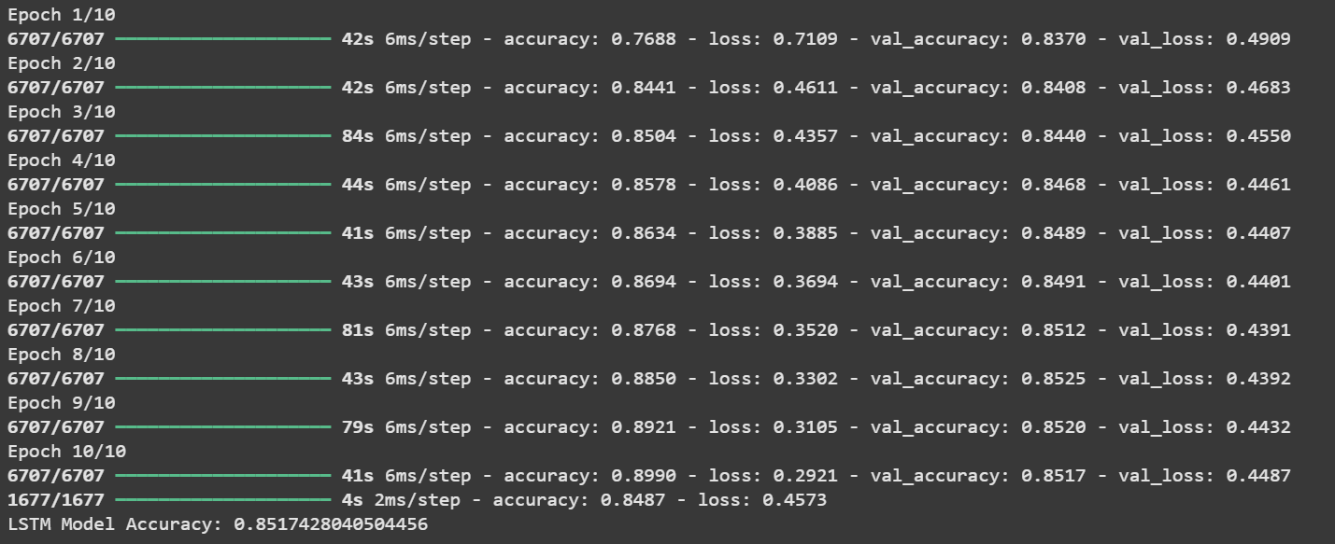
LSTM

Slide 9
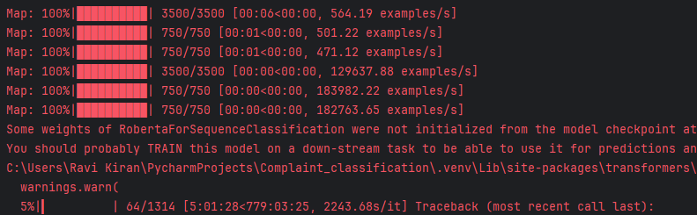
RoBerta

Slide 10
Conclusion
Random Forest achieved the highest F1 score of 0.84, making it a strong candidate for classification tasks, with a good balance between precision and recall.
Logistic Regression and XGBoost achieved decent F1 scores (0.81 and 0.82), making them also viable options, with XGBoost providing slightly better results than logistic regression.
For deep learning models, LSTM outperformed RNN with an accuracy of 0.85, which indicates that the LSTM model is better at capturing sequential dependencies in the data.
The RoBERTa model could not be trained due to hardware limitations (lack of GPU), which would have been a strong contender for performance improvement if the necessary resources were available.
Random Forest or LSTM would be the most suitable choices based on your current results. However, if GPU access becomes available, you might want to revisit RoBERTa for potentially improved performance.

