Slide 1
SentimentScope: A specialized sentiment analysis web platform

Slide 2
agenda
Motivation
Project Description
Methods
Data
Evaluation
Results
Lessons Learned
Web App

Slide 3
MOTIVATION
The motivation for this project arises from the necessity for sentiment analysis tools that are more precise and specialized, capable of effectively managing a variety of text inputs.
By using advanced NLP models, SentimentScope aims to provide a higher level of accuracy and insight compared to generic models across diverse text sources.
The project uses modern NLP techniques covered in the course, such as text preprocessing, tokenization, and model training, with the use of advanced models like RoBERTa and DistilBERT. This showcases the practical application of these concepts and aligns with the course's focus on understanding and utilizing large language models (LLMs).

Slide 4
METHODOLOGY
Data Collection and Preprocessing:
Collected real-time Twitter tweets, Amazon product reviews, and user-generated content reflecting emotions. Preprocessing included handling missing values, Data transformation(transforming target classes from categorical to numerical), Dummy Variables creation, special characters, and tokenization.
Model Selection:
Implemented a multi-model approach with RoBERTa for tweets, DistilBERT for user-text-emotion data, and DistilBERT for Amazon product reviews. Models selected for their performance in sentiment analysis within their respective text domains.
Fine-tuning and Training:
Each model was fine-tuned and trained on its respective dataset. Adjusted model parameters and hyperparameters on validation splits. Integrated models into SentimentScope webapp for sentiment prediction.

Slide 5
Data
Amazon Product Reviews:
Utilized 'amazon us reviews/Mobile Electronics v1 00/0.1.0.csv’ taken from TensorFlow Datasets with 131,000 reviews.
Source Datset
Text-Emotion Detection: Used 'emotion.csv’ taken from Hugging Face Datasets with 20,000 entries tagged with specific emotions.
Source Dataset
Twitter Sentiment Analysis: Analyzed 'twitterentitysentiment-analysis.csv’ taken from Kaggle with 79,089 tweets.
Source Dataset
Note: for every above dataset data split percentage is as follows:
80% training, 10% validation, 10% testing.

Slide 6
EVALUATION
Precision, Recall, F1 Score, Accuracy:
Calculated quantitative measures for sentiment analysis and emotion detection tasks for measuring model’s performance.
Human Evaluation:
We Analyzed responses to 15 real-time examples, including tweets, Amazon product reviews, and user-generated texts.
Rated on correctness of output(Verifying if the web app displays the expected output) and whether the web app functions as expected.

Slide 7

RESULTS
Text-Emotion Detection:
DistilBERT model showed strong performance, with validation loss from 0.343724 to 0.224668 over two epochs. Accuracy and F1 scores improved from ~89% to ~92%, demonstrating effective learning and good generalization.
Twitter Data Sentiment Analysis: RoBERTa model exhibited robust performance across three epochs.Validation loss decreased from 0.5089 to 0.1840.
Overall accuracy of 88% and F1 scores for all classes were above 0.89, showcasing strong sentiment classification capabilities.
Amazon Product Reviews: DistilBERT model demonstrated consistent improvement across three epochs. Training loss varied, but validation loss decreased to 0.5395. Accuracy and F1 scores grew to ~83.4%. Overall evaluation showed 86.97% accuracy, 84.21% precision, and 83.69% recall
Note: For human evaluation, we tested 45 real-time examples (15 from each category described in the previous slide) and achieved 44 correct expected outputs."

Slide 8

LESSONS LEARNED
Challenges Faced:
Fine-tuning multiple models and integrating predictions due to varying sentiment nuances.
Approach and Improvements:
Dedicated models for different text sources proved more efficient.
Future Enhancements:
Focus on better cross-validation, improve data cleaning, use external dictionaries, support more languages, and create easy-to-understand visualizations.
Future Directions:
Enhance preprocessing, integrate real-time sentiment adjustments, support additional languages, and create better visualization tools.

Slide 9
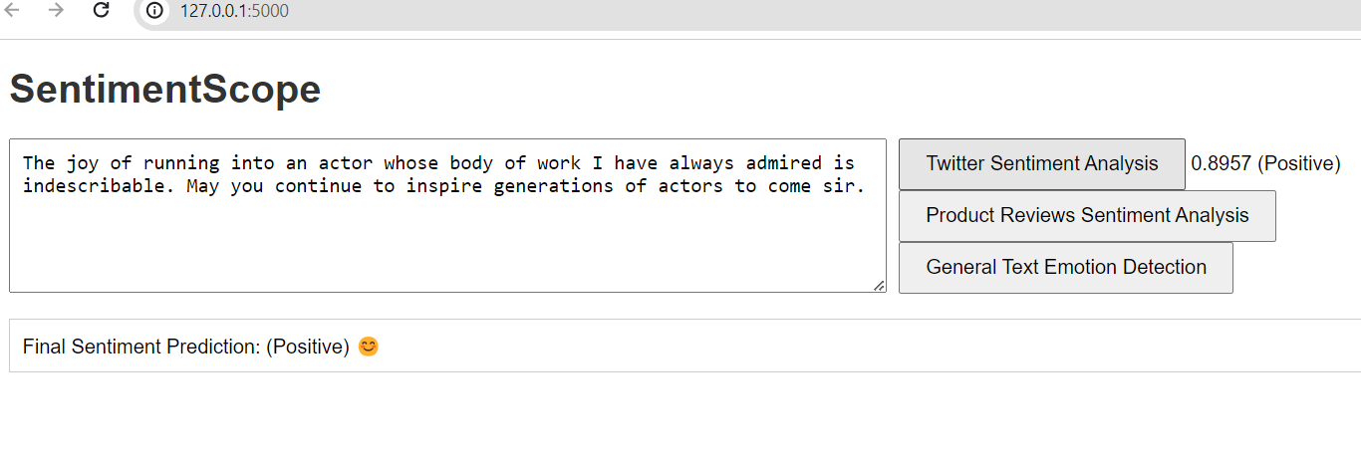
SENTIMENTSCOPE WEB APPLICATION INTERFACE

Slide 10
Thank you
Hanuma Sashank Samudrala
Ashish Athimamula
Varun G

