Slide 1
Distributed File System
Ashish Athimamula
Hanuma Sashank Samudrala

Slide 2
Problem and approach
In a local file system, users or clients most possibly face the challenges of limited accessibility, scalability, single point failure or even network failure effecting the work flow of any organization. This local file system cannot address the concurrent write, reads and even it cannot store back up copies of data.
To overcome these challenges, we have designed a robust distributed file system. Our approach includes the implementation of an Active Server, Lock Servers, Data Base Server and File Servers, ensuring seamless file operations while maintaining data consistency. By integrating fair locking mechanisms and dynamic server interactions, we aim to provide a reliable and scalable solution for modern file management needs.

Slide 3
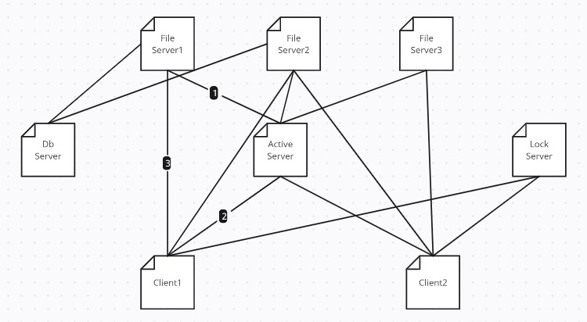
Architecture Diagram

Slide 4
Characteristics of our proposed system
Location Transparency: Users seamless interact with files unaware of their physical location or the hosting server. The system abstracts file locations, enabling uniform access regardless of storage locations
Concurrency Transparency: (Locking Mechanism) We attained concurrency transparency by allowing clients to request file locks for writing without needing to comprehend the intricate locking process. The system transparently manages the locking mechanism, ensuring fair access and orderly write and read operations(FIFO).
Replication Transparency: (Pessimistic Server Replication) In our system, users interact with files without being aware of replicated copies or their locations. The system transparently manages replication, ensuring consistency and fault tolerance across replicas.
Performance Transparency
A modular design with three servers alleviates file server loads, providing users with consistent performance. Transparent request distribution ensures efficient resource utilization across servers.
Availability: Our system ensures continuous service with primary and replica copies on separate servers, allowing seamless failover during disruptions. Random assignment of a single replica for a primary copy enhances reliability.

Slide 5
Implementation Details
Initialization of Core Servers : Activating Db_Server, Active_Server, Lock_Server
File Server Activation: Fileserver1, Fileserver2, Fileserver3
Server Activation Communication: Fileservers broadcast their availability to Active_server
Client Connection Setup: Client connecting to the one of the Fileserver directed by active server
Client-Server Interactions: Requesting connected fileservers for normal file system Operations
Primary File Creation: Primary copy residing in server client connected to and location details entered in Db_server
Replication Process: Replicate on one of the other active server on creation
Write Operations on Primary Copy: First Update in primary copy and then replicas ensuring data Integrity.
Dynamic Server Selection for Write and Read Access: Selection of primary server of that file directed by DB_server
Deletion of File: When a file is requested to delete from the system both primary and replicas are deleted
File Retrieval Process: Getting the file location details from the DB_server
Lock Acquisition for Write Access: Client locking a file before writing
Lock Status Verification for Reads: Polling for the access (check lock status on the file)
Fair Locking Implementation: Following FIFO process by the clients to acquire access for file
System File List Retrieval: Getting the list of available files from DB_server
Backup Db Implementation(Node Failure): Frequently logging and retrieving the status of the fileservers during Turn On and Off

Slide 6
TRADE OFFs
Assuming all the backup servers should be active for managing the node disconnection, if backservers are also off system compramises(todo)
Replication factor is low (replicating only on one other fileserver rather than primary)
Considered only working with text “.txt” files
Considered working with small files only

Slide 7
Future work (todo)
We are exploring the implementation of a backup server system to enhance node failure and disconnection management. This system aims to automatically redirect connections to corresponding backup nodes when a primary node is switched off. The envisioned setup includes the creation of backup servers for each node, providing a seamless transition for connecting clients and ensuring continuous system availability even in the face of node failures.
As of now we have included backup database for every fileserver to store the current status of the fileserver before turning off and retrieving back the previous state information of the server after turning on.

Slide 8
Functionality testing
How does the system handle file creation and replication across distributed servers?
How does the system enable file reading from a server that doesn’t host the requested file (primary or replica)?
How is file writing facilitated on the primary copy and immediate updating in replicas from a server that doesn’t host the file?
Checking process of file deletion, including both primary and replica file removal
Does the system generate and provide a comprehensive list of available files within the distributed environment
Checked file locking mechanism, ensuring client access in a First-In-First-Out (FIFO) order
Backing up of fileserver data(status of fileserver) before the server switching off and loading the previous state of the server after activating the server(node failure management)

Slide 9
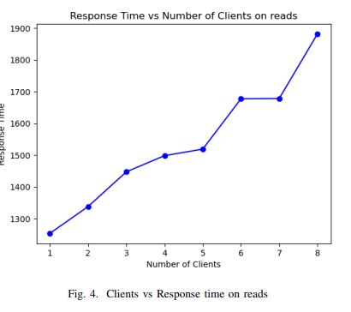
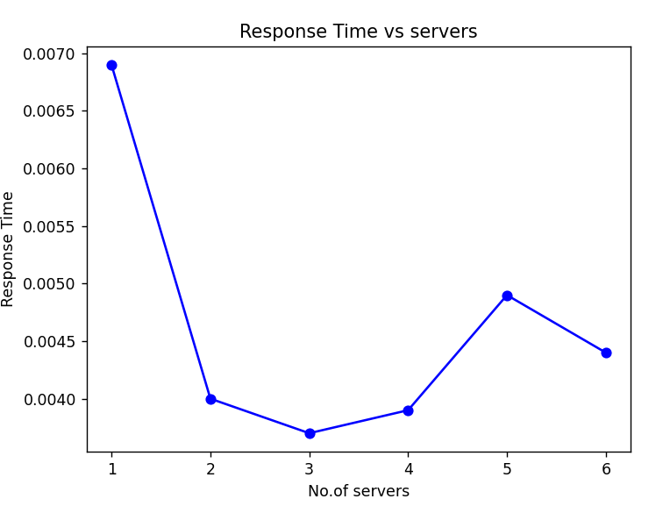
Experiment evaluation
SCALABILITY ANALYSIS
Response time calculation on increasing No.of clients and servers in the system
Note: Observed gradual increment in response time with respect to no.of clients and gradual decreament in response time with increasing of servers(though seen some anomalies)

Slide 10
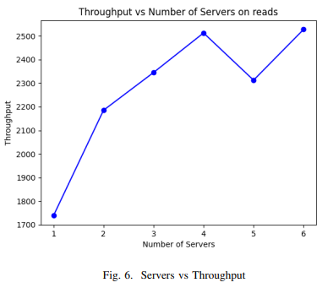
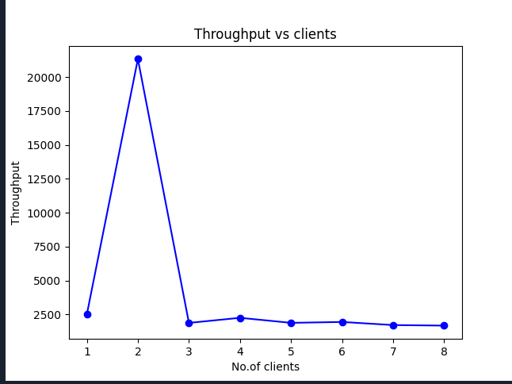
Experiment evaluation
Scalability Analysis
Throughput calculation on increasing No.of clients and servers in the system
Note: Observed gradual increment in throughput with respect to no.of servers and gradual decreament in throughput with increasing of clients(though seen some anomalies)

Slide 11
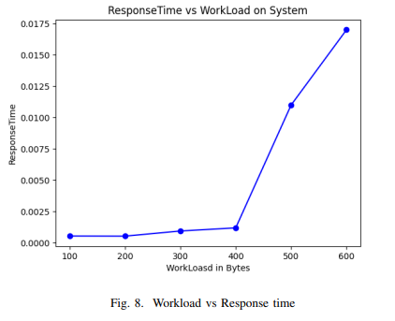
Experiment evaluation
Workload Analysis
Calculation of Response time with increasing of workload
Note: Observed gradual increment in response time with respect to increasing of workload on the system(no anomaly)

Slide 12
SUMMARY
Our distributed file system seamlessly integrates robust features to ensure efficient, fault-tolerant, and concurrent file operations across interconnected servers. It follows a modular architecture involving DB_server, Active_server, and Lock_servers, alongside individual file servers. The workflow encompasses server activation, primary copy creation, replication, and dynamic handling of write and read operations. A fair locking mechanism and transparent replication strategies contribute to consistent performance. By strategically distributing client requests and ensuring redundancy, our system minimizes downtime, guarantees data accessibility, and addresses challenges associated with node failures. The design choices involve trade-offs to balance factors like consistency, availability, performance, and scalability, creating a resilient and user-friendly distributed file system.

Slide 13
THANK YOU
Ashish Athimamula
ka42455@umbc.edu
Hanuma Sashank Samudrala
hanumas1@umbc.edu

