Slide 1
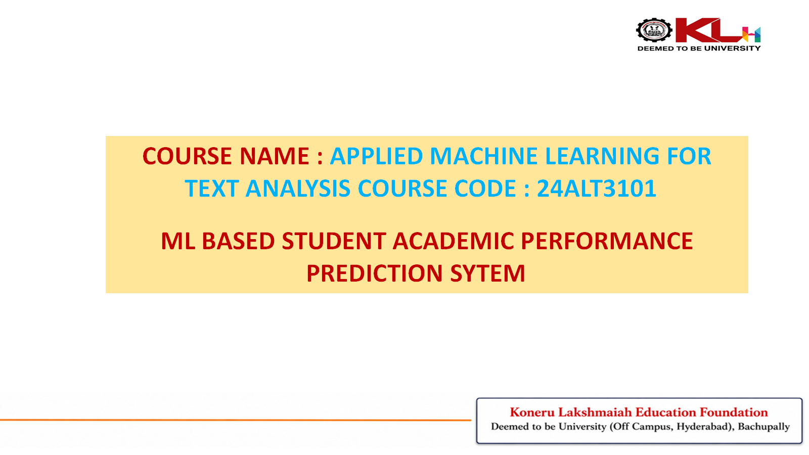

COURSE NAME : APPLIED MACHINE LEARNING FOR TEXT ANALYSIS COURSE CODE : 24ALT3101
ML BASED STUDENT ACADEMIC PERFORMANCE PREDICTION SYSTEM APPLIED MACHINE LEARNING FOR TEXT ANALYSIS COURSE CODE : 24ALT3101
ML BASED STUDENT ACADEMIC PERFORMANCE PREDICTION SYTEM

Slide 2
Team Members :
2420030285 | B.Vignesh Reddy
2420030404 | P.Karthik
2420080062 | T.Nishanth
2420090088 | H.Niranjan Reddy

Slide 3
Problem Statement
To identify low-performing students only after midterm or final examinations, which results in delayed academic support.
To address the difficulty of providing scalable personalization when academic advisors monitor a large number of students.
To develop an ML-based early warning system that can identify academic risk at an earlier stage.

Slide 4
Objectives
To develop an ML-based model to predict student academic risk at an early stage.
To develop a data pipeline to collect, clean and preprocess student academic data.
To train and compare multiple supervised machine learning models for performance prediction.
To integrate the prediction model with an interactive dashboard for visualization, risk flagging and alerts.
To provide early insights that can support timely academic intervention.

Slide 5
DataSets Used
To use the UCI Student Performance Dataset as the primary dataset for the project.
To apply the dataset within the Education Analytics domain.
To model student performance using academic and personal attributes available in the dataset.
To use the processed dataset to train, validate and evaluate machine learning models for student performance prediction.

Slide 6
Literature Survey
To study the evolution of student performance prediction approaches over time.
From 2015–2018, to model performance mainly through linear regression and past GPA, with limited ability to capture nonlinear student behavior.
From 2018–2021, to integrate data-mining approaches such as Decision Trees and Naïve Bayes with demographic and midterm data.
From 2021 onwards, to apply advanced models such as Random Forest, XGBoost and Artificial Neural Networks, particularly with LMS activity.

Slide 7
Research Papers – I
• Alalawi, K., Athauda, R., & Chiong, R. (2023) – “Contextualizing the current state of research on the use of machine learning for student performance prediction: A systematic literature review.”
• To review 162 research articles published from 2010–2022 and identify major ML approaches used for student performance prediction.
• To model student performance using commonly applied algorithms such as Decision Tree, Random Forest, Naïve Bayes, Artificial Neural Network and Support Vector Machine.
• Key finding: Classification was the dominant approach, while historical grades, LMS data and demographic information were among the most common predictive features.
• Research gap identified: very few studies connected prediction results with actual remedial actions for at-risk students.

Slide 8
Research Papers – II
• Balaji, P., Alelyani, S., Qahmash, A., & Mohana, M. (2021) – “Contributions of Machine Learning Models towards Student Academic Performance Prediction: A Systematic Review.”
• To analyze 2,700 initially identified articles and systematically examine algorithms, datasets and features used in student performance prediction.
• To categorize predictive features into demographic, academic and behavioral groups and evaluate the role of ML methods.
• Key finding: ML can predict student outcomes using academic and behavioral information, but differences in datasets make it difficult to identify one universally best model.
• 2026 review update: a recent systematic review of 72 studies reports that tree-based models and neural networks dominate current approaches, while Explainable AI is emerging as an important direction.

Slide 9
Innovation, Creativity & Novelty
To develop a Multi-Checkpoint Early Warning System that evaluates student risk periodically during the academic term.
To integrate academic and behavioral features, including assignment submission latency and discussion forum engagement, for improved risk assessment.
To model the relationship between predicted risk and its dominant factors to support targeted intervention.
To trigger prescriptive actions such as tutoring or attendance counselling based on identified risk factors.

Slide 10
Feasibility Analysis
To assess project feasibility from technical, operational and economic perspectives.
To develop the system using established open-source technologies such as Python, Scikit-Learn, XGBoost and Streamlit or Flask.
To integrate a non-technical dashboard so academic staff can use the system without requiring machine learning expertise.
To deploy the solution using scalable and cost-effective cloud infrastructure such as basic AWS or Azure tiers.

Slide 11
THANK YOU

