Slide 1

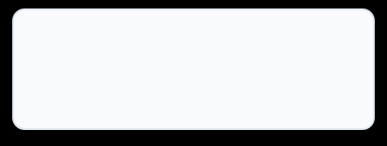


APPLIED MACHINE LEARNING FOR TEXT ANALYSIS, S-7, GROUP-12
ML Based Student Academic Performance Prediction System
An Intelligent System to predict Student Academic Risk and support Timely Intervention
Machine Learning
Data Analytics
Predictive Modelling
Explainable AI
PROJECT TEAM
T. Nishanth
H. Niranjan Reddy
P. Karthik
2420080062
2420090088
2420030404

Slide 2
01 · THE PROBLEM
Problem Statement
Students at academic risk are often identified only after their performance has declined, resulting in delayed academic support .
TRADITIONAL ACADEMIC MONITORING → LIMITED
· Manual tracking and fixed criteria
· Delayed identification of struggling students
· Difficult to scale across large student groups
Delayed identification of at risk Students
Limited personalized academic support
Large number of students to monitor
Manual monitoring is time consuming
ML-BASED EARLY WARNING → PROACTIVE
Academic and personal features are analyzed to classify students at Good Performance / At Risk, with a risk score, explanations and recommendations for timely intervention.
Difficult to prioritize interventions
Need for data-driven early warning

Slide 3
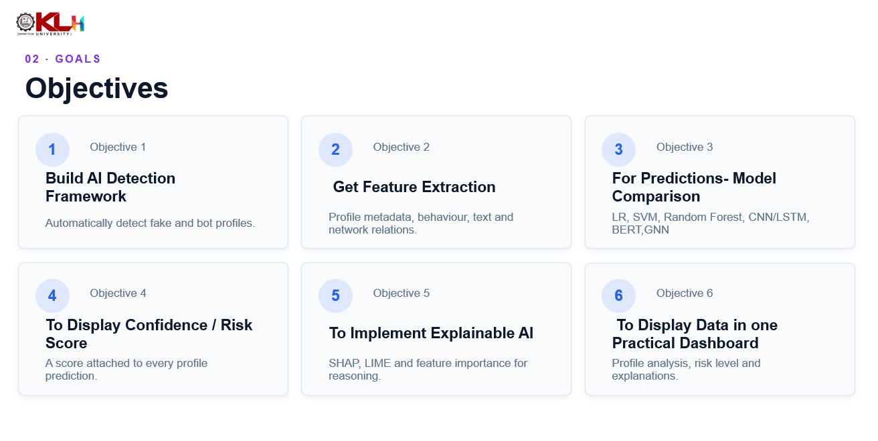
02 · GOALS
Objectives
1
Objective 1
2
Objective 2
3
Objective 3
Build AI Detection Framework
Get Feature Extraction
For Predictions- Model Comparison
Automatically detect fake and bot profiles.
Profile metadata, behaviour, text and network relations.
LR, SVM, Random Forest, CNN/LSTM, BERT,GNN
4
Objective 4
5
Objective 5
6
Objective 6
To Display Confidence / Risk Score
To Implement Explainable AI
To Display Data in one Practical Dashboard
A score attached to every profile prediction.
SHAP, LIME and feature importance for reasoning.
Profile analysis, risk level and explanations.

Slide 4
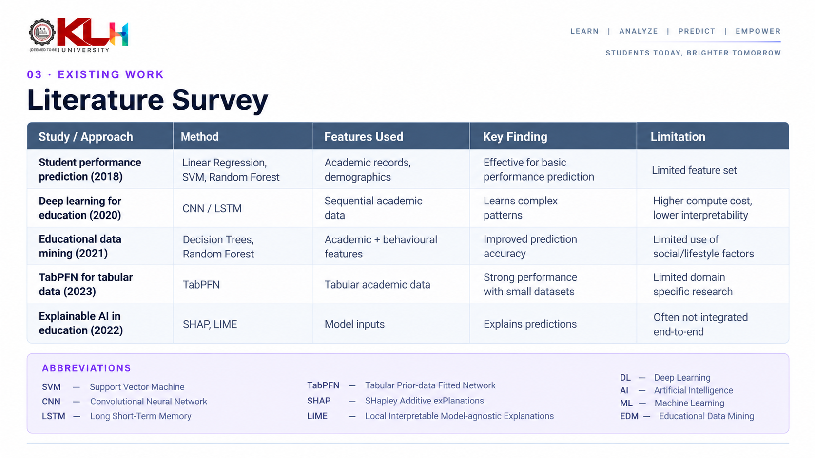

03 · EXISTING WORK
Literature Survey
Study / Approach
Detection Method
Features
Key Finding
Limitation
ML-based fake
account detection(2018)
Random Forest, SVM,
Logistic Regression
Profile metadata,
behavioural attributes
Effective on structured
account features
Strong dependence on
handcrafted features
Deep learning social
bot detection(2022)
CNN / LSTM / DNN
Behavioural and textual
patterns
Learns patterns without
manual feature design
Higher compute cost,
limited interpretability
NLP-based fake
profile detection(2023)
TF-IDF, Word
Embeddings, BERT
Bio and post content
Captures linguistic cues
in profile text
Text-only view ignores
network relationships
Graph-based bot
Detection(2019)
Graph Neural Networks,
graph learning
Follower–following
structure
Uses relational structure
between accounts
Needs graph data;
computationally expensive
Explainable AI for
Classification(2021)
SHAP, LIME, Feature
Importance
Model inputs and
contributions
Explains why a
prediction was made
Usually added on, not
integrated end-to-end
ABBREVIATIONS
CNN — Convolutional Neural Network
BERT — Bidirectional Encoder Representations from Transformers
LSTM — Long Short-Term Memory (network)
SHAP — SHapley Additive exPlanations
DNN — Deep Neural Network
LIME — Local Interpretable Model-agnostic Explanations
TF-IDF — Term Frequency – Inverse Document Frequency

Slide 5
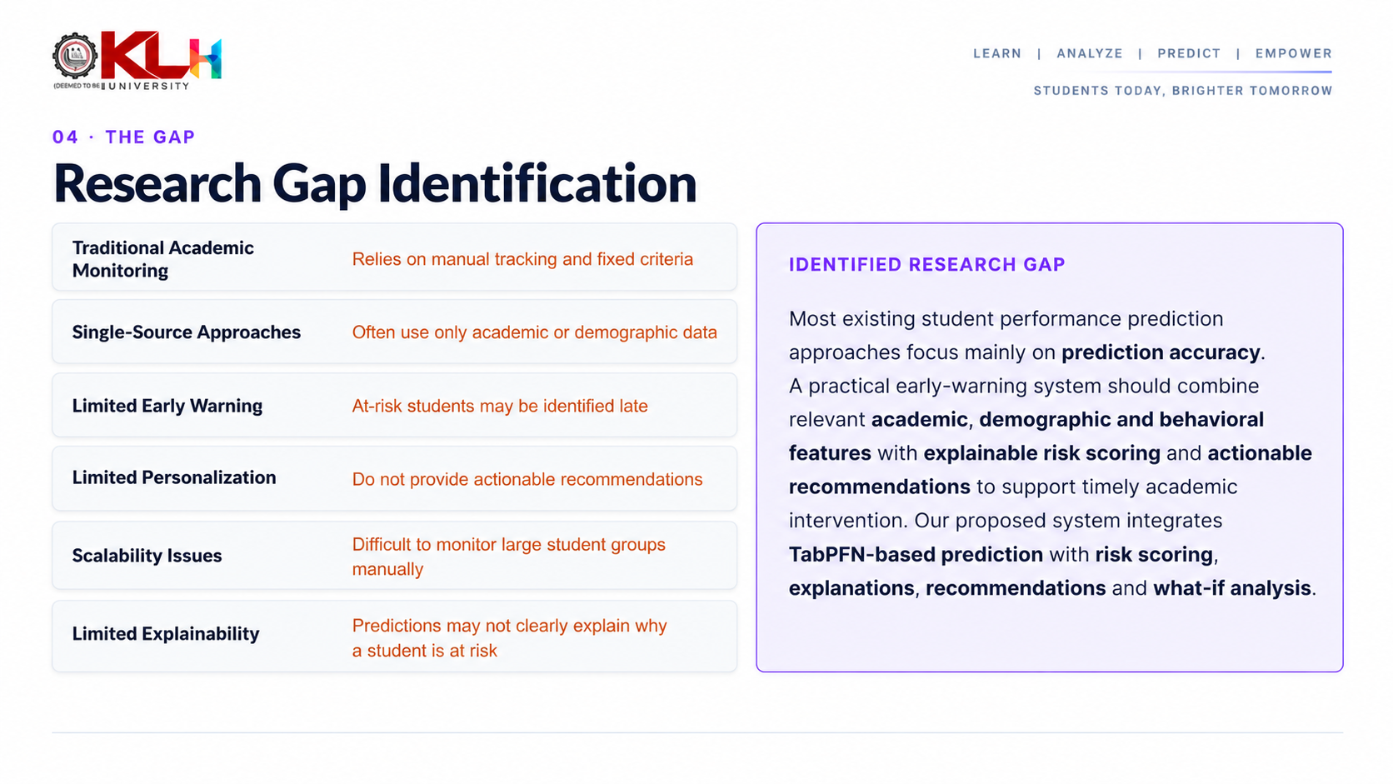
04 · THE GAP
Research Gap Identification
Rule-Based Detection
Cannot adapt easily to evolving fake behaviour
IDENTIFIED RESEARCH GAP
Profile-Based ML
Limited view of user activity
Most existing approaches focus on one or a limited set of information sources, while a unified framework combining profile metadata, behavioural patterns, NLP-based text features, network structure and explainable AI can provide a more comprehensive detection approach.
Behaviour-Based Detection
May ignore textual and network information
Text-Based Detection
Cannot capture social relationships
Graph-Based Detection
Often requires complex network data
Deep Learning
Can be difficult to interpret
Explainable AI
Often not integrated into the full detection pipeline

Slide 6
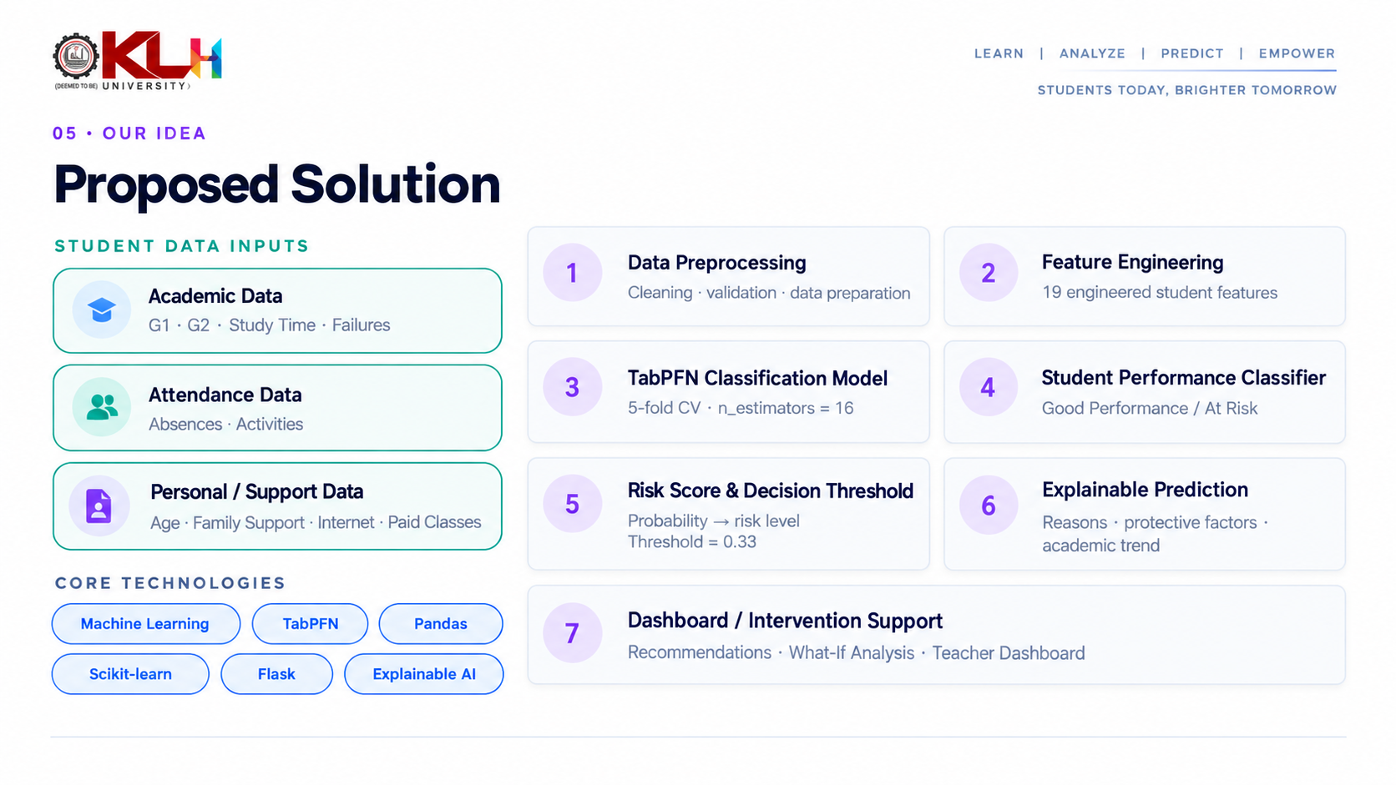
05 · OUR IDEA
Proposed Solution
HETEROGENEOUS INPUTS
1
Data Preprocessing
2
Feature Engineering
Profile Metadata
Cleaning · normalisation
Metadata · text · graph
Behavioural Data
3
AI / ML Models
4
Fake Profile Classifier
ML · DL · BERT · GNN
Genuine / Fake / Bot
Textual Data
5
Confidence & Risk Score
6
Explainable AI
Network Graph
Probability → risk band
SHAP · LIME
7
Dashboard / Moderator Alert
CORE TECHNOLOGIES
Human-readable explanation
Machine Learning
Deep Learning
NLP
BERT
GNN
Explainable AI

Slide 7
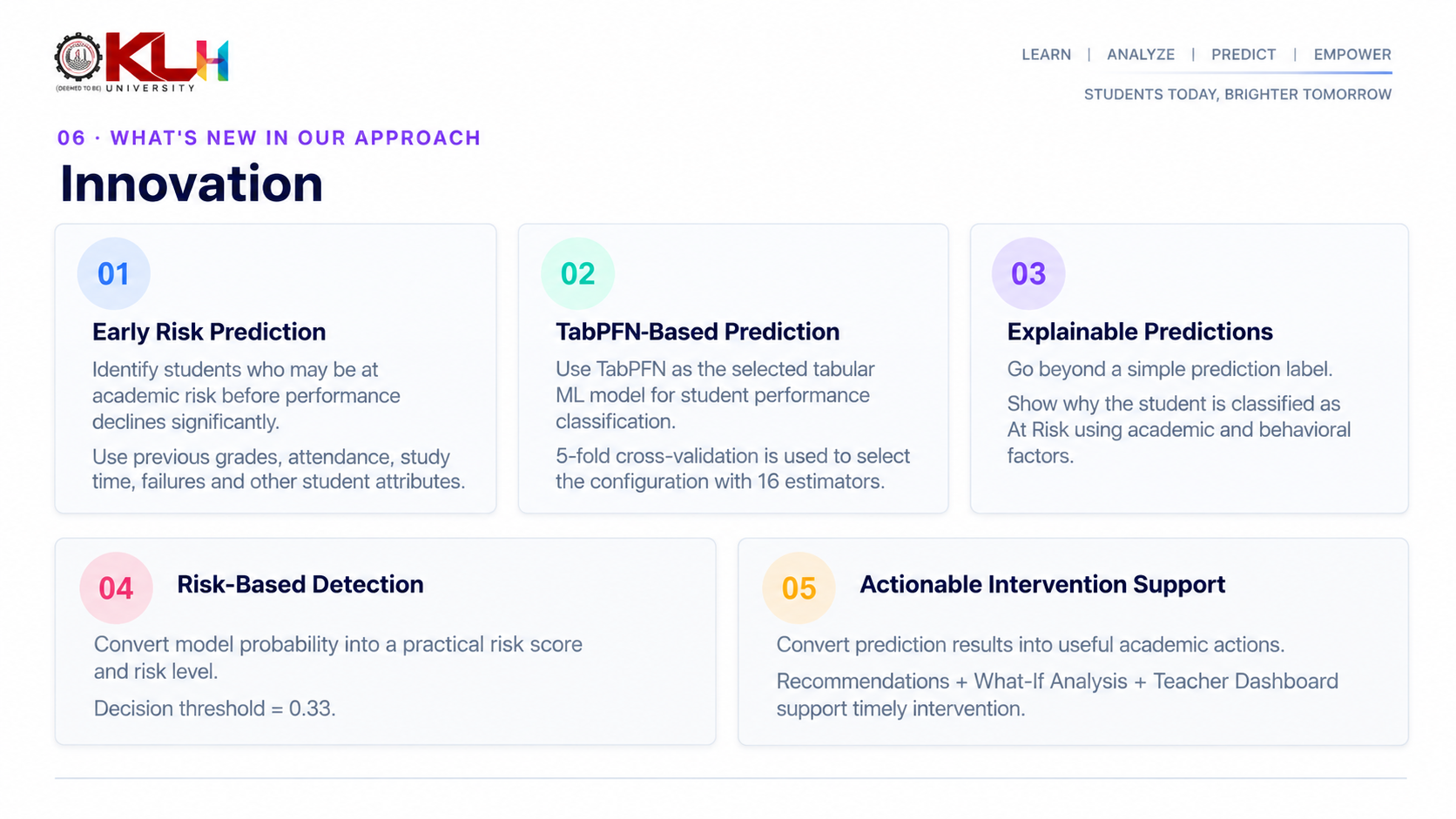
06 · WHAT'S NEW IN APPROACH
Innovation
01
02
03
Multi-Signal Detection
Hybrid AI Approach
Explainable Predictions
Metadata + Behaviour + Text + Network instead of a single feature category.
Benchmark classical ML against deep learning to find the most suitable model.
Identify the influential factors behind each classification, not just a label.
04
Risk-Based Detection
05
Moderator-Oriented Output
Output a risk level and confidence score with an explanation.
Turn model results into insights that support moderation decisions.

Slide 8
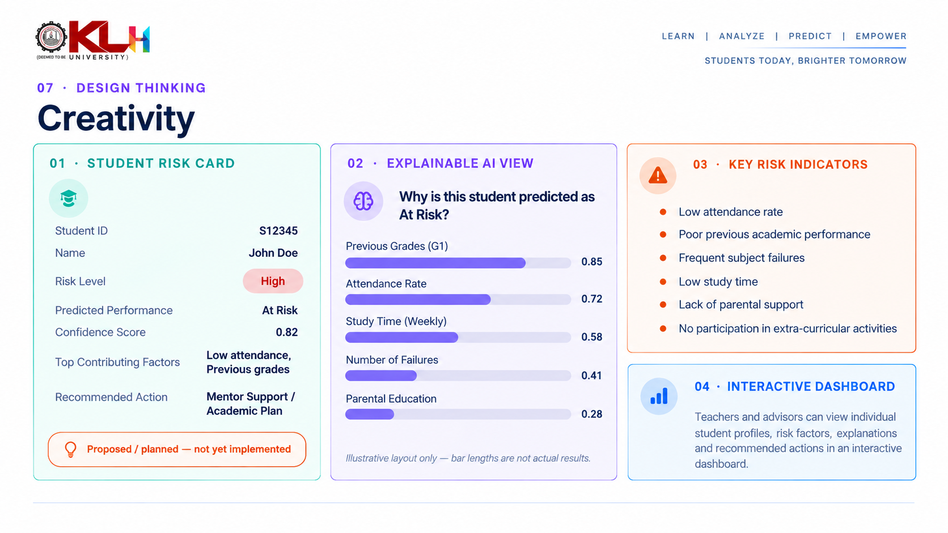
07 · DESIGN THINKING
Creativity
01 · PROFILE RISK CARD
02 · EXPLAINABLE AI VIEW
03 · SUSPICION INDICATORS
Username
@example_user
Why was this profile flagged?
• Unusual activity
Risk Level
High
• Suspicious connections
Follower / Following Ratio
Confidence
Model-derived score
• Repetitive content
Account Age
• Abnormal engagement
Suspicious Features
Top contributing signals
• Incomplete profile
Recommended Action
Review / Flag
Posting Frequency
Proposed / planned — not yet implemented
Username Pattern
04 · INTERACTIVE DASHBOARD
Illustrative layout only — bar lengths are not results.
Moderators inspect individual profiles and see the reasoning behind each prediction.

Slide 9
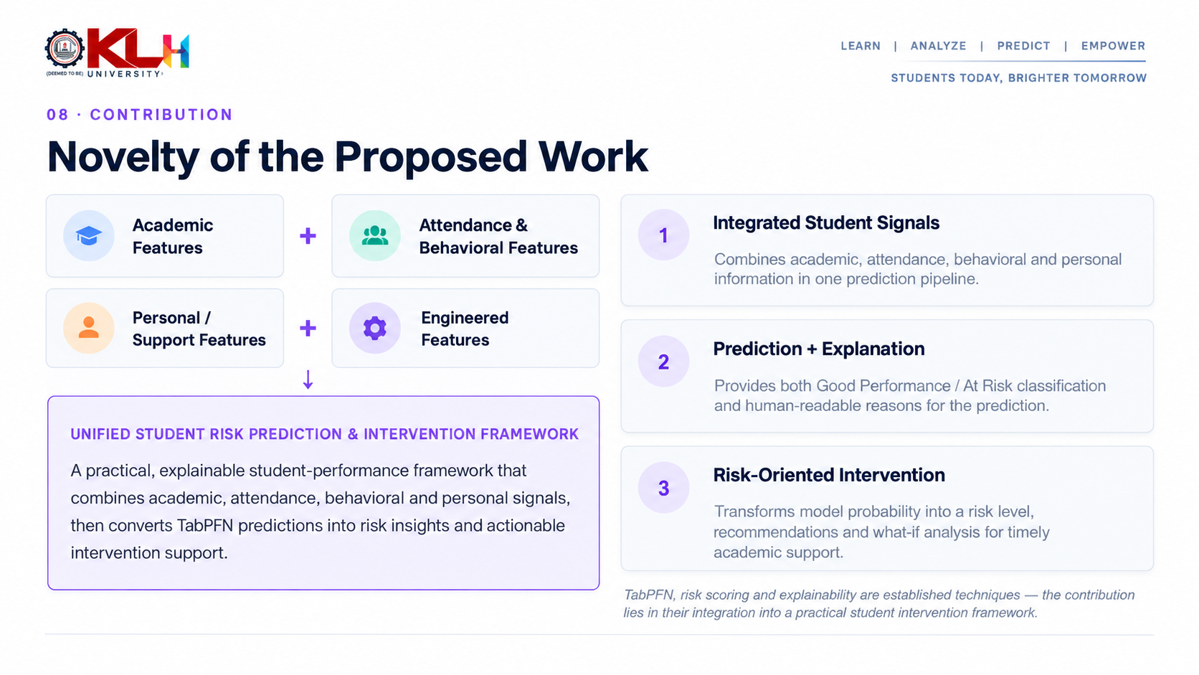
08 · CONTRIBUTION
Novelty of the Proposed Work
Profile Features
+
Behaviour Features
1
Multi-level representation
Combines individual profile, behavioural, textual and network-level information.
NLP / BERT Features
+
Graph / GNN Features
Explainable AI
2
Prediction + Explanation
The framework aims to provide both classification and reasoning together.
↓
UNIFIED DETECTION & EXPLANATION FRAMEWORK
A unified, explainable multi-modal fake-profile detection framework that combines heterogeneous social-network signals and converts AI predictions into human-readable risk insights.
3
Risk-oriented output
Transforms predictions into confidence and risk information useful for moderation.
BERT, GNN, SHAP and Random Forest are established techniques — the novelty lies in their integration into a single application framework.

Slide 10
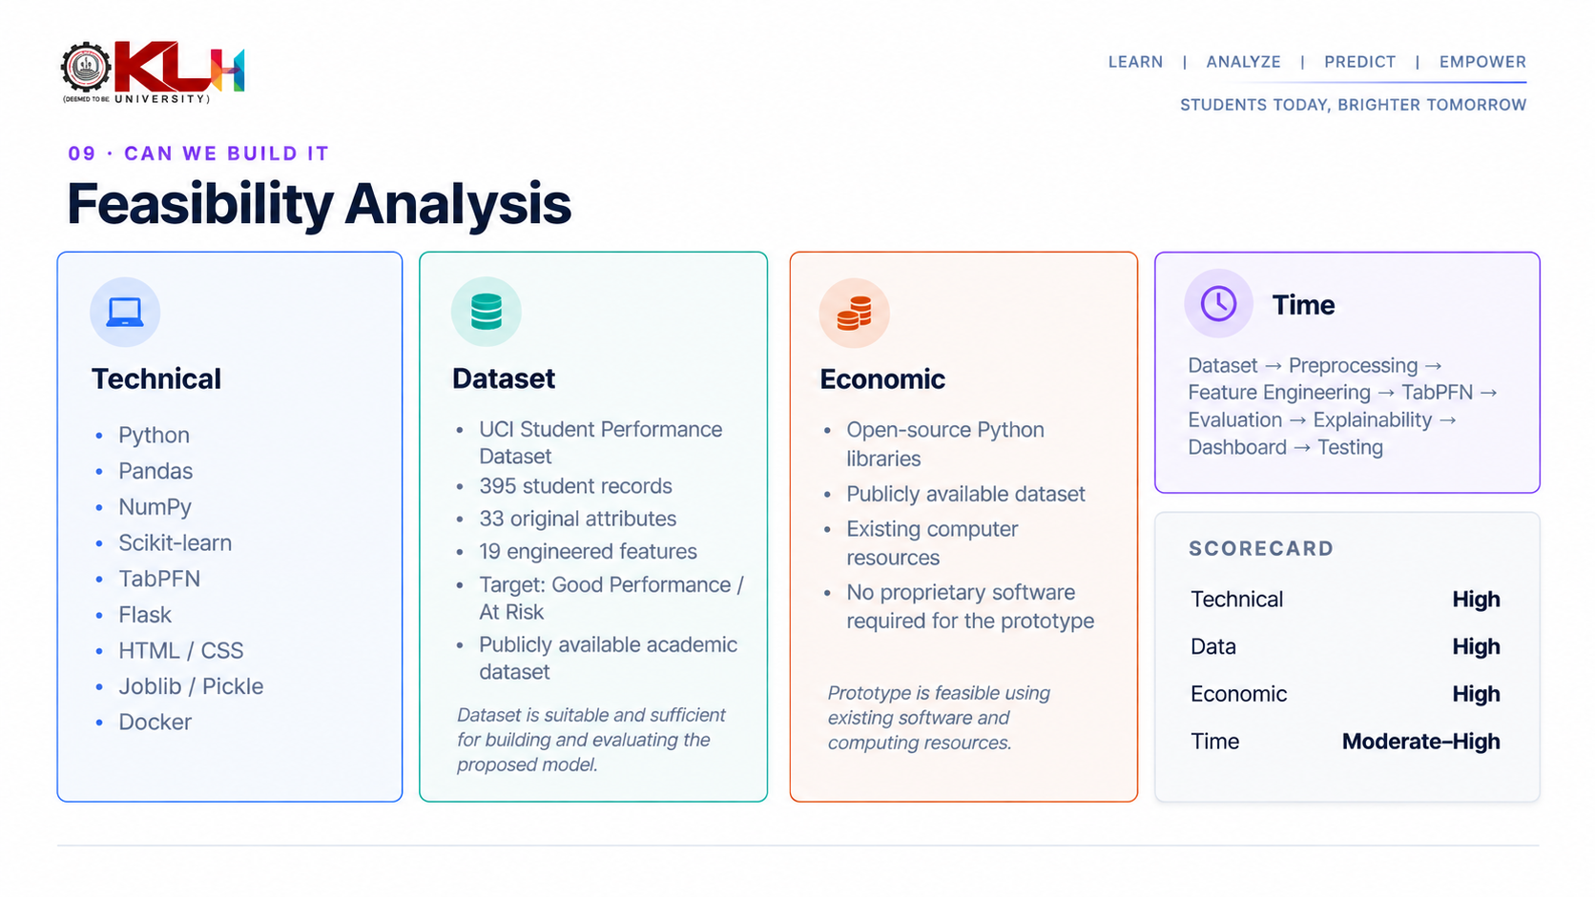
09 · CAN WE BUILD IT
Feasibility Analysis
Technical
Dataset
Economic
Time
Dataset → Preprocessing → Features → Models → Evaluation → Explainability → Dashboard → Testing
· Python
· Scikit-learn
· TensorFlow / PyTorch
· Transformers
· NetworkX / PyG
· SHAP · LIME
· FastAPI · Streamlit / React
Publicly available candidates on Kaggle:
· Open-source ML libraries
· Public datasets
· Existing student computing resources
· No proprietary software needed for the prototype
· Instagram Fake / Spammer / Genuine Accounts
· Fake Social Media Account Detection
· Twitter Genuine / Fake User Profiles
SCORECARD
Technical
High
Data
High
Dataset sizes to be confirmed after collection.
Economic
High
Time
Moderate–High

Slide 11
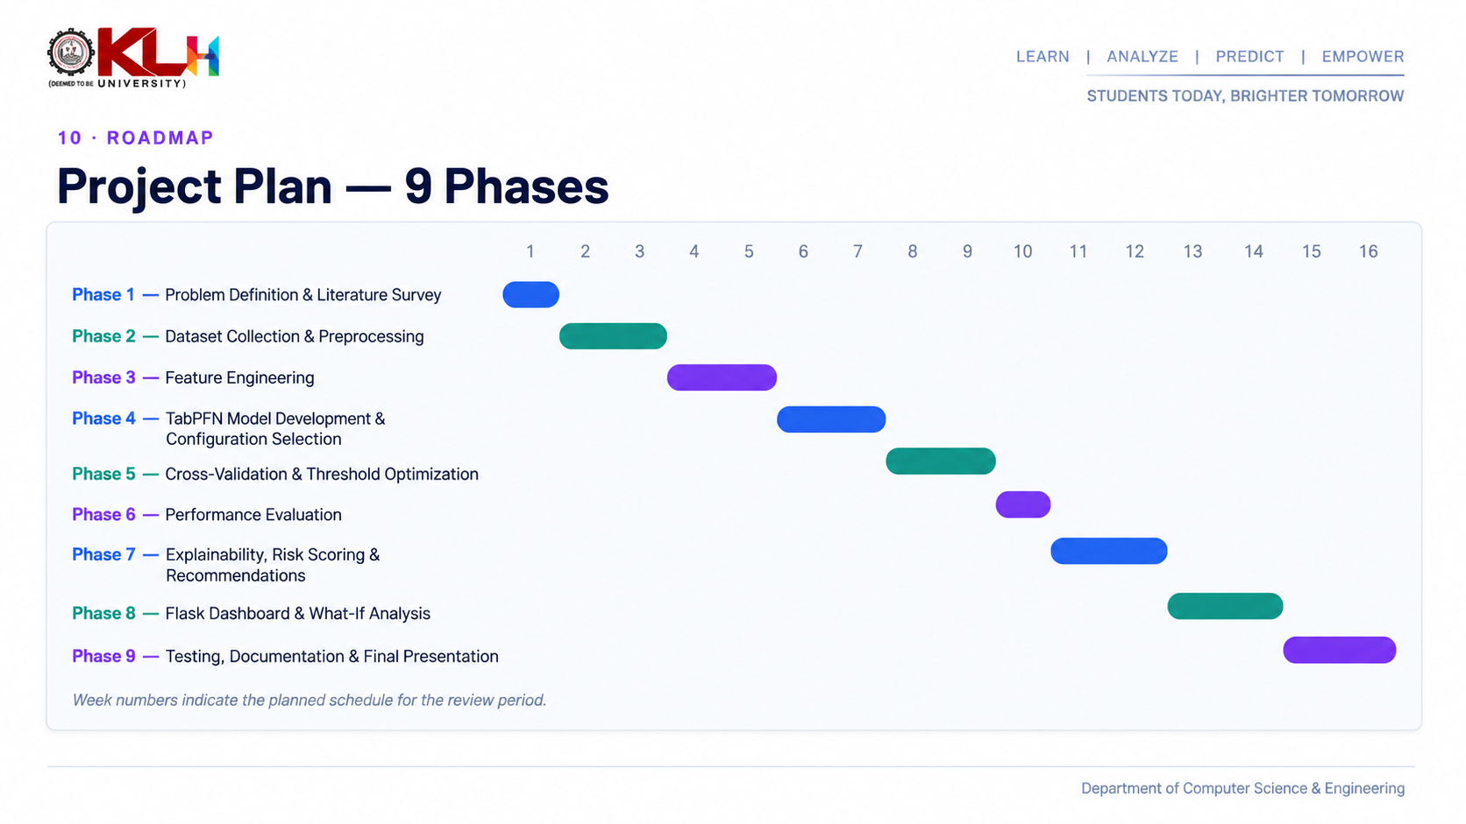
10 · ROADMAP
Project Plan — 9 Phases
1
2
3
4
5
6
7
8
9
10
11
12
13
14
15
16
Phase 1 — Problem Definition & Literature Survey
Phase 2 — Dataset Collection & Preprocessing
Phase 3 — Feature Engineering
Phase 4 — Baseline ML: RF · SVM · Logistic Regression
Phase 5 — Deep Learning / NLP / Graph: CNN-LSTM · BERT · GNN
Phase 6 — Evaluation: Accuracy · Precision · Recall · F1 · ROC-AUC
Phase 7 — Explainable AI: SHAP · LIME · Feature Importance
Phase 8 — Dashboard Development
Phase 9 — Testing, Documentation & Final Presentation
Week numbers indicate the planned schedule for the review period.
Department of Computer Science & Engineering

Slide 12
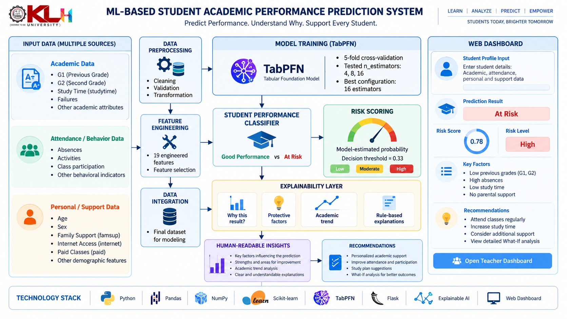
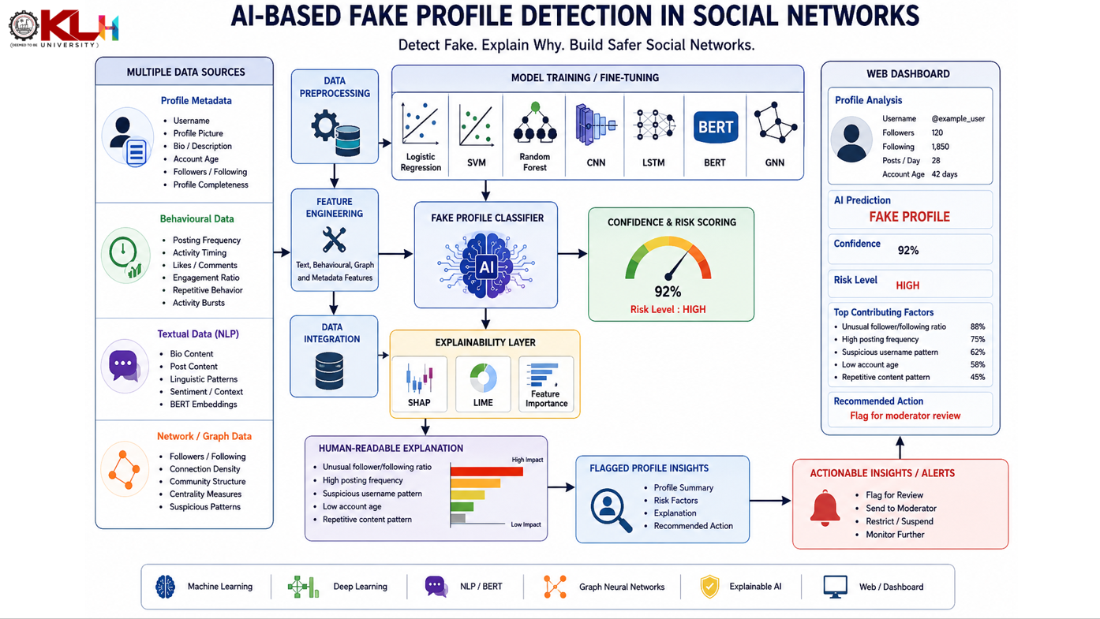

Slide 13
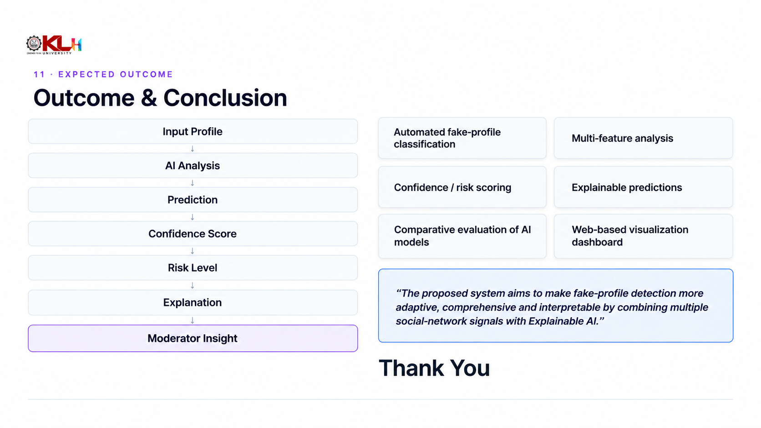
11 · EXPECTED OUTCOME
Outcome & Conclusion
Input Profile
Automated fake-profile classification
Multi-feature analysis
↓
AI Analysis
Confidence / risk scoring
Explainable predictions
↓
Prediction
↓
Comparative evaluation of AI models
Web-based visualization dashboard
Confidence Score
↓
Risk Level
↓
“The proposed system aims to make fake-profile detection more adaptive, comprehensive and interpretable by combining multiple social-network signals with Explainable AI.”
Explanation
↓
Moderator Insight
Thank You
Questions & Discussion

