Slide 1
Introduction to POWER BI
PRESENTED BY – REMYA R S

Slide 2
Business Intelligence
Need
Collection
Analyze
Visualize
Decision

Slide 3
Gartner Magic Quadrant
Gartner's IT consulting company produces a series of market research studies called Magic Quadrant (MQ) that use exclusive qualitative data analysis techniques to show industry trends like direction, maturity, and participation. Their studies are carried out for several distinct technology businesses, and they are updated every one to two years.
Vendors are rated by Gartner based on : completeness of vision and ability to execute.
Completeness of vision - The completeness of the vision reflects the originality and innovation of the seller and if the vendor is leading or following the market.
Ability to Execute - Highlights elements including the vendor's financial stability, responsiveness to the market, product development, sales channels, and client base.

Slide 4
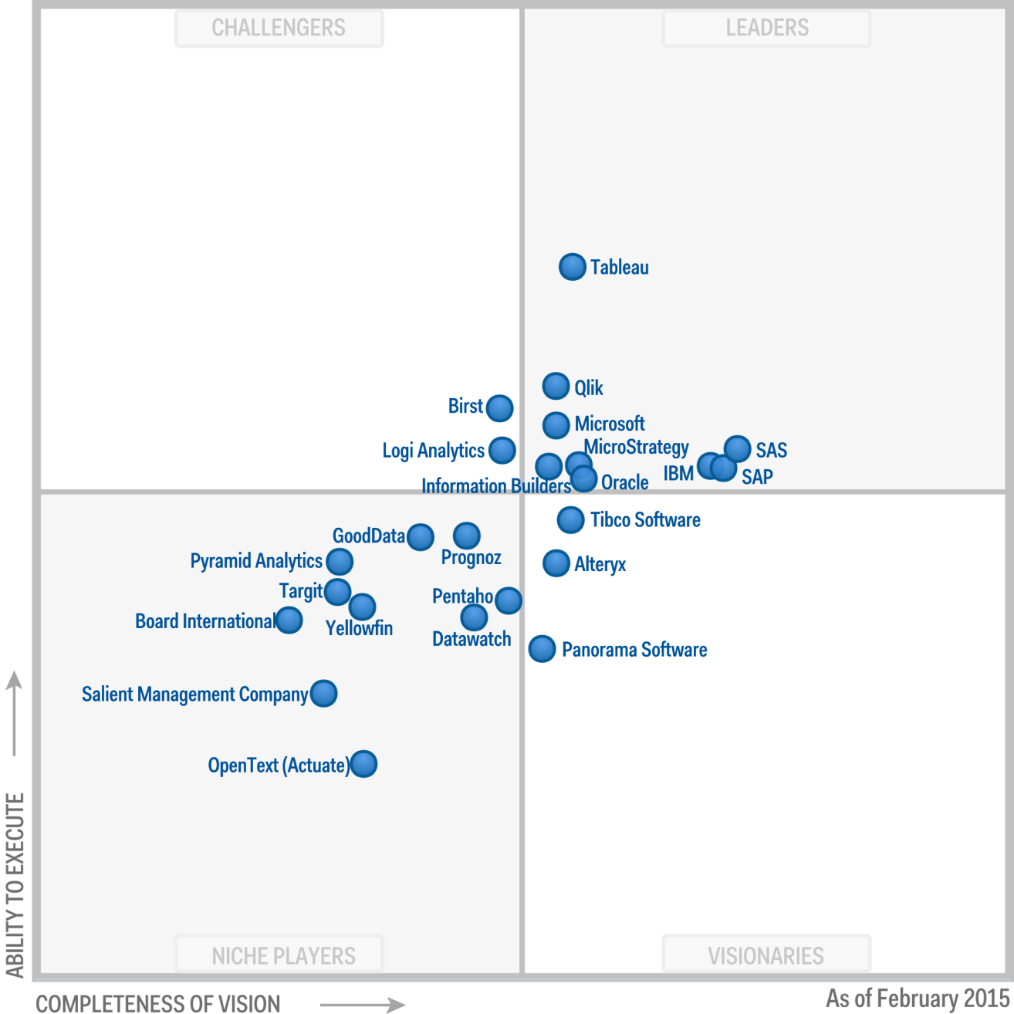
BI tools in 2015

Slide 5
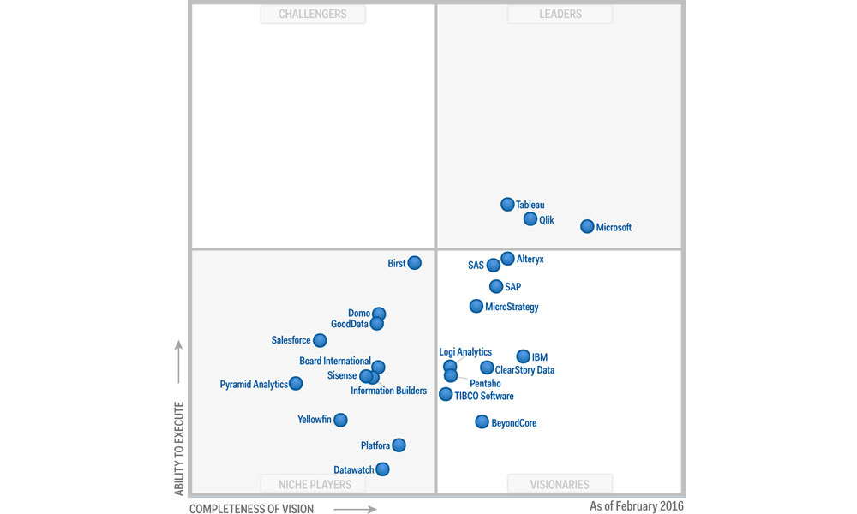
BI tools in 2016

Slide 6

BI tools in 2017

Slide 7
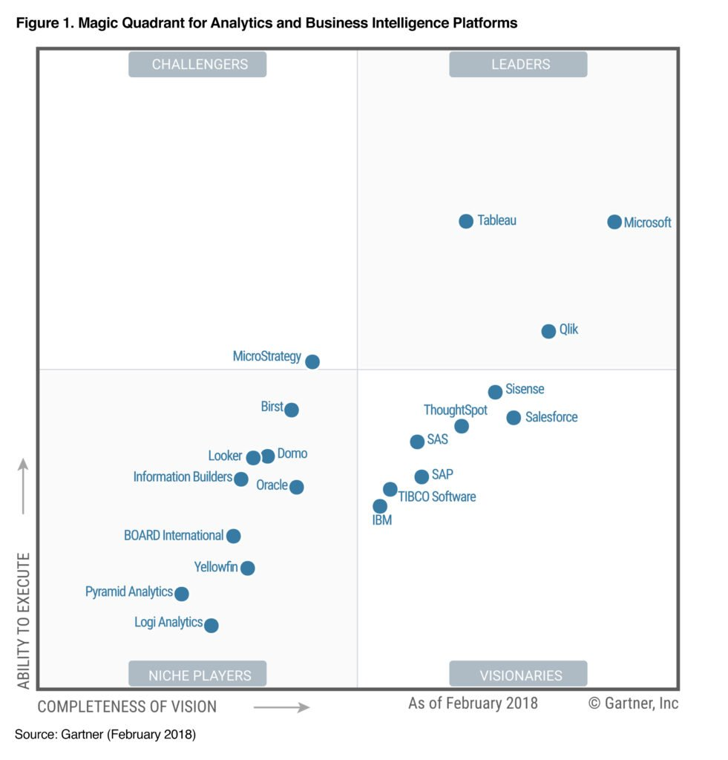
BI tools in 2018

Slide 8
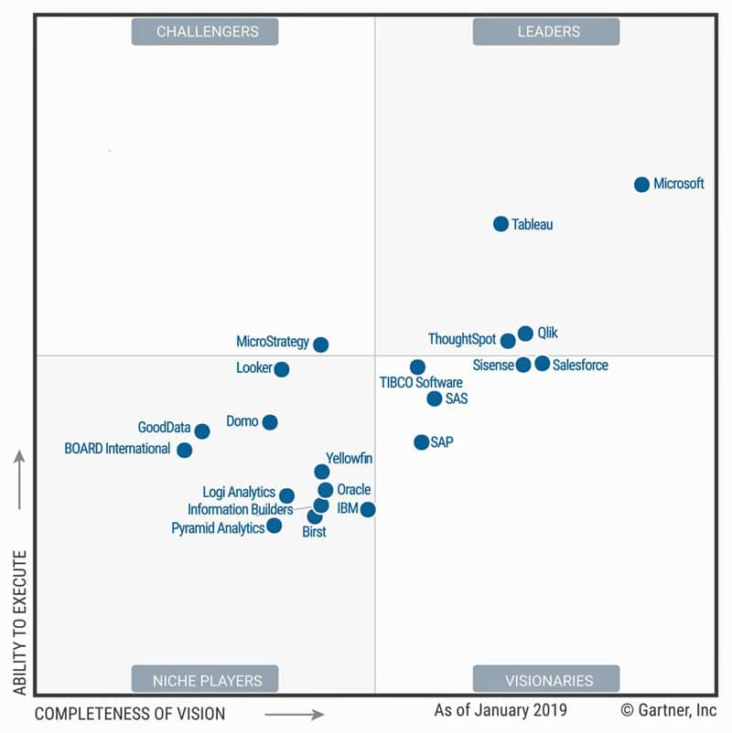
BI tools in 2019

Slide 9
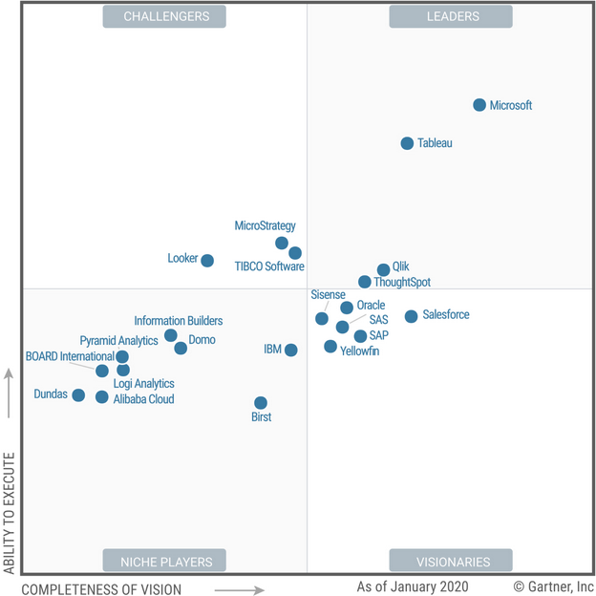
BI tools in 2020

Slide 10
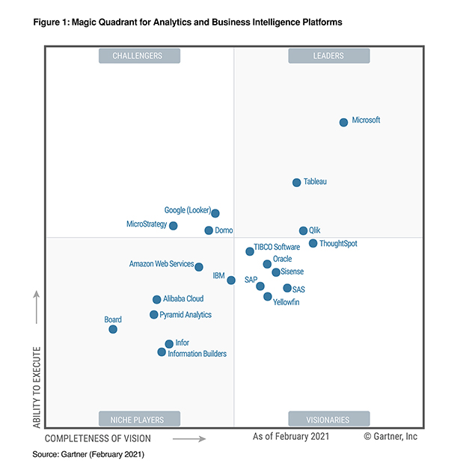
BI tools in 2021

Slide 11
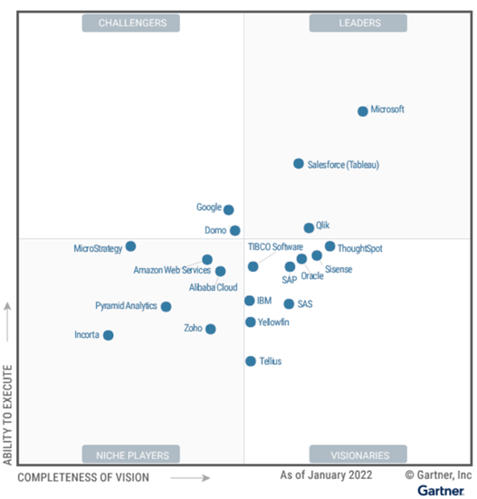
BI tools in 2022

Slide 12
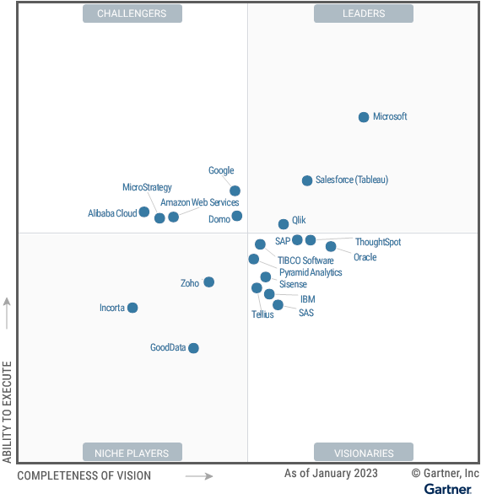
BI tools in 2023
Power BI has been recognized by Gartner as the market's most complete and potent platform for the fifth year in a row.

Slide 13
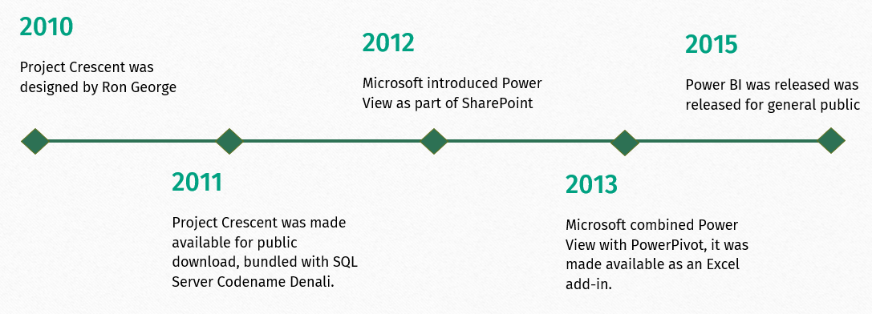
facts
It was originally designed by Ron George in the summer of 2010 and named Project Crescent.

Slide 14
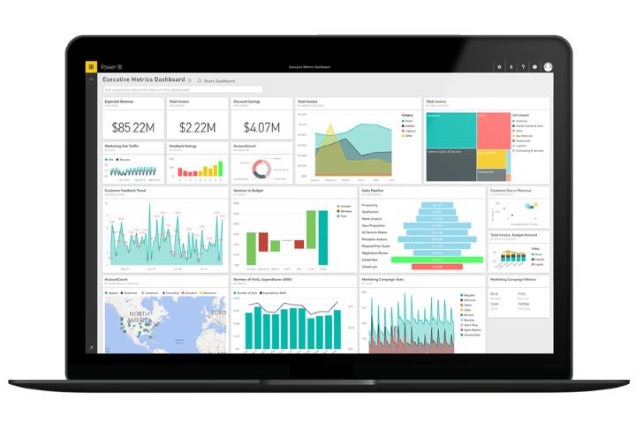
Power BI
Power BI – Business intelligence tool, used to clean and convert data into visualization format like dashboards and reports
Its business analytics service provided by Microsoft
Power BI Desktop - Application where we do visualization
1200 different functions available
280 visuals
Least expensive compared to other BI tools
Can accept data from 100 different data sources
Recognized by Gartner Company (which compares all BI products)

Slide 15
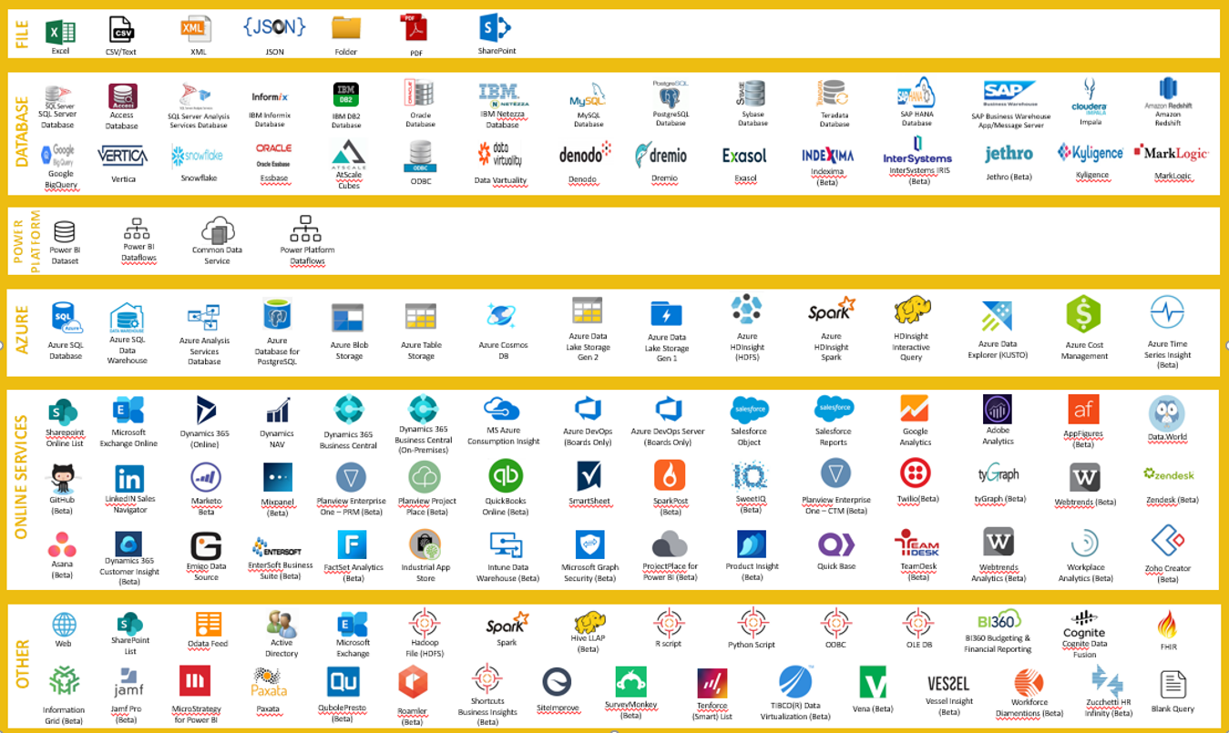
Data sources

Slide 16
Working with PBI Step by Step
Power Query
Formula Bar
Power BI Service
Extract
Transform
Load
Data Modelling
DAX
Report Building
Publish Report
Dashboard Creation
Share & Create
Power Pivot
Power View
Power BI Desktop
Power BI Service

Slide 17




Working with PBI Step by Step - Example
Power Query - The Script Writer
Data Modeling with DAX - The Plot Architect/ story teller
Visualization Pane - The Scene Director
Power BI Service - The Box Office Premiere

Slide 18
Job roles in Power BI & corresponding Average Salary
Power BI Manager - ₹ 21.5 Lakhs
Power BI Project Manager - ₹ 14.1 Lakhs
Power BI Administrator - ₹ 8.6 Lakhs
Power BI Consultant - ₹ 6.3 Lakhs
Power BI Semantic Model Developer - ₹ 5.9 Lakhs
Power BI Developer - ₹ 5.8 Lakhs
Data Analyst - ₹ 4.3 Lakhs

Slide 19


