Slide 1
Understanding static
We can define a class member that will be used independently of any object of that class.
When a member (variable or method) is declared static, it can be accessed before any objects of its class are created.
Methods declared as static have several restrictions
They can only directly call other static methods.
They can only directly access static data.
They cannot refer to this or super in any way.

Slide 2
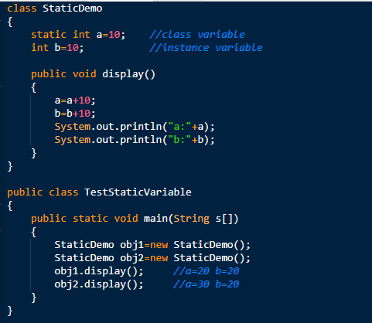

Understanding static Variable
OUTPUT

Slide 3
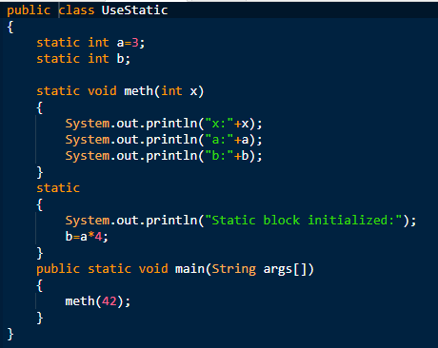

Understanding static block
OUTPUT

Slide 4
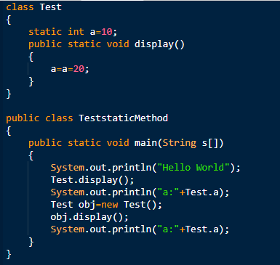

Understanding static method
OUTPUT

Slide 5
Constructors in Java
In Java, a constructor is a block of codes similar to the method.
It is called when an instance of the class is created.
At the time of calling constructor, memory for the object is allocated in the memory.
It is a special type of method which is used to initialize the object.
Every time an object is created using the new() keyword, at least one constructor is called.
5

Slide 6
Constructors in Java
It calls a default constructor if there is no constructor available in the class. In such case, Java compiler provides a default constructor by default.
There are two types of constructors in Java: no-arg constructor, and parameterized constructor.
Note: It is called constructor because it constructs the values at the time of object creation. It is not necessary to write a constructor for a class. It is because java compiler creates a default constructor if your class doesn't have any.
6

Slide 7
Rules for Creating Constructors in java
There are two rules defined for the constructor.
Constructor name must be the same as its class name
A Constructor must have no explicit return type
A Java constructor cannot be abstract, static, final, and synchronized
Note: We can use access modifiers while declaring a constructor. It controls the object creation. In other words, we can have private, protected, public or default constructor in Java.
7

Slide 8
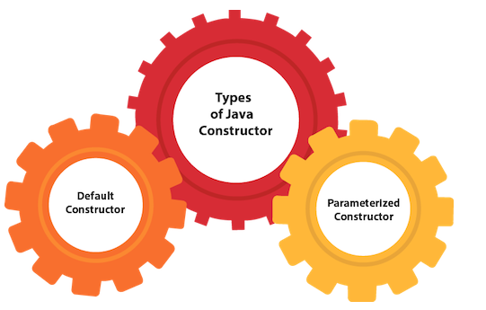
Types of Constructors in java
8

Slide 9
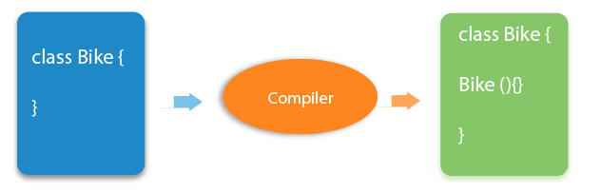
Default Constructors in java
A constructor is called "Default Constructor" when it doesn't have any parameter.
Syntax of default constructor:
class_name()
{
}
If there is no constructor in a class, compiler automatically creates a default constructor.
9

Slide 10
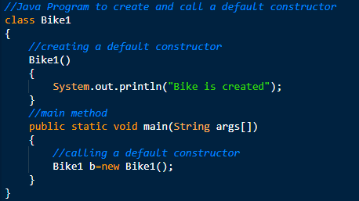
Default Constructors in java
OUTPUT
The default constructor is used to provide the default values to the object like 0, null, etc., depending on the type.
10

Slide 11
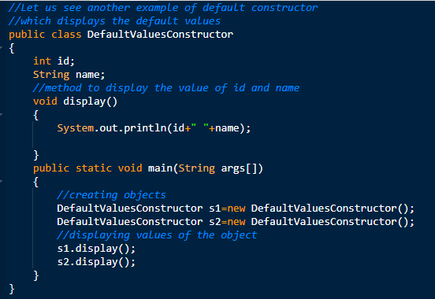

Default Constructors in java
OUTPUT
In the above class,you are not creating any constructor so compiler provides you a default constructor. Here 0 and null values are provided by default constructor.
11

Slide 12
Parameterized Constructors in java
A constructor which has a specific number of parameters is called a parameterized constructor.
The parameterized constructor is used to provide different values to distinct objects. However, you can provide the same values also.
12

Slide 13
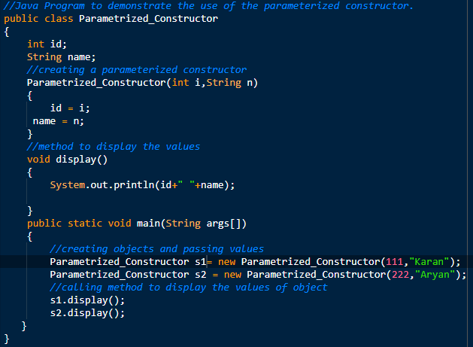

Parameterized Constructors in java
OUTPUT
13

Slide 14
Constructor Overloading in java
In Java, a constructor is just like a method but without return type. It can also be overloaded like Java methods.
Constructor overloading in Java is a technique of having more than one constructor with different parameter lists.
They are arranged in a way that each constructor performs a different task.
They are differentiated by the compiler by the number of parameters in the list and their types.
14

Slide 15
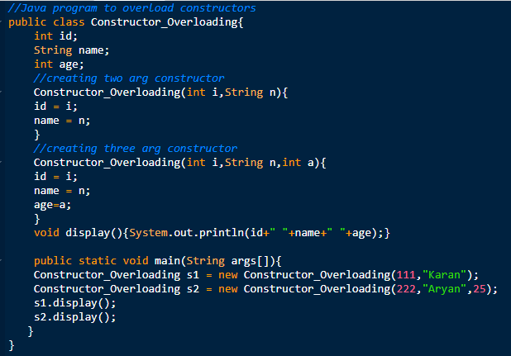

Constructor Overloading in java
OUTPUT
15

Slide 16
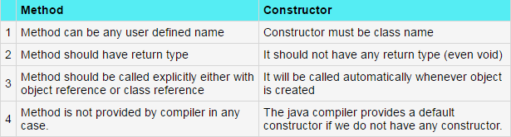
Difference between constructor and method in Java
16

Slide 17
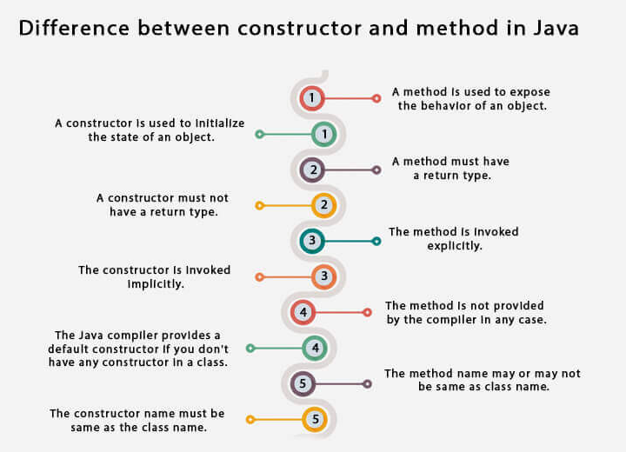
17

Slide 18
Java Copy Constructor
There is no copy constructor in Java. However, we can copy the values from one object to another like copy constructor in C++.
There are many ways to copy the values of one object into another in Java. They are:
By constructor
By assigning the values of one object into another

Slide 19
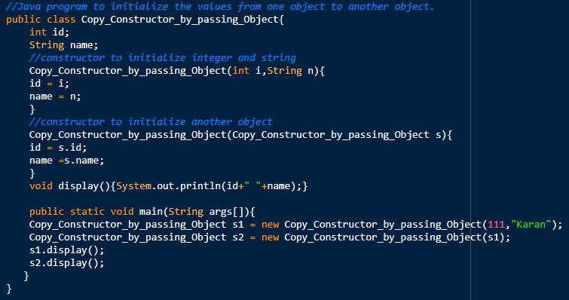

Java Copy Constructor
OUTPUT

Slide 20
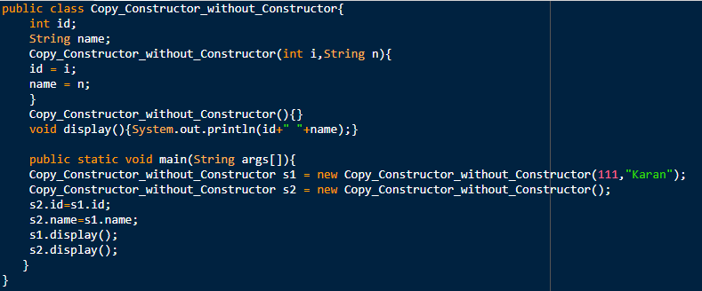
Java Copy Constructor
OUTPUT

Slide 21
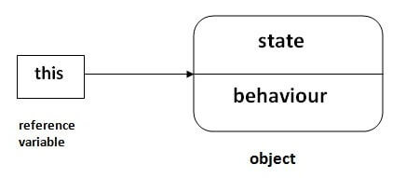
this keyword in java
There can be a lot of usage of java this keyword. In java, this is a reference variable that refers to the current object.

Slide 22
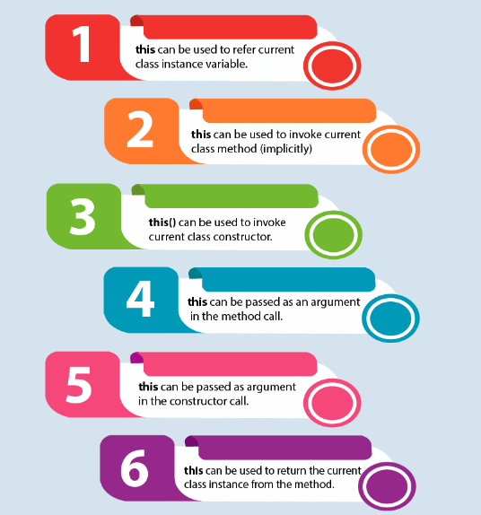
Usage of this keyword in java
this can be used to refer current class instance variable.
this can be used to invoke current class method (implicitly)
this() can be used to invoke current class constructor.
this can be passed as an argument in the method call.
this can be passed as argument in the constructor call.
this can be used to return the current class instance from the method.

Slide 23
1) this: to refer current class instance variable
The this keyword can be used to refer current class instance variable. If there is ambiguity between the instance variables and parameters, this keyword resolves the problem of ambiguity.

Slide 24
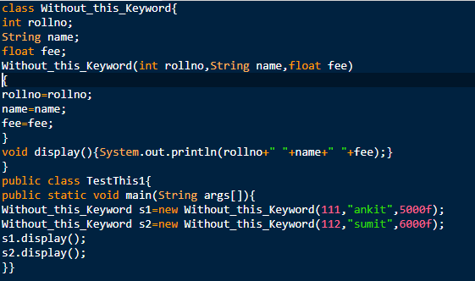

Understanding the problem without this keyword
OUTPUT

Slide 25
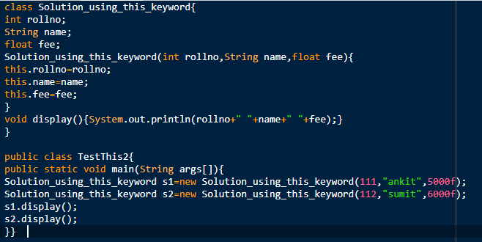

Solution to the problem using this keyword
OUTPUT

Slide 26
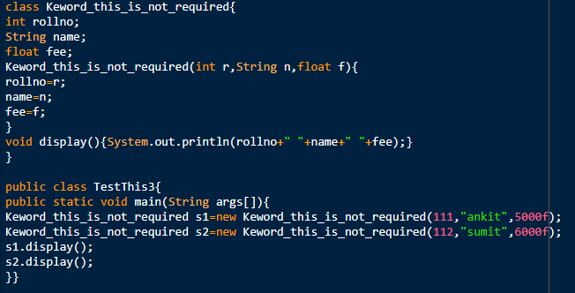
Program where this keyword is not required
OUTPUT
If local variables(formal arguments) and instance variables are different, there is no need to use this keyword

Slide 27
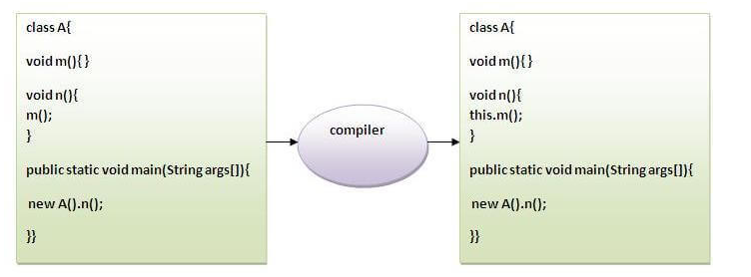
2) this: to invoke current class method
You may invoke the method of the current class by using the this keyword.
If you don't use the this keyword, compiler automatically adds this keyword while invoking the method.

Slide 28
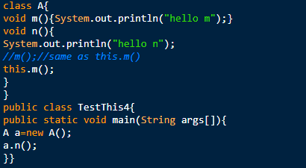

2) this: to invoke current class method
OUTPUT

Slide 29
3) this() : to invoke current class constructor
The this() constructor call can be used to invoke the current class constructor.
It is used to reuse the constructor. In other words, it is used for constructor chaining.

Slide 30
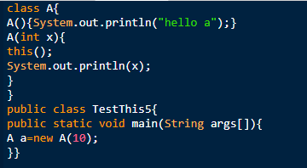

Calling default constructor from parameterized constructor
OUTPUT

Slide 31
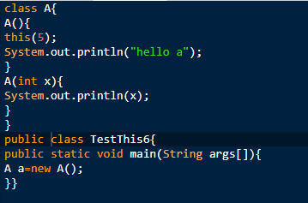

Calling parameterized constructor from default constructor
OUTPUT

Slide 32
Real usage of this() constructor call
The this() constructor call should be used to reuse the constructor from the constructor.
It maintains the chain between the constructors i.e. it is used for constructor chaining.

Slide 33
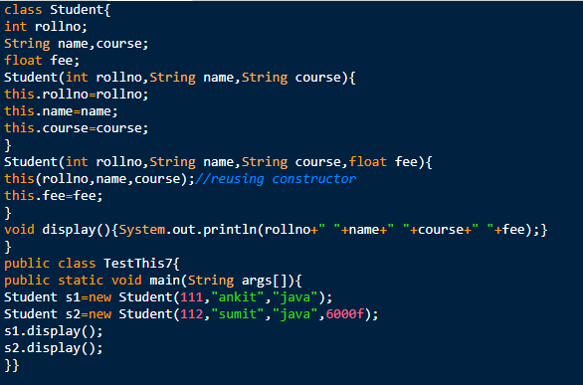

Real usage of this() constructor call
OUTPUT

Slide 34
Garbage Collection in Java
Java garbage collection is the process by which Java programs perform automatic memory management.
Java programs compile to bytecode that can be run on a Java Virtual Machine, or JVM for short.
When Java programs run on the JVM, objects are created on the heap, which is a portion of memory dedicated to the program.
Eventually, some objects will no longer be needed. The garbage collector finds these unused objects and deletes them to free up memory.

Slide 35
How Java Garbage Collection Works
Java garbage collection is an automatic process.
The programmer does not need to explicitly mark objects to be deleted.
The garbage collection implementation lives in the JVM.
Each JVM can implement garbage collection however it pleases; the only requirement is that it meets the JVM specification.
Although there are many JVMs, Oracle’s HotSpot is by far the most common. It offers a robust and mature set of garbage collection options.

Slide 36
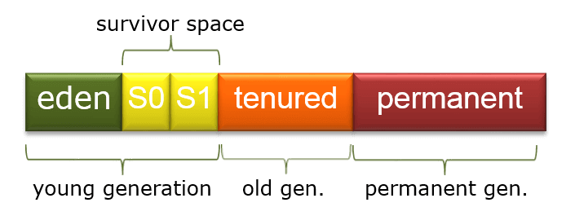
How Java Garbage Collection Works
When a typical Java application is running, it is creating new objects, such as Strings and Files, but after a certain time, those objects are not used anymore.
for (File f : files) {
String s = f.getName();
}
In the above code, the String s is being created on each iteration of the for loop. This means that in every iteration, a little bit of memory is being allocated to make a String object.
The garbage collector will look for objects which aren't being used anymore, and gets rid of them, freeing up the memory so other new objects can use that piece of memory.

Slide 37
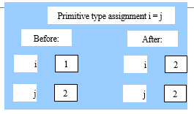
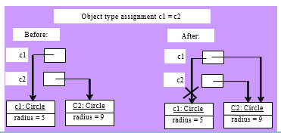
Copying Variables of Primitive Data Types and Object Types
As shown in the figure, after the assignment statement c1 = c2, c1 points to the same object referenced by c2. The object previously referenced by c1 is no longer referenced. This object is known as garbage. Garbage is automatically collected by JVM.
26

Slide 38
The finalize() method
The java.lang.Object.finalize() is called by the garbage collector on an object when garbage collection determines that there are no more references to the object. A subclass overrides the finalize method to dispose of system resources or to perform other cleanup.
Following is the declaration for java.lang.Object.finalize() method
protected void finalize()

Slide 39
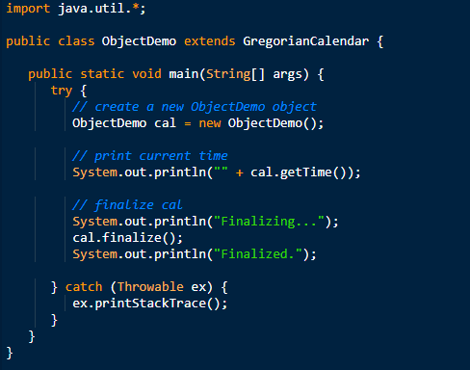

The finalize() method
OUTPUT

Slide 40
Types of polymorphism in java
There are two types of polymorphism in java
Runtime polymorphism( Dynamic polymorphism)
Compile time polymorphism (Static polymorphism).
Method overriding is a perfect example of runtime polymorphism.
Method overloading is a perfect example of compile time polymorphism.
Operator Overloading (Supported in C++, but not in Java)

Slide 41
Method Overloading in java
If a class has multiple methods having same name but different in parameters, it is known as Method Overloading.
If we have to perform only one operation, having same name of the methods increases the readability of the program.
Suppose you have to perform addition of the given numbers but there can be any number of arguments, if you write the method such as a(int,int) for two parameters, and b(int,int,int) for three parameters then it may be difficult for you as well as other programmers to understand the behavior of the method because its name differs.

Slide 42
Method Overloading in java
Advantage of method overloading
Method overloading increases the readability of the program.
Different ways to overload the method
There are two ways to overload the method in java
By changing number of arguments
By changing the data type
Note: In Java, Method Overloading is not possible by changing the return type of the method only.

Slide 43
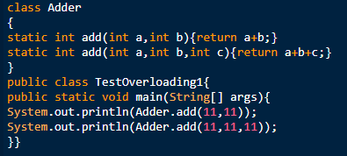

Method Overloading: changing no. of arguments
OUTPUT

Slide 44
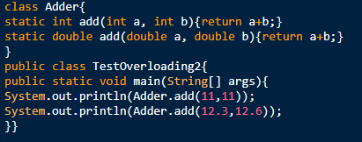

Method Overloading: changing data type of arguments
OUTPUT

Slide 45
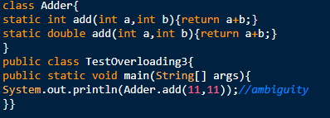

Why Method Overloading is not possible by changing the return type of method only?
OUTPUT

Slide 46

Can we overload java main() method?
OUTPUT

Slide 47
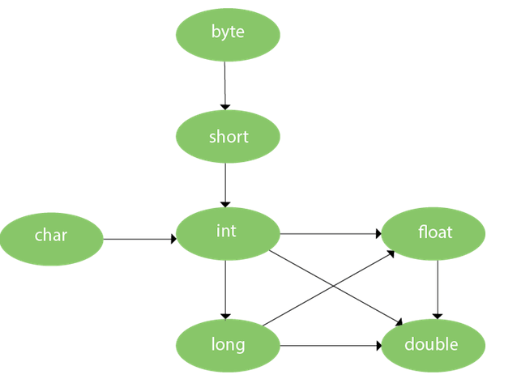
Method Overloading and Type Promotion
One type is promoted to another implicitly if no matching datatype is found.

Slide 48
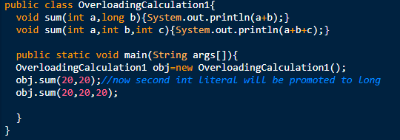

Method Overloading and Type Promotion
OUTPUT
Method Overloading with TypePromotion

Slide 49
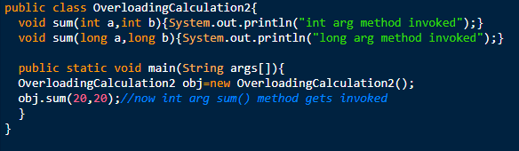
Method Overloading and Type Promotion
OUTPUT
Method Overloading with Type Promotion if matching found

Slide 50
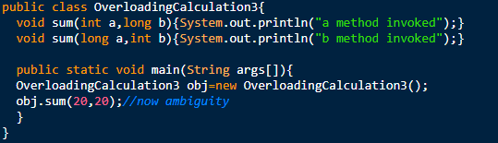

Method Overloading and Type Promotion
OUTPUT
One type is not de-promoted implicitly for example double cannot be depromoted to any type implicitly.

Slide 51
Passing and Returning Objects in Java
Java is strictly pass by value, the precise effect differs between whether a primitive type or a reference type is passed.
When we pass a primitive type to a method, it is passed by value. But when we pass an object to a method, the situation changes dramatically, because objects are passed by what is effectively call-by-reference.

Slide 52
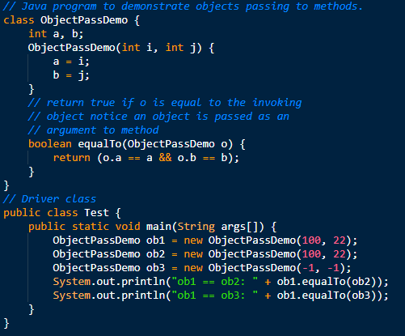

Objects passing to methods
OUTPUT

Slide 53
Returning Objects
In java, a method can return any type of data, including objects. For example, in the following program, the incrByTen( ) method returns an object in which the value of a (an integer variable) is ten greater than it is in the invoking object.

Slide 54
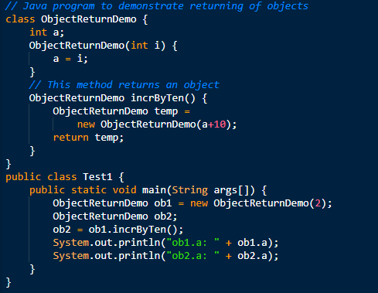

Returning Objects
OUTPUT

Slide 55
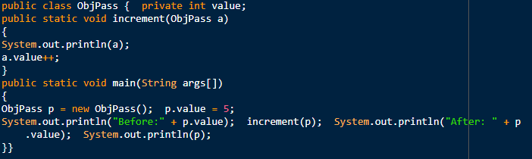

Example Passing Object
OUTPUT
Here we pass exactly is a handle of an object, and in the called method a new handle created and pointed to the same object. From the example above you can see that both p and a refer to the same object.

Slide 56
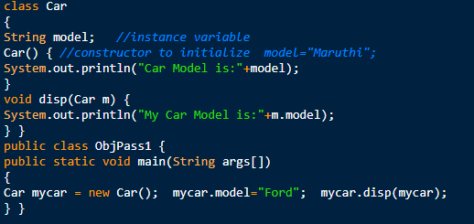

Example Passing Object
OUTPUT
We can access the instance variables of the object passed inside the called method. It is good practice to initialize instance variables of an object before passing object as parameter to method otherwise it will take default initial values.

Slide 57
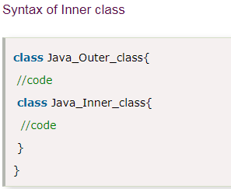
Java Inner Classes
Java inner class or nested class is a class which is declared inside the class or interface.
We use inner classes to logically group classes and interfaces in one place so that it can be more readable and maintainable.
Additionally, it can access all the members of outer class including private data members and methods.

Slide 58
Advantages of Inner Classes
Nested classes represent a special type of relationship that is it can access all the members (data members and methods) of outer class including private.
Nested classes are used to develop more readable and maintainable code because it logically group classes and interfaces in one place only.
Code Optimization: It requires less code to write.
Difference between nested class and inner class in Java
Inner class is a part of nested class.
Non-static nested classes are known as inner classes.

Slide 59
Types of Nested Classes
There are two types of nested classes non-static and static nested classes.
The non-static nested classes are also known as inner classes.
Non-static nested class (inner class)
Member inner class
Anonymous inner class
Local inner class
Static nested class

Slide 60
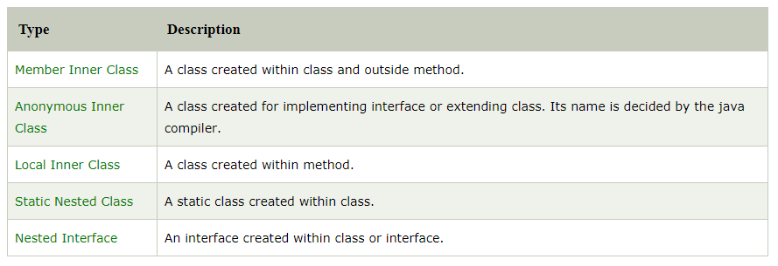
Types of Nested Classes

Slide 61
Member Inner class
A non-static class that is created inside a class but outside a method is called member inner class.
Syntax:
class Outer
{
//code
class Inner
{
//code
}
}

Slide 62
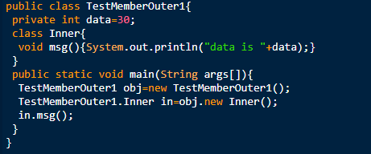
Member Inner class
OUTPUT

Slide 63
Java Anonymous inner class
A class that have no name is known as anonymous inner class in java.
It should be used if you have to override method of class or interface.
Java Anonymous inner class can be created by two ways:
Class (may be abstract or concrete).
Interface

Slide 64
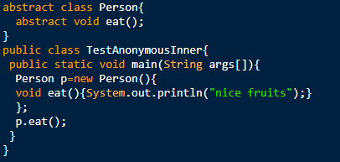

Java Anonymous inner class
OUTPUT

Slide 65
Java Local inner class
A class i.e. created inside a method is called local inner class in java. If you want to invoke the methods of local inner class, you must instantiate this class inside the method.

Slide 66
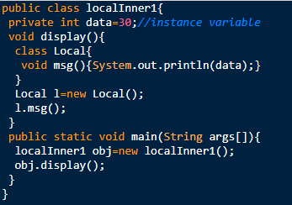
Java local inner class
OUTPUT

Slide 67
Java Static inner class
A static class i.e. created inside a class is called static nested class in java. It cannot access non-static data members and methods. It can be accessed by outer class name.
It can access static data members of outer class including private.
Static nested class cannot access non-static (instance) data member or method.

Slide 68
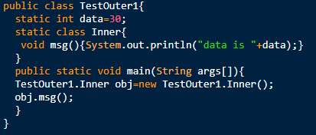
Java Static inner class
OUTPUT

Slide 69
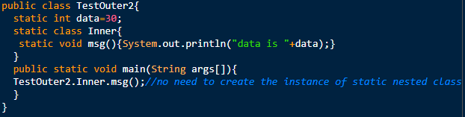
Java Static inner class
OUTPUT
If you have the static member inside static nested class, you don't need to create instance of static nested class.

Slide 70
Access modifiers in Java
Private: The access level of a private modifier is only within the class. It cannot be accessed from outside the class.
Default: The access level of a default modifier is only within the package. It cannot be accessed from outside the package. If you do not specify any access level, it will be the default.
Protected: The access level of a protected modifier is within the package and outside the package through child class. If you do not make the child class, it cannot be accessed from outside the package.
Public: The access level of a public modifier is everywhere. It can be accessed from within the class, outside the class, within the package and outside the package.

Slide 71

Access modifiers in Java

Slide 72
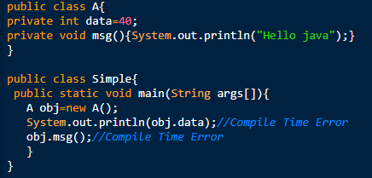
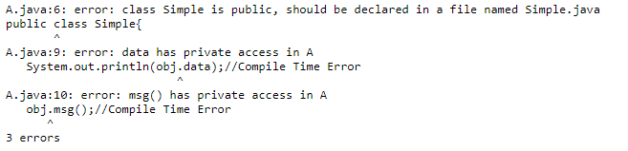
private

Slide 73
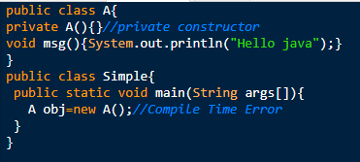
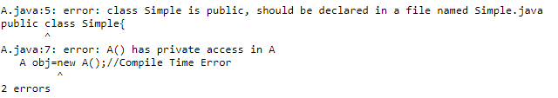
private
If you make any class constructor private, you cannot create the instance of that class from outside the class.

Slide 74
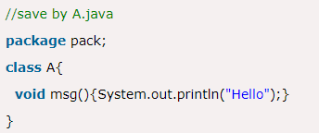

default
If you don't use any modifier, it is treated as default by deaccessible only within package. It cannot be accessed fault. The default modifier is from outside the package. It provides more accessibility than private. But, it is more restrictive than protected, and public.
the scope of class A and its method msg() is default so it cannot be accessed from outside the package.

Slide 75



protected
The protected access modifier is accessible within package and outside the package but through inheritance only.
The protected access modifier can be applied on the data member, method and constructor. It can't be applied on the class.
It provides more accessibility than the default modifer.

Slide 76



public
The public access modifier is accessible everywhere. It has the widest scope among all other modifiers.

Slide 77
final keyword in java
The final keyword in java is used to restrict the user. The java final keyword can be used in many context. Final can be:
variable
method
class

Slide 78


final variable

Slide 79


final method
If you make any method as final, you cannot override it.

Slide 80


final class
If you make any class as final, you cannot extend it.

