Slide 1
Managing Containers Effectively with Kubernetes

Slide 2
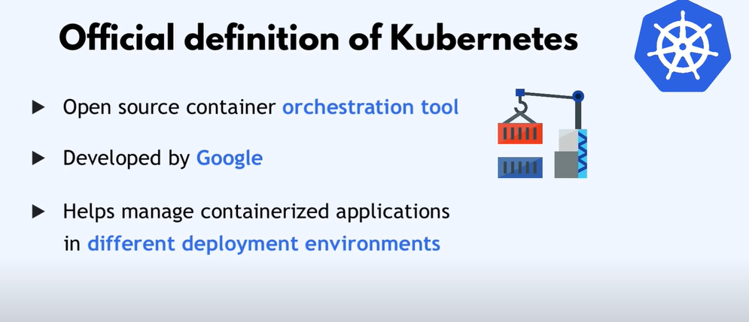
Official Definition of Kubernetes

Slide 3
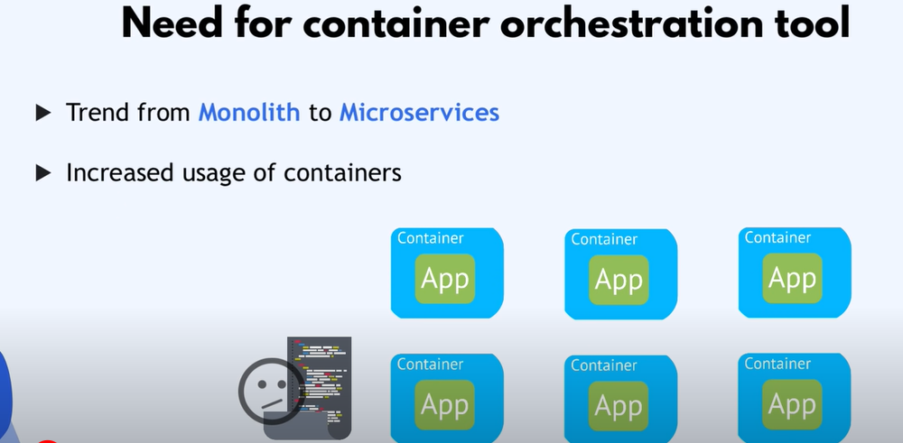
Need for container orchestration tool

Slide 4
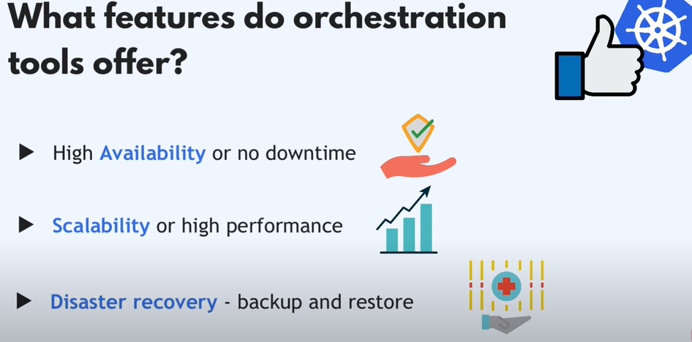
Featuures

Slide 5
Introduction to Kubernetes
There are two major container orchestration tools on the market:
Docker Swarm
Kubernetes
The major difference between the platforms is based on complexity. Kubernetes is well suited for complex applications.
On the other hand, Docker Swarm is designed for ease of use, making it a preferable choice for simple applications.

Slide 6
Introduction to Kubernetes
Features of Kubernetes
Automated Scheduling
Self-Healing Capabilities
Automated rollouts & rollback
Horizontal Scaling & Load Balancing
Offers environment consistency for development, testing, and production

Slide 7
Introduction to Kubernetes
Features of Kubernetes
Infrastructure is loosely coupled to each component can act as a separate unit.
Provides a higher density of resource utilization
Offers enterprise-ready features
Application-centric management
Auto-scalable infrastructure
You can create predictable infrastructure

Slide 8
Introduction to Kubernetes
Kubernetes Basics
Cluster: It is a collection of hosts(servers) that helps you to aggregate their available resources. That includes ram, CPU, ram, disk, and their devices into a usable pool.
Master: The master is a collection of components which make up the control panel of Kubernetes. These components are used for all cluster decisions. It includes both scheduling and responding to cluster events.

Slide 9
Introduction to Kubernetes
Kubernetes Basics
Node: It is a single host which is capable of running on a physical or virtual machine. A node should run both kube-proxy, minikube, and kubelet which are considered as a part of the cluster.
Namespace: It is a logical cluster or environment. It is a widely used method which is used for scoping access or dividing a cluster.

Slide 10
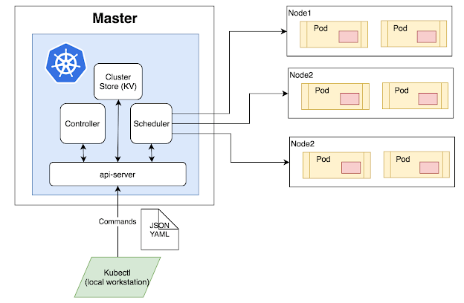
Kubernetes Architecture

Slide 11
Kubernetes Architecture
Master Node:
The master node is the first and most vital component which is responsible for the management of Kubernetes cluster.
It is the entry point for all kind of administrative tasks.
There might be more than one master node in the cluster to check for fault tolerance.
The master node has various components like API Server, Controller Manager, Scheduler, and ETCD.

Slide 12
Kubernetes Architecture
API Server:
The API server acts as an entry point for all the REST commands used for controlling the cluster.
Scheduler:
The scheduler schedules the tasks to the slave node.
It stores the resource usage information for every slave node.
It is responsible for distributing the workload.

Slide 13
Kubernetes Architecture
Scheduler:
It also helps you to track how the working load is used on cluster nodes.
It helps you to place the workload on resources which are available and accept the workload.
Etcd:
etcd components store configuration detail and wright values.
It communicates with the most component to receive commands and work.
It also manages network rules and port forwarding activity.

Slide 14
Kubernetes Architecture
Worker/Slave nodes:
Worker nodes are another essential component which contains all the required services to manage the networking between the containers, communicate with the master node, which allows you to assign resources to the scheduled containers.
Kubelet:
This gets the configuration of a Pod from the API server and ensures that the described containers are up and running.

Slide 15
Kubernetes Architecture
Docker Container:
Docker container runs on each of the worker nodes, which runs the configured pods.
Kube-proxy:
Kube-proxy acts as a load balancer and network proxy to perform service on a single worker node.
Pods:
A pod is a combination of single or multiple containers that logically run together on nodes.

Slide 16
Kubernetes - Other Key Terminologies
Replication Controllers
A replication controller is an object which defines a pod template.
It also controls parameters to scale identical replicas of Pod horizontally by increasing or decreasing the number of running copies.
Replication Sets
Replication sets are an interaction on the replication controller design with flexibility in how the controller recognizes the pods it is meant to manage.
It replaces replication controllers because of their higher replicate selection capability.

Slide 17
Kubernetes - Other Key Terminologies
Deployments
Deployment is a common workload which can be directly created and manage.
Deployment use replication set as a building block which adds the feature of life cycle management.
Stateful Sets
It is a specialized pod control which offers ordering and uniqueness.
It is mainly used to have fine-grained control, which you have a particular need regarding deployment order, stable networking, and persistent data.

Slide 18
Kubernetes - Other Key Terminologies
Daemon Sets
Daemon sets are another specialized form of pod controller that runs a copy of a pod on every node in the cluster.
This type of pod controller is an effective method for deploying pods that allows you to perform maintenance and offers services for the nodes themselves.

Slide 19
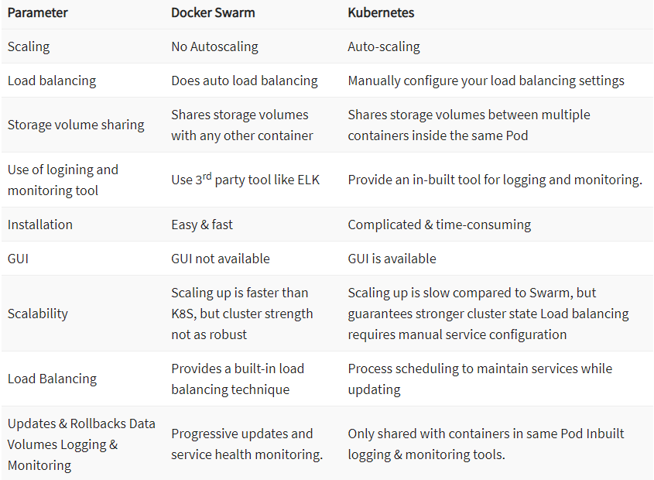
Kubernetes vs. Docker Swarm

Slide 20
Introduction to Kubernetes
Advantages of Kubernetes:
Easy organization of service with pods
It is developed by Google, who bring years of valuable industry experience to the table
Largest community among container orchestration tools
Offers a variety of storage options, including on-premises, SANs and public clouds
Adheres to the principals of immutable infrastructure
Kubernetes can run on-premises bare metal, OpenStack, public clouds Google, Azure, AWS, etc.

Slide 21
Introduction to Kubernetes
Advantages of Kubernetes:
Helps you to avoid vendor lock issues as it can use any vendor-specific APIs or services except where Kubernetes provides an abstraction, e.g., load balancer and storage.
Containerization using kubernetes allows package software to serve these goals. It will enable applications that need to be released and updated without any downtime.
Kubernetes allows you to assure those containerized applications run where and when you want and helps you to find resources and tools which you want to work.

Slide 22
Introduction to Kubernetes
Disadvantages of Kubernetes:
Kubenetes dashboard not as useful as it should be
Kubernetes is a little bit complicated and unnecessary in environments where all development is done locally.
Security is not very effective.

Slide 23
Installing Kubernetes on a local machine
When developing a containerized application that is to be hosted on Kubernetes, it is important to be able to run the application (with its containers) on your local machine, before deploying it on remote Kubernetes production clusters.
In order to install a Kubernetes cluster locally, there are several solutions, which are as follows:
The first solution is to use Docker Desktop.
1. In Docker Desktop, activate the Enable Kubernetes option in Settings in Kubernetes tab

Slide 24
Installing Kubernetes on a local machine
1. In Docker Desktop, activate the Enable Kubernetes option in Settings in Kubernetes tab

Slide 25
Installing Kubernetes on a local machine
2. After clicking on the Apply button, Docker Desktop will install a mini Kubernetes cluster, and the kubectl client tool, on the local machine.
The second solution is to install Minikube, which also installs a simplified Kubernetes cluster locally.
Following the local installation of Kubernetes, check its installation by executing the following command in a Terminal:
kubectl version --short

Slide 26

Installing the Kubernetes dashboard
After installing our Kubernetes cluster, there is a need for another element, which is the Kubernetes dashboard.
In order to install the Kubernetes dashboard, which is a pre-packaged containerized web application that will be deployed in our cluster, we will run the following command in a Terminal:

Slide 27
Installing the Kubernetes dashboard
Its execution is shown in the following screenshot:

Slide 28
Installing the Kubernetes dashboard
To open the dashboard and connect to it from our local machine, first create a proxy between the Kubernetes cluster and our machine by performing the following steps:
1. To create the proxy, we execute the kubectl proxy command in a Terminal, and the detail of the execution is shown in the following screenshot:
The proxy is open on the localhost address (127.0.0.1) with the 8001 port.

Slide 29
Installing the Kubernetes dashboard
Then, in a web browser, open the URL
http://localhost:8001/api/v1/namespaces/kubernetes-dashboard/services/https:kubernetes-dashboard:/proxy/#/login
This is a local URL (localhost and 8001) that is created by the proxy, and that points to the Kubernetes dashboard application that we have installed.

Slide 30
Installing the Kubernetes dashboard
After clicking on the SIGN IN button, the dashboard is displayed as follows:

Slide 31
First example of Kubernetes application deployment
After installing our Kubernetes cluster, deploy an application in it.
First of all, it is important to know that when deploying an application in Kubernetes, create a new instance of the Docker image in a cluster pod, and need to have a Docker image that contains the application.
To deploy a instance of the Docker image, create a new k8sdeploy folder, and, inside it, create a Kubernetes deployment YAML specification file (myappdeployment.yml) with the following content:

Slide 32
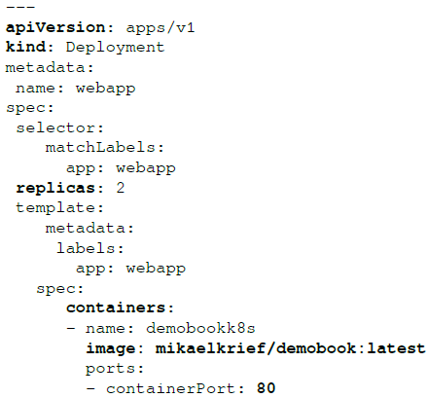
First example of Kubernetes application deployment

Slide 33
First example of Kubernetes application deployment
In this code, description of deployment is as follows:
The apiVersion property is the version of api that should be used.
In the Kind property, we indicate that the specification type is deployment.
The replicas property indicates the number of pods that Kubernetes will create in the cluster; here, we choose two instances.

Slide 34
First example of Kubernetes application deployment
In this example, chose two replicas, which can, at the very least, distribute the traffic charge of the application (put in more replicas if there is a high volume of load).
And also ensure the proper functioning of the application.
Therefore, if one of the two pods has a problem, the other, which is an identical replica, will ensure the proper functioning of the application.
Then, in the containers section, we indicate the image (from the Docker Hub) with name and tag.
Finally, the ports property indicates the port that the container will use within the cluster.

Slide 35
First example of Kubernetes application deployment
To deploy our application, we go to our Terminal, and execute one of the essential kubectl commands (kubectl apply) as follows:
kubectl apply -f myapp-deployment.yml
The -f parameter corresponds to the YAML specification file.
This command applies the deployment that is described in the YAML specification file on the Kubernetes cluster.
Following the execution of this command, check the status of this deployment, by displaying the list of pods in the cluster.

Slide 36
First example of Kubernetes application deployment
To do this in the Terminal, we execute the kubectl get pods command, which returns the list of cluster pods.
The following screenshot shows the execution of the deployment and displays the information in the pods, which we use to check the deployment:

Slide 37
First example of Kubernetes application deployment
In the preceding screenshot, the second command displays two pods, with the name (webapp) specified in the YAML file, followed by a unique ID, and Running status.
Also visualize the status of cluster on the Kubernetes web dashboard, the webapp deployment with the Docker image that has been used, and the two pods that have been created.
The application has been successfully deployed in Kubernetes cluster.
But, for the moment, it is only accessible inside the cluster only.
And for it to be usable, we need to expose it outside the cluster.

Slide 38
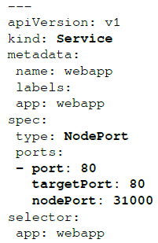
First example of Kubernetes application deployment
In order to access the web application outside the cluster, add a service type and a NodePort category element to the cluster.
To add this service type and NodePort, in the same way as for deployment, create a second YAML file (myapp-service.yml) of the service specification in the same k8sdeploy directory, which has the following code:
In this code, we specify the kind, Service, as well as the type of service, NodePort.

Slide 39
First example of Kubernetes application deployment
Then, in the ports section, we specify the port translation: the 80 port, which is exposed internally, and the 31000 port, which is exposed externally to the cluster.
To create this service on the cluster, we execute the kubectl apply command, but this time with our myapp-service.yaml file as a parameter, as follows:
kubectl apply -f myapp-service.yml

Slide 40
First example of Kubernetes application deployment
The execution of the command creates the service within the cluster, and, to test the application, open a web browser with the http://localhost:31000 URL, and the page is displayed as follows:
The application is now deployed on a Kubernetes cluster, and it can be accessed from outside the cluster.

Slide 41
Automatic deployment of the application in Kubernetes
The settings for the Deploy to Kubernetes task are as follows:
Choose the endpoint of the Kubernetes cluster—the New button allows us to add a new endpoint configuration of a cluster.
Then, choose the apply command to be executed by kubectl—here, we will execute an application.
Finally, choose the directory, coming from the artifacts, which contains the YAML specification files.
4. We save the release definition by clicking on the Save button.
5. Finally, we click on the Create a new release button, which triggers a deployment in our AKS cluster.

Slide 42
Automatic deployment of the application in Kubernetes
At the end of the release execution, it is possible to check that the application has been deployed by executing the command in a Terminal as follows:
kubectl get pods,services
This command displays the list of pods and services that are present in our AKS Kubernetes cluster, and the result of this command is shown in the following screenshot:

Slide 43
Automatic deployment of the application in Kubernetes
We can see our two deployed web applications pods and the NodePort service that exposes our applications outside the cluster.
Then, we open a web browser with the http://localhost:31000 URL, and our application is displayed correctly:

