Slide 1
DR.B.R AMBEDKAR UNIVERSITY ,SRIKAKULAM, COLLEGE OF ENGINEERNG DEPARTMENT OF COMPUTER SCIENCE ENGINEERNG
GUESS THE GAME
PRESENTED BY:
H.ASHA
Y.POOJA
N.ASHA RASHMI

Slide 2
Introduction
It is a number gusseing game in which the user needed to guess the number between the range of 1-10
Some random number are selected by the system and user needed to find it out
It is a very simple game where it increases the intrest of the user at evrey othet trail .
It is not so difficult to play as it is desgined of very small range
Kids will defnitely love the game and it makes them happy at evrey particular win .
The highest limit is set uped as 10 so it helps to end game by a win .

Slide 3
ANALYISIS :
The range is given as 1-10 . SO lwt us assume the number which is sellected by system is 5 .Then if u enter an number between 1-4 in the guess field and submit guess ,the system replies the us as "OOPS SORRY!! TRY A GREATER NUMBER". If u enter an number between
6-10 in the guess field amd submit guess, the system replies us as"OOPS SORRY!!TRY A SMALLER NUMBER" .
If u enter 5 in the guess field and submit guess ,then the system replies as "Congratulations!!! You guessed it right" .

Slide 4
ALGORITHAM
User inputs the lower bound and upper bound of the range.
The compiler generates a random integer between the range and store it in a variable for future references.
For repetitive guessing, a if loop will be initialized.
If the user guessed a number which is greater than a randomly selected number, the user gets an output “OOPS SORRY!! TRY A GREATER NUMBER "
Else If the user guessed a number which is smaller than a randomly selected number, the user gets an output “OOPS SORRY!! TRY A SMALLER NUMBER”
And if the user guessed in a minimum number of guesses, the user gets a “Congratulations!!! You guessed it right” Output.

Slide 5
Time Complexity:
Depends upon number of gusses the use taken .
Space complexity :
All the variables used in the code are of same size , so there no need of extra space to store the values .

Slide 6
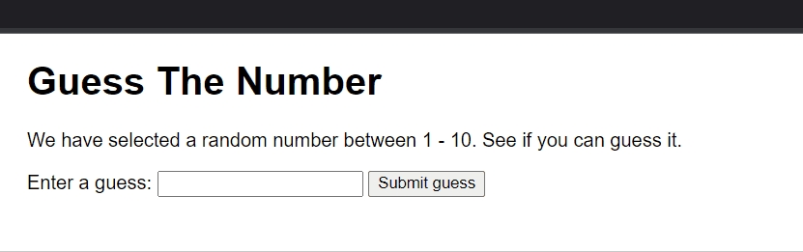
Output:

Slide 7
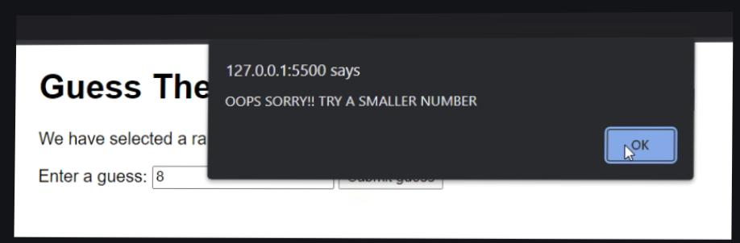

Slide 8
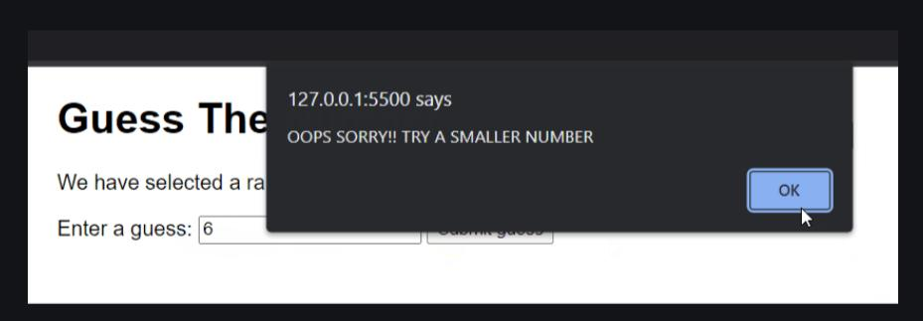

Slide 9
conclusion :
In this game of guessing numbers we created a particular range whuch is comfortable to play with out any irriatation by multiple guess works .Furtherly we can devolep it by incraesing the range of the numbers .It is clearly desgined for letting player to know how to take the next step.It is a very basic version but working in a great way

