Slide 1
Mirror, Mirror on the Wall, Is AI Transforming Us All?
Exploring AI's Impact on Human Behavior Through News Headline Analysis
RAISE-26
Team Name -> Agentic Minds
Team Members -> Hanumath Chowdary Mandadi| Abubaker Ahmadi

Slide 2



What Do We Mean by “Human Behavior”?
Human behavior is not just what people do, it’s what they accept, delegate, and trust.
In this study, human behavior includes:
Who we trust to act (humans vs. machines)
What skills we keep vs. give up
How responsibility is assigned
How comfortable we are with delegation to AI
Key distinction: Behavior ≠ actions alone Behavior = mindset + acceptance + surrender

Slide 3
Why News Headlines Reveal Human Behavior
Why Headlines Matter
They shape public belief
They normalize narratives
They simplify complex realities
They reflect what editors think audiences will accept
Key insight: What sounds “normal” today shapes human behavior tomorrow.

Slide 4
Why AI Changes Human Behavior (Not Just Technology)
AI differs from past tools because it:
Acts autonomously
Makes decisions
Mimics human cognition
Operates at scale
Behavioral consequence:
Humans stop doing → start overseeing

Slide 5
Overview
Central Question
How is AI shaping the ways humans think, act, and interact?
Our approach
Dataset: 3,500 AI news headlines (RAISE-26 Dataset B)
Semantic embeddings to capture meaning beyond keywords
Unsupervised clustering to discover impact themes
Multi-method validation (sentiment, sources, behavioral classes)
LLM-powered interpretation (Qwen2.5-7B open-weights)
Deliverable
Data-driven insights on AI's heterogeneous transformation of human behavior
Key Finding
AI discourse has evolved from technical novelty into four critical behavioral spheres, primarily dominated by concerns over labor, healthcare, and governance.

Slide 6
Competition Guidelines
Dataset -> Dataset B (3,500 rows) | dataset_B_news_subset_3500.csv
Environment -> Python 3 via Google Collab
Libraries -> sentence-transformers, scikit-learn, transformers (AutoModelForCausalLM), etc..
Models -> all-MiniLM-L6-v2, Qwen2.5-7B-Instruct
Execution -> Notebook supports one-click run execution.

Slide 7
"Technical Approach: Multi-Method Pipeline"
1. Data Preprocessing & Cleaning.
2. Semantic Embedding Generation.
5. Sentiment & Impact Analysis.
6. Actionable Insight Generation via LLM.
3. Clustering
4. Automated Cluster Naming

Slide 8
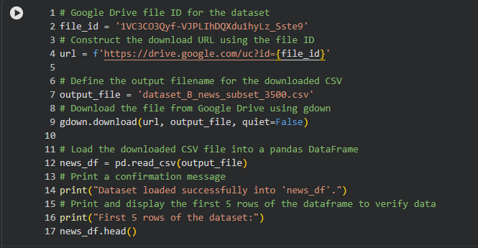
Loading the dataset
1. Data Preprocessing & Cleaning.
2. Semantic Embedding Generation.
5. Sentiment & Impact Analysis.
6. Actionable Insight Generation via LLM.
3. Clustering
4. Automated Cluster Naming

Slide 9

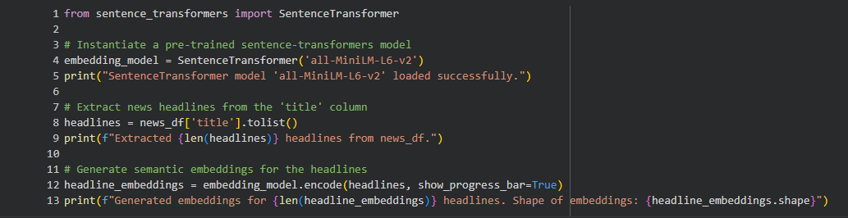
Semantic Embeddings
1. Data Preprocessing & Cleaning.
2. Semantic Embedding Generation.
5. Sentiment & Impact Analysis.
6. Actionable Insight Generation via LLM.
3. Clustering.
4. Automated Cluster Naming.
WHAT: Transform headlines into numerical vectors (384 dimensions)
WHY: Captures meaning beyond keywords "AI threatens jobs" ≈ "Automation displaces workers"
(Different words, same meaning → similar vectors)
MODEL: all-MiniLM-L6-v2 (Sentence Transformers) - Optimized for short text -Fast and efficient - Proven accuracy.
MATH: Each headline h → vector v ∈ ℝ³⁸⁴
Similarity = cosine distance.
NORMALIZATION: All vectors scaled to unit length.

Slide 10
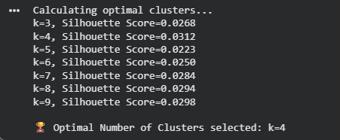
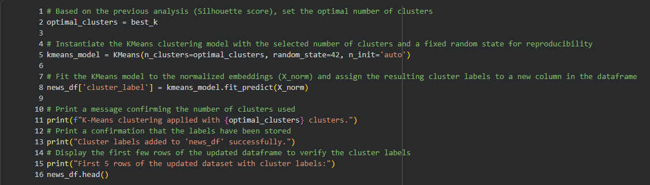
K-MEANS CLUSTERING
1. Data Preprocessing & Cleaning.
2. Semantic Embedding Generation.
5. Sentiment & Impact Analysis.
6. Actionable Insight Generation via LLM.
3. Clustering
4. Automated Cluster Naming
OBJECTIVE
Partition headlines into k groups by minimizing within-cluster variance
ALGORITHM
Initialize k centroids randomly
Assign headlines to nearest centroid
Update centroids (mean of assigned points)
Repeat until convergence
OPTIMAL k SELECTION
Tested k = 3 to 9 using silhouette score
Measures cluster cohesion + separation
Range: -1 (poor) to +1 (excellent)
RESULTS
k=4 optimal with score = 0.0312
Four meaningful clusters discovered

Slide 11
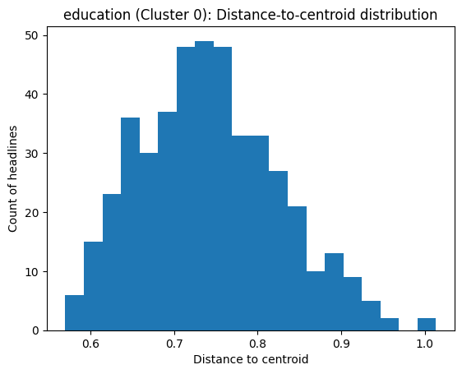
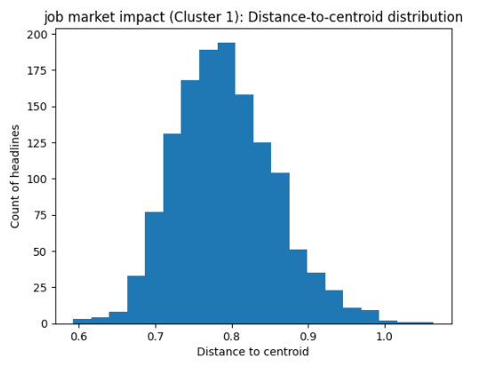
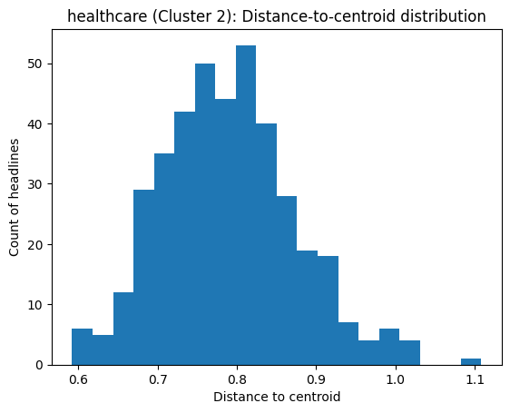
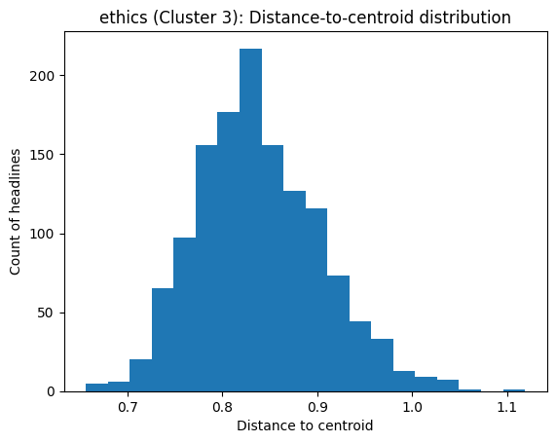
Distance-to-Centroid Distribution
Calculate the distance-to-centroid distribution for each cluster
Then separate the headlines closest to the centroid, and provide it to the LLM to generate recommendations to optimize the results
Why This Matters
Cluster quality assessment:
Tight distributions validate that K-Means found meaningful groups
Wide distributions suggest cluster may contain multiple sub-themes
Outliers (far from centroid) may be misclassified or represent edge cases
Comparison across clusters:
Comparing distributions reveals which domains have clearer boundaries (Education) vs. fuzzier boundaries (Ethics)
Histograms of distances from headlines to their cluster centroid reveals cluster cohesion and structure.

Slide 12
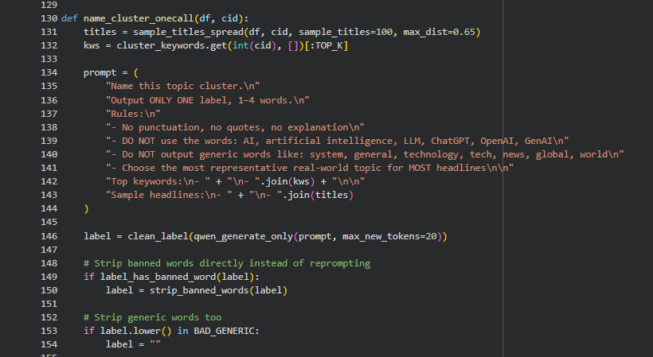

Automated Cluster Naming
1. Data Preprocessing & Cleaning.
2. Semantic Embedding Generation.
5. Sentiment & Impact Analysis.
6. Actionable Insight Generation via LLM.
3. Clustering
4. Automated Cluster Naming
CHALLENGE: K-Means produces numeric labels (0,1,2,3). Need interpretable names capturing each cluster's theme without bias.
Labeling Strategy: Used the Fβ score (balancing coverage and precision) and the Qwen2.5-7B-Instruct model to name clusters without human bias.
Process:
Step 1: Extract Context
Step 2: Construct Prompt
Step 3: Generate Name
Step 4: Validate
Step 5: Fallback
4 Detected “Spheres of Behavior“ (Clusters):
Education: Impacts on students, literacy, and classrooms.
(Keywords: student, teacher, learn)
Job Market Impact: Effects on workers and layoffs.
(Keywords: layoff, jobs, replace)
Healthcare: Innovation in diagnosis and patient care.
(Keywords: diagnosis, cancer, detection)
Ethics: Regulation, lawsuits, and ethical frameworks
(Keywords: deepfake, scam, regulation)

Slide 13
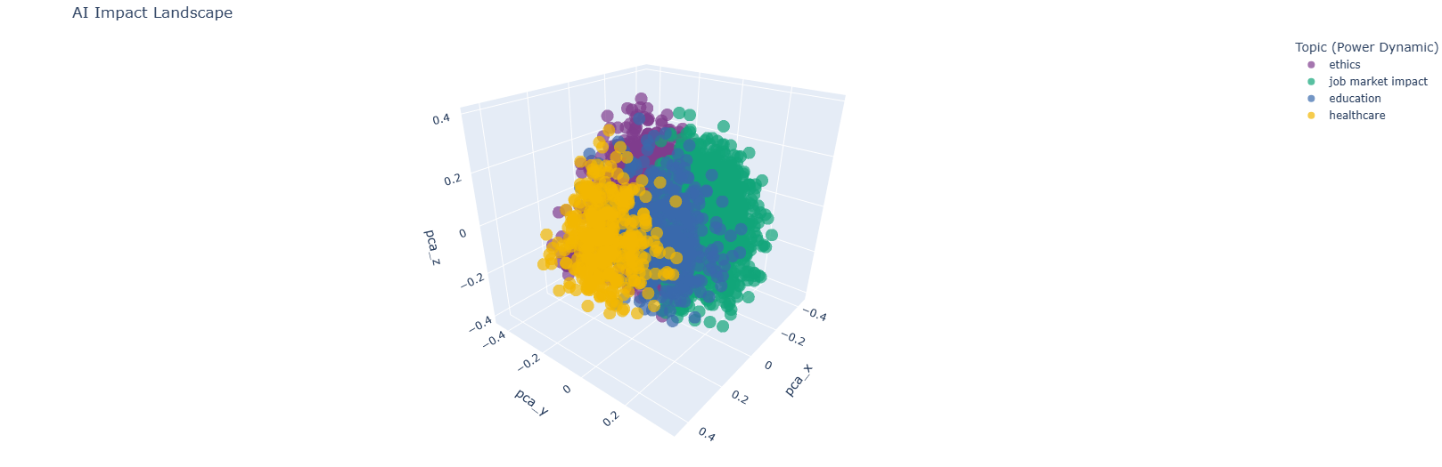
Visualizing the AI Impact Landscape
Applied PCA (Principal Component Analysis) to reduce complex embedding vectors into 3D coordinates (X, Y, Z).
Displaying a 3D scatter plot of the clusters reveals the "topography" of AI discourse, showing how specific topics like ethics or technical updates group together

Slide 14
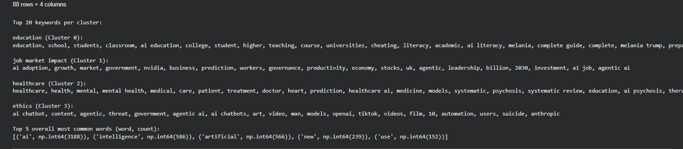
Thematic Discovery – TF-IDF Keywords
Method: Used c-TF-IDF (Class-based Term Frequency-Inverse Document Frequency) to find the top 20 keywords for each cluster.
Insight: This identifies the "signature" terms for each group, such as "layoff" in labor clusters or "diagnosis" in healthcare clusters.

Slide 15
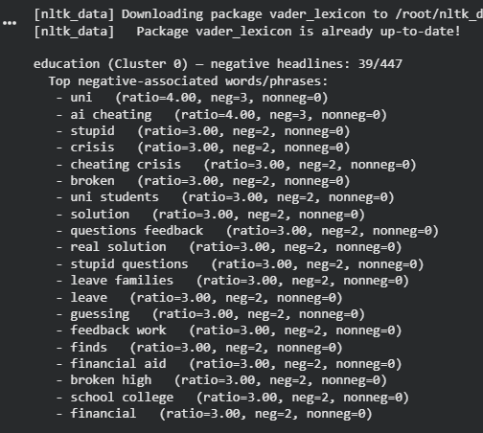
Sentiment Analysis – Human Emotional Context
Tool: Used VADER Sentiment Intensity Analyzer.
Threshold: Headlines with a compound score ≤ -0.2 were flagged as "negative impact.“
Behavioral Link: This allows us to track which AI-human interactions are causing the most anxiety or fear in society

Slide 16

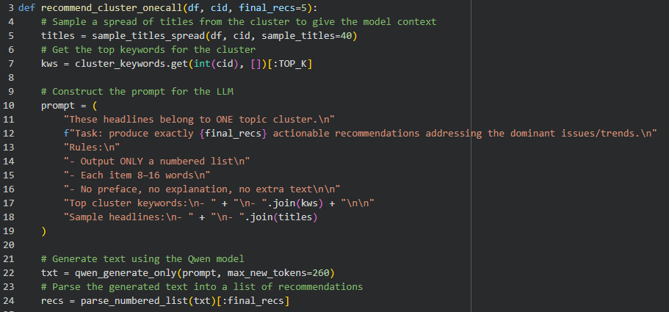
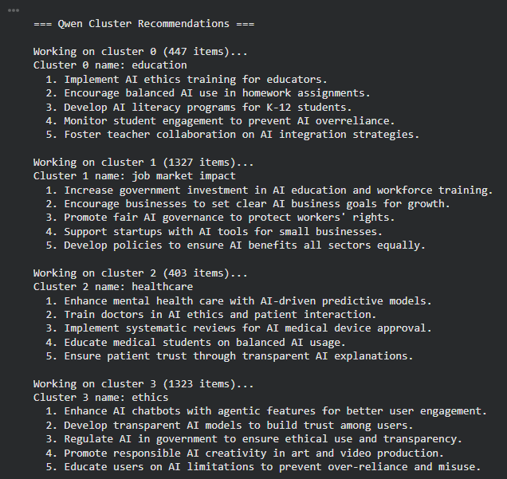
Generating Recommendations (LLM)
The LLM Engine
Model: Uses Qwen/Qwen2.5-7B-Instruct, a competition-compliant, open-weights model.
Method: Employs deterministic generation (zero temperature) to ensure concise and accurate results.
Process
Contextual Sampling: For each cluster, the system provides the LLM with the closest headlines to the centroid.
Targeted Prompting: The model is prompted to identify dominant trends and generate exactly five recommendations per theme.
Quality Control & Output
• Consistency: A fallback mechanism automatically adds risk-aligned guidance if the model produces fewer than five items.

Slide 17
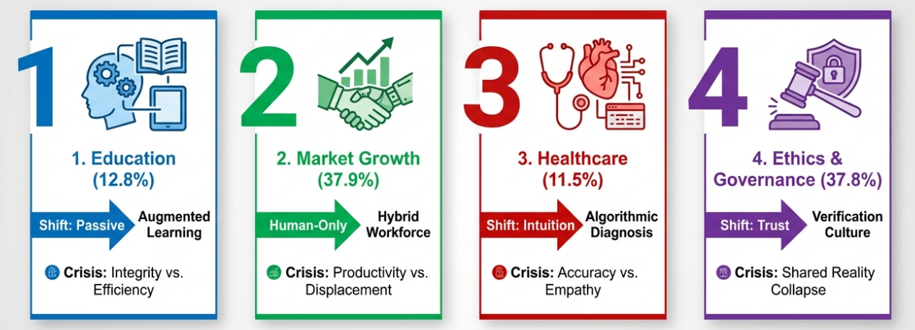
Is AI Transforming us all ? - YES
We Are Transforming Across Four Distinct Pathways
Job Market Impact

Slide 18

Education: Redefining Learning & Teaching
Size: 447 headlines (12.8%)
Behavioral shift: From passive learning → AI-augmented, personalized education
Validated by class labels
51.3% Learning, Knowledge & Education
16.2% Human Roles
Behavioral transformation: From → To
Students: Independent problem-solving
AI-assisted learning - Teachers: Content delivery
AI integration facilitation - Assessment: Traditional testing
AI-resilient evaluation - Pedagogy: Memorization
Critical thinking emphasis - Integrity: Honor system
Detection/prevention protocols
Key concern: Pedagogical Identity Crisis
What is "learning" when AI knows more? How do we assess understanding vs AI capability?
Recommendations:
Implement AI tools to enhance personalized learning experiences.
Train teachers in AI literacy to effectively integrate technology.
Develop policies to prevent academic dishonesty with AI.

Slide 19
Job Market Impact: Economic Anxiety & Adoption
Size: 1,327 headlines (37.9%) — LARGEST CLUSTER
Behavioral shift
From human-only workflows → human-AI collaboration
Validated by class labels
26.0% Work, Jobs & Economy
10.3% Sentiment (Positive/Negative Feelings)
Behavioral transformation From → To
Workers: Stable careers → Continuous reskilling/adaptation
Businesses: Cautious adoption → "Adopt or die" urgency
Investors: Diversified → AI-heavy portfolios (e.g., NVIDIA)
Governments: Passive → Active AI infrastructure investment
Baseline: Human-only performance → Human+AI collaboration
Key concern: Productivity Paradigm Shift Expectations shifting from human baseline to human+AI baseline. Workers who don't adapt risk marginalization. Not just about jobs—about identity and value proposition.
Recommendations:
Increase government investment in AI infrastructure.
Train workers for AI-driven job roles.
Implement robust AI governance frameworks.

Slide 20
Healthcare: Trust Recalibration
Size: 403 headlines (11.5%) — SMALLEST CLUSTER
Behavioral shift
From doctor-centric → AI-augmented medical decision-making
Validated by class labels
35.8% Health, Safety & Risk — MOST CONCENTRATED
9.3% Learning, Knowledge & Education (medical training)
Highly focused domain ✓
Source profile
67% from peer-reviewed journals (Frontiers, Nature, ScienceDirect)
Most evidence-based, scientifically rigorous coverage
Behavioral transformation: From → To
Patients: Trust doctor alone → Trust AI-assisted diagnosis
Doctors: Sole experts → AI-augmented practitioners
Diagnosis: Experience-based → Predictive model-enhanced
Mental health: Traditional therapy → AI chatbot supplementation
Care model: Reactive treatment → Predictive, preventive care
Key concerns: Trust Recalibration Healthcare requires profound trust—patients entrust lives to doctors. AI introduces third party. Will patients accept AI diagnoses? Does AI reduce human empathy?
Recommendations:
1. Enhance mental health care with AI-driven predictive models.
2. Train doctors in AI tools for better patient outcomes.
3. Implement systematic reviews to assess AI in healthcare efficacy.

Slide 21
Ethics: Epistemic Crisis
Size: 1,323 headlines (37.8%) — SECOND LARGEST
Behavioral shift
From trusting content → constant verification & skepticism
Validated by class labels
Most diverse cluster (no single dominant dimension):
15.4% Technology & Interaction
12.0% Society, Ethics & Culture
11.2% Routine, Lifestyle & Behavior
Behavioral transformation From → To
Content consumers: Trust visual/audio → "Deepfake skepticism"
Creators: Human-only work → Fighting AI replication
Citizens: Shared reality → Fragmented truth
Regulators: Clear frameworks → Governance lag
Society: Baseline trust → Constant verification mindset
Key concern:
Epistemic Crisis Loss of ability to distinguish real from fake. Erosion of shared reality about truth. When we can't agree on facts, democratic deliberation, justice, social cohesion collapse.
Recommendations:
Enhance content creation tools to prevent AI theft.
Train AI chatbots for ethical job assistance.
Develop agentic AI for responsible content generation.

Slide 22
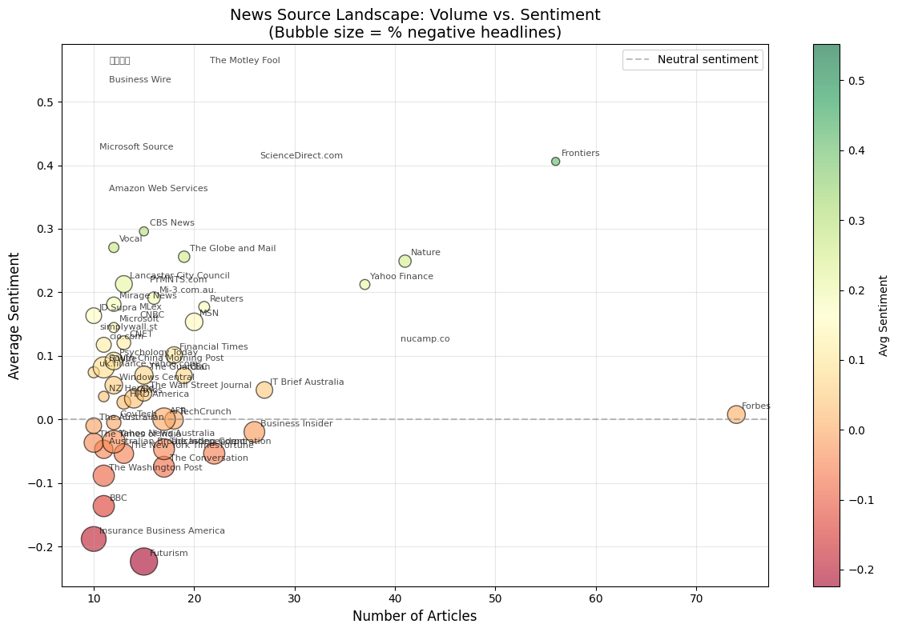
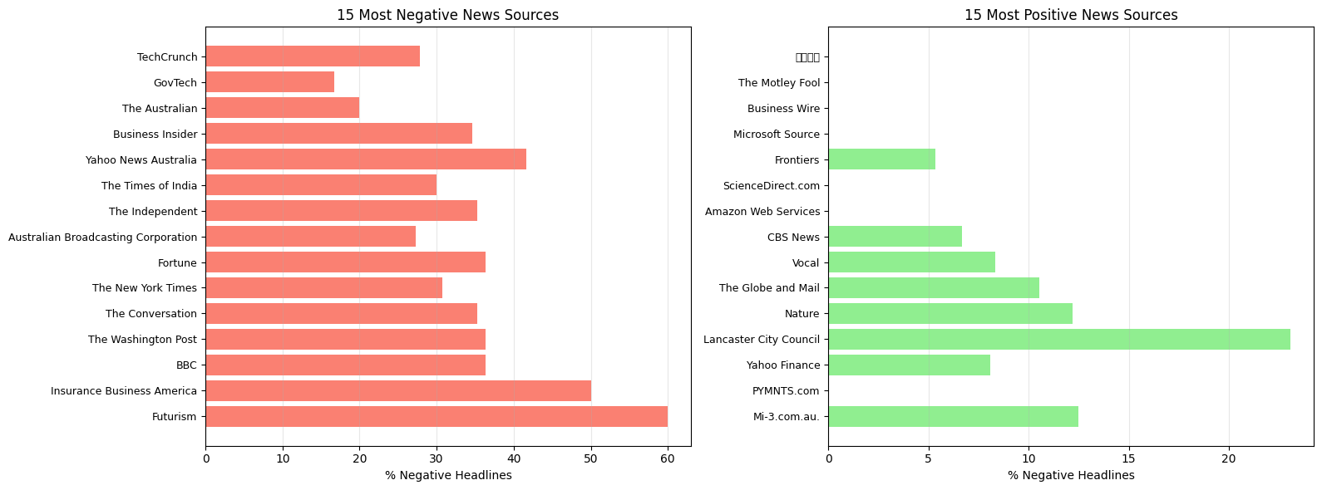

Which News Outlets Frame AI Differently?

Slide 23
Which News Outlets Frame AI Differently?
Graph 1 — News Source Landscape: Volume vs. Sentiment (Bubble size = % negative)
X-axis: number of articles per source (coverage volume)
Y-axis: average sentiment (above 0 = more positive, below 0 = more negative)
Bubble size: % of that source’s headlines that are negative (bigger = more negative share)
Key takeaway: Most sources cluster around moderate volume + near-neutral sentiment, but a few stand out:
High-volume, near-neutral example: Forbes (lots of articles but sentiment ~neutral)
More negative framing example: Futurism (lower sentiment + larger negative share)
More positive framing example: Frontiers (higher sentiment)
Graph 2 — 15 Most Negative vs 15 Most Positive News Sources (% Negative Headlines)
These charts rank sources by how often their headlines are negative (percentage), not by total volume.
Most negative sources (left): higher % negative → more risk/fear framing
Top examples: Futurism (~60%), Insurance Business America (~50%)
Most positive sources (right): lowest % negative → more neutral/constructive framing
Examples with very low % negative: The Motley Fool, Business Wire, Microsoft Source
Main point: Sentiment around AI depends heavily on the outlet, some sources consistently frame AI as risk, others as opportunity/innovation.

Slide 24
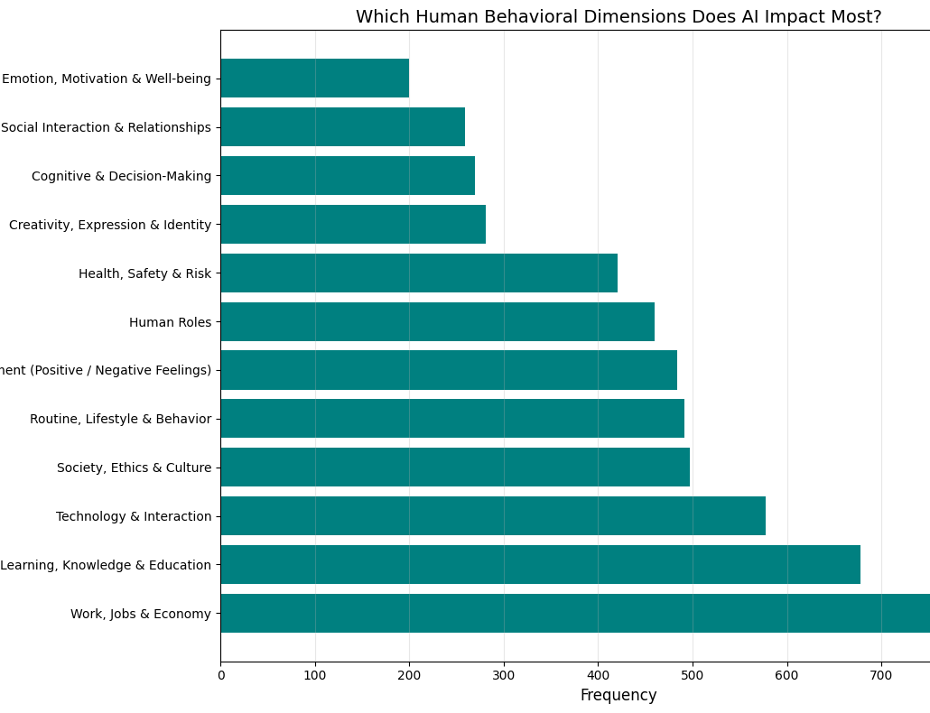
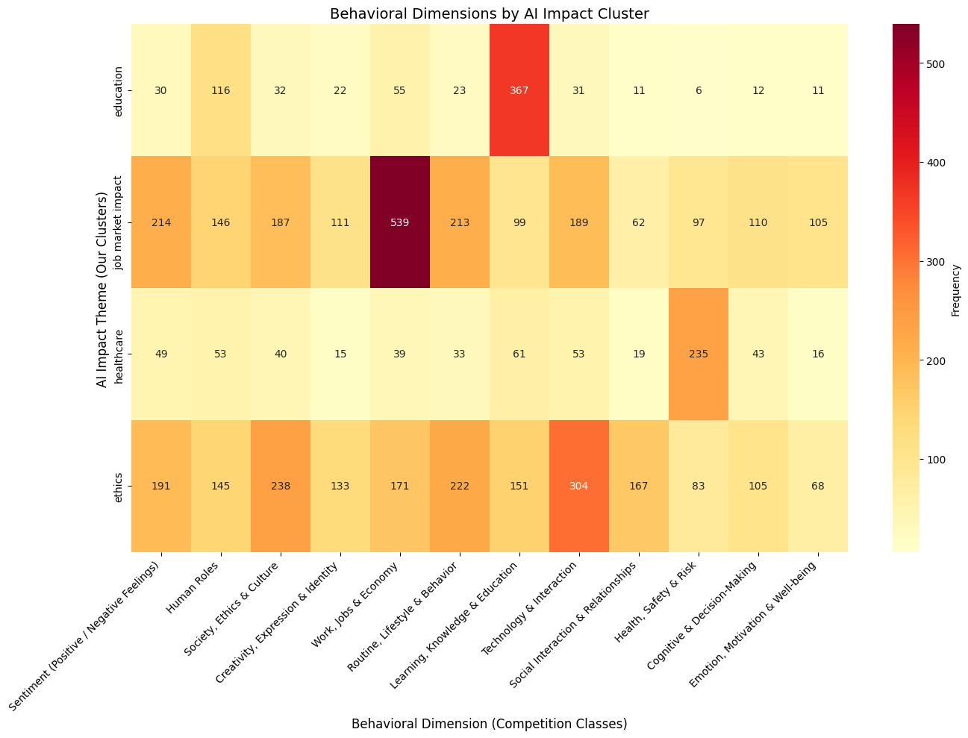
PREDEFINED CLASS LABEL DEEP DIVE

Slide 25
PREDEFINED CLASS LABEL DEEP DIVE
These two visuals summarize how AI is framed as a force that changes human behavior—both overall and by theme.
Graph 1 (Bar Chart) shows the overall frequency of behavioral dimensions mentioned across the dataset. The dominant impacts are Work/Jobs/Economy and Learning/Education, followed by Technology & Interaction and Society/Ethics/Culture—while emotion and relationships appear much less often.
Graph 2 (Heatmap) breaks that same behavioral impact down by our 4 AI impact clusters (Education, Job Market, Healthcare, Ethics). It reveals that each cluster has a distinct “behavioral signature”:
Education → concentrated in Learning & Education
Job Market → concentrated in Work/Jobs/Economy (plus noticeable sentiment)
Healthcare → concentrated in Health/Safety/Risk
Ethics → distributed across Technology, Society/Ethics, and Routine/Lifestyle
Together, the charts show both the “big picture” (what AI affects most overall) and the “structure” (which impacts dominate within each theme).

Slide 26
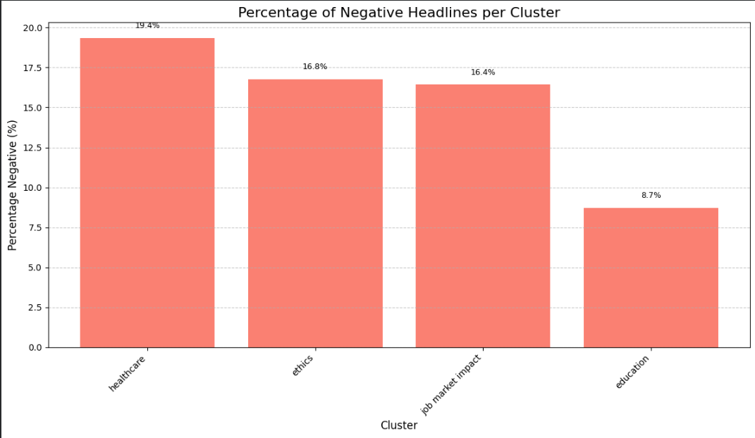
Where is the fear concentrated

Slide 27
Percentage of Negative Headlines per Cluster
This chart shows how often headlines are negative within each AI impact cluster.
Healthcare is the most negative (19.4%), meaning AI is most often framed as risk/harm in medical contexts.
Ethics (16.8%) and Job Market Impact (16.4%) are also frequently negative, reflecting trust/regulation concerns and job-displacement anxiety.
Education is the least negative (8.7%), suggesting AI in education is framed more positively/constructively than the other themes.

Slide 28
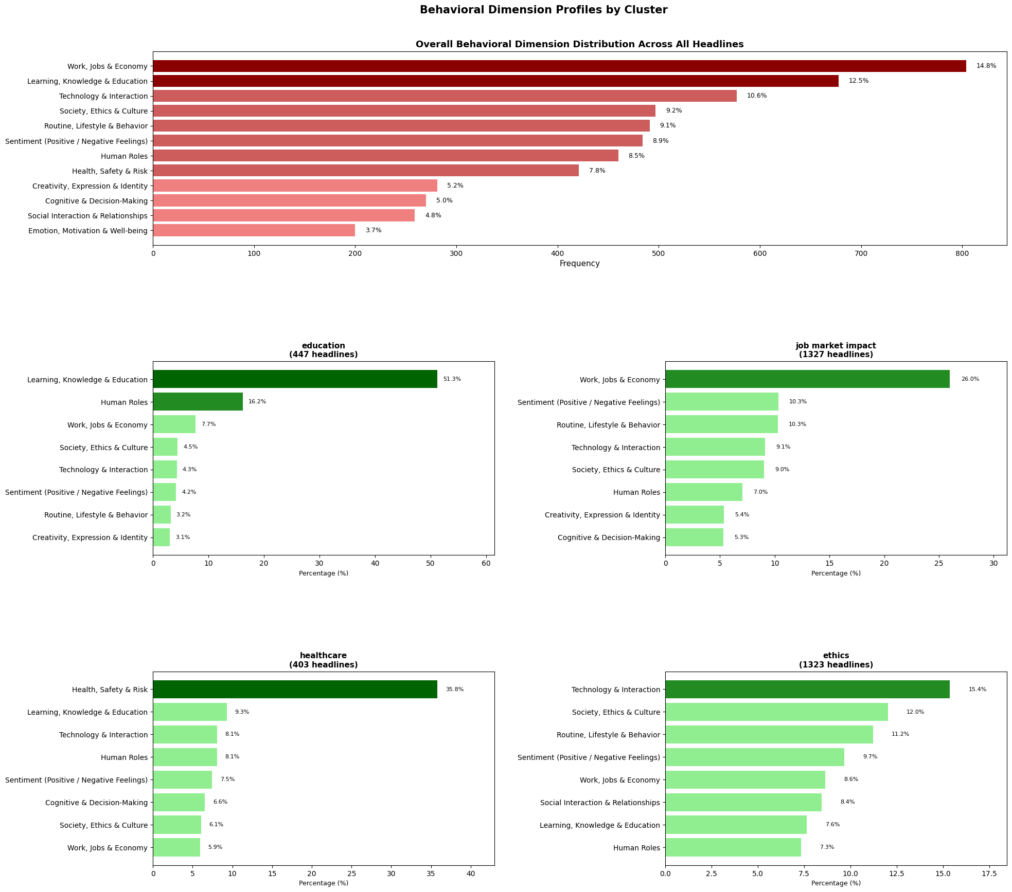
Behavioral Dimensions Profiles by cluster

Slide 29
Behavioral Dimension Profiles by Cluster (Slide Explanation)
What this does: It combines the overall behavioral dimension distribution (top chart) with cluster-specific “profiles” (four charts below) to show what AI is affecting most and how that differs by theme.
Overall pattern (top chart): AI headlines focus most on Work/Jobs/Economy (14.8%) and Learning/Education (12.5%), then Technology & Interaction (10.6%). The least emphasized are Emotion/Well-being (3.7%) and Social Relationships (4.8%).
Cluster fingerprints (bottom charts):
Education (447 headlines): overwhelmingly Learning/Education (51.3%) + Human Roles (16.2%) → AI framed as reshaping teaching/learning roles.
Job Market Impact (1327): led by Work/Jobs/Economy (26.0%), with Sentiment (10.3%) + Routine (10.3%) → jobs + anxiety + day-to-day workflow change.
Healthcare (403): dominated by Health/Safety/Risk (35.8%) → strongest “high-stakes risk” framing.
Ethics (1323): most distributed; top are Technology & Interaction (15.4%), Society/Ethics (12.0%), Routine (11.2%) → governance/trust + platform behavior change.
One-liner takeaway: Each cluster has a distinct behavioral signature, education centers learning, job market centers economic impact, healthcare centers safety risk, and ethics spreads across society + tech + daily behavior.

Slide 30
Conclusion: What the Data Proves
Using a reproducible, competition-compliant pipeline, we analyzed 3,500 AI news headlines to study AI’s impact on human behavior.
Technical foundation:
Semantic embeddings capture meaning beyond keywords
K-Means clustering (k = 4, silhouette-validated) reveals natural domains
Distance-to-centroid analysis confirms cluster quality
Sentiment analysis identifies fear vs optimism
LLM interpretation (Qwen2.5-7B, zero temperature) generates grounded insights
Key result: AI discourse has evolved from technical novelty into measurable behavioral transformation.

Slide 31
Conclusion: Behavioral Insights at Scale
What changes when AI enters human systems:
Decision-making: Humans shift from acting → overseeing
Skill valuation: Static expertise → continuous reskilling
Trust models: Human authority → human+AI verification
Responsibility: Individual judgment → shared human–machine accountability
Evidence from the data:
Work & Education dominate discourse (27.3% pipeline)
Healthcare shows the highest risk framing (19.4% negative)
Ethics is the most fragmented domain → trust instability
Psychological impacts are underreported (3.7%) despite systemic change
Insight: AI reshapes not just what we do, but how we think about control, trust, and responsibility.

Slide 32
Conclusion: The Mirror’s Answer
Yes, AI is transforming us across all four pathways:
Education: AI-augmented learning challenges integrity and identity
Job Market Growth: Human+AI becomes the new productivity baseline
Healthcare: Trust is recalibrated toward AI-assisted care
Ethics: Society moves from trust to constant verification
Final takeaway: AI’s transformation is inevitable but whether it amplifies human potential or erodes human agency depends on policy, education, and governance choices made today.
The technology is advancing. The choice remains human.

Slide 33
System PROMPTS
Recommendations
prompt = (
"These headlines belong to ONE topic cluster.\n"
f"Task: produce exactly {final_recs} actionable recommendations addressing the dominant issues/trends.\n"
"Rules:\n"
"- Output ONLY a numbered list\n"
"- Each item 8–16 words\n"
"- No preface, no explanation, no extra text\n\n"
"Top cluster keywords:\n- " + "\n- ".join(kws) + "\n\n"
"Sample headlines:\n- " + "\n- ".join(titles)
)
Naming
prompt = (
"Name this topic cluster.\n"
"Output ONLY ONE label, 1–4 words.\n"
"Rules:\n"
"- No punctuation, no quotes, no explanation\n"
"- DO NOT use the words: AI, artificial intelligence, LLM, ChatGPT, OpenAI, GenAI\n"
"- Do NOT output generic words like: system, general, technology, tech, news, global, world\n"
"- Choose the most representative real-world topic for MOST headlines\n\n"
"Top keywords:\n- " + "\n- ".join(kws) + "\n\n"
"Sample headlines:\n- " + "\n- ".join(titles)
)

Slide 34
APPENDIX (LLM Prompts)
I have a CSV of ~3,500 AI-related news headlines. What basic cleaning steps should I apply before doing any NLP or clustering?
For short news headlines, what sentence embedding model would work well, and why? How should I use it in Python?
After running K-Means, how can I tell if the clusters are actually meaningful or just random groupings?
I want to understand what topics define each cluster. What’s a good way to extract representative keywords for clustered text?
I want to use an LLM to summarize patterns from each cluster. How can I structure prompts, so it interprets results instead of inventing them?
How can I clearly explain that our findings are data-driven and not just opinions, especially to a non-technical audience?

