Slide 1
Dominosa
Han Wang
Notes:
Hi, the puzzle I chose for the final project called Dominosa.

Slide 2
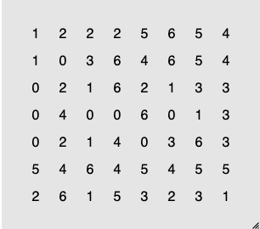

What is Dominosa?
Board:
n+2 × n+1 grid,
filled with numbers (0, 1, ..., n)
Domino:
1×2 rectangles
Notes:
What is domimosa?
Dominosa is a board game. First, in this board, the number is 0, 1,2, 3, 4, 5, 6, so the width of the board is 6 + 2 is 8, and the height of the board is 6 + 1 is 7. We will play on this board. You will ask: What is a domino ? Domino here is a rectangle whose width is 1 and height is 2. like this

Slide 3
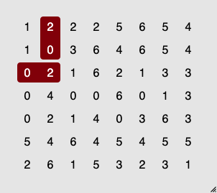
How to solve Dominosa?
every domino appears exactly once
We can’t place (2, 0) and (0, 2)
That is,
every possible pair of numbers,
including doubles
Notes:
The rule of this game is: every domino can appear exactly once. This means the numbers in the domino, so 2, 0 and 0, 2 is considered as same.
And double numbers like 2, 2 is also considered as a kind of domino.

Slide 4
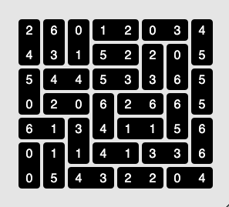
How to solve Dominosa?
Notes:
What we want to do is place dominos on the board and put every cell into a domino. Also the type of domino can appear only once.

Slide 5
Generator:
Randomly fill the board with available numbers.
For a 3-size game, the numbers can be used to fill the board are:
[0,0,0,0,0
1,1,1,1,1
2,2,2,2,2
3,3,3,3,3]
Check whether it has a solution. If not, generate again.

Slide 6
Solver:
I use backtrack to solve the game.

Slide 7
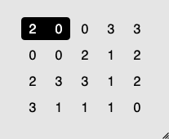
Solver:
Notes:
When starting, by default I will put a horizontal domino first. This domino is valid.

Slide 8
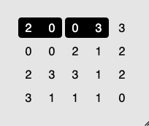
Solver:
Notes:
Then place 0 ,3

Slide 9
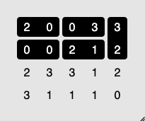
Solver:
Notes:
When I try to put a domino on this 3, I meet the bound. So I will put a vertical domino. Same, we got 0, 0 and 2, 1

Slide 10
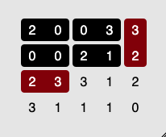
Solver:
Notes:
Now I try to put 2, 3 in the third row it's duplicate. So I will try to put a vertical 2, 3, but it's also duplicate. It means the 2, 1 I placed on last step is wrong

Slide 11
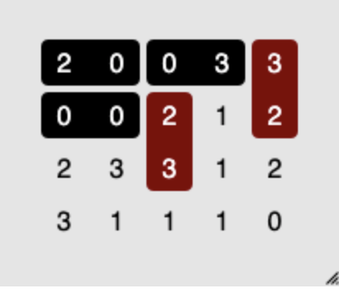
Solver:
Notes:
Then I go back to 2, 1 and change it to vertical. But we can't, which means this 0, 0 is wrong. So right now the things will happen next is obvious.

Slide 12
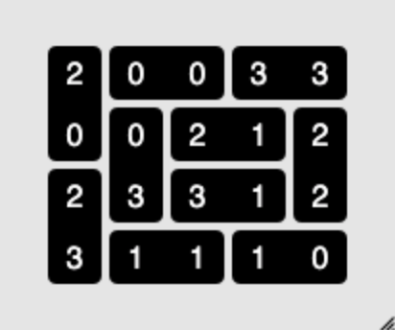
Solver:
Notes:
Finally we got the solution.

Slide 13
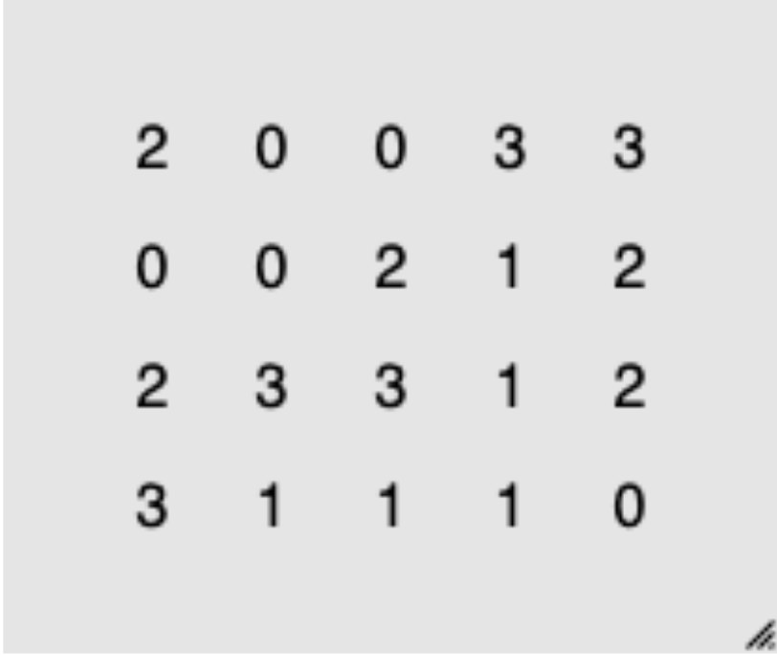
Code:
n
-1
-1
n + 1
-1
-1
-1
-1
-1
-1
-1
-1
Notes:
For code, I put this board into a 2-D list. The size of this game is 3, which means the biggest number in the board. So the height of this board is 4, and the width is 5. The method I use here will iterate all the elements in this board, so, because we have 2 type of domino, I add one row and one column at the bound. Thus we won't need to deal with the bound problem while iterating.

Slide 14
Code:
Place -1 to mark that this cell has been put into a domino successfully.
Before solving:
for each_row in grid:
for each_cell in row:
if each_cell != -1
we_have_a_solution = False
Notes:
Here we will change the value of the domino to -1 to represent that this cell has been put into a domino. So at the start of the function, I will check whether all of the cells in the board is -1. If they are, it means we have already put every cell into domino, we get the solution.

Slide 15
Code:
is -1?
-1
-1
-1
-1
-1
-1
-1
-1
-1
-1
-1
-1
-1
-1
-1
-1
-1
-1
-1
-1
-1
-1
Notes:
If not, it will start from the first cell, and check whether it equals to -1. If it is, the function will be recurred at the next cell. If it's not, it will check whether the cell next to the first horizontally is -1. Here it's zero, so the first domino is 2, 0 (click) and I will place them to -1, and save (02) to a list

Slide 16
Code:
is -1?
is -1?
is -1?
-1
-1
-1
-1
-1
-1
-1
-1
-1
-1
-1
-1
-1
-1
-1
-1
-1
-1
-1
-1
-1
-1
-1
-1
Notes:
Same, put the second domino and save the numbers to a list. But when we are trying to put the third domino, we find that the cell is -1. So we change the orientation to vertical(click)

Slide 17
Code:
is -1?
-1
-1
-1
-1
-1
-1
-1
-1
-1
-1
-1
-1
-1
-1
-1
-1
-1
-1
-1
-1
-1
-1
-1
-1
Notes:
Assume this 0, 2, which means we already have these 2 numbers in our solution list. The backtracking method here will go back to the previous step and change the 03 to vertical, that is 02, which is also duplicate right? So it well go back to 20

Slide 18
