Slide 1
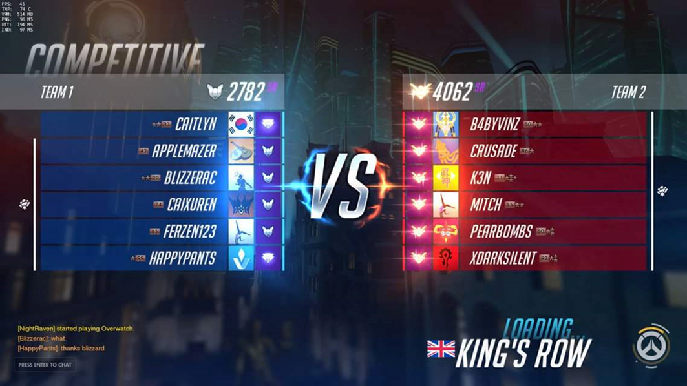
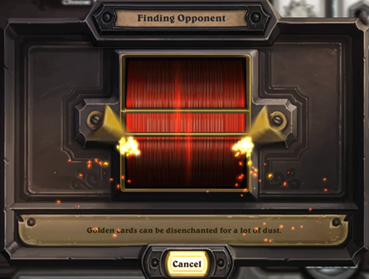
What is game matchmaking?
In multiplayer video games, matchmaking is the process of connecting players together for online play sessions. The design of matchmaking has significant impact on playing experience of players

Slide 2
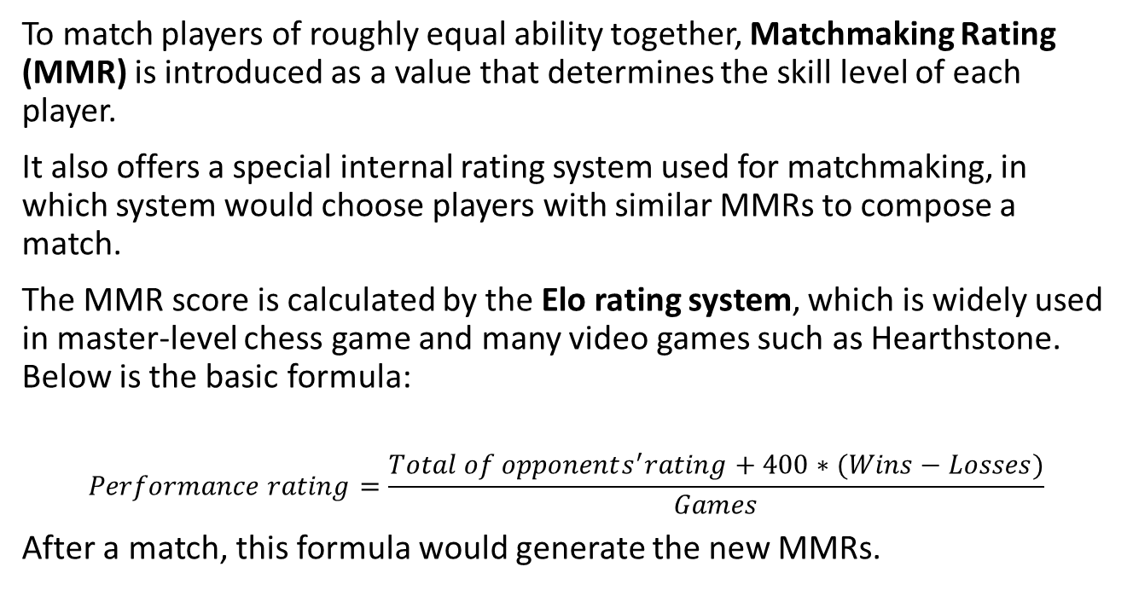
Rule of matchmaking
To match players of roughly equal ability together, Matchmaking Rating (MMR) is introduced as a value that determines the skill level of each player.
It also offers a special internal rating system used for matchmaking, in which system would choose players with similar MMRs to compose a match.
The MMR score is calculated by the Elo rating system, which is widely used in master-level chess game and many video games such as Hearthstone. Below is the basic formula:
$$Performance rating=\frac{Total of opponents^{′}rating+400∗(Wins−Losses)}{Games}$$
After a match, this formula would generate the new MMRs.

Slide 3
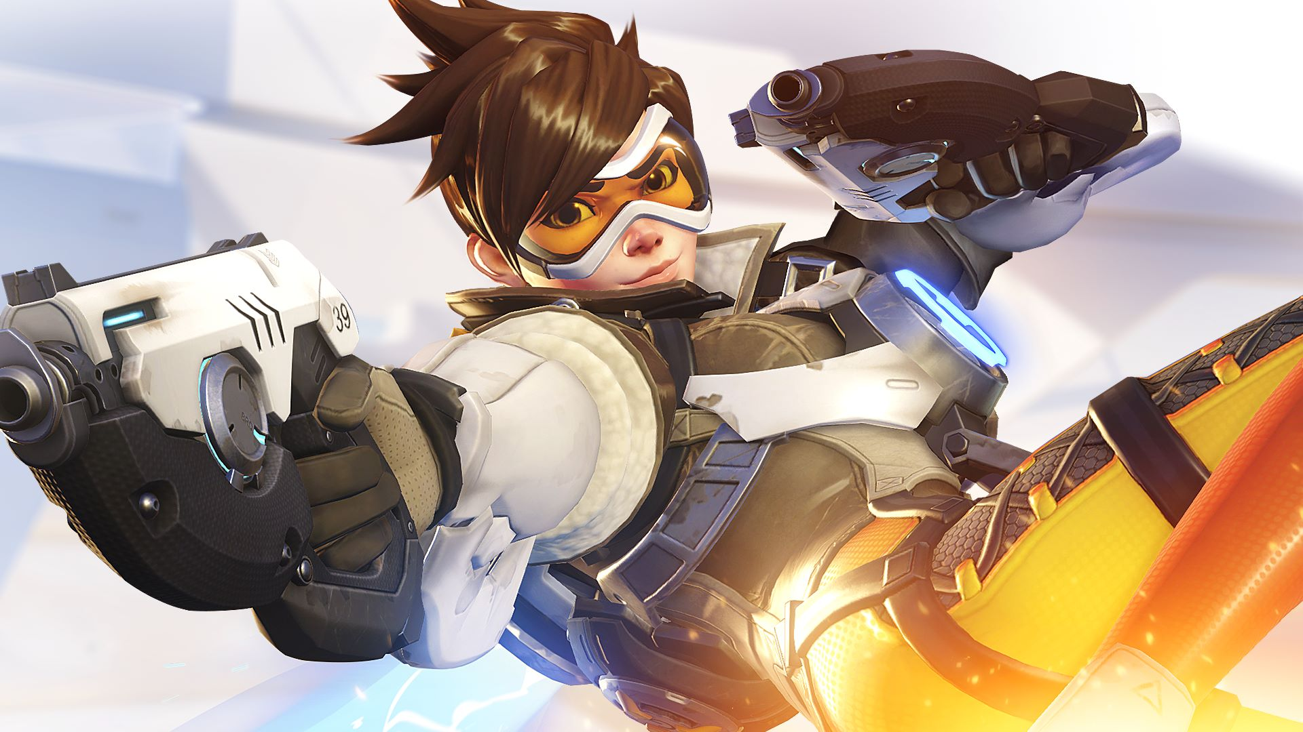
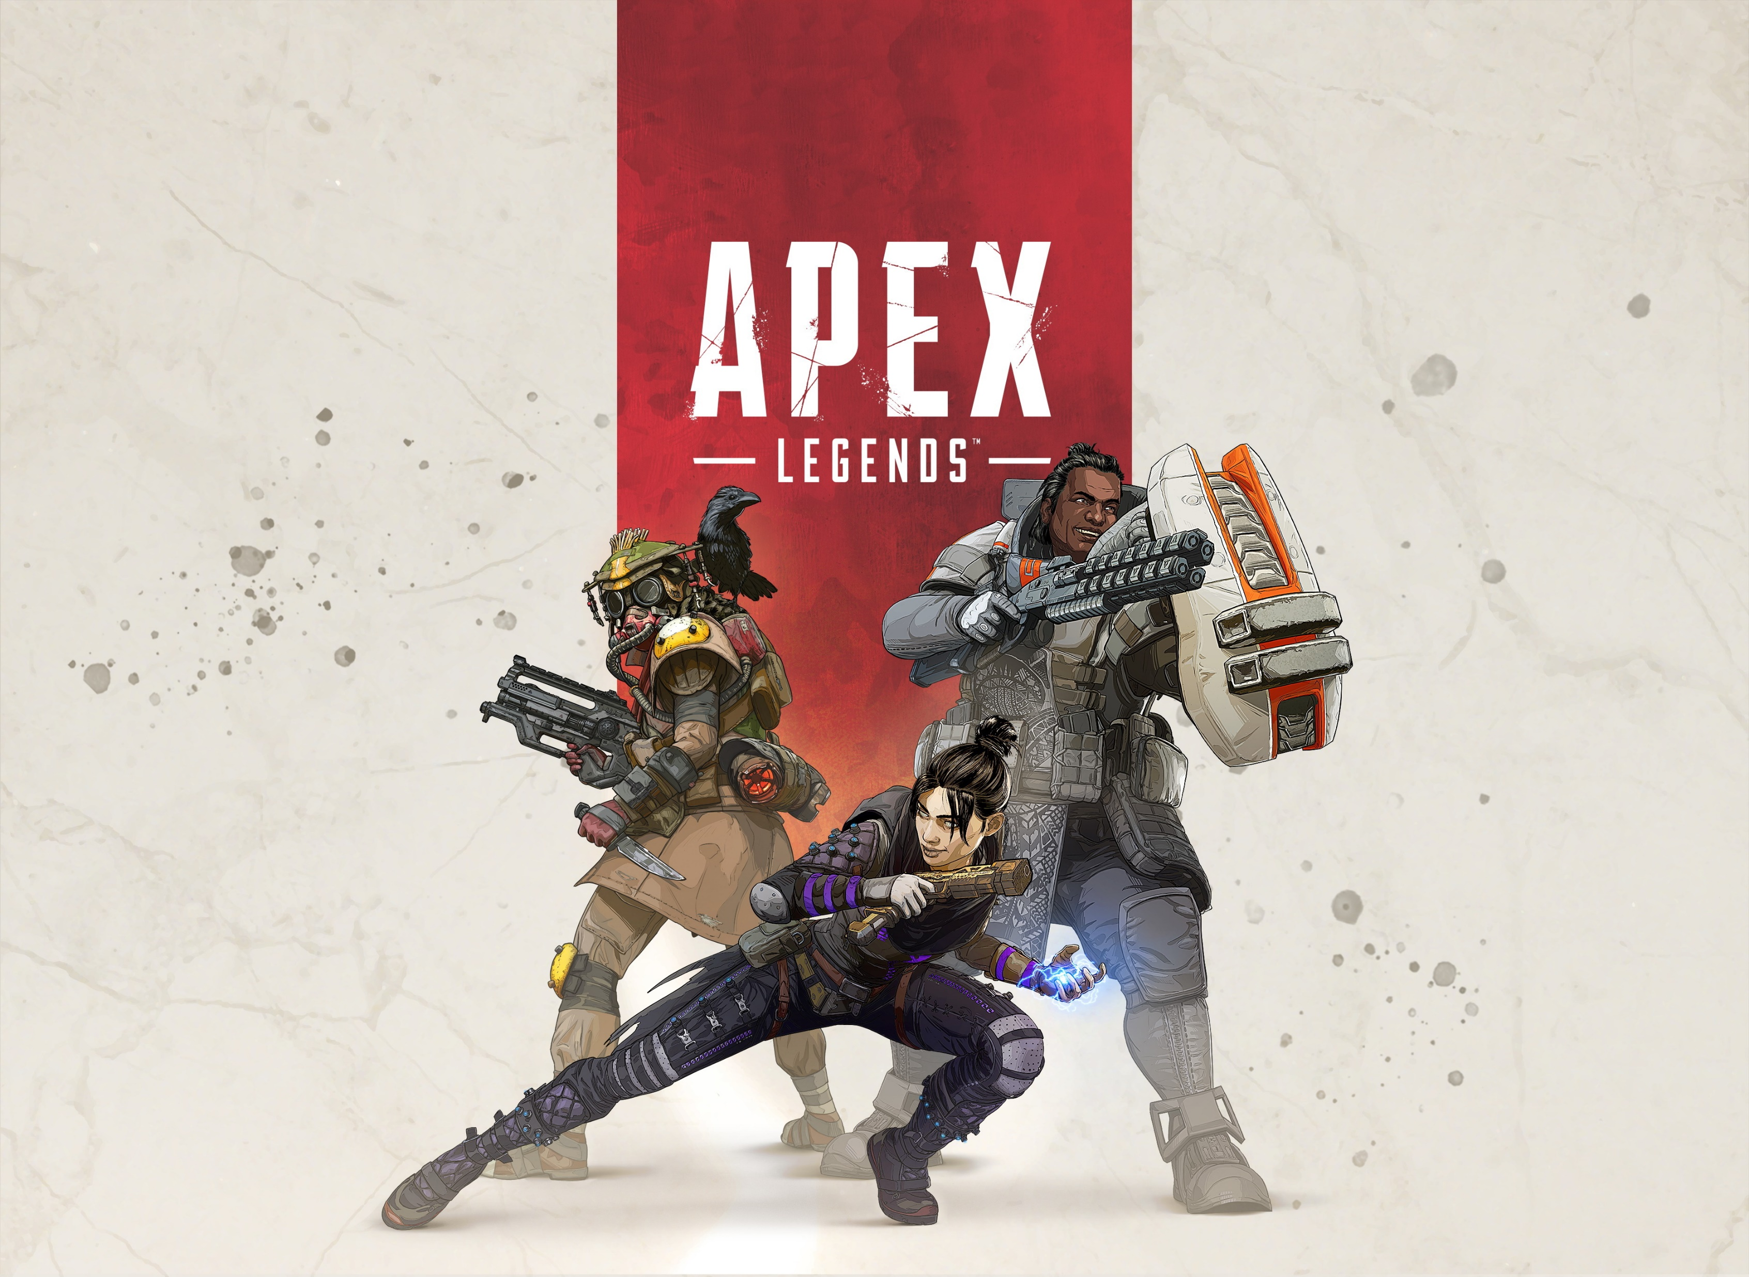
Monte Carlo Simulation on Game Matchmaking
Jiani Shi, Han Wang

Slide 4
Assumption and Hypothesis
If the difference of MMRs in a match is too large, there is a significant probability that players on both sides would have a terrible or boring playing experience.
If the difference is too small, the waiting time of matchmaking would be too long, which also negatively affect the playing experience.
In this project
we would focus on finding an appropriate MMR range rule for matchmaking to allow players to have optimal playing experience.
The changes of MMR distribution under different rules would be analyzed.

Slide 5
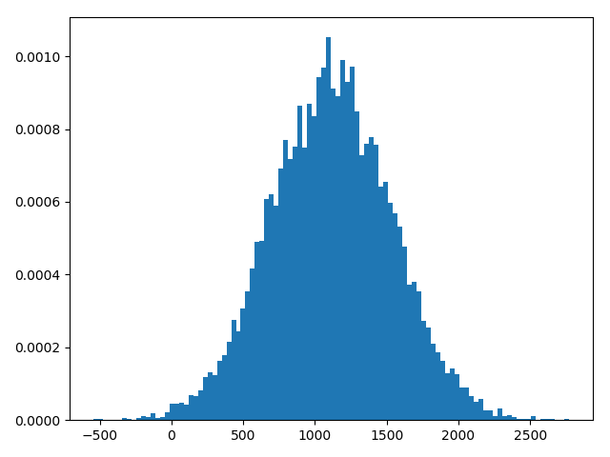
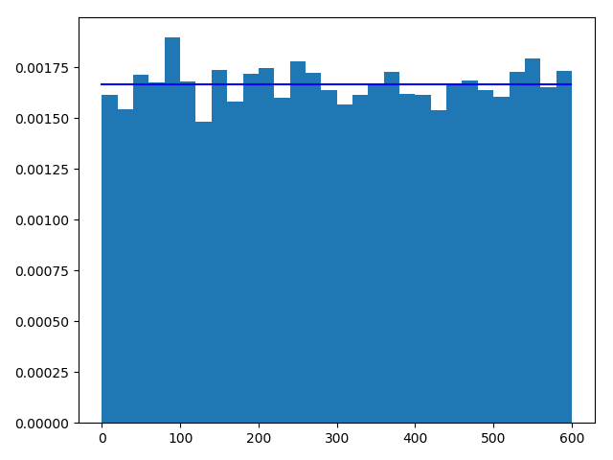

Method
We would simulate the matchmaking process in an amount of players. Each player would be represented by the MMR score, which is supposed to follow normal distribution.
players will enter the waiting pool separately and the waiting time would begin to be calculated.
Matchmaking would be processed every $t_{1}$ seconds.
The result of each match would be estimated by Elo rating system, which is also used to adjust and generate player’s new MMR based on the result.

Slide 6
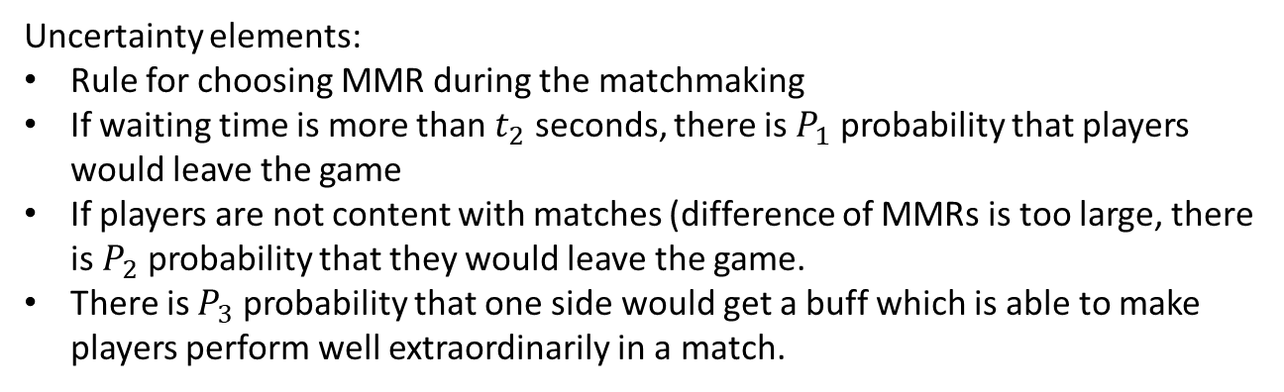
Uncertainty elements:
Rule for choosing MMR during the matchmaking
If waiting time is more than $t_{2}$ seconds, there is $P_{1}$ probability that players would leave the game
If players are not content with matches (difference of MMRs is too large, there is $P_{2}$ probability that they would leave the game.
There is $P_{3}$ probability that one side would get a buff which is able to make players perform well extraordinarily in a match.
Limitation:
Our code only simulates 1 vs 1 scenario like Hearthstone. More elements would be considered in other scenarios.
We simplified the scenario compared to real video games, which are much more complicated when computing MMR

