Slide 1
MACRO-Korea: open technical questions
Provincial power-sector model · 17 provinces · 8,760 chronological hours · 2021–2050 myopic

Slide 2
Agenda
2021 Calibration issue - after changed the transmission
Capacity expansion and generation by tech (Ref vs NDC) – diagnosis
Renewable energy expansion rate - Can we limit a national build rate?
Unit commitment parameter - How should nuclear and MinFlow be configured?
Carbon price (related to nuclear) - Is the carbon price real?
Notes:
Five things. We'll start with where the base year stands, because there's a known gap and I want to flag it before you see any numbers.
Then capacity and generation for both scenarios so you have the picture.
Then three questions: the renewable build rate, the unit commitment parameters, and the carbon price.

Slide 3
STATUS
Where the model is
Structure
Complete. 7 periods, 8,760 h, linear-relaxed UC, myopic, Gurobi barrier.
Solve
Ref 2.5 h · NDC 4.6 h on 24 cores / 192 GB. ~13.6M rows.
Transmission
99.1 GW network from NREL ITLs, calibrated to the KPX metro limit. Expands.
Base year
NOT calibrated. Coal 300 TWh vs 198 observed; gas 58 vs 167.
Staged fixes
Coal availability 0.65 · nuclear 0.85→0.78 · 2021 gas retirement blocked.
Notes:
Structurally we're complete. Seven periods, 8,760 chronological hours, linearly relaxed unit commitment, myopic, Gurobi barrier. About 13.6 million rows. Ref solves in two and a half hours, NDC in four and a half, on 24 cores.
Transmission is in good shape. We built a 99 gigawatt inter-province network from NREL interface transfer limits, calibrated to the KPX metro import limit, and it now expands — which it never did before.
The base year is not calibrated. We can check about this next slide.

Slide 4
CONTEXT
The results you are about to see predate the base-year fix
Flagged so the known gap is not re-diagnosed. Fixes are staged, not yet run.
Notes:
Here's that gap. Coal and gas are inverted.
The cause is simple: coal and gas carried no availability field at all, so both defaulted to 1.0 — available every hour of the year, no maintenance, no outages, no seasonal curtailment. Coal is half the variable cost of gas, so nothing stopped it running at a 95% capacity factor and taking gas's work.
Three fixes are staged. Coal availability at 0.65, nuclear from 0.85 down to 0.78, and blocking a gas retirement the model was making in the calibration year itself. I'm flagging this so we don't spend the meeting re-diagnosing it.

Slide 5
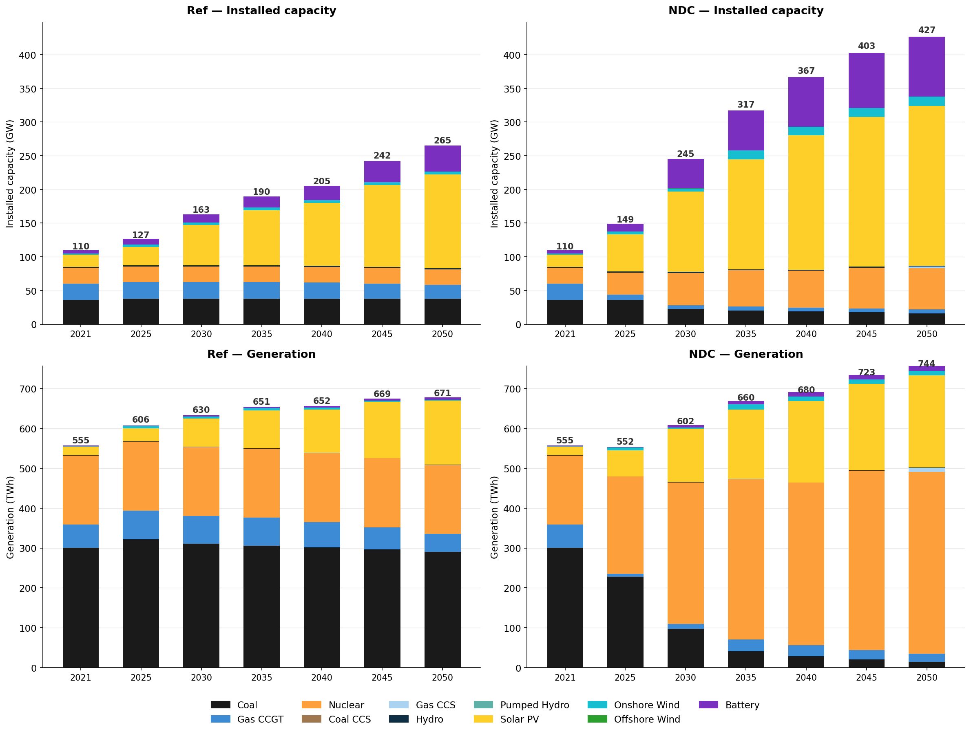
CONTEXT
Notes:
This is the whole picture for both scenarios, capacity on top and generation below.
Two things to notice. In NDC, battery capacity is enormous — 83 gigawatts. And the gap between installed capacity and generation widens a lot, which is the curtailment we'll come back to.

Slide 6
QUESTION 1 · HIGHEST PRIORITY
MaxNewCapacityConstraint is per-asset, so we cannot cap a national build rate
We need ≤ 5 GW/yr nationally. The only lever is 6,000 MW per province per period. Is a grouped MaxNewCapacityConstraint available upstream?
Notes:
First question. We need to limit how fast solar is built — roughly 5 gigawatts a year, against a Korean record of 4.1.
MaxNewCapacityConstraint applies per asset in the version we're running, so we can't write that. The only lever is a per-province cap, and the arithmetic doesn't work: 6,000 megawatts per province per five-year period is 1.2 gigawatts a year each, or 20.4 nationally if all seventeen bind.
And it doesn't bite. When we tightened from 7,500 to 6,000, the national peak moved from 6.5 to 6.0 gigawatts a year — and Ref 2050 solar actually went up, from 139 to 142. The red cells are at the cap; their neighbours just absorb the build.
So: is a grouped or system-wide version available upstream? And if not, is user_additions the right place to write one?

Slide 7
QUESTION 2
MinFlowConstraint on all five thermal technologies ran us out of memory
Rows, MinFlow on coal + gas CCGT only
13.60 M
Rows, MinFlow on all five
14.05 M
Added by three technologies
≈ 450,000 rows
Outcome at 128 GB
killed — two jobs
Current state
off for nuclear, coal CCS, gas CCS; mem raised to 192 GB
min_flow_fraction values are still in the CSVs for those three technologies but the constraint is not declared.
Is that row growth expected? Is there a cheaper MinFlow formulation under relaxed UC — and are the undeclared min_flow_fraction values truly inert?
Notes:
Second question, two parts. This is the first.
We tried declaring MinFlowConstraint on all five thermal technologies. The model went from 13.6 to 14.05 million rows — about 450,000 added by three technologies — and two jobs were killed at 128 gigabytes.
We backed it out for nuclear and both CCS technologies and raised memory to 192. It runs, but we're now in a slightly uncomfortable position: the min_flow_fraction values are still sitting in the CSVs for those three, with the constraint undeclared.
Is that row growth what you'd expect? Is there a cheaper formulation under relaxed UC? And can we rely on those undeclared values being genuinely inert?

Slide 8
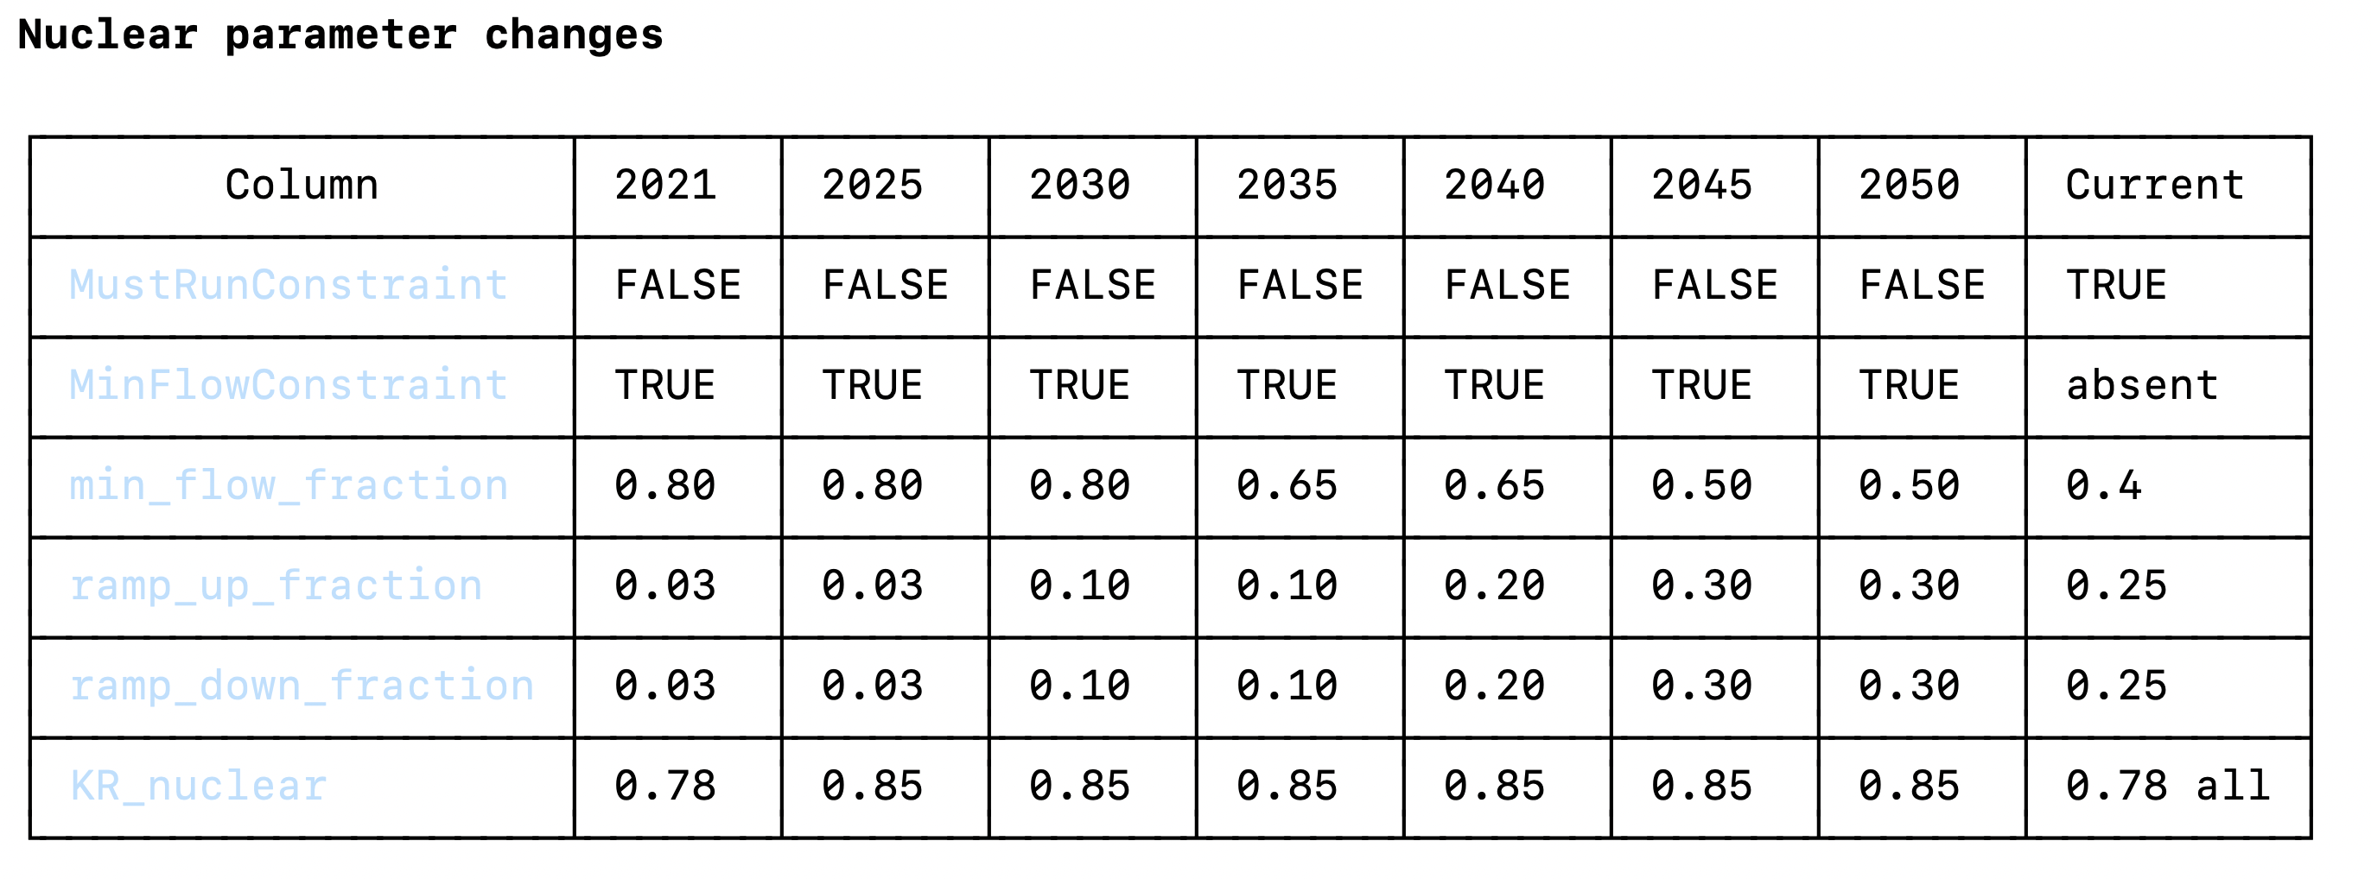
QUESTION 2
Nuclear
Notes:
Second part, and this one I've partly answered since I built the slide.
▎ Nuclear currently carries MustRunConstraint with a flat 0.85 availability. In MACRO that's an equality, not a floor — so nuclear sits at exactly 85% of capacity in every one of the 8,760 hours. I checked the hourly output: 53.46 gigawatts, standard deviation zero.
▎ I'd planned to ask you what to replace it with. Korean data mostly answers it. KHNP's current operating floor is 80% of rated output, and their flexible-operation plan targets 50% by the early 2030s. The APR-1400 is designed for 100-50-100 daily load following. Korea already curtails nuclear — twenty-one times at Hanbit alone in early 2025.
▎ So our model is more rigid than the real fleet is today. This table is what we'd change: drop MustRun, turn MinFlow on, and let the floor follow the policy path from 0.80 down to 0.50.
▎ Which lands back on the previous question — that's exactly the constraint that blew our memory.

Slide 9
QUESTION 3
Nuclear is completely rigid, and the carbon price absorbs the consequence
What is the idiomatic way to represent near-baseload nuclear in MACRO? Drop MustRun for a low min_flow_fraction instead?
Notes:
Third question, and it follows directly.
▎ Nuclear is 468 terawatt-hours of completely immovable output in NDC 2050. Minimum national demand that year is 52.8 gigawatts and nuclear alone is 53.5 — so at three in the morning nuclear is already above the entire load. For 2,782 hours a year, nuclear plus solar exceeds demand on its own.
▎ Nuclear can't back down. Batteries are 5.6 hours. We have no long-duration storage, no hydrogen, no demand response, no BECCS, and CCS is capped by 4.75 megatonnes a year of CO₂ storage. So the only way to meet the cap is to build more solar and throw most of it away — that's 51 terawatt-hours of curtailment.
▎ The shadow price lands between three and ten thousand dollars a tonne. Forty to a hundred times the EU ETS.
▎ My reading is that this isn't expensive abatement, it's absent abatement. I'd like to know whether you'd read it the same way, or whether a dual this size points at a formulation problem we should be looking for.

