Slide 1
MACRO-Korea: open technical questions
Provincial power-sector model · 17 provinces · 8,760 chronological hours · 2021–2050 myopic

Slide 2
Agenda
2021 Calibration issue - after changed the transmission
Capacity expansion and generation by tech (Ref vs NDC) – diagnosis
Renewable energy expansion rate - Can we limit a national build rate?
Unit commitment parameter - How should nuclear and MinFlow be configured?
Carbon price (related to nuclear) - Is the carbon price real?
Notes:
Five things. We'll start with where the base year stands, because there's a known gap and I want to flag it before you see any numbers.
Then capacity and generation for both scenarios.
Then three questions: the renewable build rate, the unit commitment parameters, and the carbon price.

Slide 3
STATUS
Where the model is
Structure
Complete. 7 periods, 8,760 h, linear-relaxed UC, myopic, Gurobi barrier.
Solve
Ref 2.5 h · NDC 4.6 h on 24 cores / 192 GB. ~13.6M rows.
Transmission
99.1 GW network from NREL ITLs, calibrated to the KPX metro limit. Expands.
Base year
NOT calibrated. Coal 300 TWh vs 198 observed; gas 58 vs 167.
Staged fixes
Coal availability 0.65 · nuclear 0.85→0.78 · 2021 gas retirement blocked.
Notes:
Structurally we're complete. Seven periods, 8,760 hours, linearly relaxed unit commitment, myopic, Gurobi barrier.
About 13.6 million rows. Ref solves in two and a half hours, NDC in four and a half, on 24 cores.
Transmission is in good shape. We built a 99 gigawatt inter-province network from NREL interface transfer limits, calibrated to the KPX metro import limit, and it now expands.
The base year is not calibrated. We can check about this next slide.

Slide 4
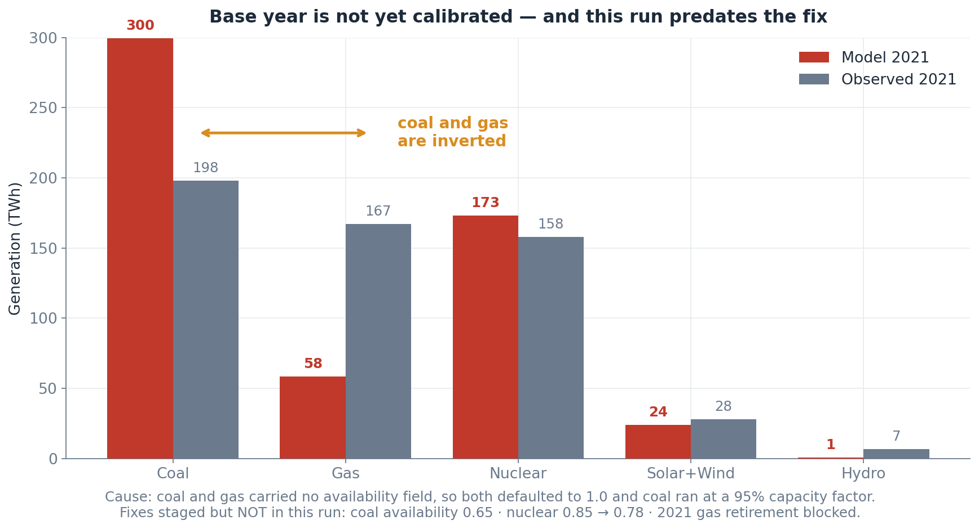
CONTEXT
The results you are about to see predate the base-year fix
Flagged so the known gap is not re-diagnosed. Fixes are staged, not yet run.
Notes:
Here's the gap. Coal and gas are the wrong way round.
The reason is simple. Coal and gas have no availability limit in the model — so they can run every hour of the year. No maintenance, no outages, no seasonal shutdowns. Coal is half the price of gas to run, so it just runs flat out. 95% capacity factor, all year, every year.
Real Korean coal runs at about 63%.
So coal does gas's job, and gas sits idle.
We've already written the fix. Cap coal at 65%, bring nuclear down from 85 to 78 — that's the real 2021 number — and stop the model retiring gas plants in the calibration year itself.
It just hasn't run yet. So everything you see today still has this in it — I'm flagging it now so we don't spend the meeting re-diagnosing something we already know.

Slide 5
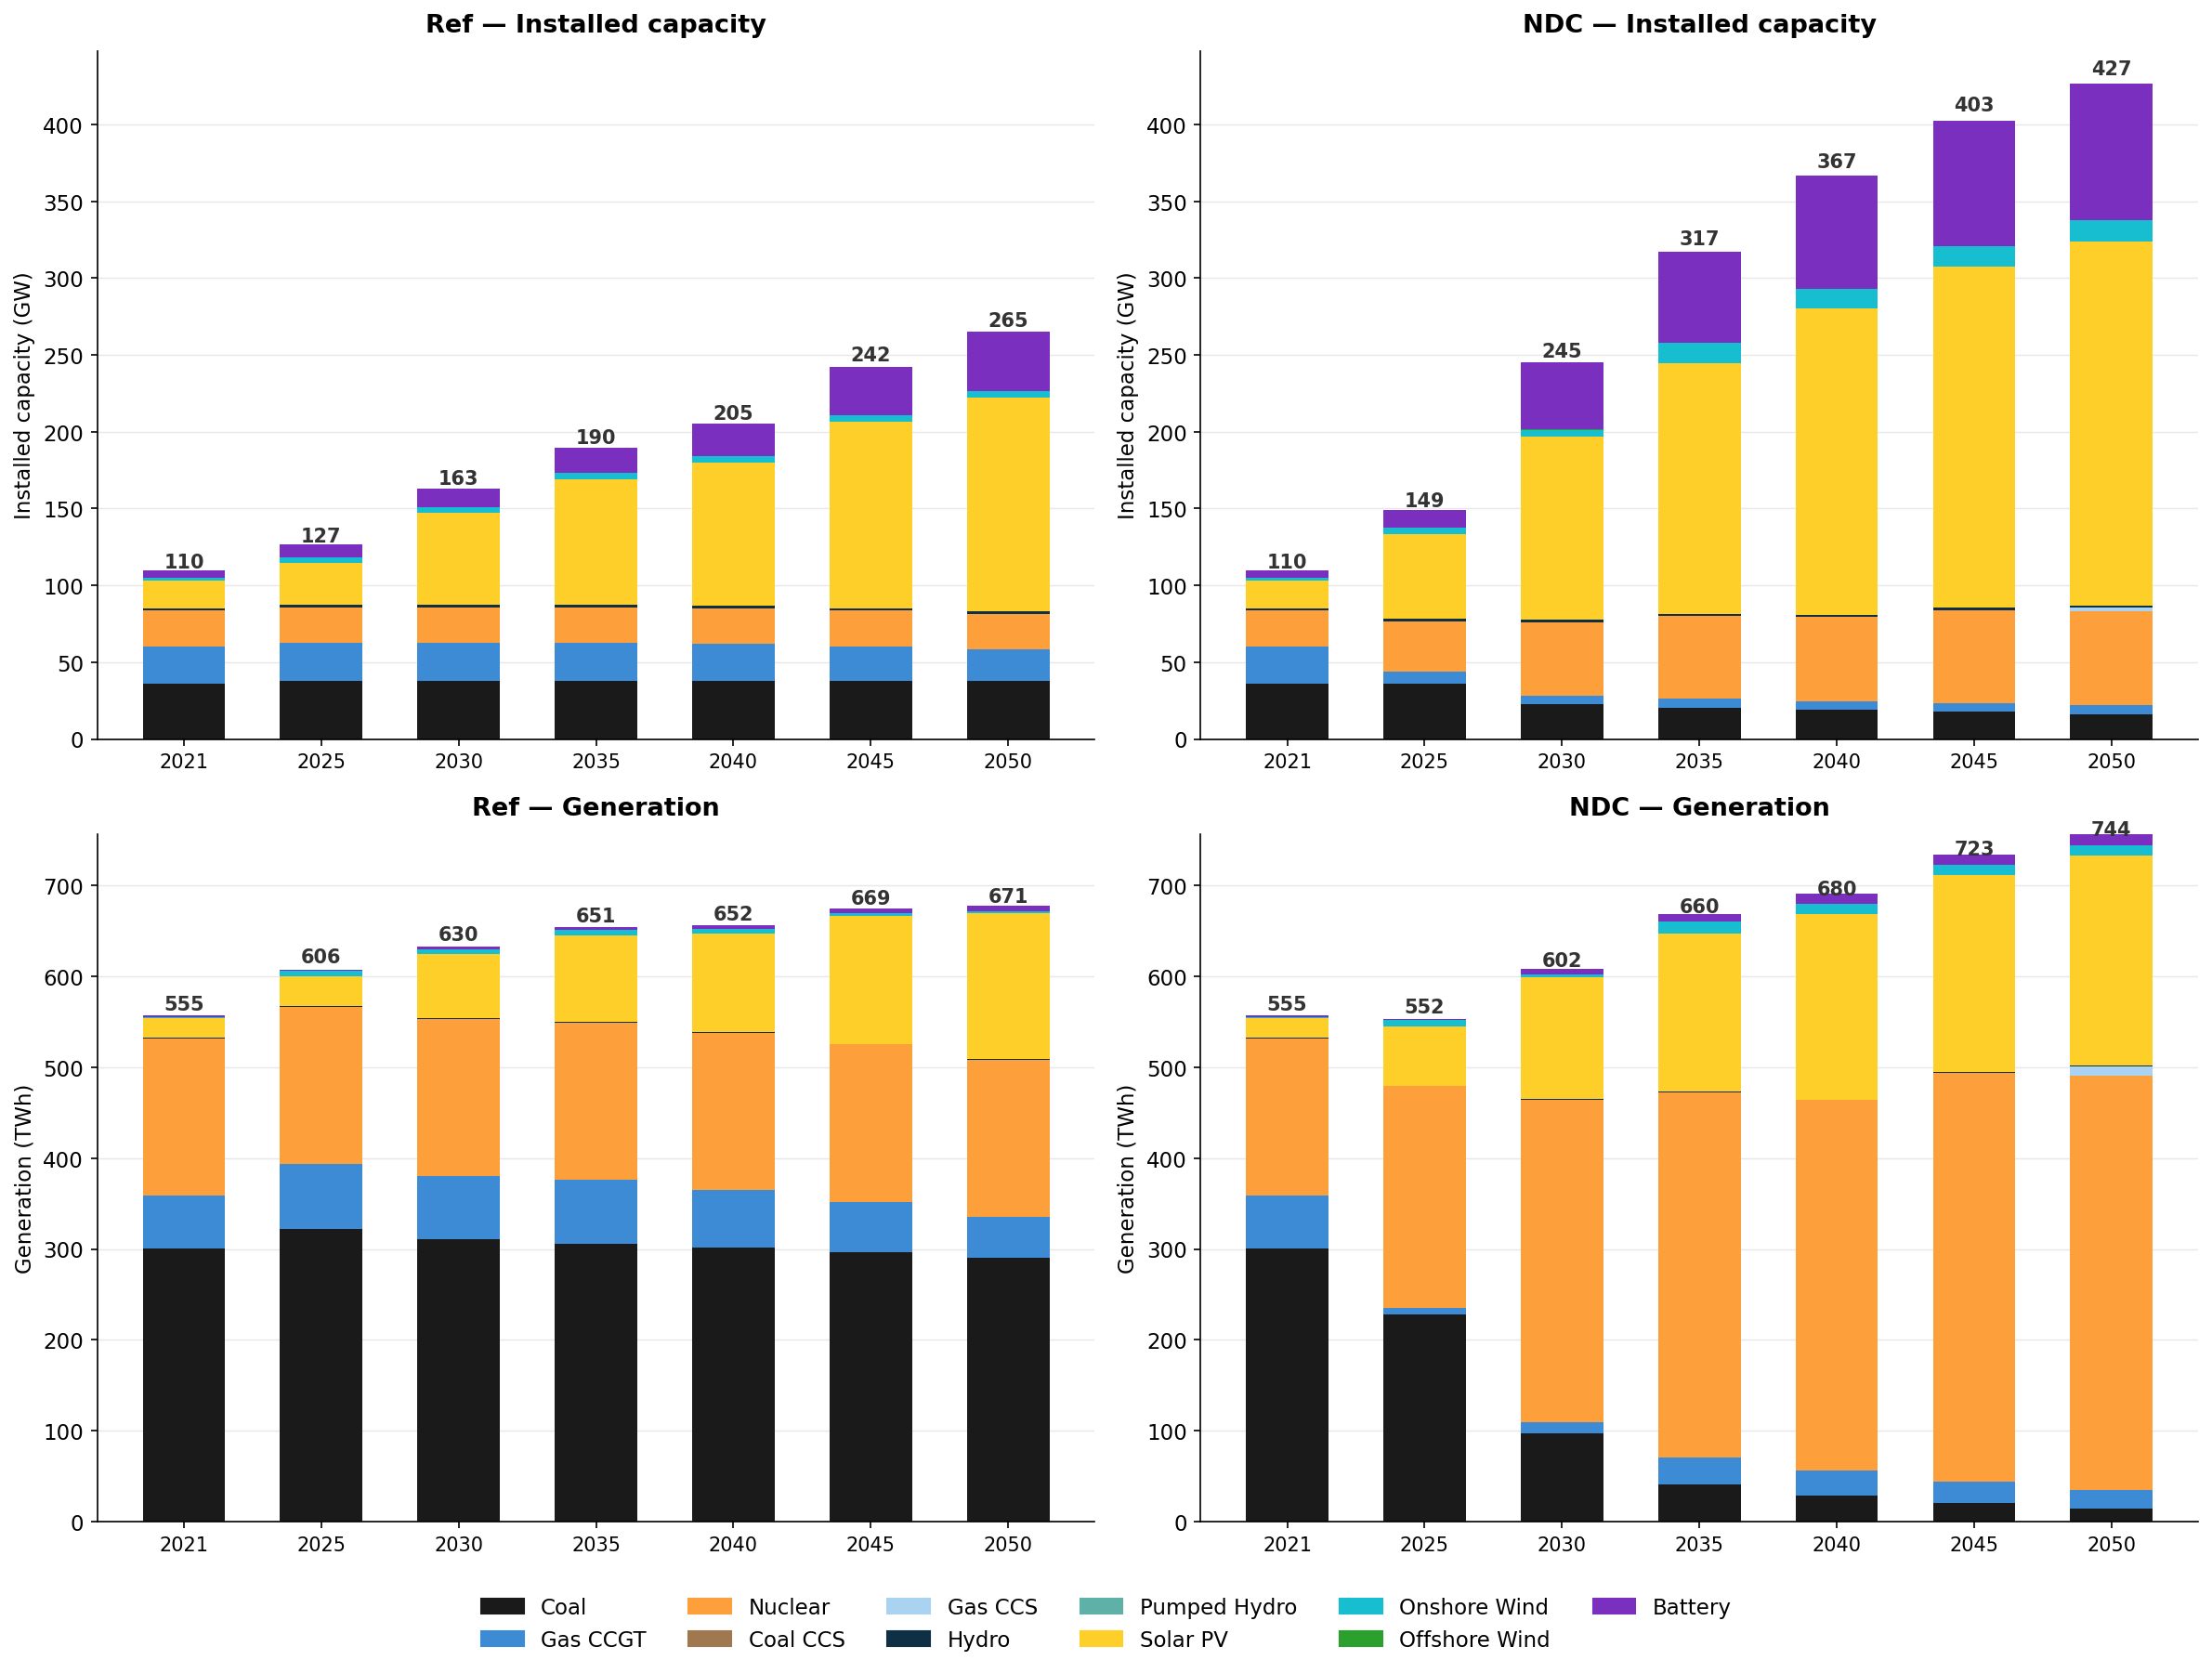
CONTEXT
Notes:
This is the whole picture for both scenarios, capacity on top and generation below.
Do you think this is feasible? I think in REF we still have lots of solar…. I think this is linked to CF and CPA.
Two things to notice. In NDC, battery capacity is enormous — 83 gigawatts. And the gap between installed capacity and generation widens a lot, which is the curtailment we'll come back to.

Slide 6
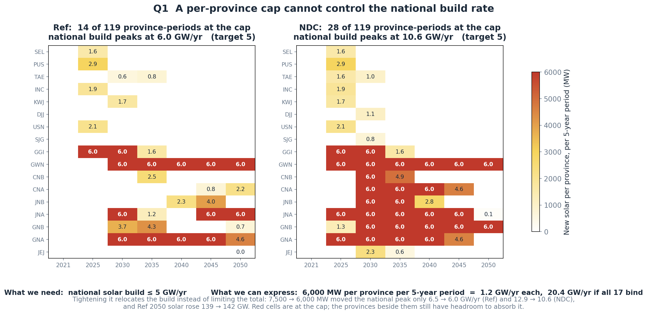
QUESTION 1 · HIGHEST PRIORITY
MaxNewCapacityConstraint is per-asset, so we cannot cap a national build rate
We need ≤ 5 GW/yr nationally. The only lever is 6,000 MW per province per period. Is a grouped MaxNewCapacityConstraint available upstream?
Notes:
First question. We want to limit how fast solar gets built. Korea's record year was 4.1 gigawatts, so something around 5 a year is realistic.
We can't write that. MaxNewCapacityConstraint works on one asset at a time, so there's no way to say "the country builds no more than 5 gigawatts a year."
All we can do is cap each province. And the maths doesn't work. We set 6,000 megawatts per province per five-year period — that's 1.2 gigawatts a year each. But there are seventeen provinces. If they all hit the cap, that's 20 gigawatts a year. Four times what we wanted.
So — is there a grouped or system-wide version upstream that we could pull in? And if not, is user_additions where we should write our own?

Slide 7
QUESTION 2
MinFlowConstraint on all five thermal technologies ran us out of memory
Rows, MinFlow on coal + gas CCGT only
13.60 M
Rows, MinFlow on all five
14.05 M
Added by three technologies
≈ 450,000 rows
Outcome at 128 GB
killed — two jobs
Current state
off for nuclear, coal CCS, gas CCS; mem raised to 192 GB
min_flow_fraction values are still in the CSVs for those three technologies but the constraint is not declared.
Is that row growth expected? Is there a cheaper MinFlow formulation under relaxed UC — and are the undeclared min_flow_fraction values truly inert?
Notes:
▎ Second question, and it has two parts. Here's the first.
▎ We wanted every thermal plant to have a minimum stable output — the floor a running unit can't go below. So we switched that constraint on for all five thermal technologies.
▎ The model only got a few percent bigger. But it ran out of memory anyway, and two jobs died.
▎ So we turned it back off for nuclear and the two CCS technologies, kept it on coal and gas, and gave the job more memory. It runs now.
▎ But that leaves us somewhere uncomfortable. Those three technologies still have a minimum-output value sitting in their input files. The constraint just isn't switched on. So the number is there, and as far as we know it does nothing.
▎ Three things I'd like to know. Is that kind of growth normal for this constraint? Is there a cheaper way to write it when unit commitment is relaxed?

Slide 8
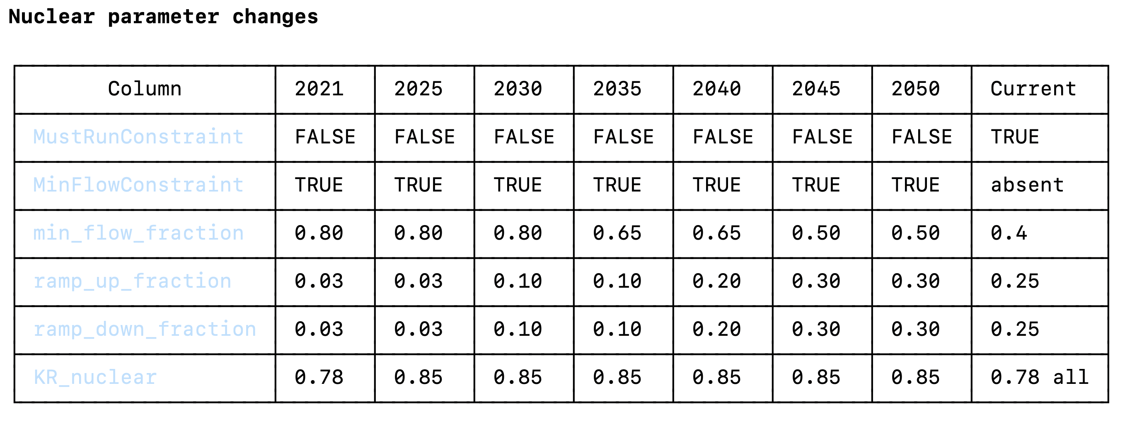
QUESTION 2
Nuclear
Notes:
▎ Second part. And I've partly answered this one myself since I made the slide.
▎ Nuclear is held at a fixed 85% of capacity. In MACRO, MustRun isn't a floor — it's an equality. So nuclear produces exactly the same amount in every hour of the year. It's a flat line. It can't go up and it can't come down.
▎ I was going to ask you what we should use instead. But Korean data mostly answers that.
▎ Korea already turns nuclear down. In early 2025 it happened twenty-one times at a single plant. The current operating floor is 80% of rated output, and KHNP's plan is to reach 50% by the early 2030s. The reactors are designed for it.
▎ So our model is more rigid than the real fleet is today — let alone in 2050.
▎ This table is what we'd change. Drop MustRun, switch MinFlow on, and let the floor come down over time. 80% now, 50% by the 2040s, following the policy path.
▎ Which puts us straight back on the last question. MinFlow is exactly the constraint that ran us out of memory.

Slide 9
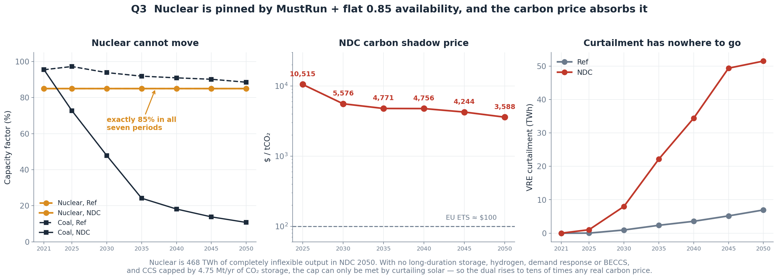
QUESTION 3
Nuclear is completely rigid, and the carbon price absorbs the consequence
What is the idiomatic way to represent near-baseload nuclear in MACRO? Drop MustRun for a low min_flow_fraction instead?
Notes:
▎ Third question, and it follows straight on.
▎ In 2050 nuclear can't move — and it's big. At three in the morning, nuclear alone is already producing more than the whole country needs. For about a third of the year, nuclear plus solar covers demand on their own.
▎ Nothing can absorb the surplus. Batteries are short. We have no long-duration storage, no hydrogen, no demand response. CCS is capped by how much CO₂ we can store.
▎ So to meet the carbon cap, the model builds more solar and throws most of it away. Fifty terawatt-hours a year.
▎ And the carbon price goes to several thousand dollars a tonne. Forty to a hundred times the EU ETS.

