Slide 1
MACRO-Korea: open technical questions
Provincial power-sector model · 17 provinces · 8,760 chronological hours · 2021–2050 myopic

Slide 2
Agenda
2021 Calibration issue - after changed the transmission
Capacity expansion and generation by tech – diagnosis
Renewable energy expansion rate
Unit commitment parameter
Carbon price

Slide 3
STATUS
Where the model is
Structure
Complete. 7 periods, 8,760 h, linear-relaxed UC, myopic, Gurobi barrier.
Solve
Ref 2.5 h · NDC 4.6 h on 24 cores / 192 GB. ~13.6M rows.
Transmission
99.1 GW network from NREL ITLs, calibrated to the KPX metro limit. Expands.
Base year
NOT calibrated. Coal 300 TWh vs 198 observed; gas 58 vs 167.
Staged fixes
Coal availability 0.65 · nuclear 0.85→0.78 · 2021 gas retirement blocked.

Slide 4
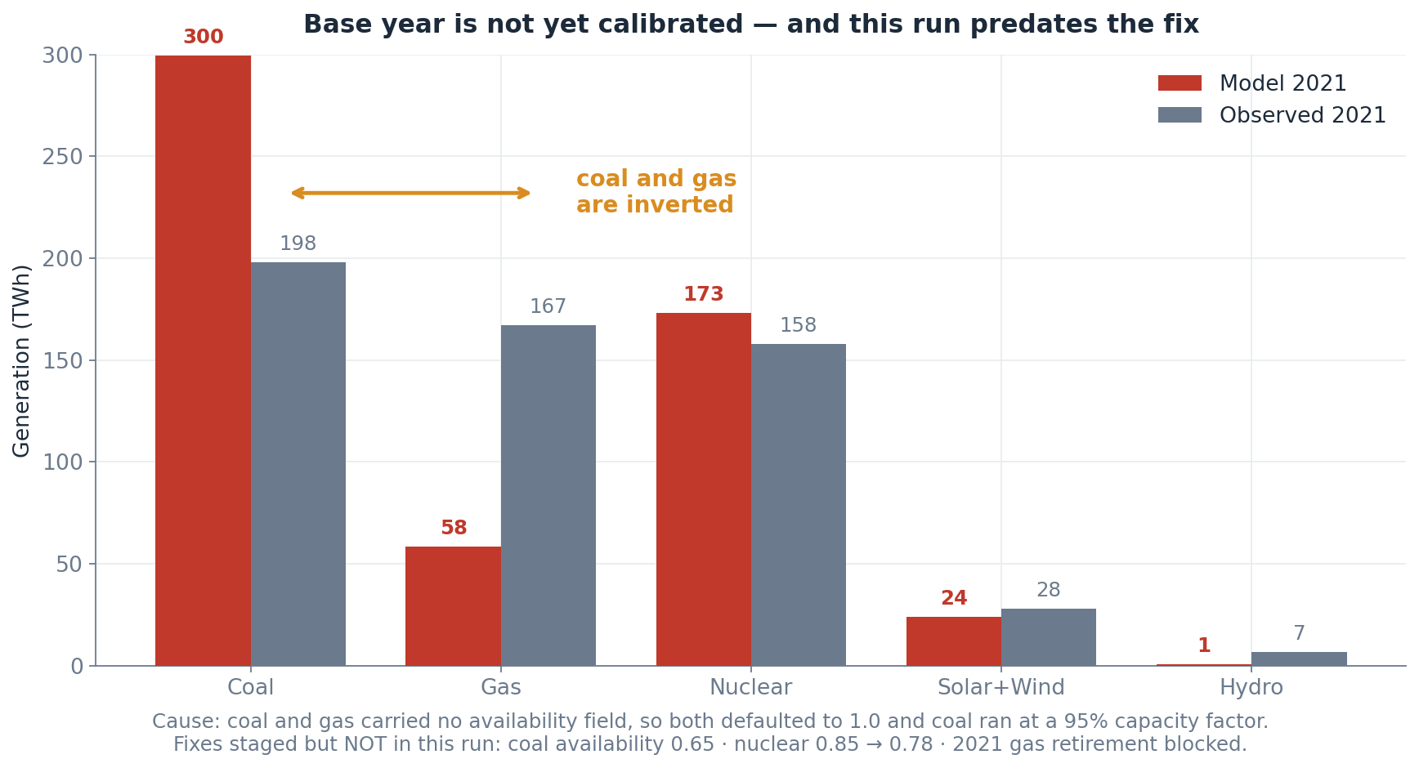
CONTEXT
The results you are about to see predate the base-year fix
Flagged so the known gap is not re-diagnosed. Fixes are staged, not yet run.

Slide 5
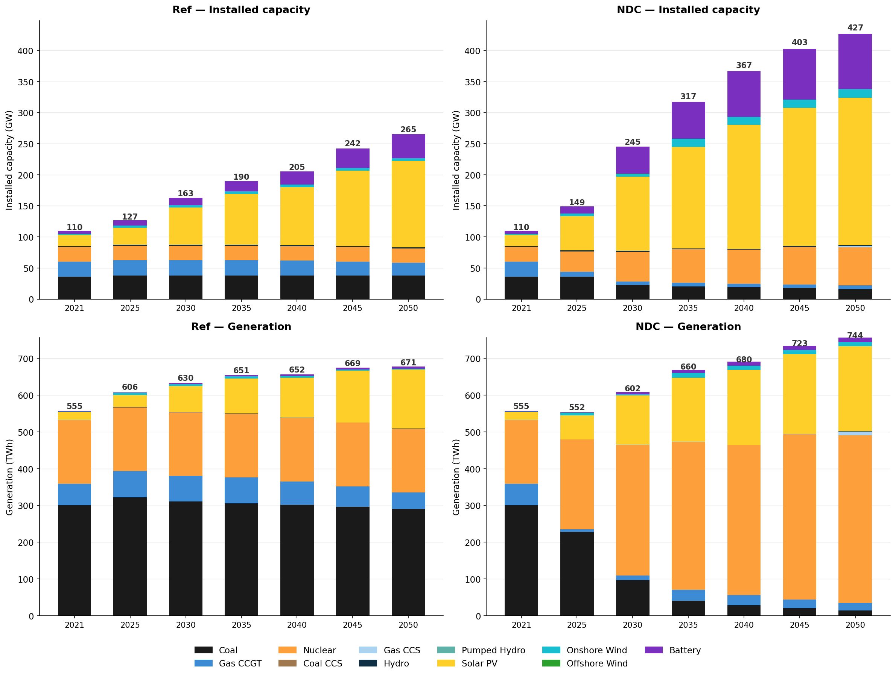
CONTEXT

Slide 6
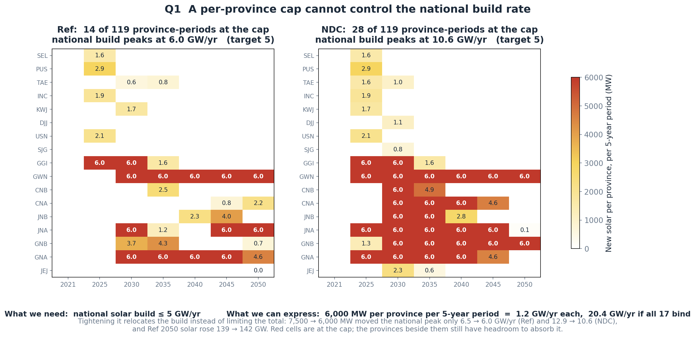
QUESTION 1 · HIGHEST PRIORITY
MaxNewCapacityConstraint is per-asset, so we cannot cap a national build rate
We need ≤ 5 GW/yr nationally. The only lever is 6,000 MW per province per period. Is a grouped MaxNewCapacityConstraint available upstream?
Notes:
We capped each province at 6 GW per five-year period. The national total came out at 6 GW per year. Same number, but one is a per-province input and the other is a national result.

Slide 7
QUESTION 2
MinFlowConstraint on all five thermal technologies ran us out of memory
Rows, MinFlow on coal + gas CCGT only
13.60 M
Rows, MinFlow on all five
14.05 M
Added by three technologies
≈ 450,000 rows
Outcome at 128 GB
killed — two jobs
Current state
off for nuclear, coal CCS, gas CCS; mem raised to 192 GB
min_flow_fraction values are still in the CSVs for those three technologies but the constraint is not declared.
Is that row growth expected? Is there a cheaper MinFlow formulation under relaxed UC — and are the undeclared min_flow_fraction values truly inert?

Slide 8
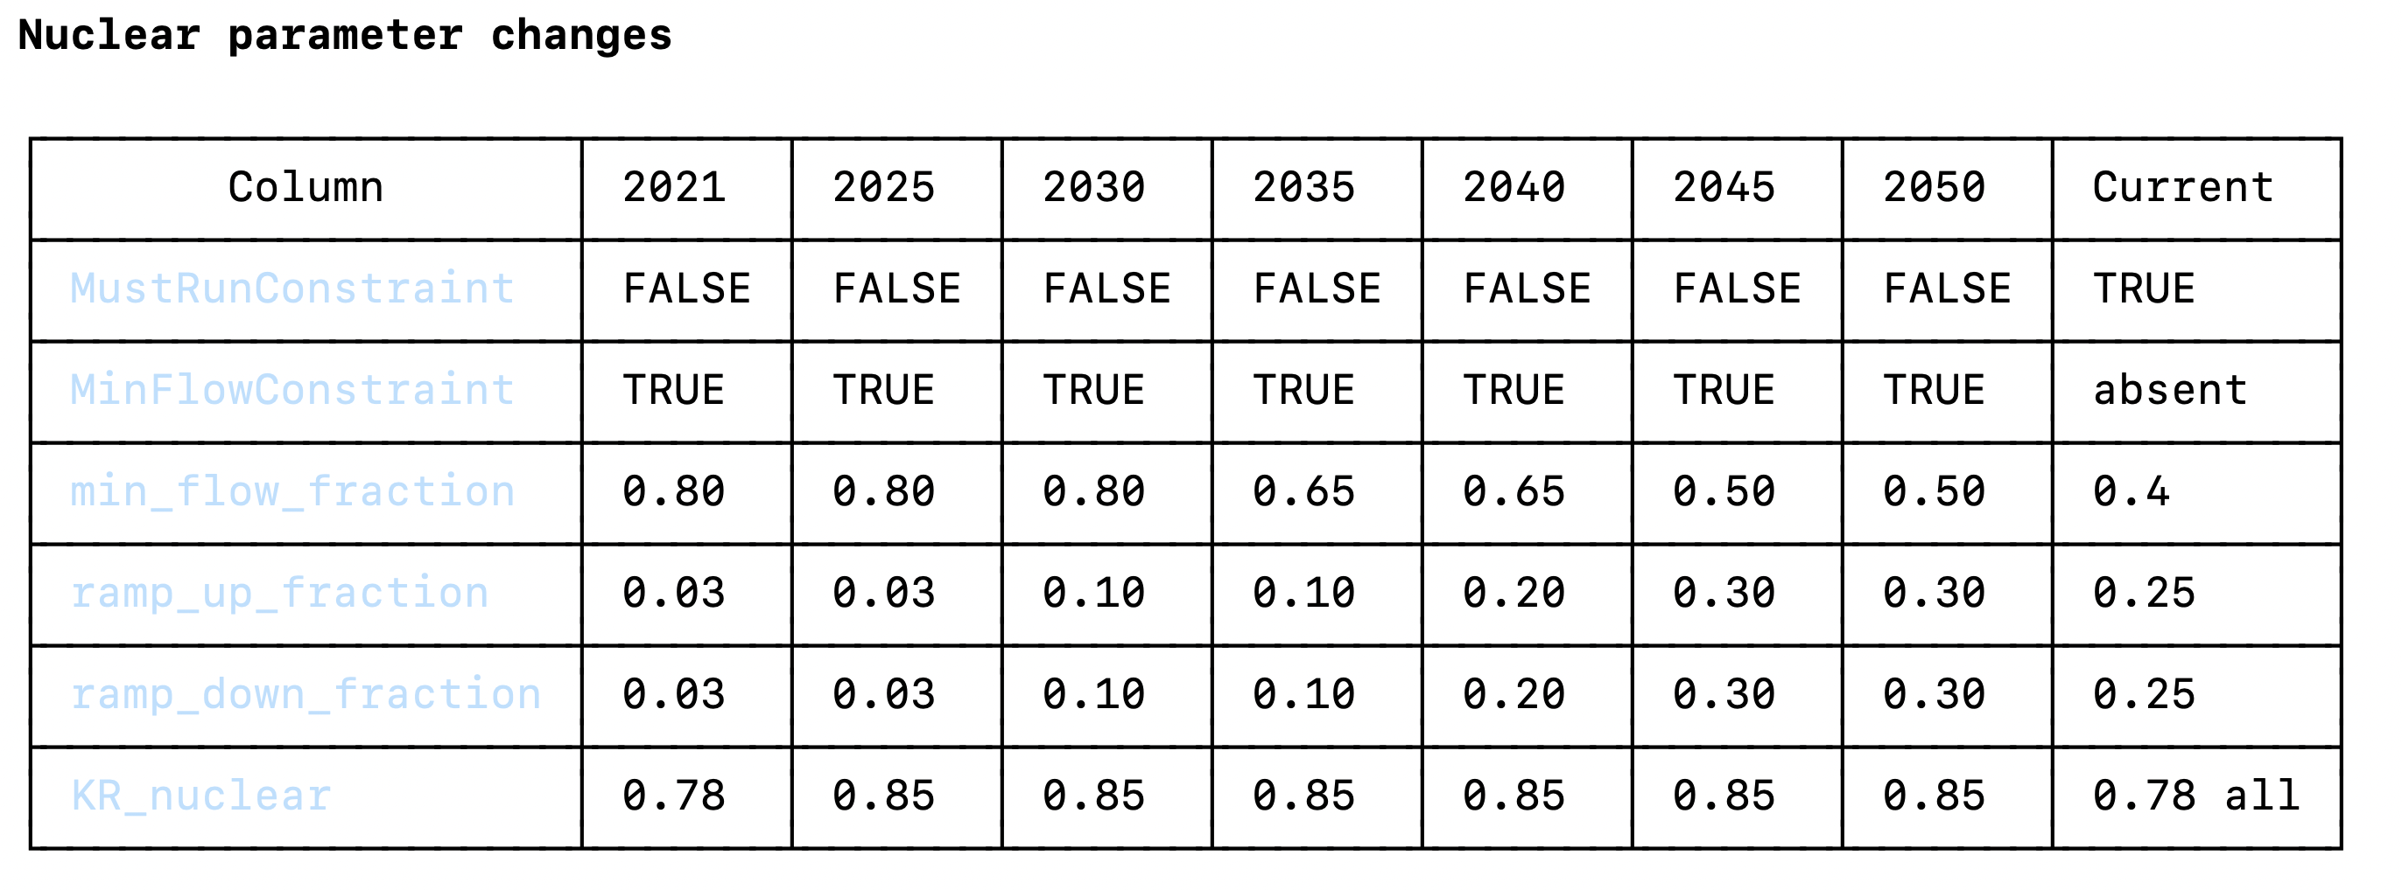
QUESTION 2
Nuclear

Slide 9
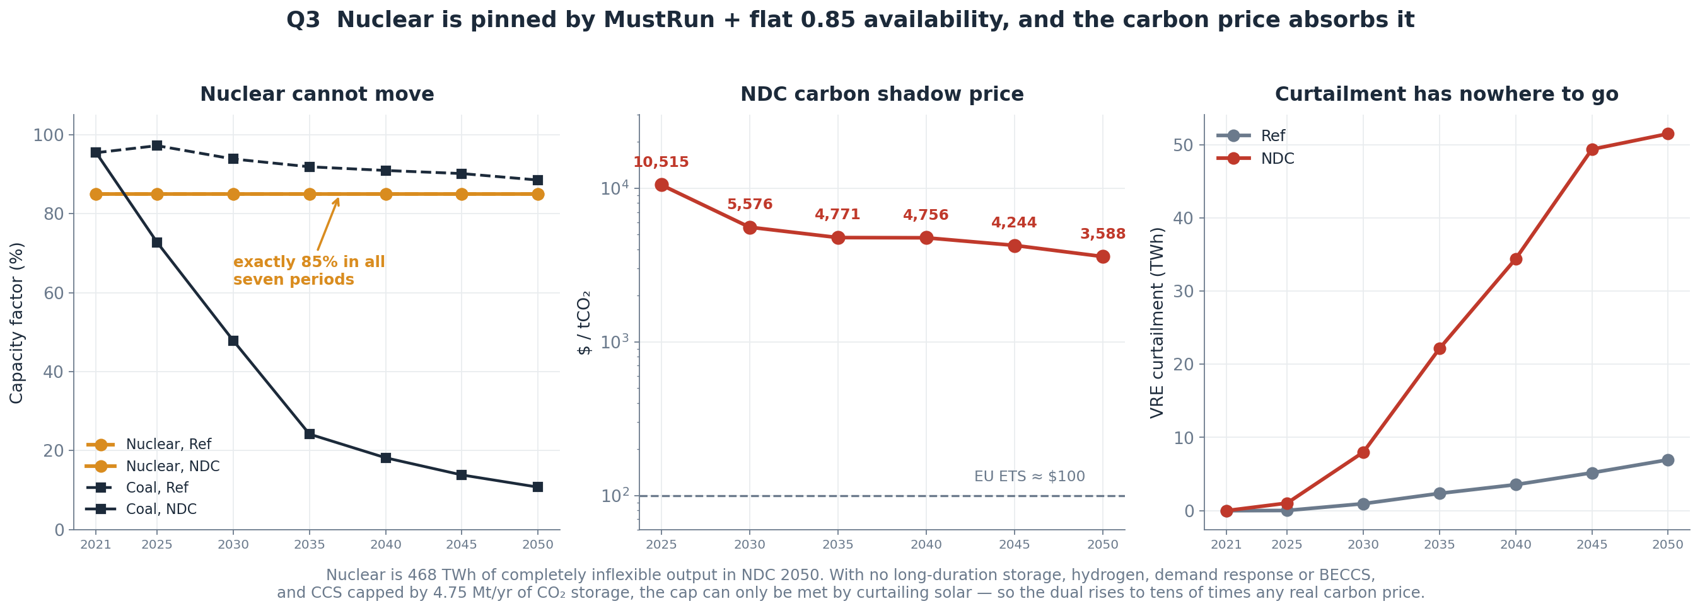
QUESTION 3
Nuclear is completely rigid, and the carbon price absorbs the consequence
What is the idiomatic way to represent near-baseload nuclear in MACRO? Drop MustRun for a low min_flow_fraction instead?
Notes:
Nuclear is held at a fixed 85% in every hour of every year — MustRun makes it an equality, not a floor. It can't move when solar floods the grid, so the model curtails 51 terawatt-hours and the carbon price goes to several thousand dollars. Korea actually curtails nuclear today and KHNP is targeting a 50% minimum by the 2030s, so we're modelling it as less flexible than it already is. We'll replace MustRun with a declining minimum-output floor.

Slide 10
SUMMARY
What we are asking for
1
Grouped MaxNewCapacityConstraint
unblocks every build-rate limit we need
2
A cheaper MinFlow formulation
or confirmation that 450k rows is simply the cost

