Slide 1
Verilog Netlist Enhancer
Developed by: Hany Moussa and Ramez Moussa

Slide 2
Programming language
Throughout the development of this project, python was used.
There exists various supporting libraries that helped in the process of parsing the liberty
The idea of representing a netlist as a graph (a dictionary of lists) and using other complex data structures (dictionary of dictionaries) are easily and best programmed using python

Slide 3
Design - graph
In this project, we represented the netlist as a Directed Acyclic Graph (DAG)
Using pyhton, this was implemented as a dictionary of lists, called graph
An instance in the dictionary is accessed by the instance name (BUFX4_6 for example)
Each instance accesses a number of lists that give data about all the instances our cell is connected to (including which pin) and the delay to all the fanout cells

Slide 4
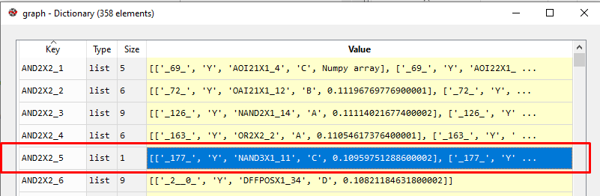
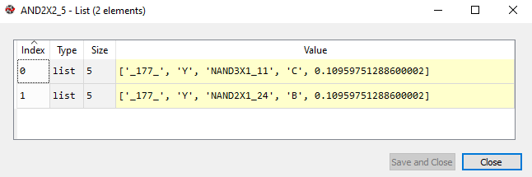
Design - graph

Slide 5
Design - graph
The previous slide shows an illustration of the graph data structure that was implemented
The example shows an instantiated cell called AND2X2_5
This cell has a fanout of 2 and its pin ‘Y’ is connected using wire _177_ to pin ‘C’ in NAND3X1_11 and pin ‘B’ in NAND2X1_24

Slide 6
Design - instancesDict
InstancesDict is a data structure for all the netlist details for all the instantiated cells
It is implemented as a dictionary of dictionaries
InstancesDict is accessed using the instance name
It provides information about the cell type (i.e. AND2X2, OR2X2, etc…), all the pins in a cell and the wires connected to each one of them

Slide 7
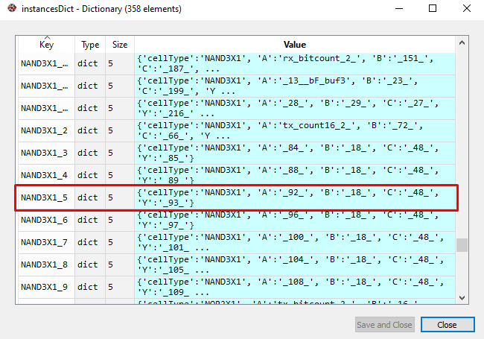
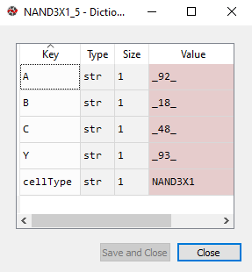
Design - instancesDict

Slide 8
Design - instancesDict
The previous slide shows an illustration of the instancesDict data structure that was implemented
The example shows an instantiated cell called NAND3X1_5
This cell is of type ‘NAND3X1’ and it has 4 pins: ‘A’ is connected to the wire _92_ , ‘B’ is connected to the wire _18_ , ‘C’ is connected to the wire _48_ , and ‘Y’ is connected to the wire _93_

Slide 9
Design - wires
Wires is a data structure that stores information about all the wires in the netlist
It is implemented as a dictionary of lists
The details of a wire are accessed by the wire name
An instance in the wires dictionary gives details regarding the source and destination cells of this wire and the pins they are connected to

Slide 10
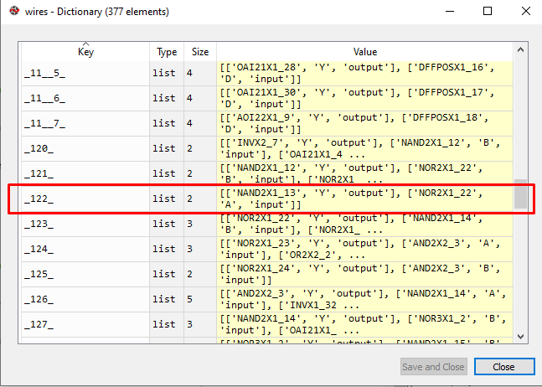
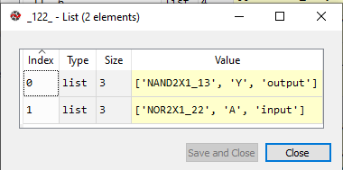
Design - wires

Slide 11
Design - wires
The previous slide shows an illustration of the wires data structure that was implemented
The example shows a wire named _122_
The source of this wire is pin ‘Y’ in the cell called NAND2X1_13 and the destination is pin ‘A’ in the cell called NOR2X1_22
Please note that there could be multiple destinations (lists that are labelled ‘input’) but there’s always only one source (lists that are labelled ‘output’)
‘Input’ simply means that this wire is an input to that cell (the wire’s destination
‘Output’ simply means that this wire is the output of that cell (the wire’s source)

Slide 12
Design - Library
The data structure containing the liberty file wasn’t internally designed
The liberty-file-parser: pypi/libertyparser was used
It parses the whole liberty file in such a way that allows the extraction of data easily

Slide 13
Implementation
The following section would provide a brief description of the functions used in the project and the task of each function

Slide 14
Implementation - parseNetlist
a function that takes a file name for a gatelevel netlist and parses it
it initializes the instances dictionary with all the instances created (accessed by instance name)
each entry in the instantiations dictionary has all the pins of the cell and the wires connected to them
it also initializes the wires dictionary
the wires dictionary is accessed using the wire name and gives information about all the cells it is connected to and whether it is the cell's output or input
finaly it stores the upper section of the gatelevel netlist so that it is printed later to the final .v file

Slide 15
Implementation - getPinCapacitance
This function gets the capacitance of a given pin in a cell
It uses the liberty file to access the desired cell
Then, it uses the specified pin name to return its capacitance

Slide 16
Implementation - getColumnDelay
get the column from the characterization table containing the delay of a cell
We use the second column in the table (as we are assuming the input transition to have the middle value, for simplicity)

Slide 17
Implementation - displayAsAnInstantiation
Display a cell from the instances dictionary as an instantiation
It uses the same format of the gatelevel netlist
This function is used to output the optimized verilog netlist when the optimization process is over

Slide 18
Implementation - getDelay
This function takes the capacitance array and the delays array
Based on the given inputs, it interpolates/extrapolates to obtain the delay corresponding to a target capacitance
The function uses the ‘scipy.interpolate.interp1d’ function
Interpolation in only 1 dimension is used as an input transition is assumed for all the cells

Slide 19
Implementation - getTotalDelay
This cell iterates over all the cells (using the graph) and sums the delays of all the cells
Please note that the delay of a cell is only considered once even if it has a fanout larger than 1. Only the maximum value is considered

Slide 20
Implementation - printNumberOfCellsOfEachType
This function counts the number of cells of each type and prints them
It simply iterates over all the instances in the instancesDict and keeps count of how many times a cellType (such as ‘AND2X2’) has been used

Slide 21
Implementation - constructGraph
This function uses the wires list to construct the graph
While doing so, it takes into consideration the fanout of each cell in order to calculate the delays of the cell
The delay of a cell to another cell in the path is represented using an edge in the graph

Slide 22
Implementation - fixByCloningSingle
This function solves the violation of a single high fanout cell using cloning
It assigns up to the maximum legal fanout to each cell and clone until all the fanouts have been divided between the clones in such a way that none of them cause violations
However, in doing so, adding clones undoubtedly increases the fanout of the previous cells driving the current cell
That being said, the function is only concerned with the current cell so no checking for violations caused is necessary

Slide 23
Implementation - fixByCloning
This function solves the violation of a single high fanout cell using cloning
It assigns up to the maximum legal fanout to each cell and clone until all the fanouts have been divided between the clones in such a way that none of them cause violations
In doing so, adding clones undoubtedly increases the fanout of the previous cells driving the current cell
Unlike fixByCloningSingle, this function is recursively called to fix any violations it might have caused

Slide 24
Implementation - removeViolationsByCloning
This is the generalized function that removes violation via cloning
It simply loops over all cells using the graph data structure and calls the fixByCloning function to fix individual violations (if exists)

Slide 25
Implementation - fixByBuffering
A function that fixes the fanout of a single cell by adding buffers
It creates a specific number of buffers in such a way that the fanout of the current cell could be divided between them equally causing no violations
Then, the function checks if the number of buffers added exceeds the maximum legal fanout.
If so, the function is recursively called to fix any violations it might have caused

Slide 26
Implementation - removeViolationsByBuffering
This is the generalized function that removes violation by adding buffers
It simply loops over all cells using the graph data structure and calls the fixByBuffering function to fix individual violations (if exists)

Slide 27
Implementation
constructAndDisplay: constructs the graph and displays the number of cells of each type
getCurrentMaxFanOut: gets the maximum fanout in a given netlist
writeToFile: writes the current netlist (potentially optimized) to a the OptimizedNetlist.v file
displayGraph: displays all the nodes in our graph (cells) and the edges (connections between cells) and their direction, weight, and related pins
displayMenu: display the main menu with all the options to allow the user pick their desired operation
reopenMenu: ask the user if they want to reopen the menu or terminate the program

Slide 28
Implementation
updateSizing: a function that uses a bruteforce algorithm to try to size every single cell and check the new delay. If it gets improved, then keep the new size. Else, return the cell to its original size.
replaceCell: a function that replaces a specific instance with a different size. It is used to replace the small cells with larger sizes.
updateWire: a function that updates a wire by replacing the old instance name by the new one

Slide 29
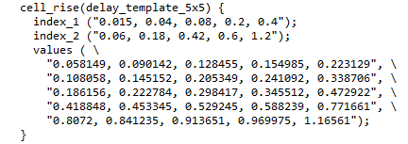
Technical Background - calculation of the delay
The delay is calculated as follows:
Obtain the load capacitance based on the capacitances of the pins of the fanouts
Using the NLDM, interpolate/extrapolate to obtain the value of the delay given a value for the capacitance
This is interpolation/extrapolation in 1 dimension (1D) as the input transition is assumed to always have the second value

Slide 30

Technical Background/Algorithms - Buffering
For buffering, a naive algorithm is used
Simply, loop over all the cells in the netlist and check for violations
When a violation is encountered, the number of buffers (nBuffers) to be used is obtained by the following equation

Slide 31
Technical Background/Algorithms - Buffering
Start assigning the specified max fanout amount to each buffer of the assigned ones
In the last buffer, assign only the remaining fanouts to as it might be less than the specified maximum fanout (the case if the fanout before optimization is not divisible by the number of buffers used
After buffering, check if the number of buffers used (nBuffers) exceeds the maximum specified fanout, recursively call the function to solve this issue
The result is a buffer tree

Slide 32
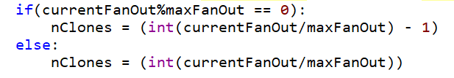
Technical Background/Algorithms - Cloning (recursive)
For the recursive cloning function, a slightly more complex algorithm is used
Similar to the buffering algorithm, loop over all the cells in the netlist and check for violations
When a violation is encountered, the number of clones of the cell (nClones) to be used is obtained by the following equation

Slide 33
Technical Background/Algorithms - Cloning (recursive)
Start assigning the specified max fanout amount to the current cell as well as each clone
In the last clone, assign only the remaining fanouts to as it might be less than the specified maximum fanout (the case if the fanout before optimization is not divisible by the number of clones used
After cloning, a check on the fanouts of all the inputs of the current cell must be made
If the fanout of any of the inputs to our cell (after adding the clones) exceeds the maximum specified fanout, recursively call the function with those cells to solve this issue
This might result in an exponential amount of recursive calls

Slide 34
Technical Background/Algorithms - Cloning (iterative)
This version for cloning could be used in other cases
As mentioned earlier, the recursive cloning function has a very large amount of nested recursive calls which might lead to a ‘maximum recursion depth’ in python
Alternatively, an iterative version is implemented
The algorithm is as follows:
Loop while the cell the with highest fanout doesn’t exceed the specified maximum fanout
Apply cloning to the cell with the highest fanout
This is a purely greedy approach that is relatively inefficient
Additionally, this greedy approach only allows obtaining a local minima and therefore, sometimes, the absolute minimum fanout for the graph might not be achieved

Slide 35
Technical Background/Algorithms - Sizing
A greedy bruteforce algorithm was used for the reduction of the delay by sizing
The algorithm utilizes the idea of ‘hill climbing’
Starting from the first instance in the instances dictionary:
Check if the cell has a higher fanout than the one specified by the user; if so:
Replace the cell with a higher size
Calculate the new total delay
If the delay is shorter than the previous delay:
If so: keep the change
Else: reverse the change
Else: go to the next cell

Slide 36
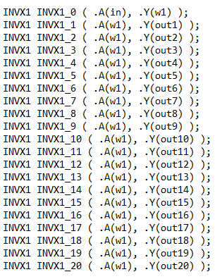
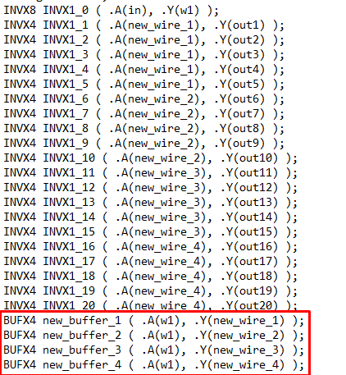
Example: buffering and sizing a high fanout cell

Slide 37
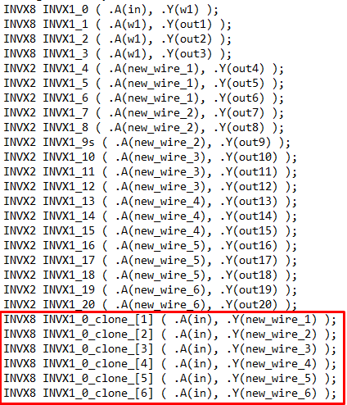
Example: cloning and sizing a high fanout cell

