Slide 1


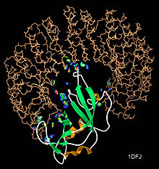
Protein-Protein Interaction Detection: Methods and Analysis
February 06, 2023
Biological Network
Aya Amr|Hanya Ahmed
Mahmoud Rabea|Mostafa Mahmoud

Slide 2
Contents
Introduction
Methods
Analysis

Slide 3
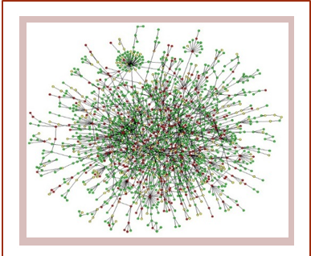
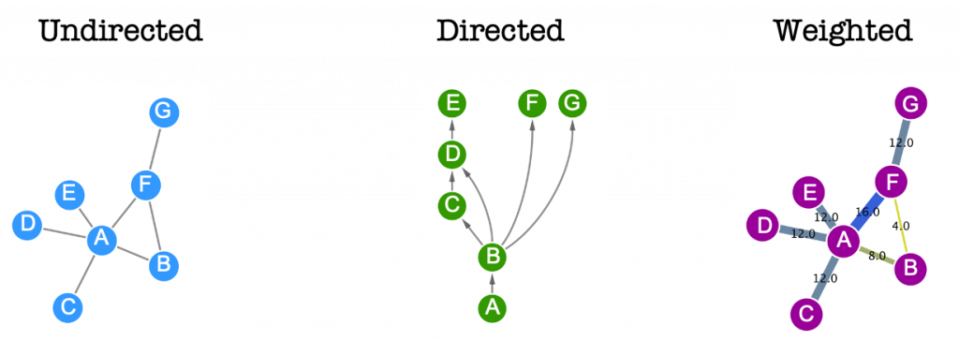
Introduction
What are biological networks?
Biological networks are considered an efficient way to represent different interactions and relations between various biological entities mostly represented using graphs.
Graphs :

Slide 4




Methods
This project was mainly implemented using the following python packages:
NetworkX : the main package to study, organize and manipulate biological networks
Pandas : For reading and handling given data
Matplotlib : for visualization and plotting
Numpy : for computations
Unipressed: Python client for the Uniprot API

Slide 5
Analysis
Our project can be divided into 7 main points
Visualize and save the weighted graph for the given dataset
Then save the first 100 proteins of highest degree centrality

Slide 6
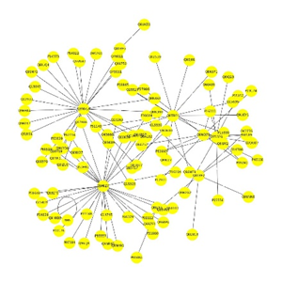
Using 200 nodes

Slide 7
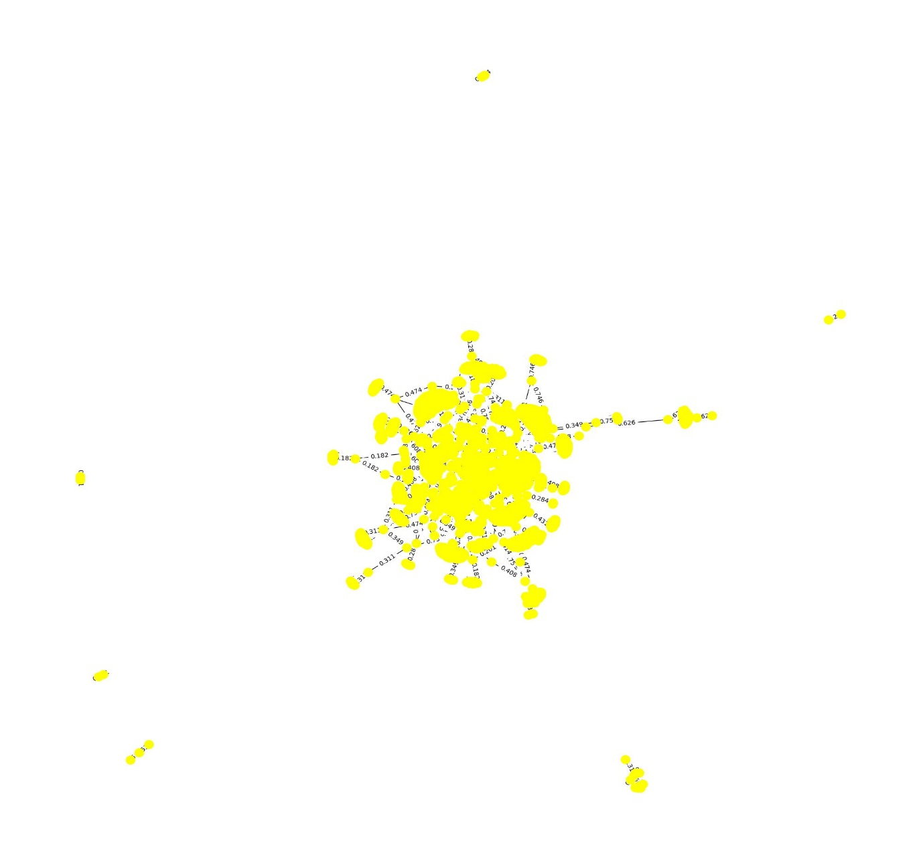
Using 2500 nodes

Slide 8

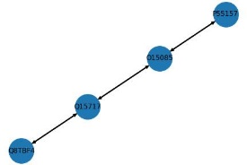

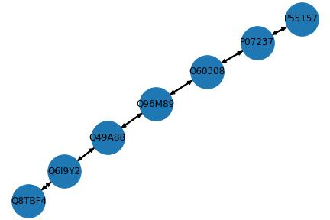
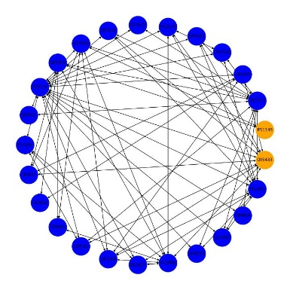
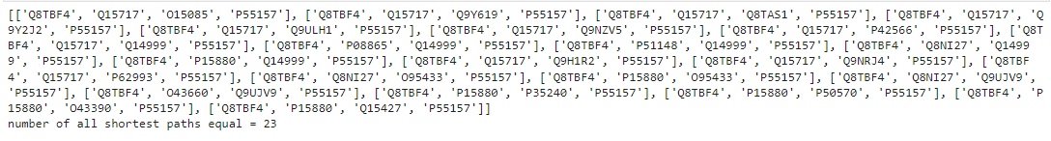
2. Given two proteins(‘Q8TBF4’ , ‘P55157’)
Then Calculate:
Unweighted shortest path
Weighted shortest path
All shortest paths

Slide 9
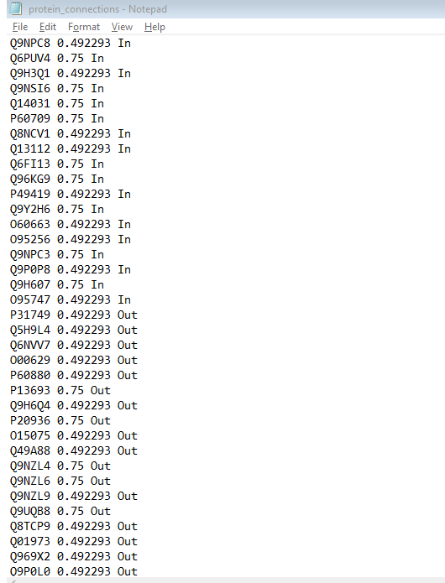
3. Picking a protein ["P05067"] then listing all the directly connected proteins to it, each
connection corresponding weight and saving them to a text file
The number of total connection is 4170
In degree: 2083
Out degree: 2087

Slide 10
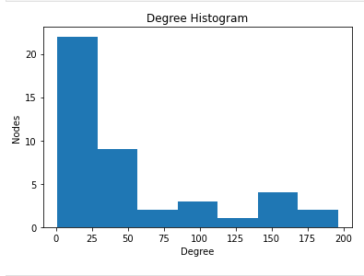
4. Given a set of proteins(from 1 to 2500)
Draw a histogram for the protein degree

Slide 11
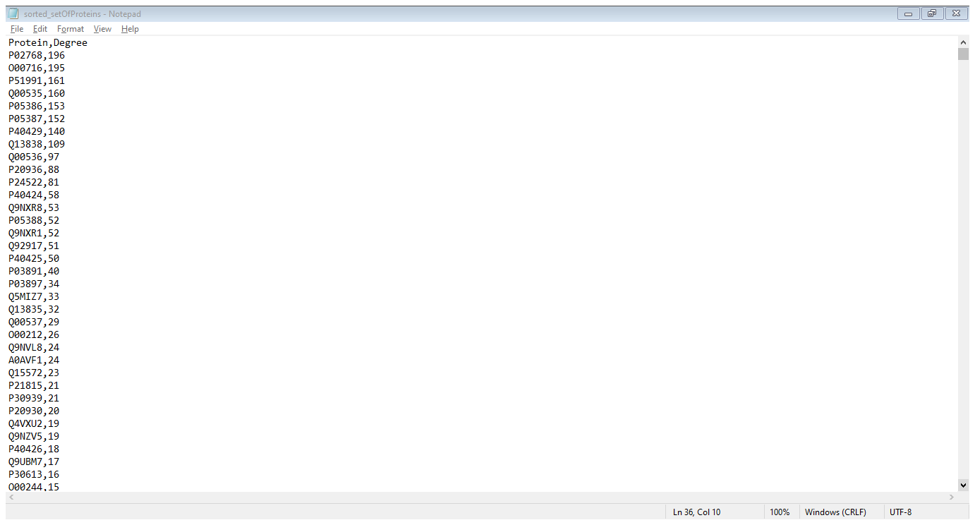
Rank these proteins from the highly connected to the least in a text file, where each line is a protein and its corresponding degree.

Slide 12
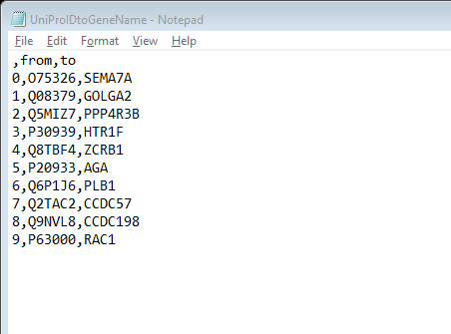
5. Convert the Protein’s UniProtID to its corresponding gene name using unipressed
and save the results in a text file.
Given one protein ['Q6UXB4’] converted to : ['CLEC4G‘]
Given a set of proteins , they are converted then saved in text file.

Slide 13
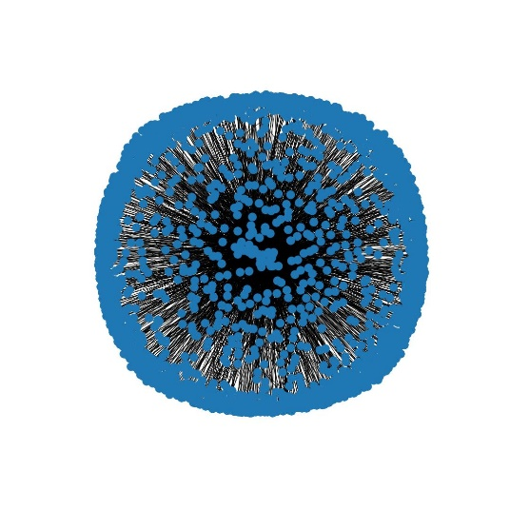
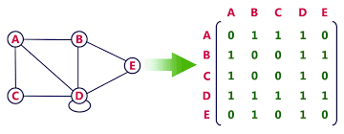
6. Convert the Weighted graph of the given data into Unweighted graph
and save it using adjacency matrix as .txt
Unweighted graph
Adjacency matrix

Slide 14
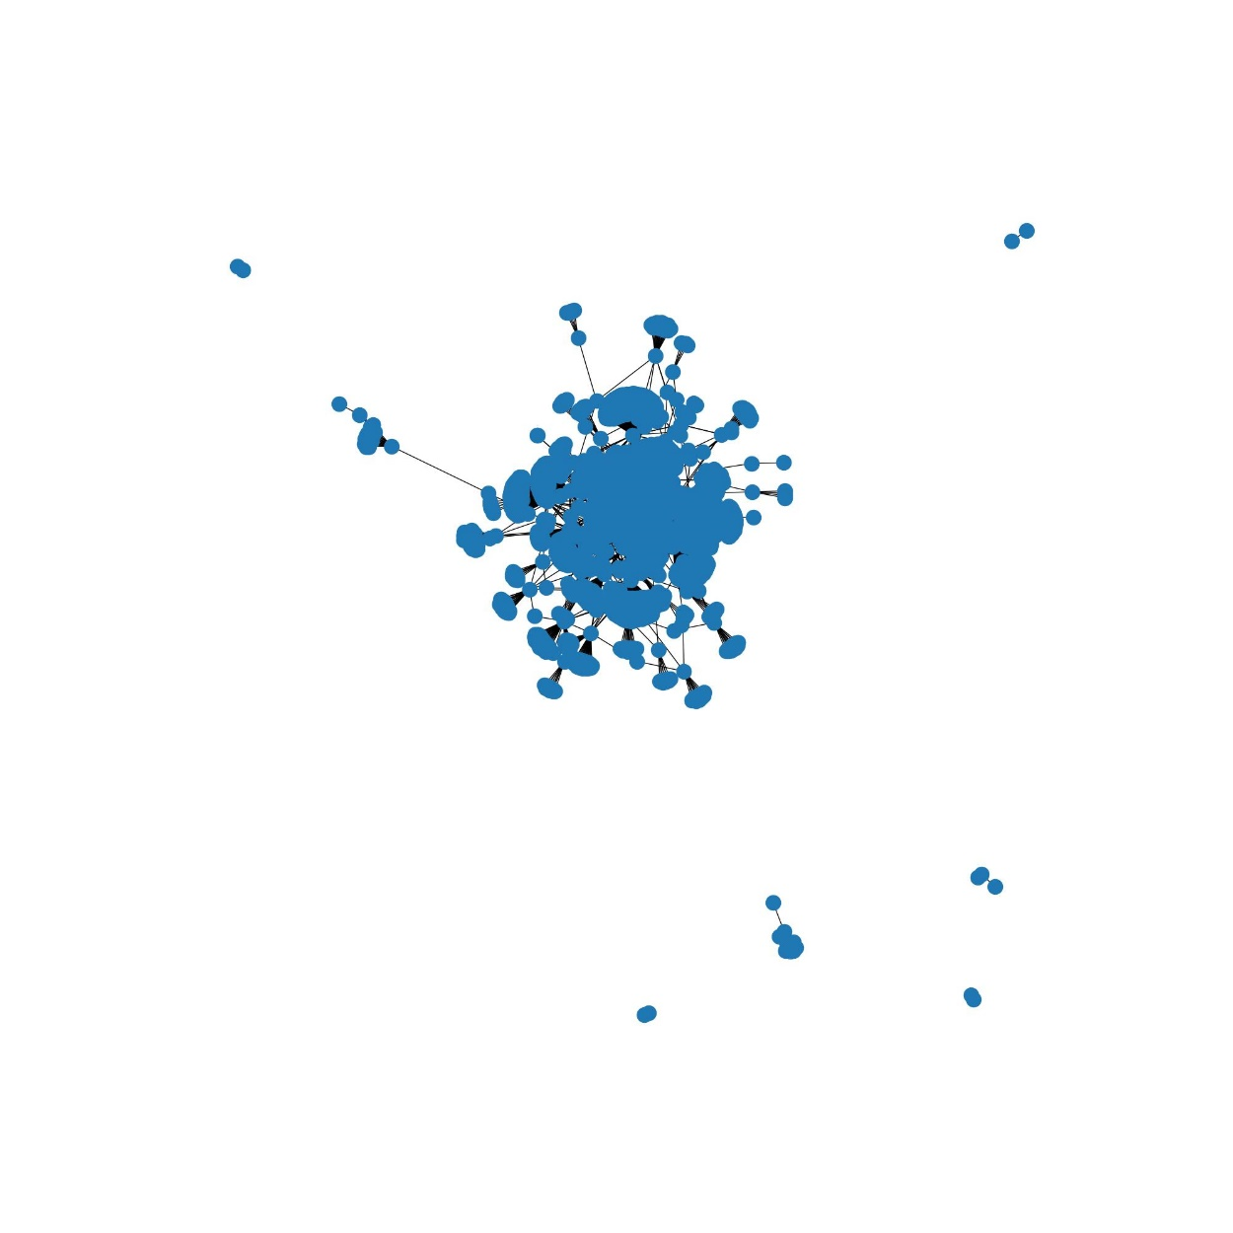
Unweighted graph using only 2500 node:

Slide 15
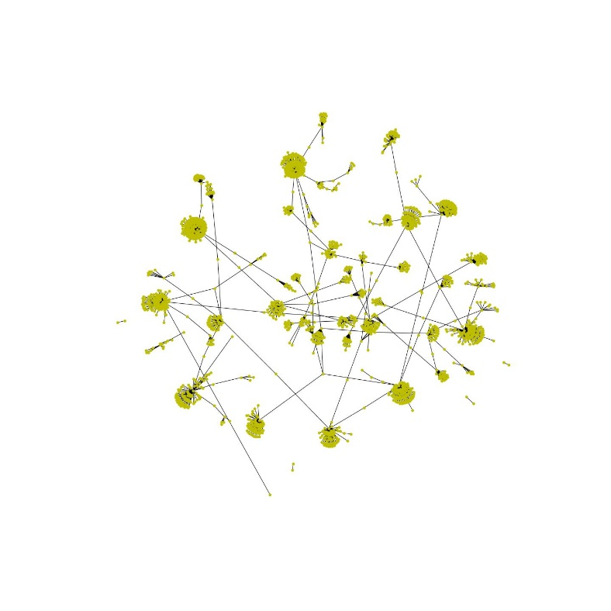
7. Create and save the minimum spanning tree of the given data using
NetworkX and Matplotlib.
MST represents all unique acyclic shortest paths

Slide 16
THANKS!

