Slide 1


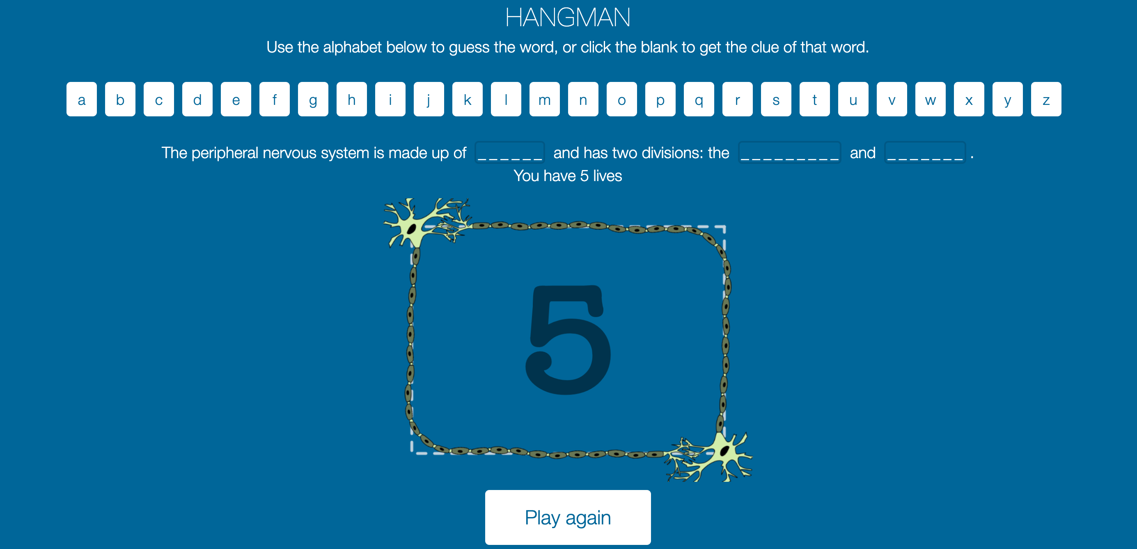
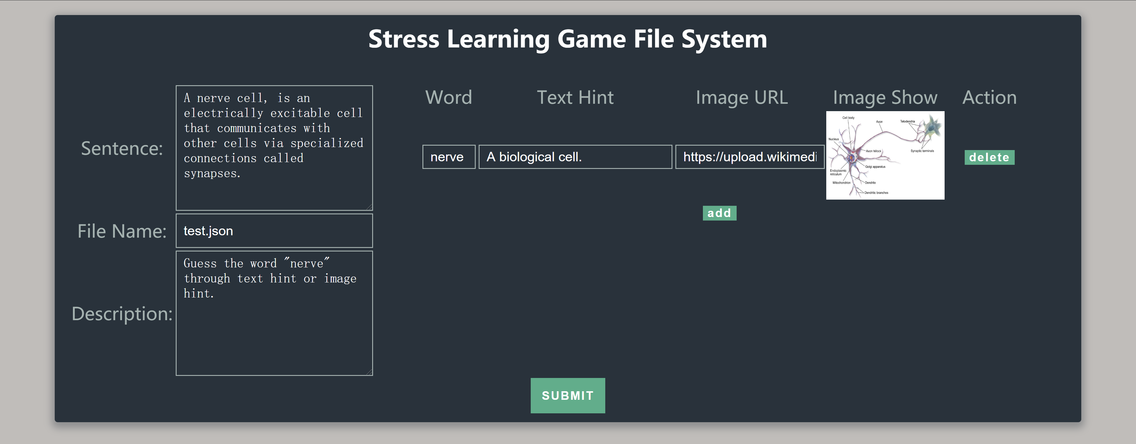
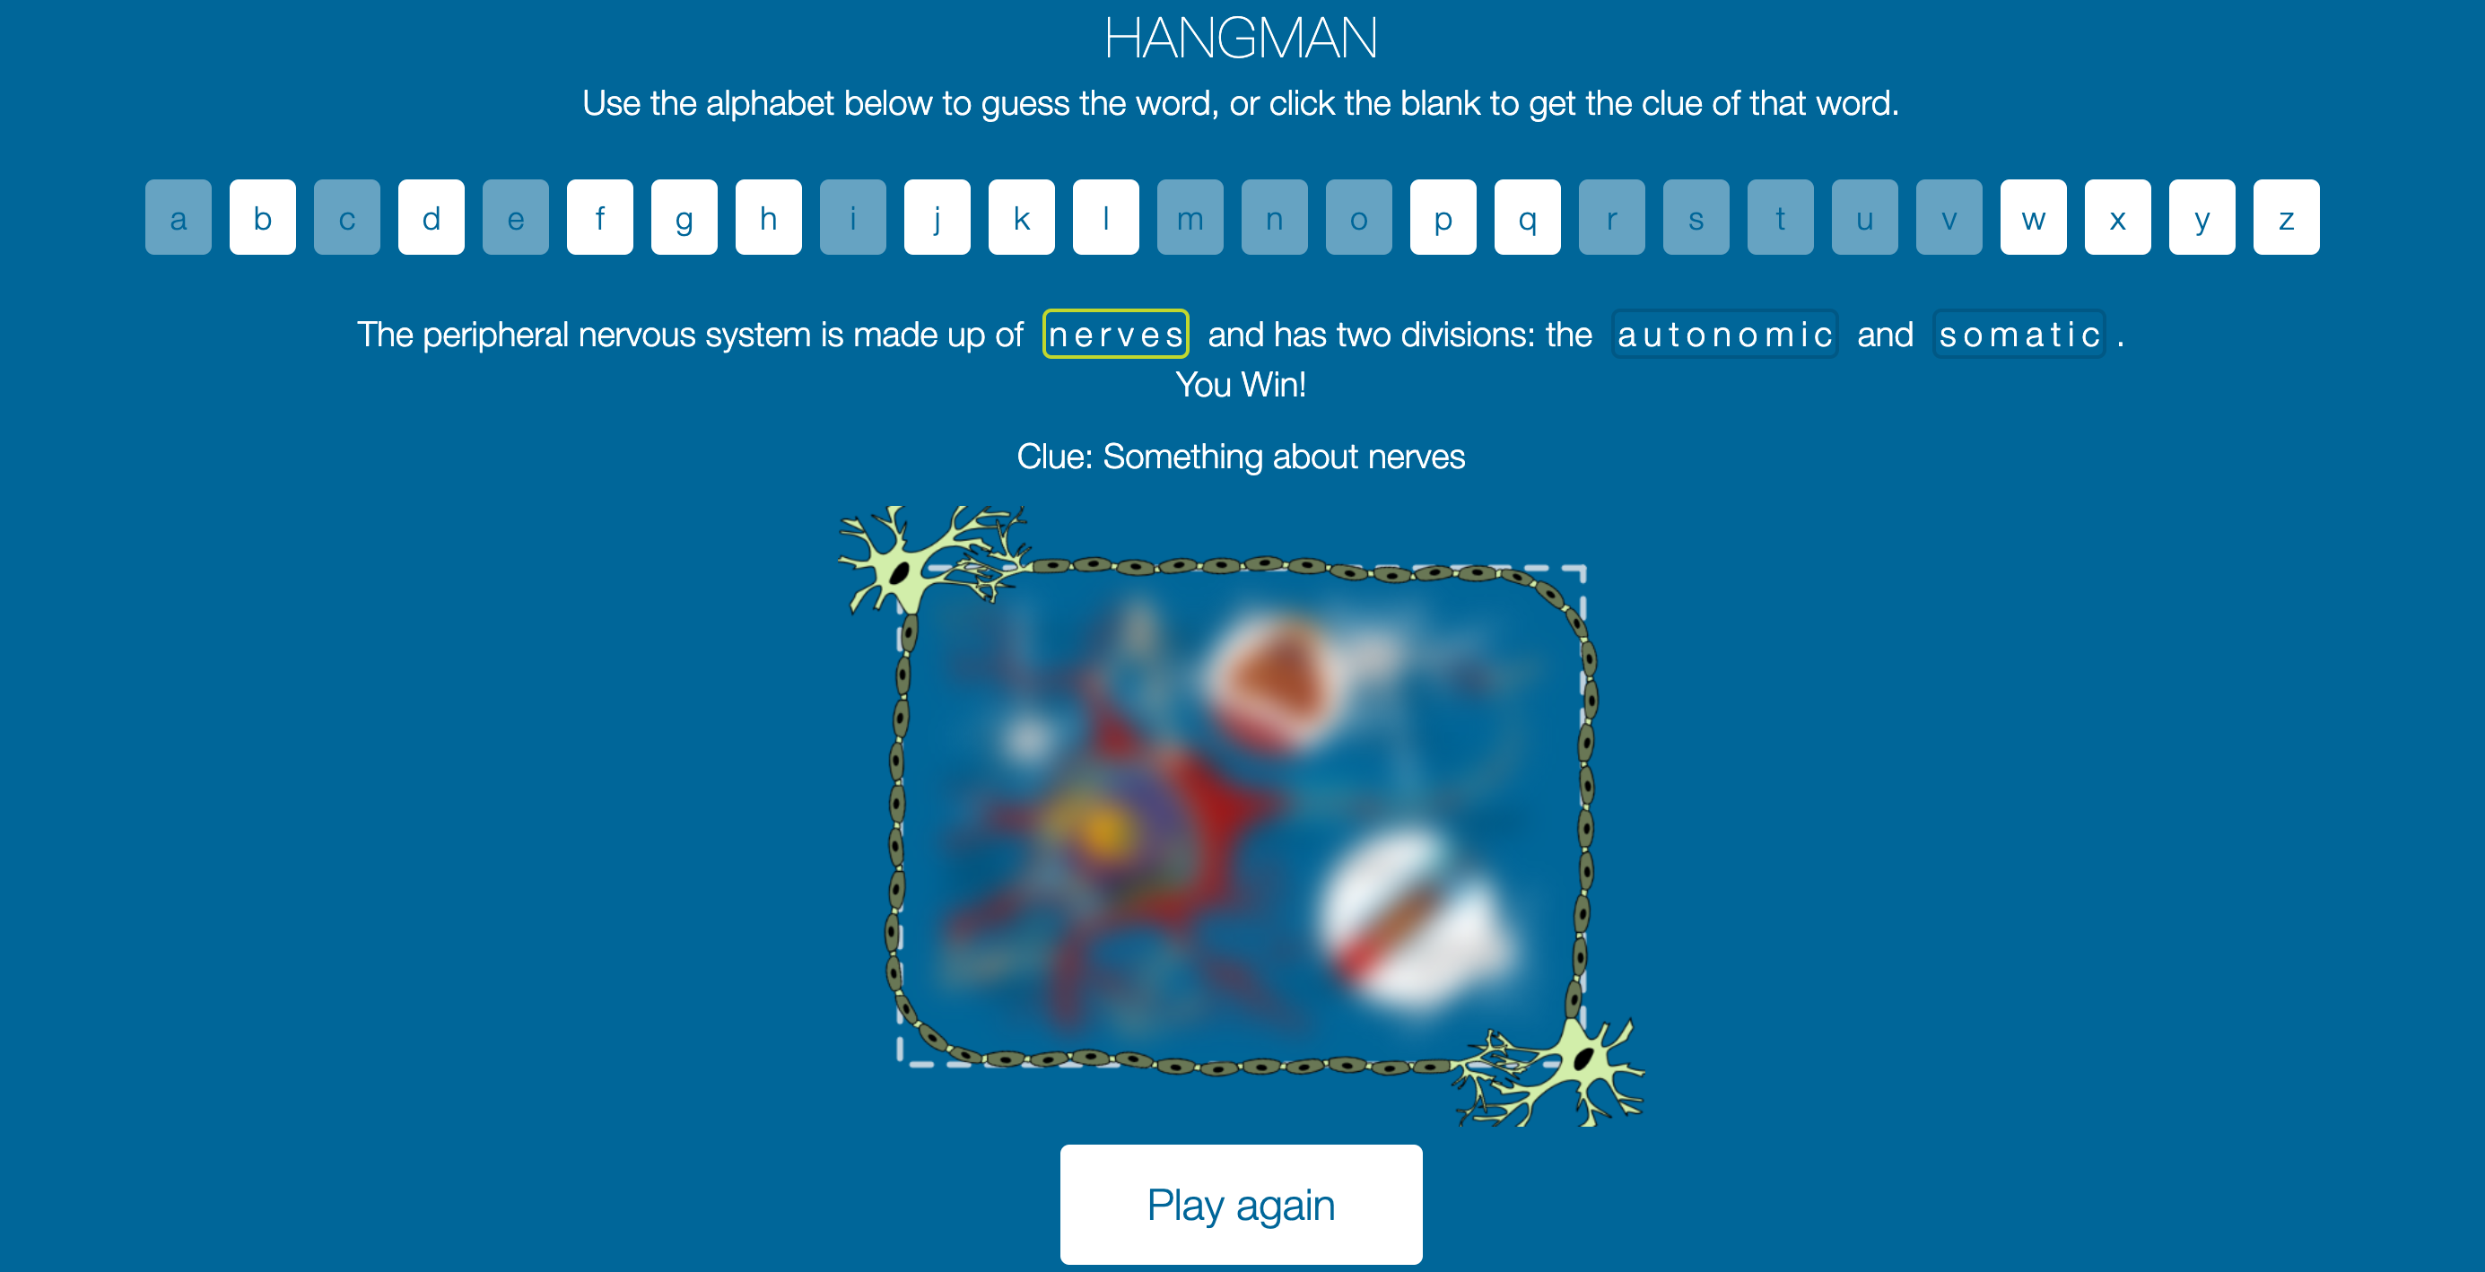
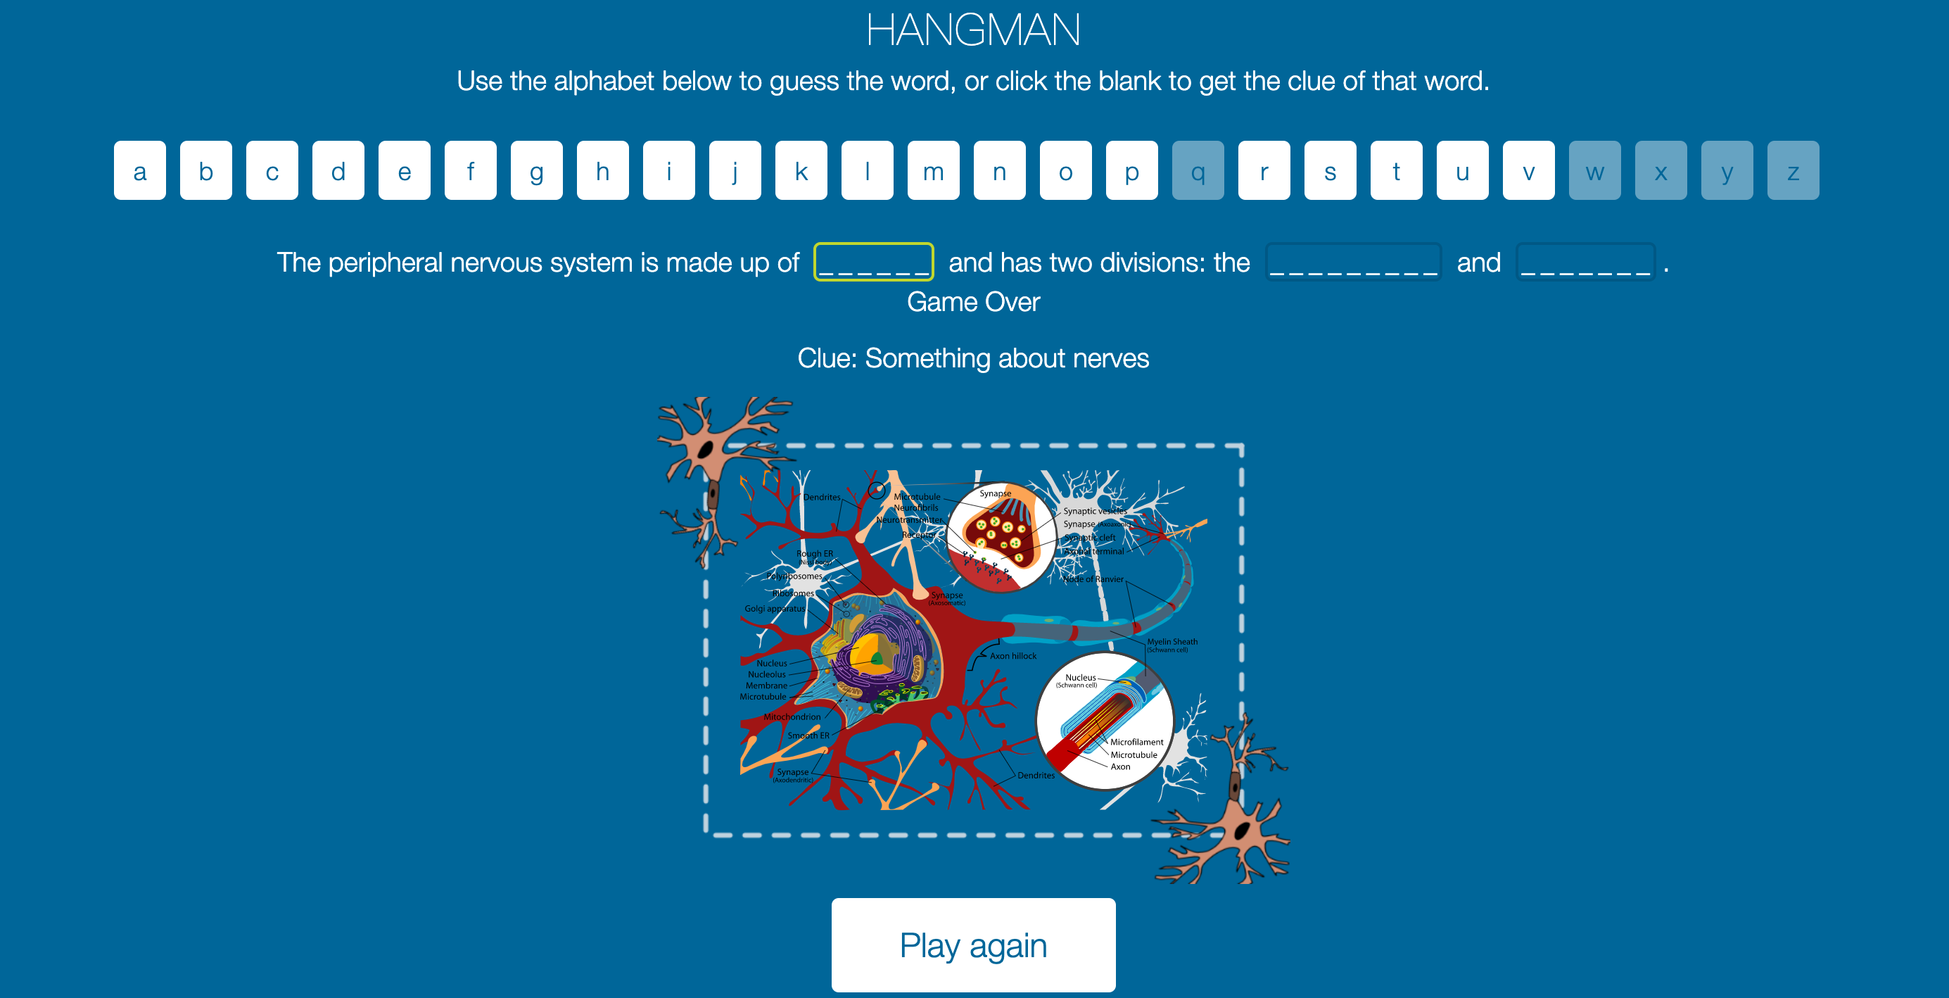
Stress Learning Game
Hanyang Li, Ping Lu, Xin Hu, Zhiyu Yan, Chaoyang Zhu, Mufeng Xie, Yipeng Lu
Dept. of Electrical and Computer Engineering, Texas A&M University
Introduction
Configuration Format
Designed to reinforce learning of stress concepts for middle school students.
Construct a file system for customers to customize the content of game they want.
Improve game experience of old version Hangman game by increasing gameplay and visual effects.
{
"sentence": "The whole sentence with hidden words",
"words": [
"word 1",
"word 2",
"word 3"
],
"hints": {
"word 1": {
"text hints": "Something about word 1",
"img hints": "http://some-website.png"
},
"word 2": {
"text hints": "Something about word 2",
"img hints": "images/picture.png"
},
"word 3": {
"text hints": "Something about word 3",
"img hints": "None"
}
},
"description": "The remark of this file"
}
Overall Flow
Customized content
Configuration generating system
Word guessing game
User
File system of Hangman Game
User Interface of Config Generating System
The file system of Hangman game is made up of the files and folders:
index.html: the web page of Hangman game.
configs: the directory to store the configuration files
images: the directory to store default images and customer’s images
css: the directory to store style sheets.
js: the directory to store JavaScript files, including game running logic.
Generate customized configuration file for stress learning game in an easy human-computer interaction. The configuration will be stored in a JSON file, which contains sentence, description, word, text hint, image URL.
Default helper texts are shown in text boxes when none input.
After setting image URL, a preview of image will be shown in box in order to help users check whether they choose the correct image.
Click “add” or “delete” to operate the question table, if client wants to add more word guess or remove some word.
Click “SUBMIT” to generate JSON file.
User Interface of Hangman Game
Running Logic of Hangman Game
Making Bad Guesses
Making Good Guesses
Lose lives.
The axons of neuron cells will become shorter.
The color of neuron cells will turn from light green to dark red.
The image hint will be more clear.
Lose the game when waste all the lives before figure out all the letters.
The letter will replace the place holders.
The image hint will still be obscure.
Win the game when figure out all the letters and have remain lives.

