Slide 1
Lab1
1. Set up Msys2
2. Set up gcc...
2. Set up git
3. Set up ssh

Slide 2
lab1
You can find some basic information here:
https://docs.google.com/document/d/13XWxOB7zRbyFEvSzqYYplheBXOztr9bL0jW6bjkPgG4/edit#

Slide 3
Set up Msys2
url: https://www.msys2.org/
(please install in the default path)

Slide 4
Set up gcc...
Open msys2
pacman -S mingw-w64-x86_64-gcc
pacman -S mingw-w64-x86_64-gdb
pacman -S mingw-w64-x86_64-make
pacman -S mingw-w64-x86_64-emacs
add environment variable
Mac : xcode-select --install

Slide 5
Set up ssh
Mac: https://www.atlassian.com/git/tutorials/install-git
Windows: pacman -S git
create a github account

Slide 6
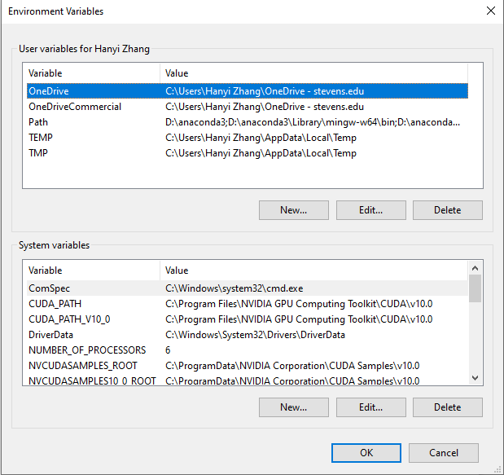
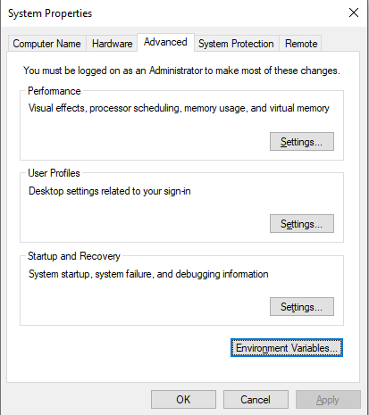
Add environment variable

Slide 7
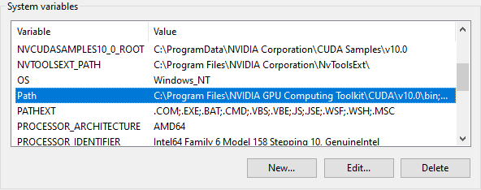
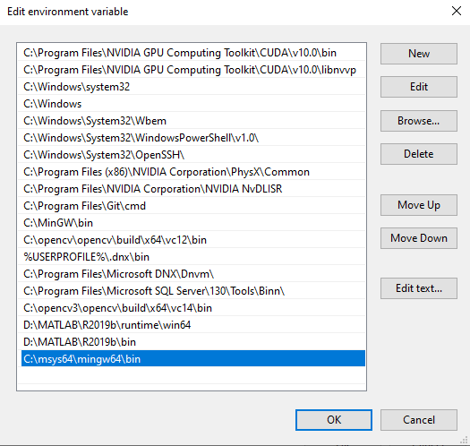
Add environment variable

Slide 8
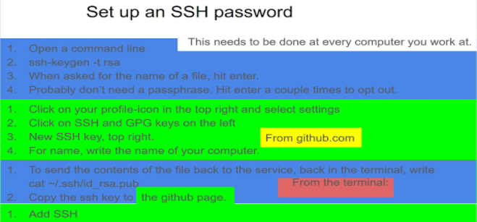
Set up ssh

Slide 9
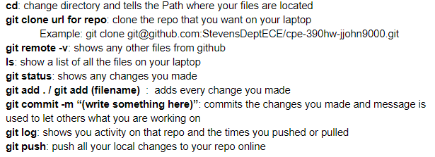
Edit document in github repo
some basic command

Slide 10
Edit document in github repo
git clone git@github.com:HanyiZhang/2020Fall-Lab-A.git
ls
cd 2020....
emacs contri....
edit it
save
git add contri....
git commit -m “...”
git push

Slide 11
Edit document in github repo
error?
use “git pull”
RE-EDIT

Slide 12
Tell me your github account
https://docs.google.com/spreadsheets/d/17Hn9xoXAnyif7ByNylQPcGuJH7FJhFiQu1nfiUV0J_A/edit?usp=sharing

Slide 13
Set up vs-code
https://code.visualstudio.com/download

Slide 14
Thank you!

