Slide 1


COVID-MAP
By Chengyuan Cai, Hanyu Liu
lin

Slide 2
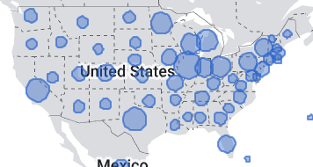
Background, Problem, and Significance
The Covid19 outbreak threatens the health and wellbeing of people around the world:
59.3 M total cases
1.4 M death
Covid19 symptoms
Fever, breathing problem, body aches
Traveling during Covid19 outbreak can be stressful and dangerous
We want to write a program that could help us find a safe and efficient path to travel across US

Slide 3

Approach
We were inspired by the pacman game
a
Create a graph with locations as nodes, and the path between them as edges
The cost of each edge needs to take in account of both the distance between 2 locations and the risk of contact patients with Covid-19
need Covid19 data (Covid-19 cases per 100k) for each state/county
need the position data for each state/county
a
Find the shortest path (Dijkstra’s algorithm)

Slide 4

Difficulties
At first we wanted to find the safest path, but it would be a fixed solution
Many users also value traveling speed, not just safety
We came up with a solution where the user can input their desired weight for safety and directness
Difficulty in finding data that gives all possible edges between 2 positions
State-level data is more available
We were able to find the neighboring states of each state. This serves as edges

Slide 5
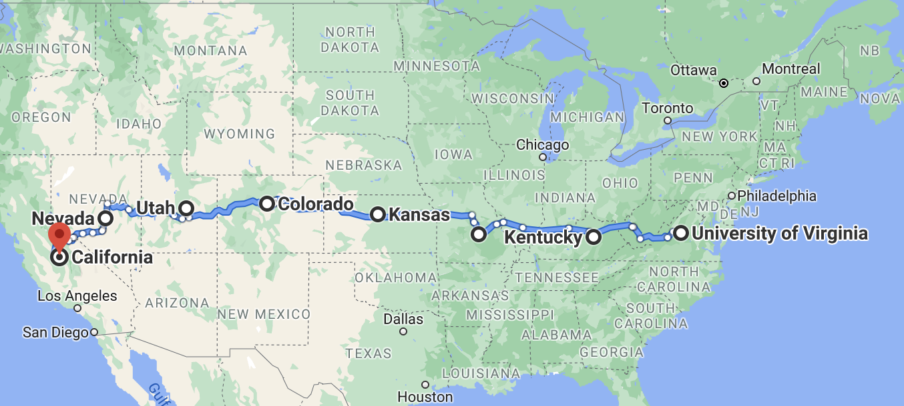
Sample Run, from VA to CA, fastest

Slide 6
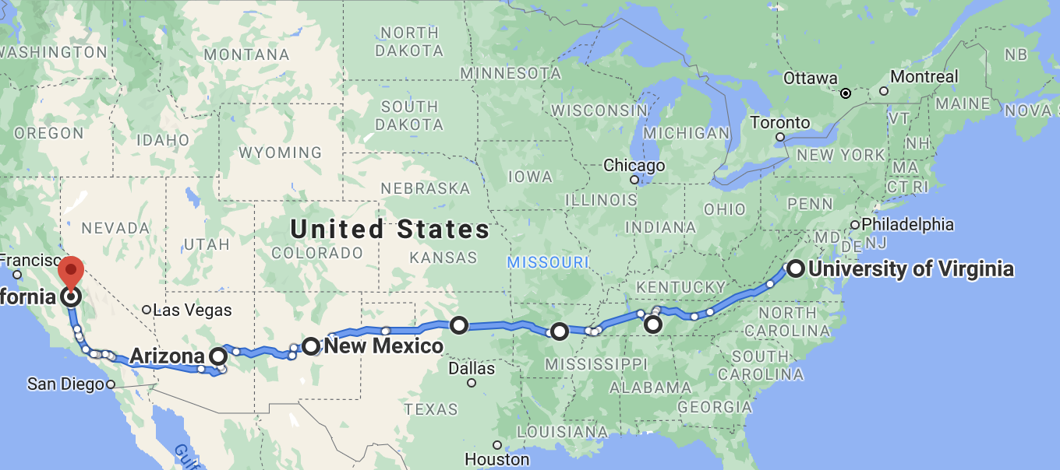
Sample Run, from VA to CA, leveraged

Slide 7
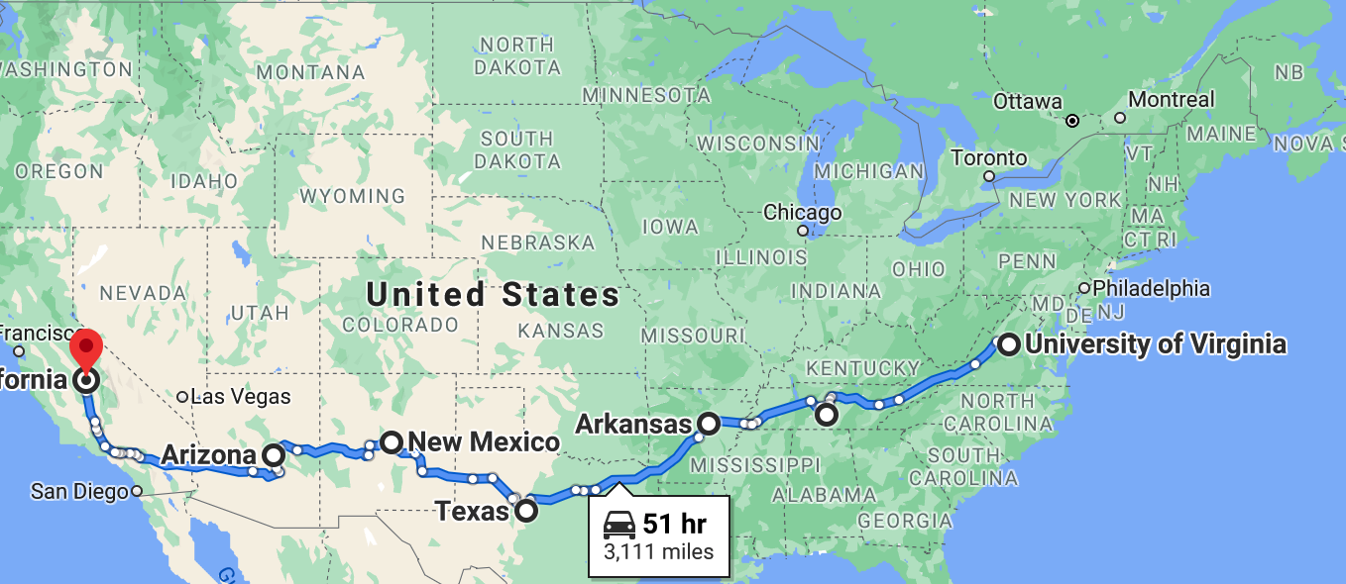
Sample Run, from VA to CA, safest

Slide 8
Future Works
Increase the precision of the program so it can find desired paths based on covid number of counties instead of states.
Find a dataset with information regards to neighboring counties
Also need covid data in county level
Implement different searching algorithms
BFS, DFS, A* Search…..
We can also apply this program globally to help air travelers.
Many air travellers face the decision to balance cost, time, and covid cases. We can create a similar program help them balance all three.
Applicable for many other problems as long as we have sufficient data
for example, if a person with pollen allergies goes on a road trip and wants to avoid areas with high pollen density.

