Slide 1
DSN 2026 | 17-minute presentation draft
LymphNode
Default-deny DNN
A plug-and-play access control method for deep neural networks
Unauthorized
neutralized utility
Goal: protect deployed DNNs before theft, not only prove ownership after theft.
Core idea: default-deny inference with feature-space credentials and sparse adversarial neutralization.
Authorized
clean fidelity
Feature-space checkpoint
GSUAP active by default; credential triggers antidote.
LymphNode | DSN 2026

Slide 2
Talk Structure
02
1
2
3
4
Problem
Prior Work
Design
Evidence
Why edge deployment creates oracle access
Watermarking, locking, output poisoning
Feature-domain credential + GSUAP
Neutralization, overhead, attacks, robustness
Suggested timing: 5 min background, 4 min design, 7 min evidence, 1 min close.
LymphNode | DSN 2026

Slide 3
Why This Problem Matters
03
Deployment pressure
Security consequence
Models are high-value IP.
Healthcare, finance, and edge deployments often cannot rely on remote APIs.
On-device or on-premise inference improves latency and data locality.
Adversaries can query the model at high volume.
Black-box outputs can leak decision behavior.
A copied model can avoid licensing and enable downstream attacks.
cloud API
edge model
attacker
LymphNode | DSN 2026

Slide 4
Threat: Oracle Access Enables Model Theft
04
Queries
Adversary
Victim DNN
Stolen / inverted model
Outputs
Model extraction: train a substitute from query-response pairs.
Model inversion: use outputs to reconstruct sensitive training information.
Edge deployment removes practical rate limits and server-side query filtering.
Sources: Tramer et al., USENIX Security 2016; Orekondy et al., CVPR 2019; Fredrikson et al., CCS 2015
LymphNode | DSN 2026

Slide 5
Related Work: Three Defense Families
05
Passive provenance
Model locking
Output poisoning
Watermarks / fingerprints verify ownership after theft.
Cryptographic or structural authorization gates model utility.
Perturb predictions to make stolen surrogates worse.
Gap: does not prevent unauthorized execution.
Gap: retraining, data access, or high runtime cost.
Gap: assumes cloud-side interposition layer.
LymphNode | DSN 2026

Slide 6
Where Existing Active Defenses Struggle
06
Method type
Original data
Retrain
Post-hoc
Edge fit
Deep-Lock / crypto
No
No
Yes
High latency
SSAT / ActiveGuard
Often yes
Yes
No
Setup heavy
AdvParams
No
No
Yes
Parameter keying
PP / CIP
No
No
API layer
Cloud-oriented
LymphNode
No or tiny
No
Yes
Constant cost
Positioning: LymphNode aims for active prevention without original-data dependence, retraining, or per-query server logic.
LymphNode | DSN 2026

Slide 7
Contribution in One Sentence
07
LymphNode turns a trained DNN into a default-deny model: unauthorized inputs hit a sparse feature-space perturbation, while authorized inputs carry a hidden credential that cancels the perturbation.
Post-hoc
Data-efficient
Feature-space
Active defense
Low overhead
LymphNode | DSN 2026

Slide 8
Threat Model and Deployment Roles
08
Model owner
Edge operator
Trains model, builds LymphNode plugin, issues keys
Deploys protected model in trusted runtime
Secure out-of-band key distribution; oracle-only attacker.
Authorized user
Adversary
Submits input with feature-domain credential
Has architecture knowledge and oracle queries, but no key or feature access
LymphNode | DSN 2026

Slide 9
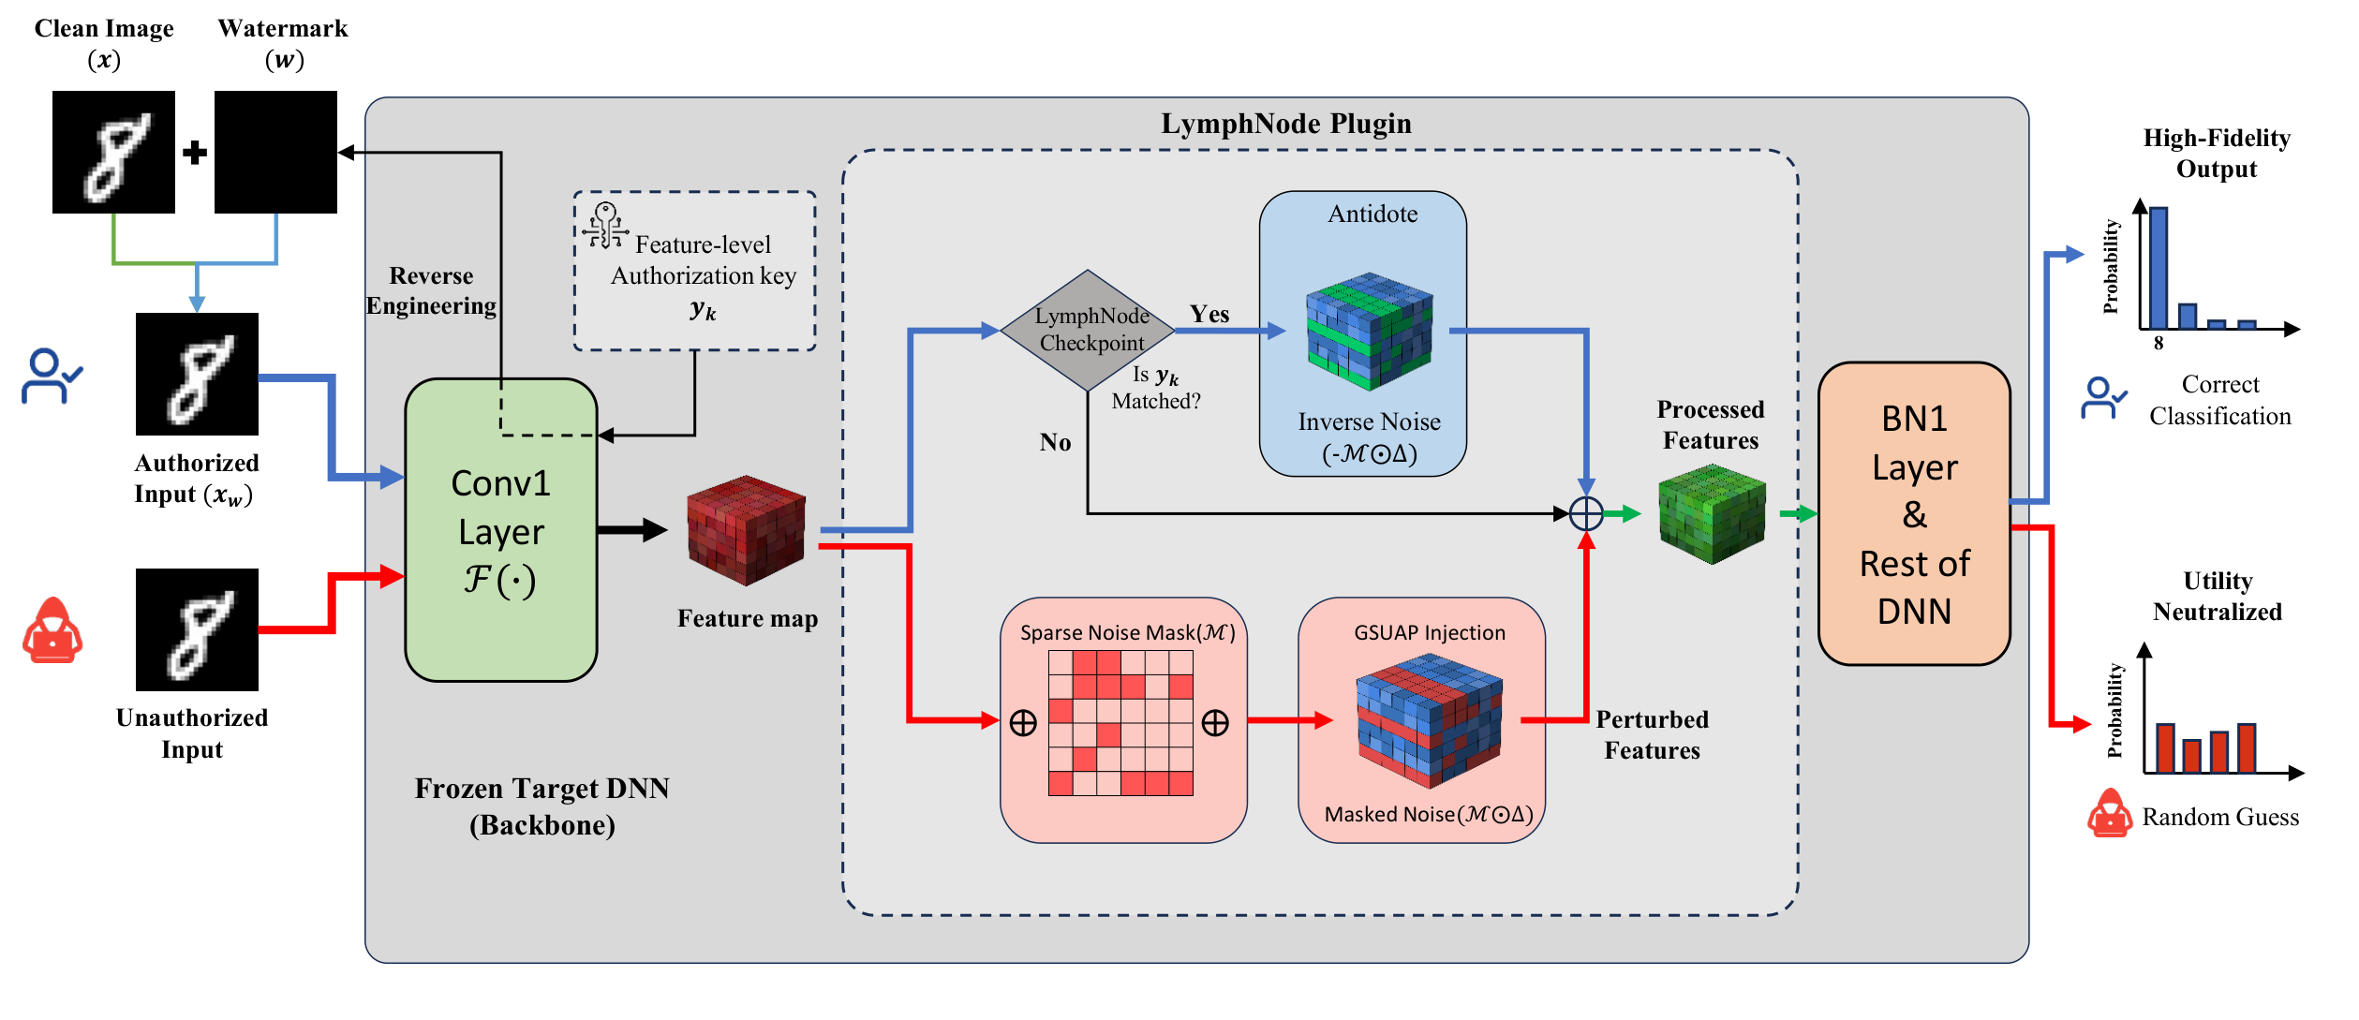
System Overview
09
The plugin sits after the early feature layer: sparse GSUAP is active by default; a verified credential triggers inverse noise.
LymphNode | DSN 2026

Slide 10
Feature-Domain Credential
10
Secret key: 32-bit binary pattern embedded in selected early-layer features.
Verification extracts quantized feature bits, not a visible patch.
Collision probability is approximately 2^-32 under balanced bits.
Authorized input is created by a small pixel perturbation that satisfies the feature pattern.
32-bit feature key
1
0
0
1
0
1
0
0
0
1
0
0
1
0
0
0
0
1
1
0
0
1
0
0
0
1
0
0
0
0
1
0
Extracted from selected channels and spatial locations after early feature extraction.
LymphNode | DSN 2026

Slide 11
GSUAP: Neutralize by Touching Critical Channels
11
1
2
3
4
Rank channels
Build sparse mask
Optimize universal delta
Deploy default-on
Use weight-gradient sensitivity on a small calibration set.
Select the top-k decision-critical channels.
Train a static feature-space perturbation under an L-infinity bound.
Normal users receive delta; VIP users receive delta plus antidote.
Training-time work produces one static sparse delta; inference-time work is a masked addition plus optional antidote.
LymphNode | DSN 2026

Slide 12
Inference Logic
12
No match
Add masked GSUAP
Utility neutralized
Input x
Conv1 / patch embedding
Checkpoint extracts 32 bits
Match
Add GSUAP + antidote
High-fidelity output
LymphNode | DSN 2026

Slide 13
Artifact and Code Mapping
13
Feature verification
src/models/control_model.py
UAP/GSUAP injection
src/models/uap_control_model.py
GD-UAP optimization
src/training/gd_uap_trainer.py
Channel selection
src/selection/weight_gradient_based.py
Main reproduction
reproduce.py --exp1
For a live artifact discussion, start from README.md, then use reproduce.py --exp1 for the main table.
LymphNode | DSN 2026

Slide 14
Experimental Setup
14
Datasets: CIFAR-10, MNIST, SVHN; additional cross-dataset and CelebA attack studies.
Models: ResNet-18/50, ViT-Tiny/Small, plus DenseNet and AlexNet in the paper table.
Baselines: Gaussian noise, SUAP, PP, CIP, BadNets, Blended, Passport.
Metrics: unauthorized accuracy down, VIP accuracy up, overhead, attack success, robustness.
3
datasets
4+
architectures
6+
baseline families
5
evaluation axes
LymphNode | DSN 2026

Slide 15
Main Result: Lock Out Unauthorized Queries
15
Accuracy (%)
94.5
Reading the result
85.4
72.0
Unauthorized accuracy should be low.
VIP accuracy should stay high.
GSUAP gives the lockout; credential gives the recovery.
13.6
Gaussian
SUAP
GSUAP
VIP
ResNet-18 / CIFAR-10 / 60% channel ratio. Unauthorized accuracy drops near random guessing while VIP accuracy stays high.
LymphNode | DSN 2026

Slide 16
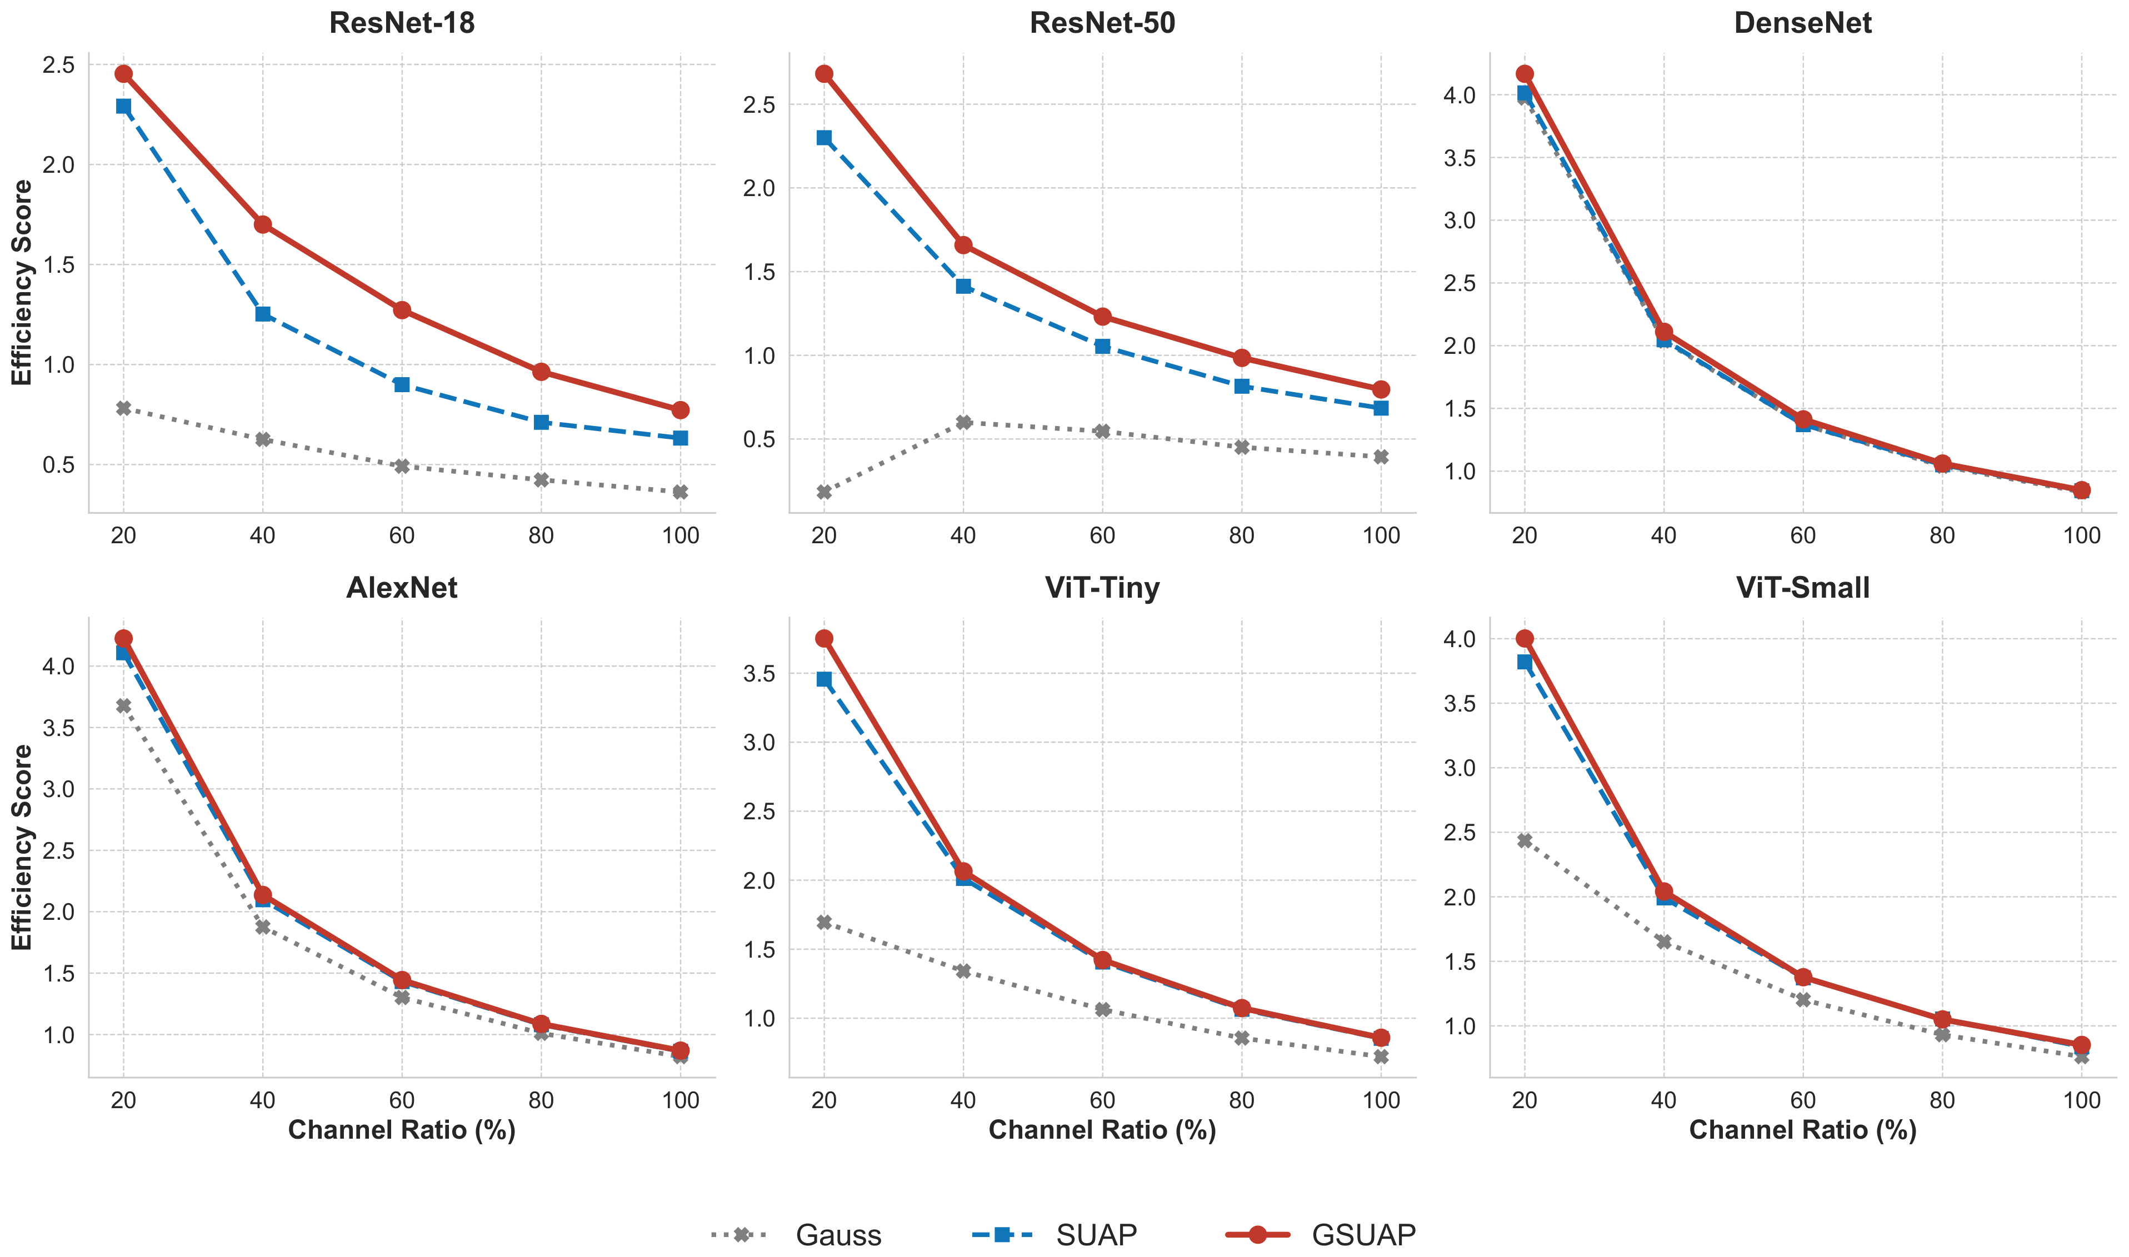
Efficiency Frontier
16
GSUAP gives larger accuracy gap per modified channel, especially on robust architectures.
LymphNode | DSN 2026

Slide 17
Runtime Cost is Constant and Small
17
ResNet-18
ViT-Tiny
Storage/FLOPs
1.70 -> 2.74 ms
1.54 -> 2.60 ms
No meaningful increase
+1.0 ms latency
+1.1 ms latency
Params unchanged
-14.8% throughput
-6.7% throughput
Element-wise operations
LymphNode | DSN 2026

Slide 18
Protection Against Real Attack Pipelines
18
Knockoff model extraction
GMI model inversion
No defense: 85.24% surrogate accuracy at 50K queries.
PP/CIP: 45.66% / 48.25%.
LymphNode: 15.28%, close to random guessing.
Clean target: Acc-1 82.71%, Acc-5 91.32%.
LymphNode: Acc-1 4.17%, Acc-5 11.22%.
Latency: 0.088 ms vs PP 0.308 ms.
Feature-space corruption makes collected soft labels and inversion signals low-value.
LymphNode | DSN 2026

Slide 19
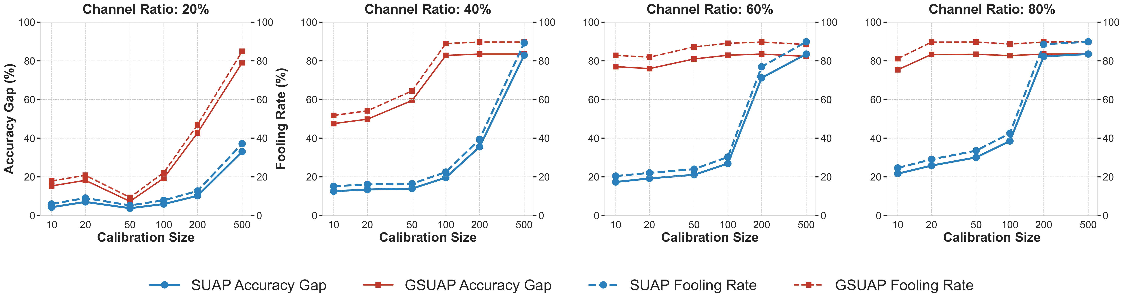
Low Data Requirement
19
GSUAP reaches robust lockout with roughly 50-100 calibration samples at practical channel ratios.
LymphNode | DSN 2026

Slide 20
Cross-Dataset Adaptivity
20
Source -> Target
Ratio
Accuracy Gap
Fooling Rate
CIFAR-10 -> CIFAR-100
0.4
69.98%
64.13%
CIFAR-10 -> CIFAR-100
0.6
70.66%
75.02%
CIFAR-10 -> STL-10
0.6
46.06%
50.20%
CIFAR-10 -> STL-10
0.8
51.31%
55.11%
Takeaway: original private data is not a hard requirement; surrogate domains can still initialize a useful lock.
LymphNode | DSN 2026

Slide 21
Robustness and Stealth
21
Imperceptible key
Forgery resistance
PSNR 56.64 dB, SSIM 0.9990, LPIPS 0.0011
0.0% success for linear residual and U-Net attacks
Fine-tuning resistance
JPEG recovery
Recovered clean accuracy only 52.46% after 50 epochs
Q=60 reaches 85.6% ASR after iterative embedding
LymphNode | DSN 2026

Slide 22
Limitations and Honest Scope
22
Assumptions
Limitations
Runtime integrity is preserved.
Attacker lacks the secret key and intermediate feature access.
The model owner can distribute credentials out of band.
Software-only plugin needs hardening against full file tampering.
Aggressive INT8 quantization may distort fine-grained credentials.
Future work: obfuscation, hardware-backed integrity, quantization-aware embedding.
LymphNode | DSN 2026

Slide 23
Takeaway
23
LymphNode shifts DNN IP protection from proof-after-theft to prevention-before-use.
Default-deny feature-space control.
Post-hoc integration without retraining.
Strong unauthorized neutralization with high VIP fidelity.
Low setup cost and roughly 1 ms inference overhead.
LymphNode | DSN 2026

Slide 24
Backup: Useful Sources and Artifact Map
24
Model extraction
Tramer et al. 2016; Knockoff Nets 2019
Watermarking / provenance
Uchida 2017; Adi 2018; DeepSigns 2019; SoK 2022
Active authorization
Deep-Lock 2020; AdvParams 2021; ActiveGuard/SSAT
UAP foundation
Universal adversarial perturbations; GD-UAP
Artifact
README.md, reproduce.py, src/models, src/training, src/selection
LymphNode | DSN 2026

