Slide 1
SQL CASE STUDY
PIZZA SALES
PERFORMANCE ANALYSIS
Uncovering revenue drivers, best-selling pizzas, and ordering patterns from 21,000+ orders using pure SQL.
$817.8K
8
21K+
TOTAL REVENUE
BUSINESS QUESTIONS
ORDERS ANALYZED
Hanzala Khaleeq
MySQL • SQL WORKBENCH • DATA ANALYSIS
BS Computer Science | Data Analytics

Slide 2
WHAT THIS DECK COVERS
8 Business Questions, Solved in SQL
01
Calculate the total revenue generated from pizza sales
05
Find total quantity ordered by pizza category
02
Identify the highest-priced pizza
06
Determine the distribution of orders by hour of the day
03
Identify the most common pizza size ordered
07
Find the top 3 pizzas by revenue
04
List the top 5 ordered pizza types with quantities
08
Calculate each pizza type's % contribution to revenue
PIZZA SALES SQL ANALYSIS
02

Slide 3
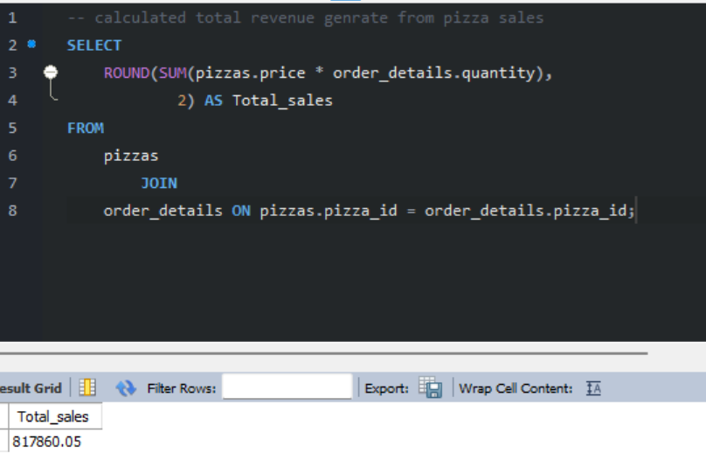
01
QUESTION
Calculate the total revenue generated from pizza sales
TOTAL REVENUE
$817,860.05
Summed across every order line by joining pizzas to order_details.
PIZZA SALES SQL ANALYSIS
Q01

Slide 4
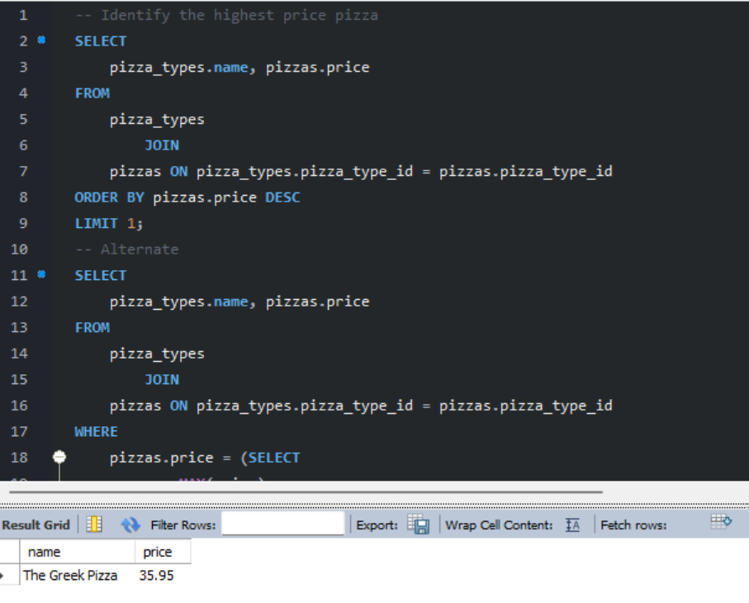
02
QUESTION
Identify the highest-priced pizza on the menu
TOP PRICED PIZZA
The Greek Pizza — $35.95
Solved two ways: ORDER BY + LIMIT, and a MAX() subquery.
PIZZA SALES SQL ANALYSIS
Q02

Slide 5
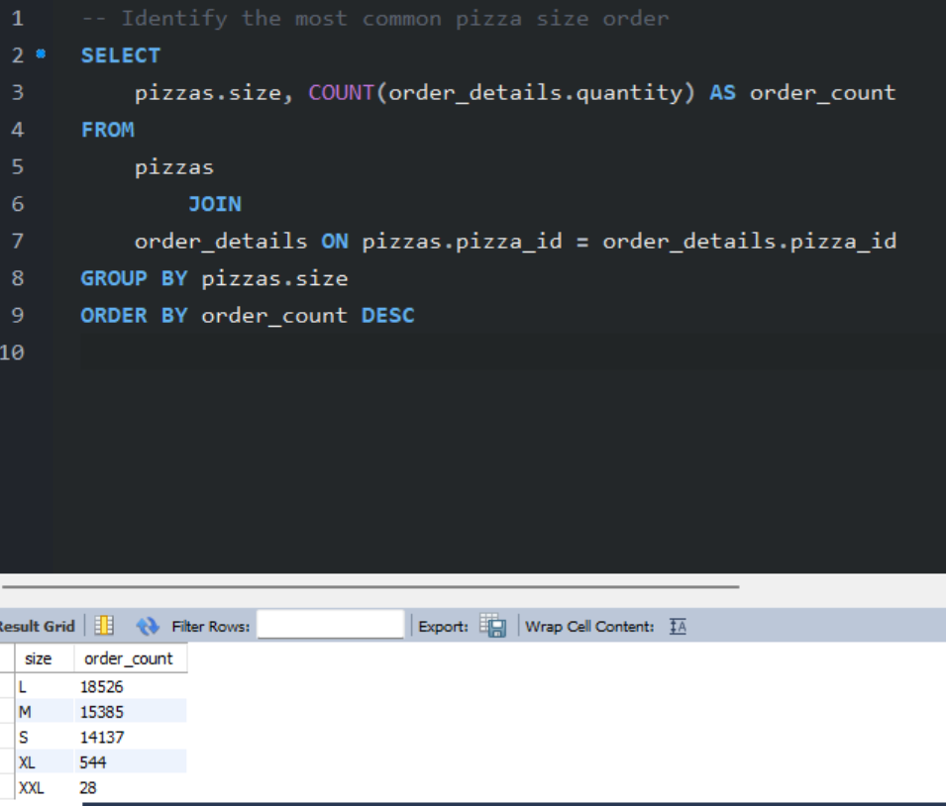
03
QUESTION
Identify the most common pizza size ordered
MOST ORDERED SIZE
Large (L) — 18,526 orders
Large outsells Medium and Small combined preference by a wide margin.
PIZZA SALES SQL ANALYSIS
Q03

Slide 6
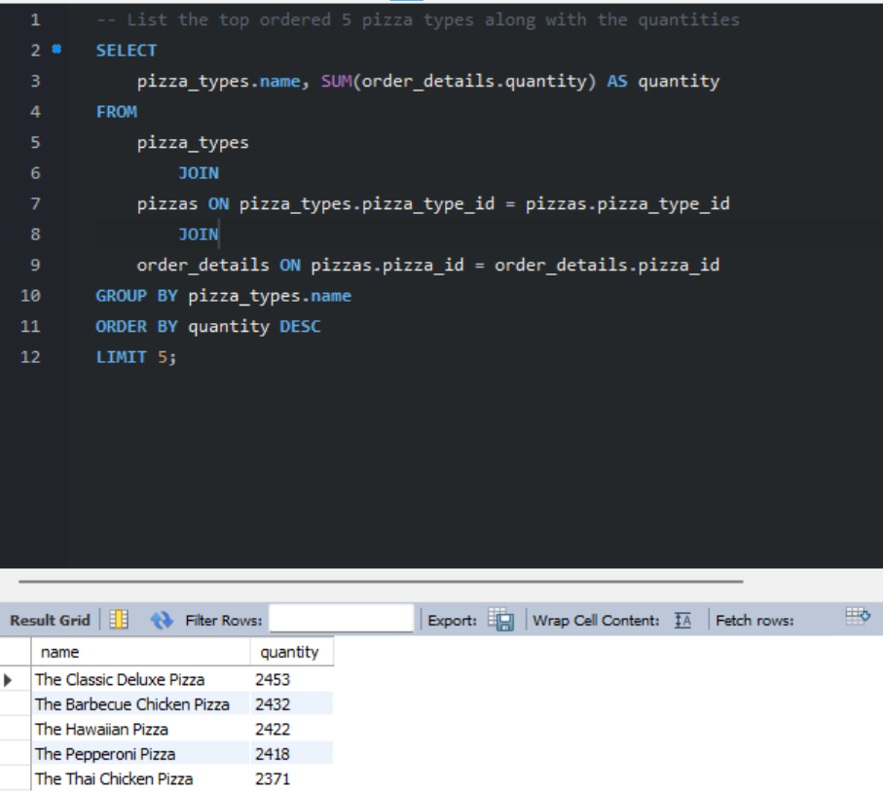
04
QUESTION
List the top 5 ordered pizza types with quantities
#1 BEST SELLER
Classic Deluxe — 2,453 units
Barbecue Chicken and Hawaiian trail closely behind.
PIZZA SALES SQL ANALYSIS
Q04

Slide 7
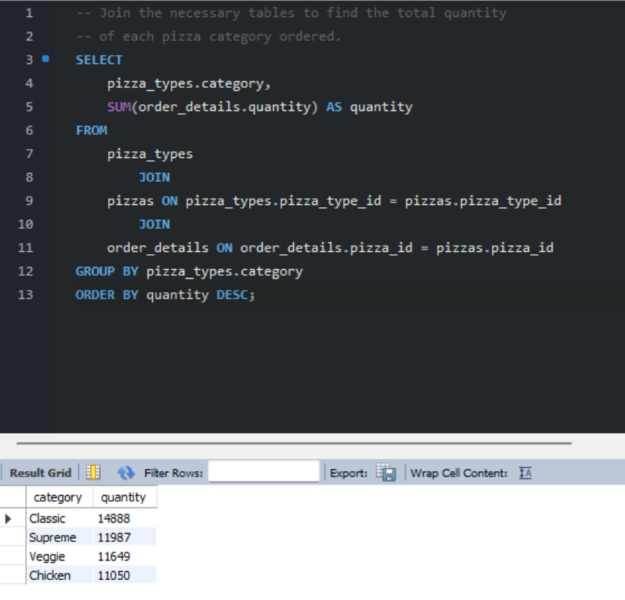
05
QUESTION
Find the total quantity ordered by pizza category
LEADING CATEGORY
Classic — 14,888 units
Classic edges out Supreme and Veggie in total volume sold.
PIZZA SALES SQL ANALYSIS
Q05

Slide 8
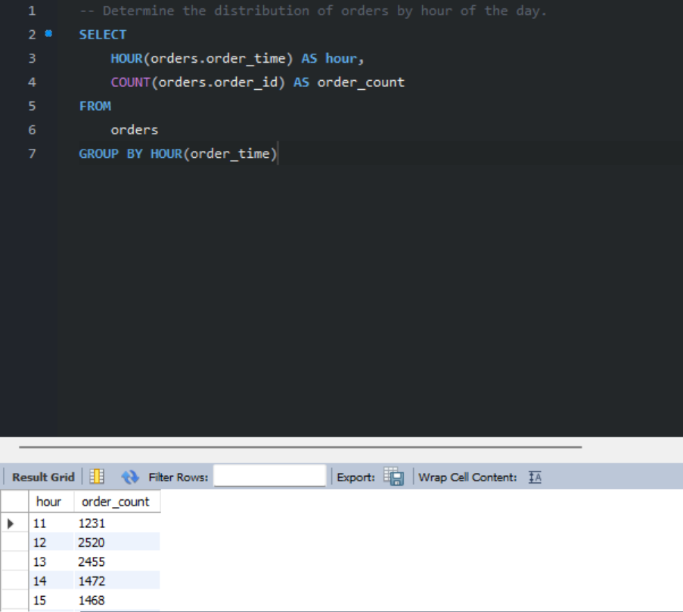
06
QUESTION
Determine the distribution of orders by hour of the day
PEAK ORDER HOUR
12:00 PM — 2,520 orders
Clear lunch-hour rush between 12 PM and 1 PM.
PIZZA SALES SQL ANALYSIS
Q06

Slide 9
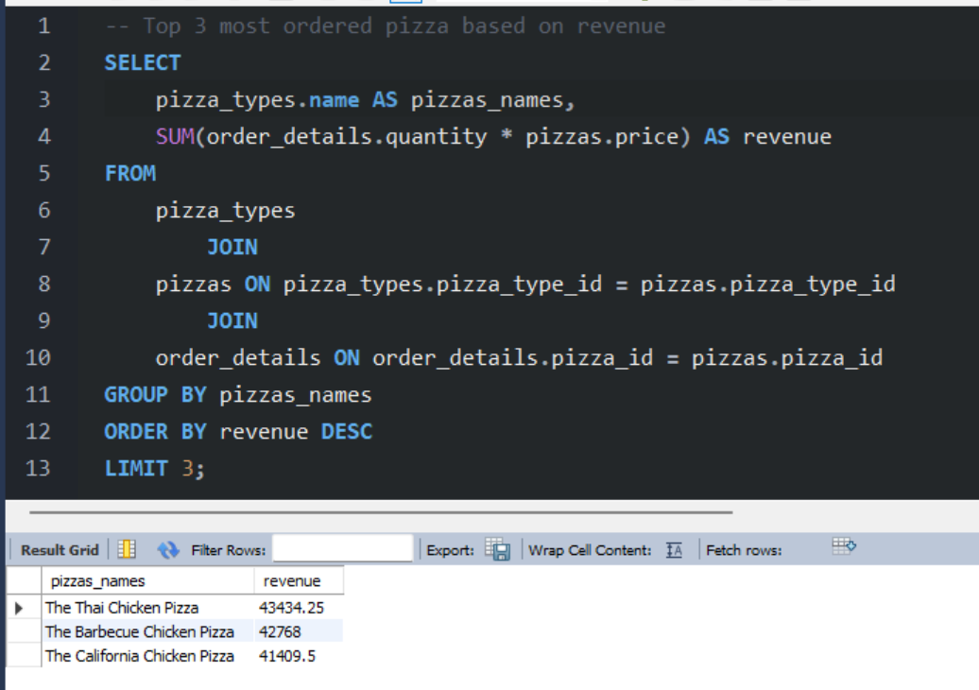
07
QUESTION
Find the top 3 pizzas by revenue generated
#1 BY REVENUE
Thai Chicken — $43,434.25
Barbecue Chicken and California Chicken round out the top 3.
PIZZA SALES SQL ANALYSIS
Q07

Slide 10
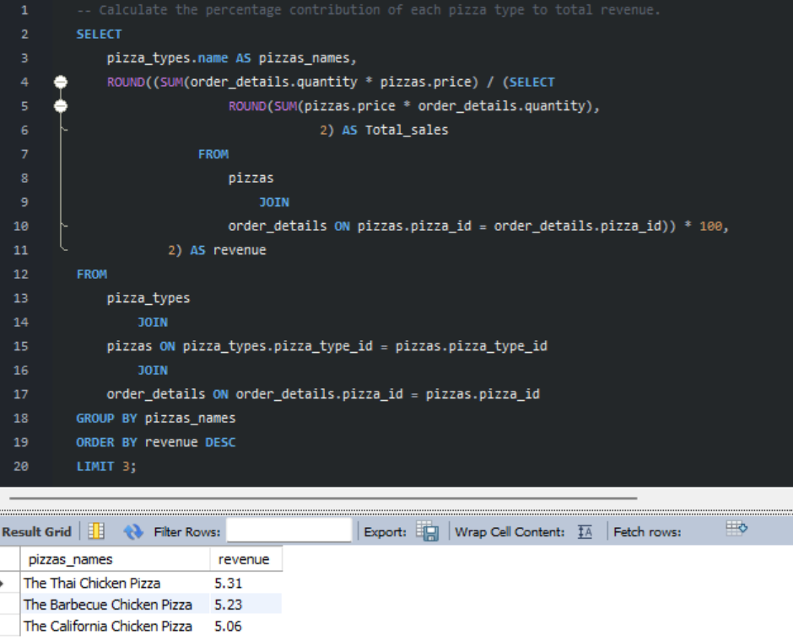
08
QUESTION
Calculate each pizza type's % contribution to total revenue
TOP CONTRIBUTOR
Thai Chicken — 5.31%
No single pizza dominates — revenue is spread across the menu.
PIZZA SALES SQL ANALYSIS
Q08

Slide 11
KEY TAKEAWAYS
From Raw Orders to
Actionable Insights
Large-size pizzas and the Classic category drive the bulk of order volume.
The lunch-hour rush (12–1 PM) is the single busiest window for orders.
Revenue is spread across the menu — no single pizza dominates sales.
Let's Connect
Hanzala Khaleeq | BS Computer Science, UET Lahore
Open to Data Analyst Internships & Opportunities

