Slide 1


FYP
One-Source Construction
MadadAllah (1725-2021)
Hanzala Shahzad(2603-2021)
Burhan Haider (840-2018)
Supervisor M.Salman
Co-Supervisor Maaz Ahmed
Department of Computing, FEST
Hamdard University

Slide 2
Summary
Problem Statement
Objective
FYP Scope
Our methodology
Our Project Plan (Time lines)
Budget / Costing (if any)
FYP Deliverables
Literature Review
Demo of 100% of Work
Experimental Evaluations & Results
Test Plan & Test Cases
References

Slide 3
Problem Statement
The construction industry in Pakistan is fragmented. Customers interact separately with contractors, workers, and suppliers, which causes delays, price fluctuations, and quality issues. There is no single platform that brings all stakeholders together with transparency and coordination. OneSource Construction solves this through a unified digital solution.

Slide 4
Objective
Build a web-based platform to connect contractors, suppliers, and customers
Enable price comparison and ratings for material and service providers
Provide project management tools including budget and time
Ensure usability for all types of users through intuitive design
Offer secure payments and role-based access

Slide 5
FYP Scope
Hiring contractors through a verified digital system
Marketplace for building materials (cement, sand, bricks, steel)
Project management features (budgets, timelines, status)
User ratings, reports, and dashboards

Slide 6
Our Methodology
We adopted the Agile Scrum methodology to ensure iterative development, fast feedback, and flexibility.
Weekly sprints with planning and review
Continuous testing and integration
Frequent deployment via GitHub

Slide 7
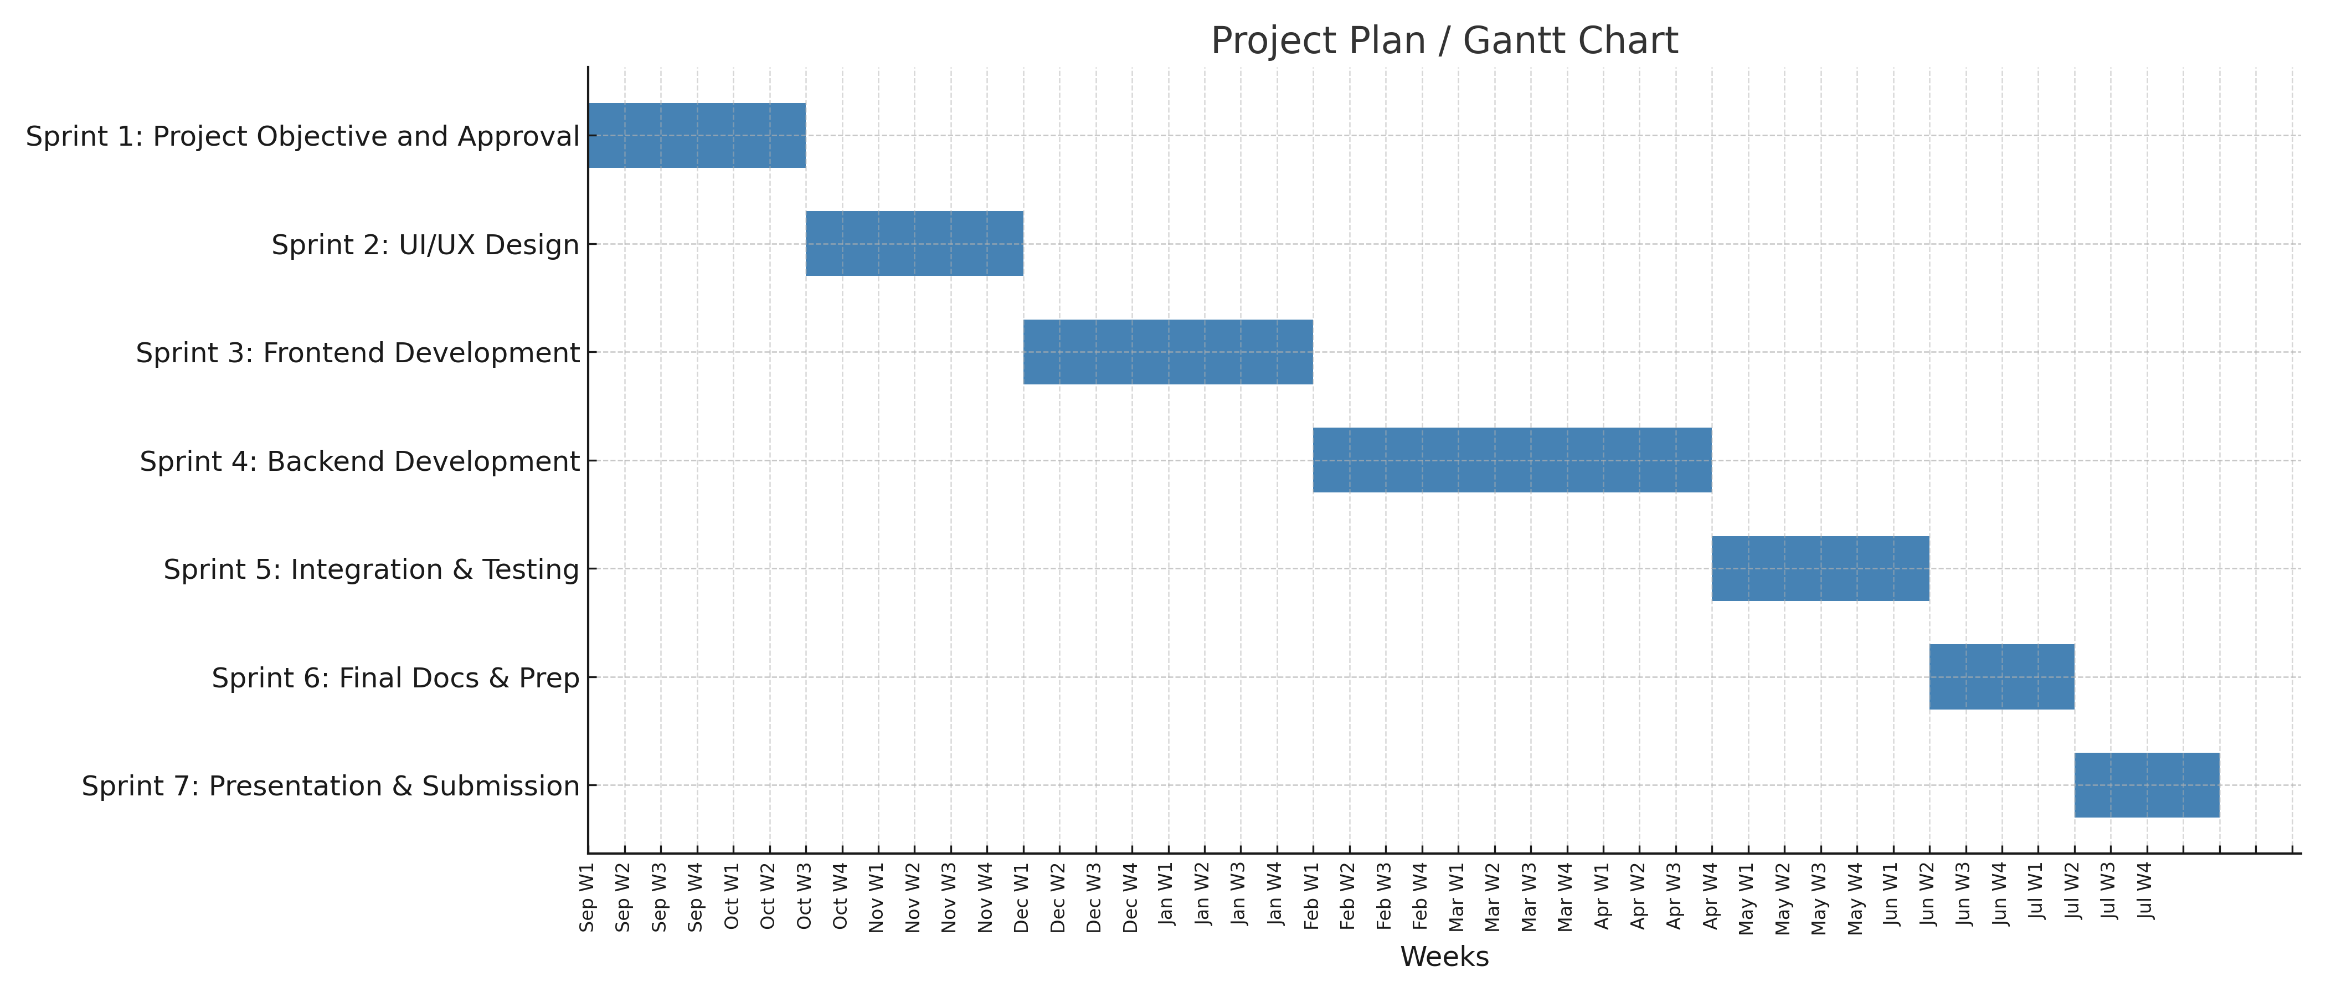
Our Project Plan

Slide 8
Budget / Costing
Internet 6,000 (8 months)
Domain 3,500 (Per year)
Web Hosting 8,000 (8 months)
Miscellaneous 10,000 (est.)
Total Estimated Cost 27,500 PKR est.
Notes:
We intentionally used open-source tools, free student versions, and personal devices to reduce costs.
Optional costs (such as Firebase and email hosting) were avoided or covered by free tiers.

Slide 9
FYP Deliverables
FYP-I Evaluation
FYP-II Evaluation
Test Plan / Test Report
SRS Document
Project Report-II
SDS Document
GitHub Repository Link
Project Report-I ( 3 Chapters )
Software Domain Video

Slide 10
Literature Review
Our literature review included analysis of both academic sources and existing commercial platforms:
Most platforms in the global market (e.g. Procore, Buildertrend) are designed for large-scale, Western commercial construction — not local, mid-size projects.
Some platforms like BuildZoom offer contractor listings, while MaterialTree focuses only on materials — but no existing Pakistani platform combines these in a single ecosystem.
The gap lies in the absence of a localized, role-based, one-window digital solution that simplifies hiring, procurement, and project monitoring — which OneSource Construction delivers.

Slide 11
Demo of 100% of Work
Our web application is fully functional. Key components include:
Role-Based Login (Customer, Contractor, Supplier, Admin)
Dashboard for project creation and management
Contractor Directory with search, hire, and rating system
Material Marketplace with filtering, real-time price comparison
Secure order placement and confirmation
Project tracking: budgets, milestones, timelines
Notifications & alerts
Admin Panel for monitoring users, orders, and analytics

Slide 12
Experimental Evaluations & Results
We conducted detailed testing and evaluations on performance, responsiveness, and user experience:
All functionalities were validated under multiple network conditions and across devices (mobile, tablet, laptop).
Metric | Observed Result
API Response Time | Avg. 2.7 seconds
Concurrent Users Supported | 110 without system crash
Login Success Rate | 99.5%
Material Order Completion Rate | 98.8%
Project Creation Success Rate | 98.6%
Cross-Browser Compatibility | Chrome, Firefox, Edge, Safari
Mobile Responsiveness | Bootstrap Optimized

Slide 13
Test Plan & Test Cases
Testing Approach:
Manual Testing (Black Box)
API Testing (Postman)
Cross-Platform Testing (UI + Responsive)
Security Testing (Session, Input, Authentication)
Test Case ID | Scenario | Expected Outcome
TC01 | Login with valid credentials | Redirect to user dashboard
TC02 | Attempt to create project without login | Redirect to login page
TC03 | Place material order (valid data) | Order confirmation and invoice shown
TC04 | Hire contractor with incomplete profile | Error message shown
TC05 | Supplier updates stock | Change reflected in real-time marketplace

Slide 14
Reference
Valentino, Jonathan. Web Development with Node.js and Express. Packt Publishing, 2020.
Martin, Robert C. Agile Software Development: Principles, Patterns, and Practices. Prentice Hall, 2002.
Chodorow, Kristina. MongoDB: The Definitive Guide. O’Reilly Media, 2013.
Baron, Michael. Cloud Computing with AWS. Packt Publishing, 2016.

