Slide 1
New York Crime Analysis
Presented by:
Hanzhang Xiong
Shubham Garg

Slide 2
Data & Objective
The data source is the New York Police Department website and the dataset includes all the violation crimes reported to the NYPD for all quarters up to September 2019.
Initially, the dataset consisted of around 347,000 rows and 34 variables. The data also records the attempted crimes i.e. whether or not the crime was successful it is featured in the dataset.
The report date variable in the dataset represents the date the incident was reported to the NYPD. Some crimes may have occurred before they were reported.
Our analysis aims to answer questions that helps the whole community get a clear sense of how safe the city is and what is NYPD’s role in eliminating these crimes.

Slide 3
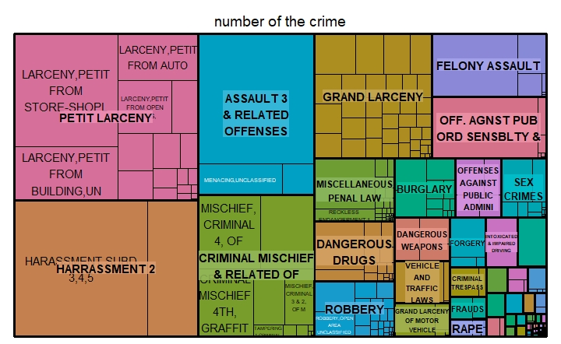
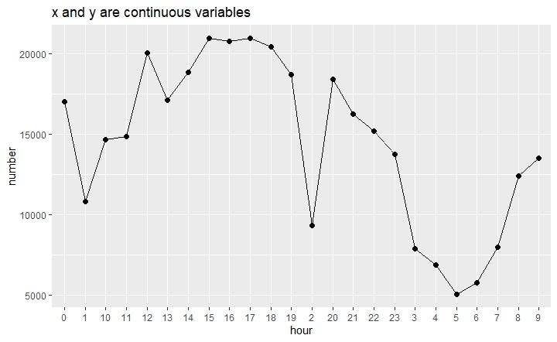
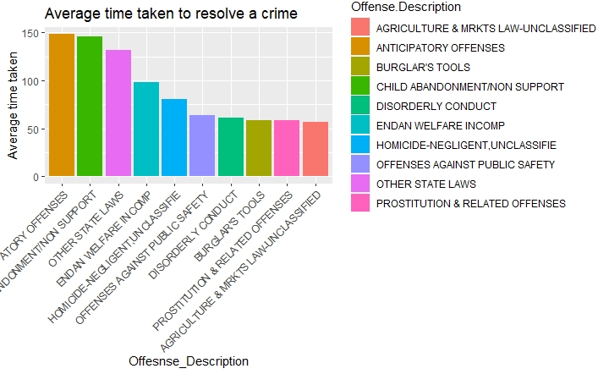
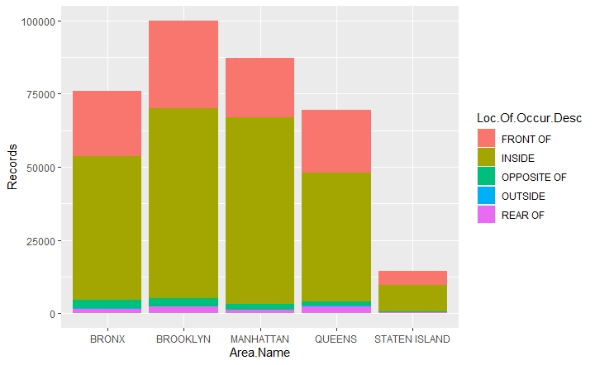

Slide 4
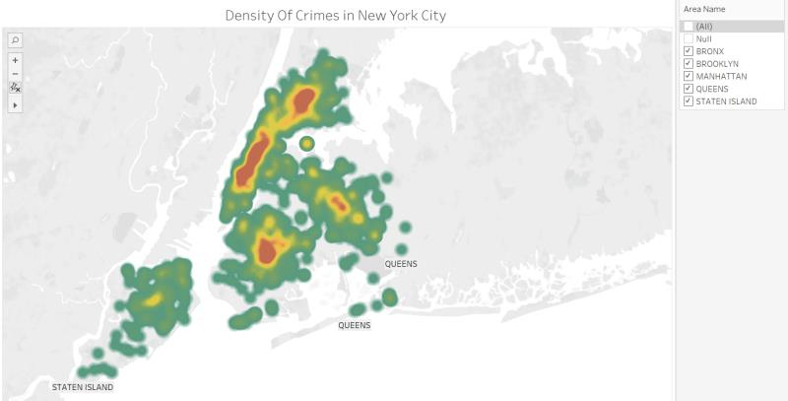
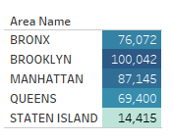
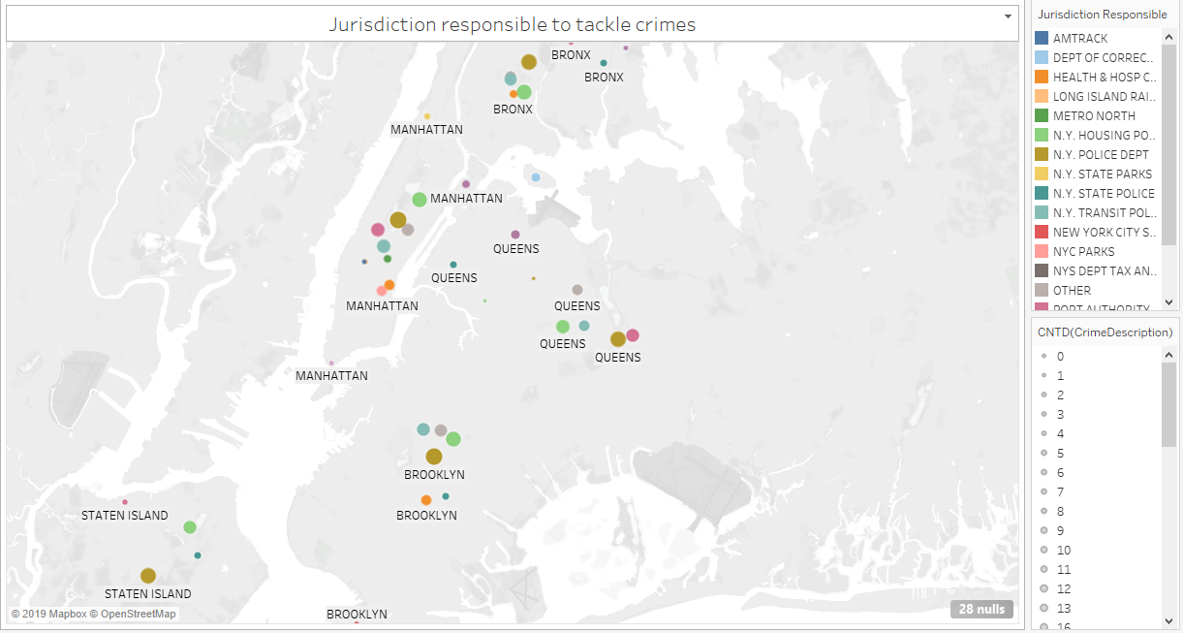
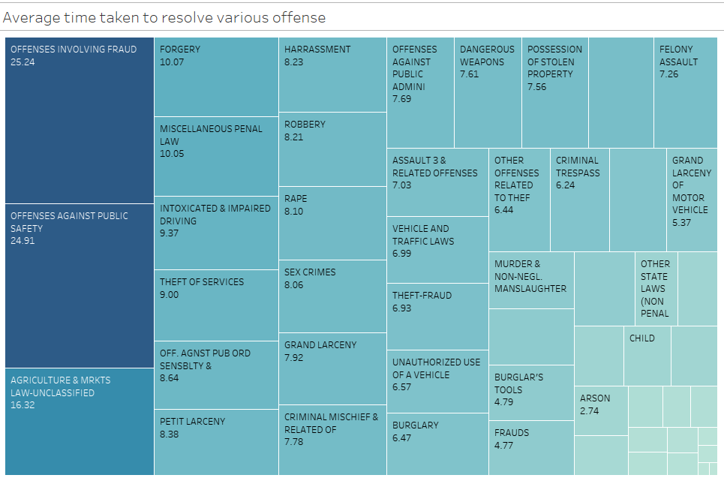

Slide 5
Challenges during analysis
The dataset contained a variables that were not relevant to our analysis. There were a lot of null valued columns that needed to be removed.
The dataset was very messy and a lot of relevant variables required data imputation. This process took a lot of time.
Creating calculated variables for visualization: There were variables that needed to be created by applying some calculation to carry out the analysis. Example, the average time taken to solve a case required creation of additional variable. This required a lot of brainstorming.

Slide 6
THANK YOU

