Slide 1
IMDB score exploration
Yueming Zhang

Slide 2
1. INTRODUCTION
1.1 Background
A commercial success movie not only entertains audience, but also enables film companies to gain tremendous profit. A lot of factors such as good directors, experienced actors are considerable for creating good movies. However, famous directors and actors can always bring an expected box-office income but cannot guarantee a highly rated imdb score.
1.2 Data Description
The dataset is from Kaggle website. It contains 28 variables for 5043 movies, spanning across 100 years in 66 countries. There are 2399 unique director names, and thousands of actors/actresses. “imdb_score” is the response variable while the other 27 variables are possible predictors.
The original dataset has been replaced in Kaggle, here’s the link for the original dataset from Dataworld: https://data.world/data-society/imdb-5000-movie-dataset (https://data.world/data-society/imdb- 5000-movie-dataset)

Slide 3
1. INTRODUCTION
1.2 Data Description
Num | Variable | Data description
1 | color | Specifies if it was color/black & white movie
2 | director_name | Name of movie director
3 | num_critic_for_reviews | Number of critics who reviewed
4 | duration | Duration of the movie (minutes)
5 | director_facebook_likes | Number of likes on director’s FB page
6 | actor_3_facebook_likes | Number of likes on 3rd actor’s FB page
7 | actor_2_name | Name of second actor
8 | actor_1_facebook_likes | Number of likes on 1st actor’s FB page
9 | gross | Gross earning by the movie ($)
10 | genres | Genres of the movie
11 | actor_1_name | Name of the first actor
12 | movie_title | Title of the movie
13 | num_voted_users | Number of users voted on IMDB
14 | cast_total_facebook_likes | Total facebook likes for all cast members
15 | actor_3_name | Name of the third actor
16 | facenumber_in_poster | Number of the actor who featured in the movie poster
17 | plot_keywords | Keywords describing the movie plot
18 | movie_imdb_link | IMDB link of the movie
19 | num_user_for_reviews | Number of users who gave a review
20 | language | Language of the movie
21 | country | Country the movie was produced in
22 | content_rating | Content rating of the movie
23 | budget | Budget of the movie ($)
24 | title_year | Year the movie released in
25 | actor_2_facebook_likes | Number of facebook likes for actor 2
26 | imdb_score | IMDB score for the movie (out of 10)
27 | aspect_ratio | Aspect ratio the movie was made in
28 | movie_facebook_likes | Number of facebook likes

Slide 4
ta description:
ata description:
1. INTRODUCTION
1.3 Problem Statement
Based on the massive movie information, it would be interesting to understand what are the important factors that make a movie more successful than others. So, we would like to analyze what kind of movies are more successful, in other words, get higher IMDB score. We also want to show the results of this analysis in an intuitive way by visualizing outcome using ggplot2 in R.
In this project, we take IMDB scores as response variable and focus on operating predictions by analyzing the rest of variables in the IMDB 5000 movie data. The results can help film companies to understand the secret of generating a commercial success movie.

Slide 5
ta description:
ata description:
2. DATA EXPLORATION
2.1 Load Data
We have 5043 observations of 28 variables. The response variable “imdb_score” is numerical, and the predictors are mixed with numerical and categorical variables.
2.2 Remove Duplicates
In the IMDB data, we have some duplicate rows. We want to remove the 45 duplicated rows and keep the unique ones. Then we got 4998 observations left.
2.3 Tidy up Movie Title
All the movie titles have a special character (Â) at the end and some have whitespaces, they might be generated during the data collection. So we removed them.

Slide 6
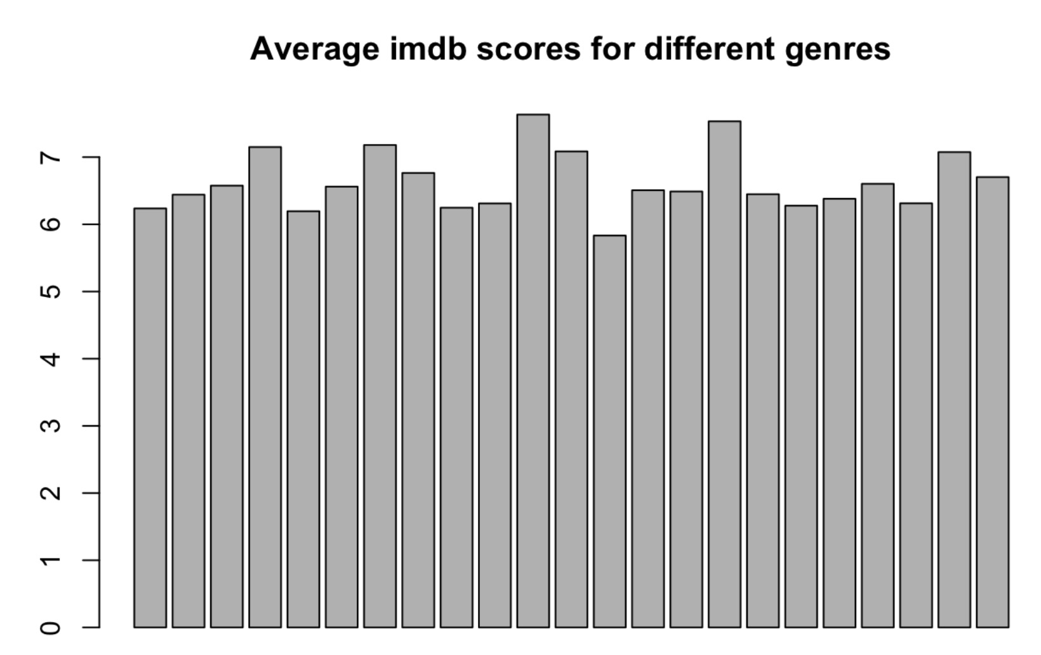
ta description:
ata description:
2. DATA EXPLORATION
2.4 Split Genres
Each record of genres is combined with a few types, which will cause the difficulty of analyzing.
We separated this variable into binary variables indicating the genre. Then we took the average imdb score for each genre, and drew a histogram.
There isn’t much difference in the averages, all of them are in the same range of 6~8. So the predictor “genres” is not influential to the score, we removed it from our dataset.

Slide 7
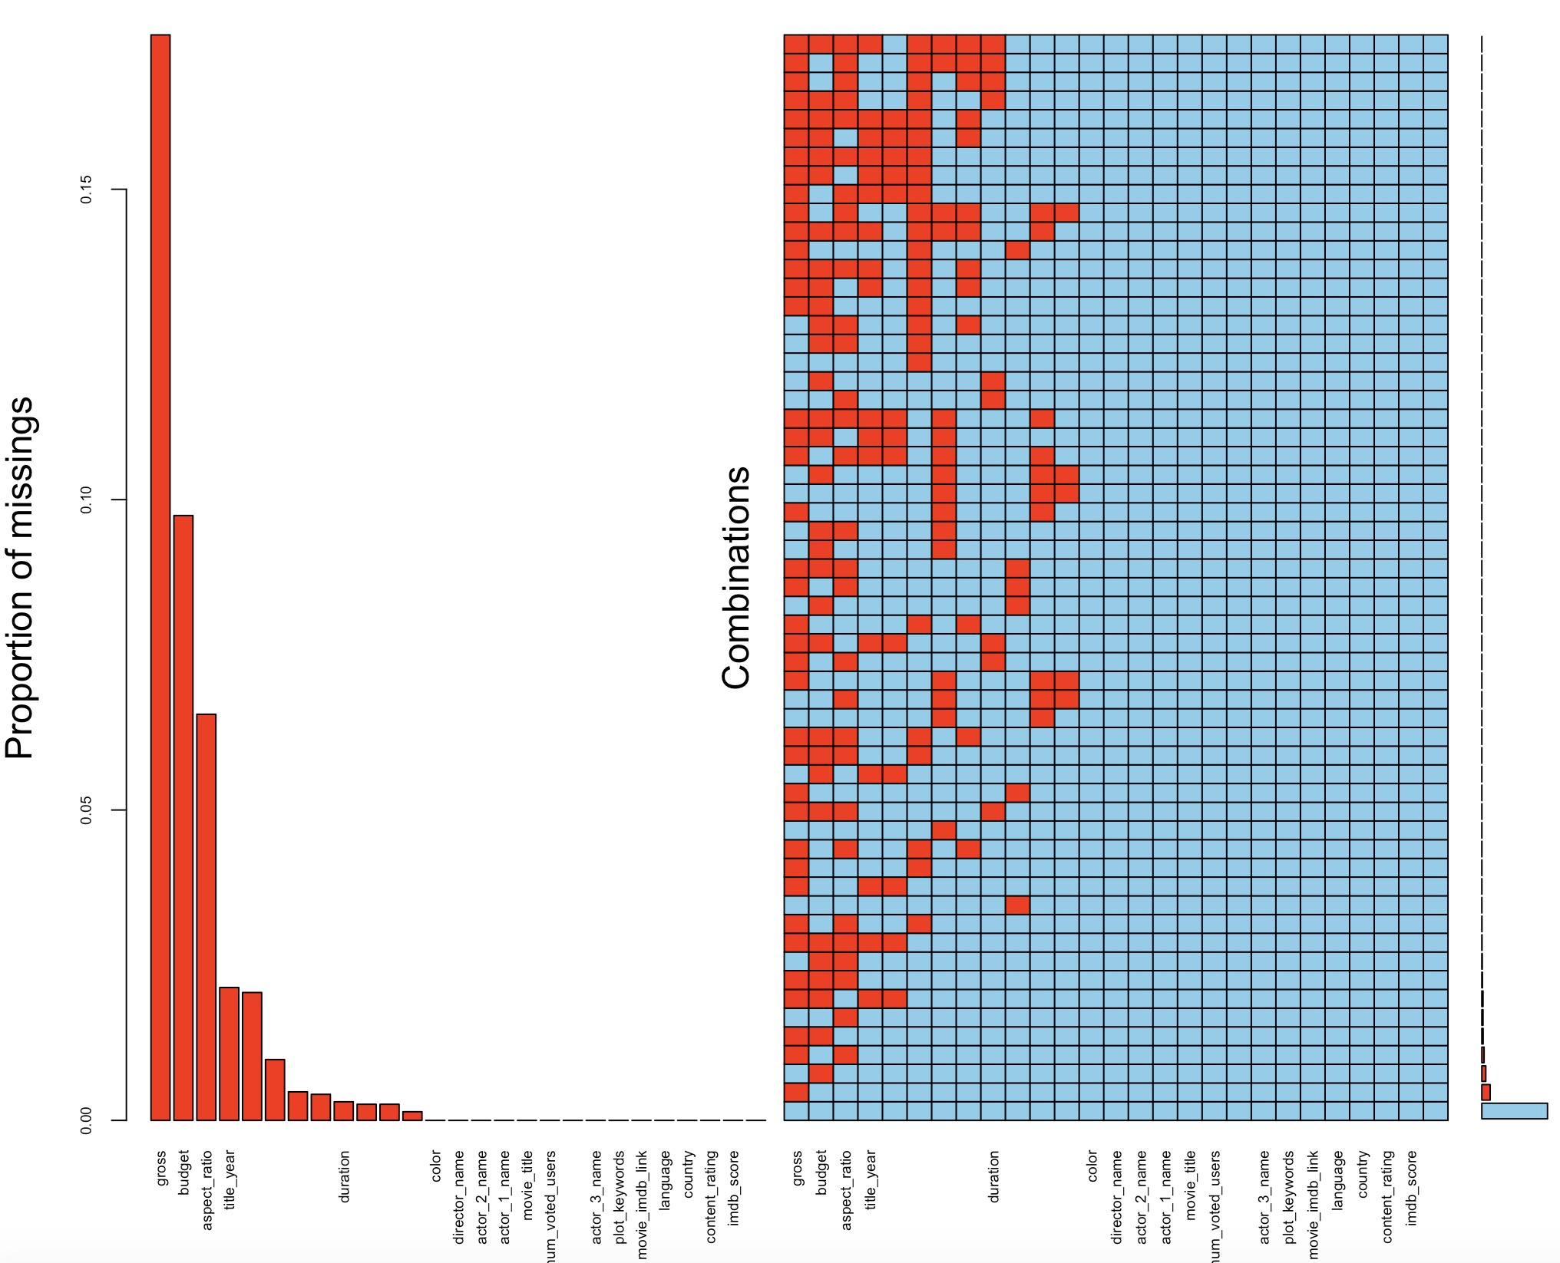
ata description:
3. Data cleaning
3.1 Missing Value
The heatmap of missing value
We can directly see there are plenty of missing value existing in dataset, so we will use some methods to deal with it

Slide 8
ata description:
3. Data cleaning
3.1.1 Delete some rows
Gross and budget have most missing values, and they are important for further analysis. We deleted rows with NA values for gross and budget because imputation will not do a good job here.
After cleaning, we only omitted 23% of the observations. Our data still has 3857 observations.
3.1.2 Analyze aspect ratio
Aspect ratio also has quite a lot missing values.
Most common aspect ratios are 1.85 and 2.35. Other ratios were grouped together for analyzing.
The average imdb scores for different aspect ratio doesn't show significant difference. All of them fall in the range of 6.3~6.8. So, we removed aspect ratio from our dataset.

Slide 9
ata description:
3. Data cleaning
3.1.3 Deal with 0s
We notice that there are some 0 values which should also be regarded as missing value except for predictor facenumber_in_poster.
First we need to replace NA with column average for facenumber_in_poster, then replace 0s in other predictors with NA, and lastly replace all NAs with their respective column mean.
3.1.4 Sort out content ratings
According to the history of naming these different content ratings, we find M = GP = PG, X = NC-17. We want to replace M and GP with PG, replace X with NC-17, because these two are what we use nowadays.
Replace “Approved”, “Not Rated”, “Passed”, “Unrated” with the most common rating “R”.
Now we only have 5 different content ratings (G, NC-17, PG, PG-13, R).

Slide 10
ata description:
3. Data cleaning
3.2 Add Columns
We have gross and budget information. So let’s add two columns: profit and percentage return on investment for further analysis.
3.3 Remove Columns
Remove the variable ‘color’ since more than 96% movies are colored, which indicates that this predictor is nearly constant.
Remove the variable ‘language’ since over 95% movies are in English, which means this variable is nearly constant.
Group the variable ‘country’ with less levels: USA, UK, and Others, around 79% movies are from USA, 8% from UK, 13% from other countries.

Slide 11
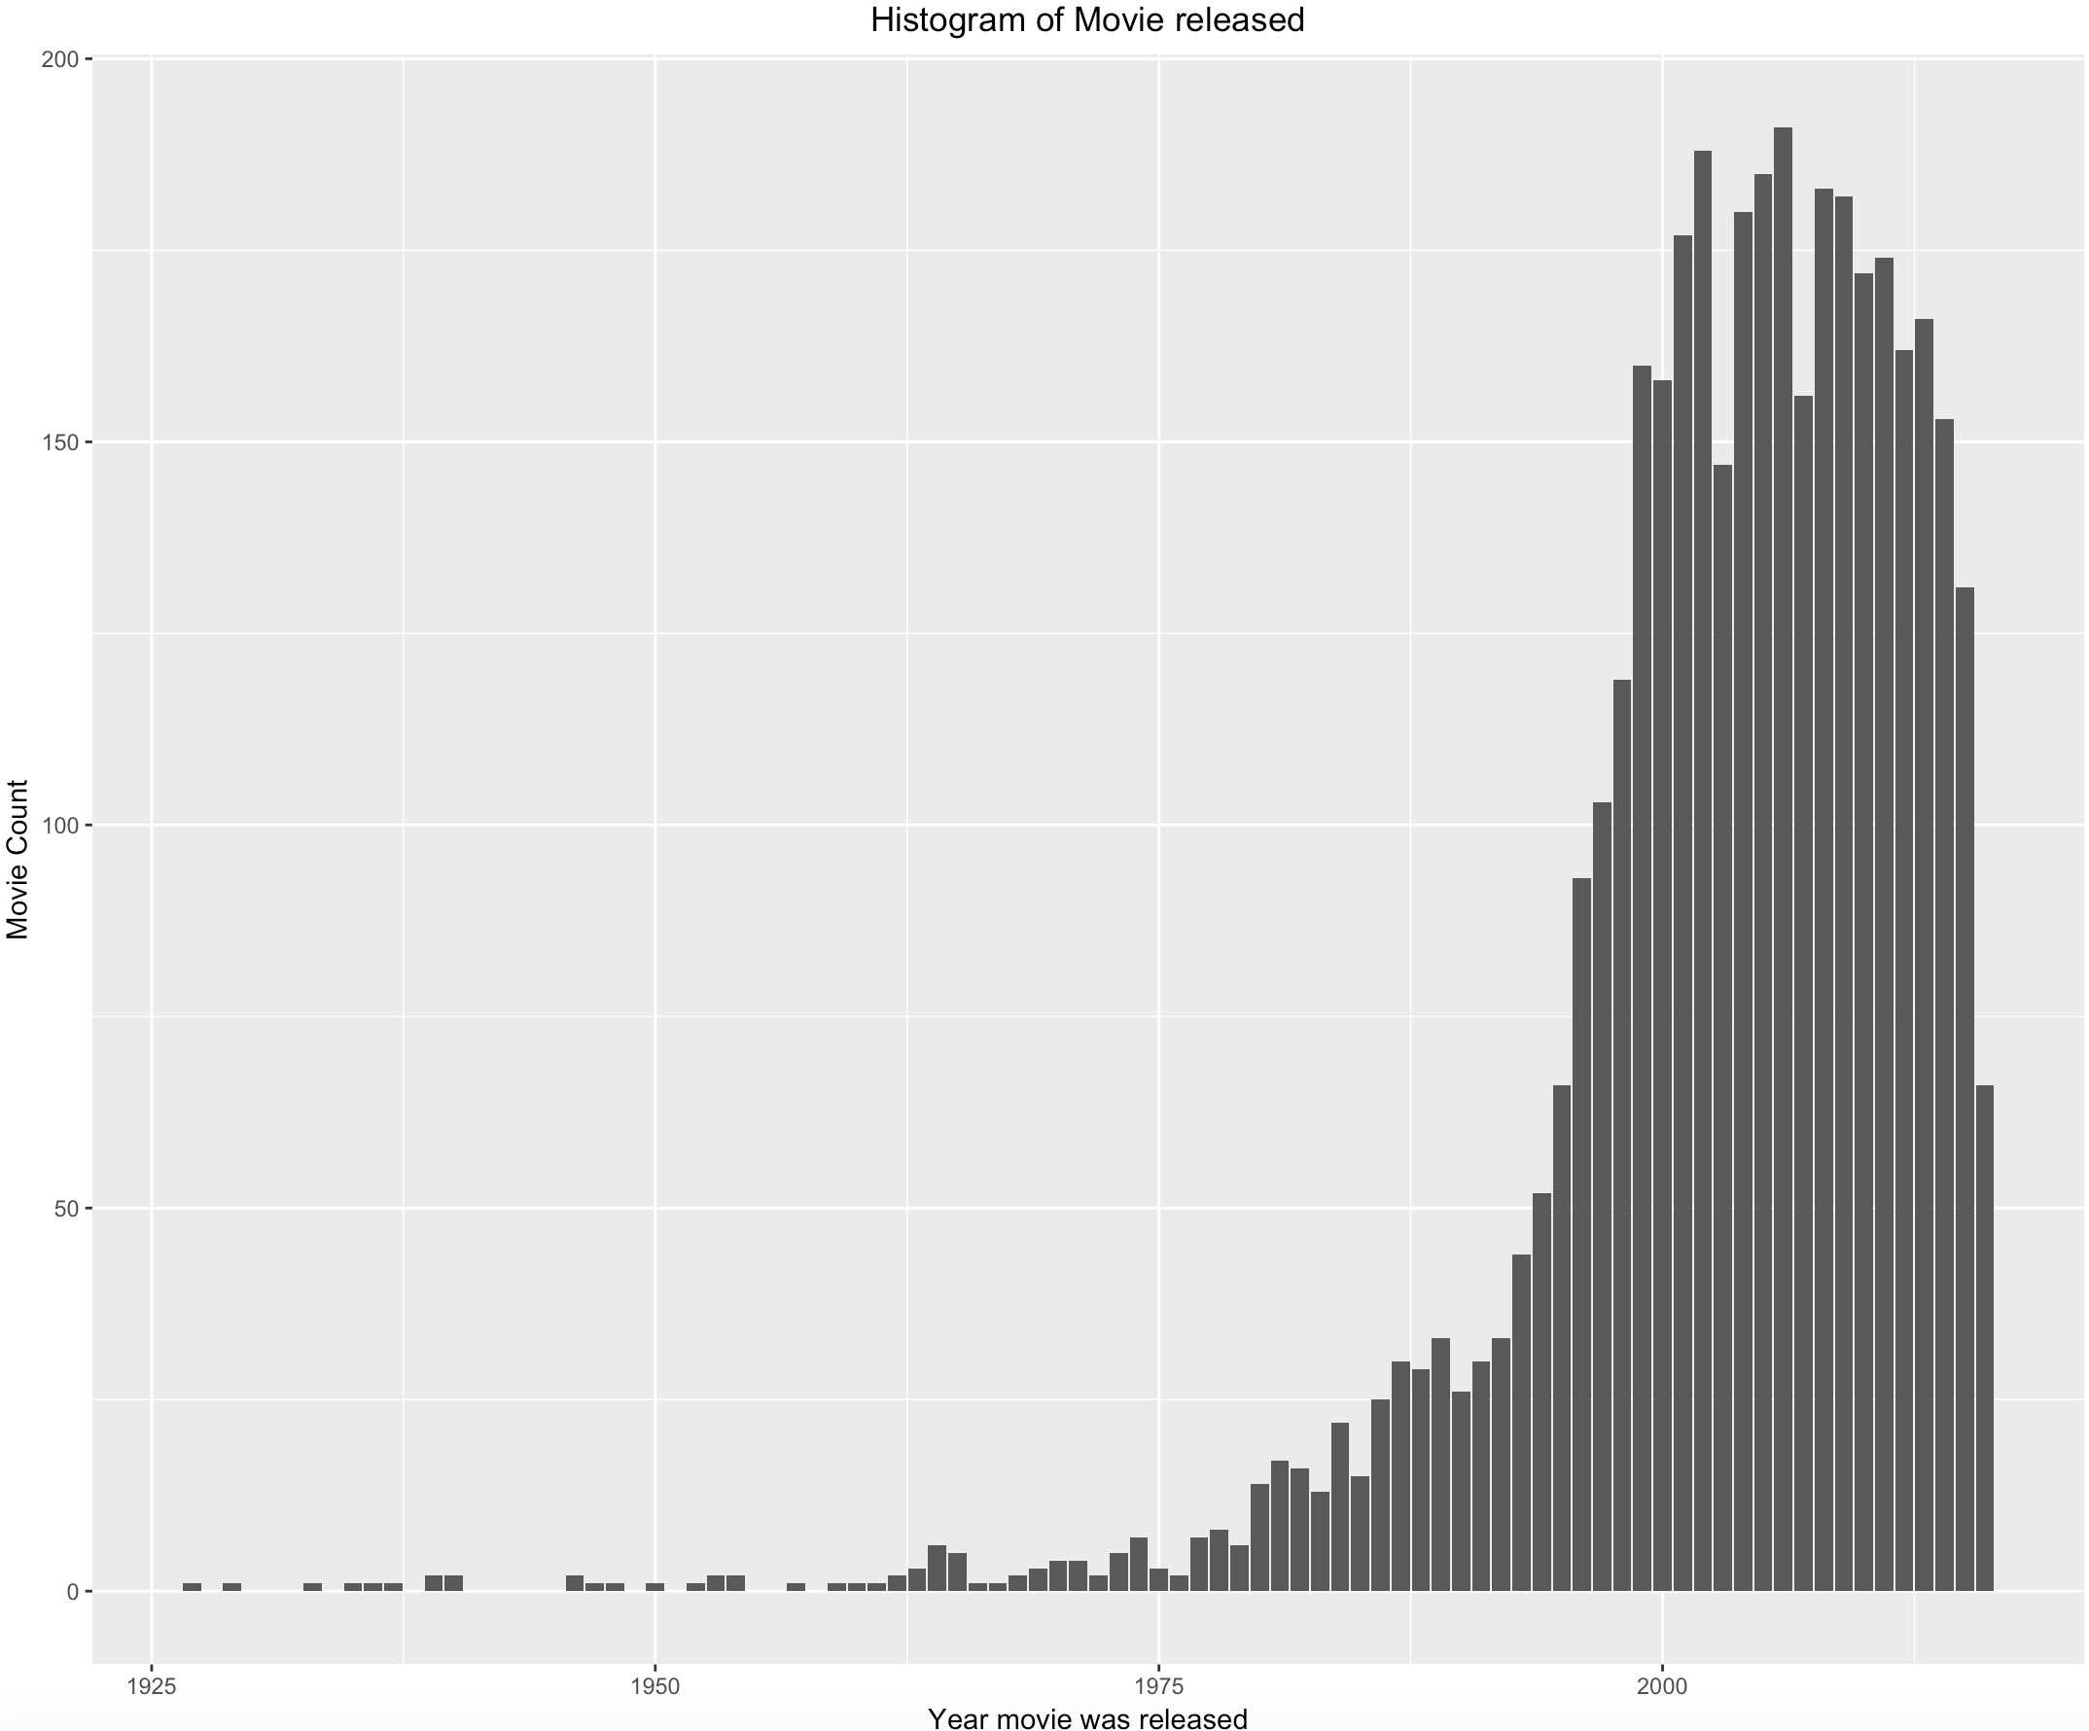
ata description:
4. Data Exploration
4.1 Histogram of Movie released
From the graph, we see there aren't many records of movies released before 1980. It's better to remove those records because they might not be representative.

Slide 12
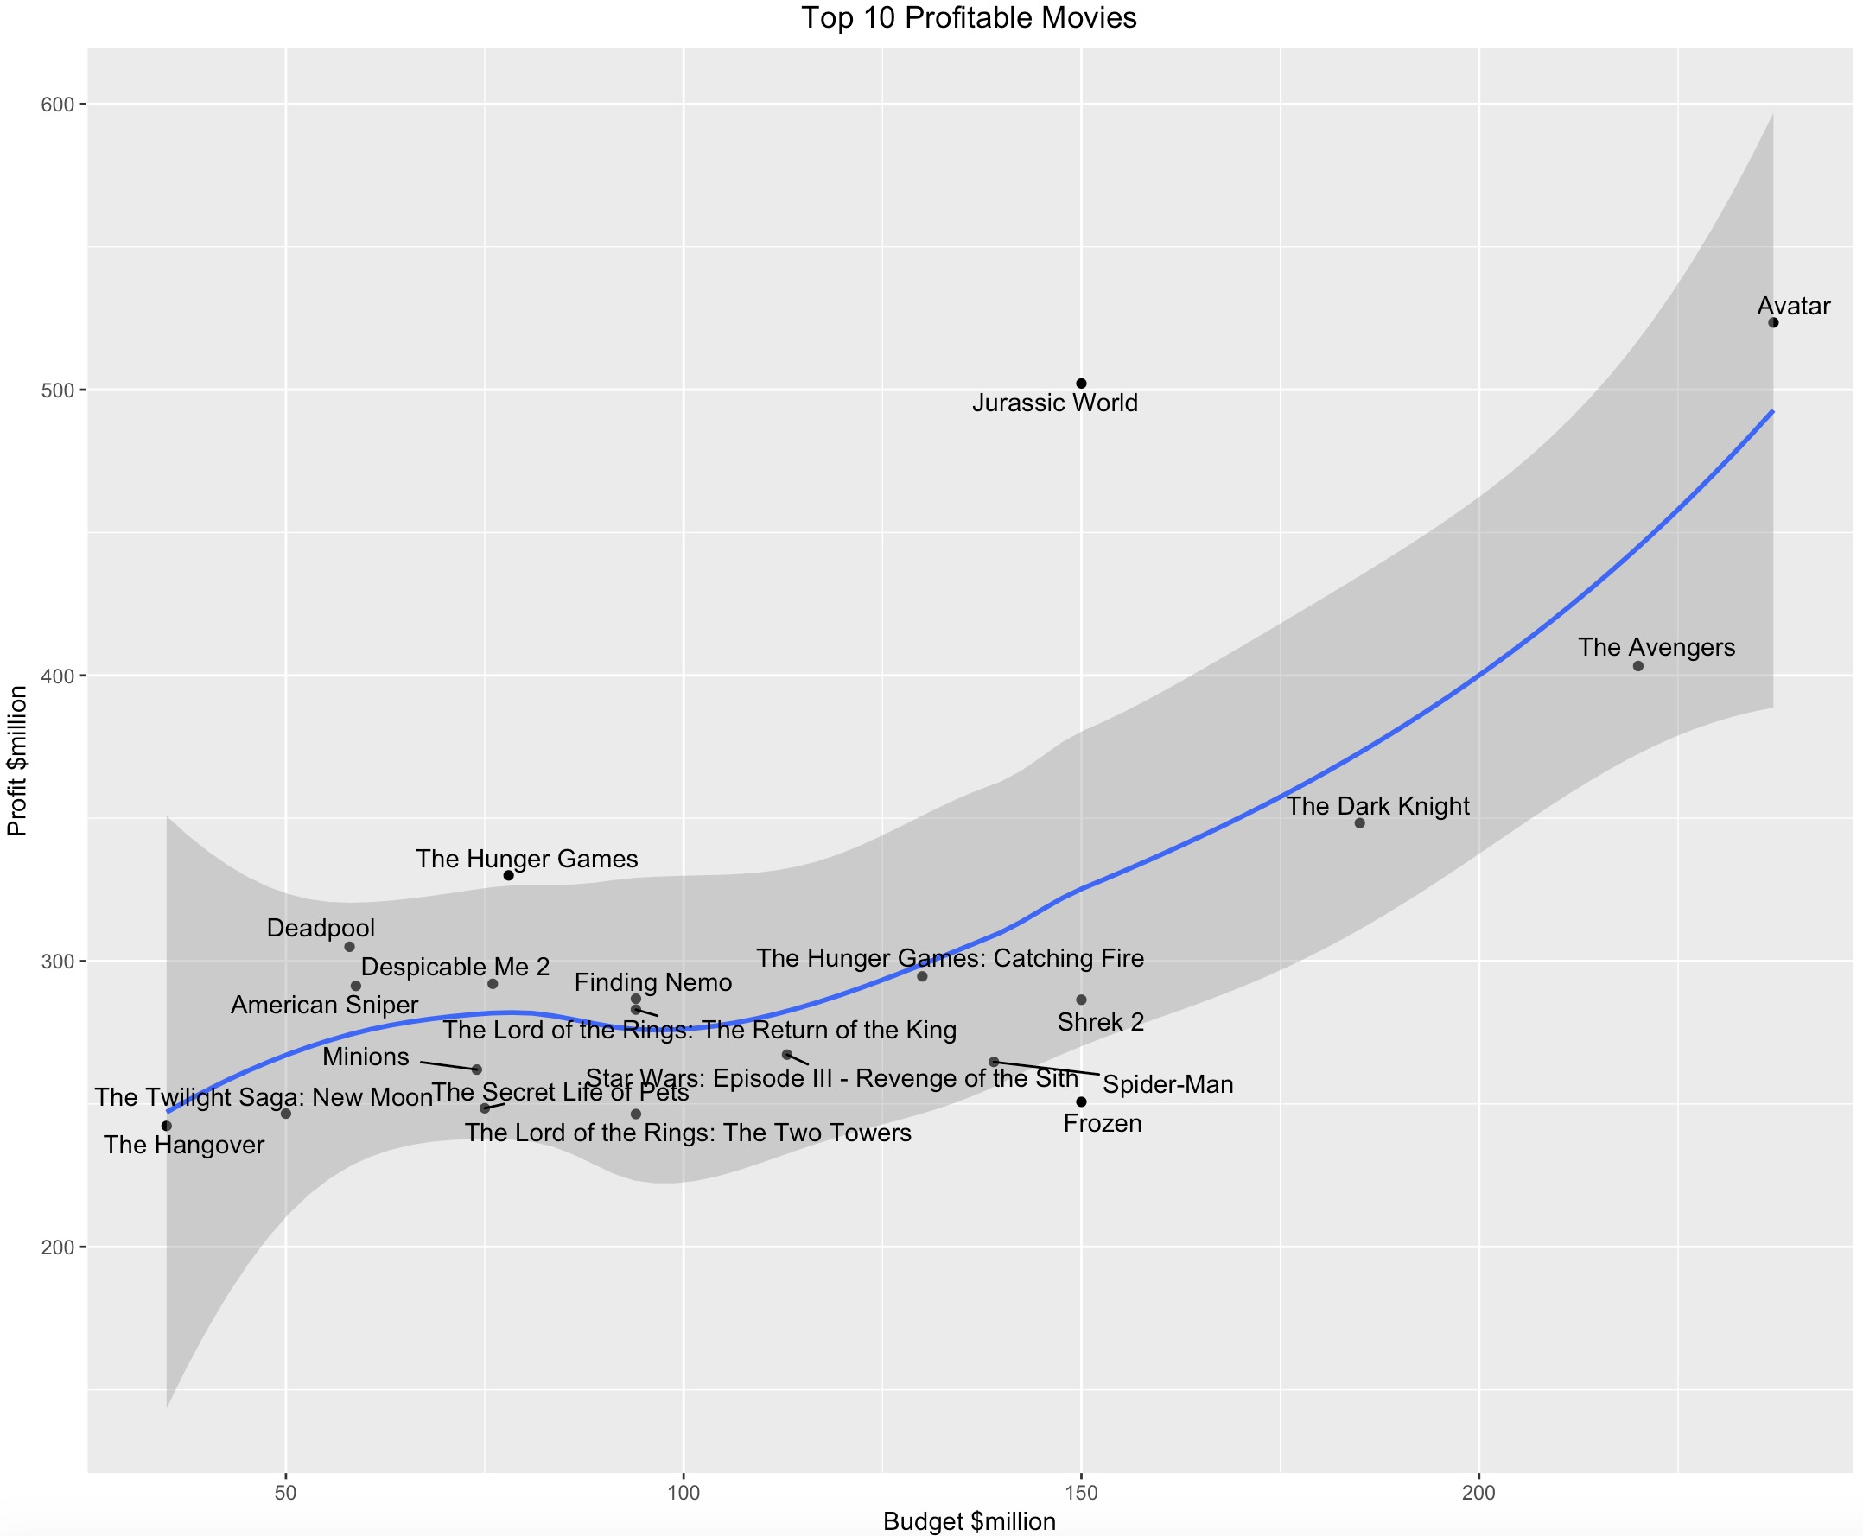
ata description:
4. Data Exploration
4.2 Top 20 movies based on its Profit
These are the top 20 movies based on the Profit earned (Gross - Budget). It can be inferred from this plot that high budget movies tend to earn more profit. The trend is almost linear, with profit increasing with the increase in budget.

Slide 13
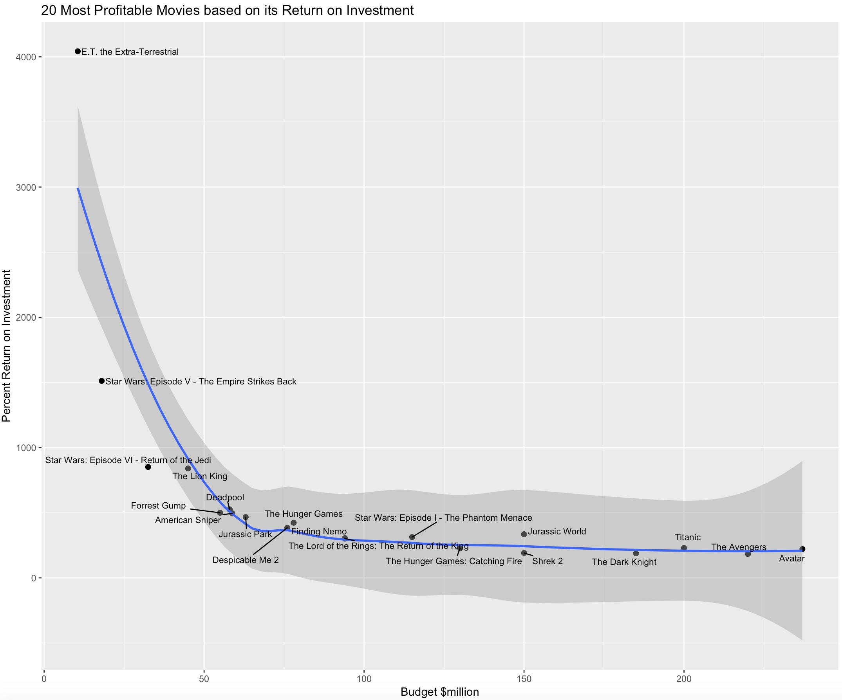
ata description:
4. Data Exploration
4.3 Top 20 movies based on its Return on Investment
These are the top 20 movies based on its Percentage Return on Investment. ((profit/budget)*100).
Since profit earned by a movie does not give a clear picture about its monetary success over the years, this analysis, over the absolute value of the Return on Investment(ROI) across its Budget, would provide better results.
As hypothesized, the ROI is high for Low Budget Films and decreases as the budget of the movie increases.

Slide 14
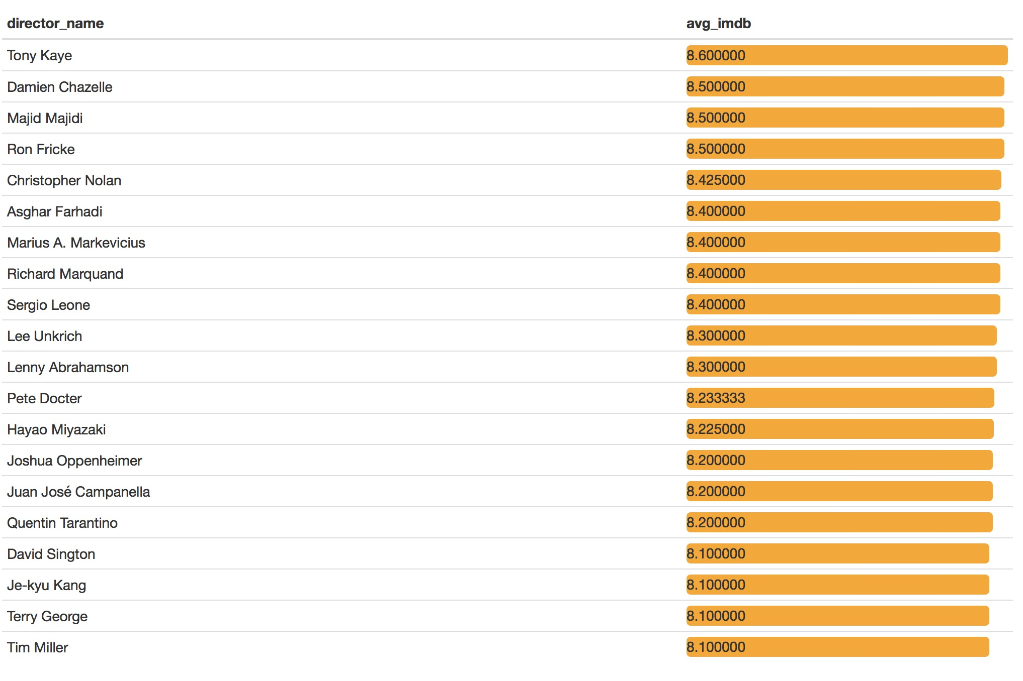
ata description:
4. Data Exploration
4.4 Top 20 directors with highest average IMDB score
We can see the top three directors who are likely to film high quality movies are Tony Kaye, Damien Chazelle and Majid Majidi
All the average imdb score are greater than 8.1 in top 20 directores.

Slide 15
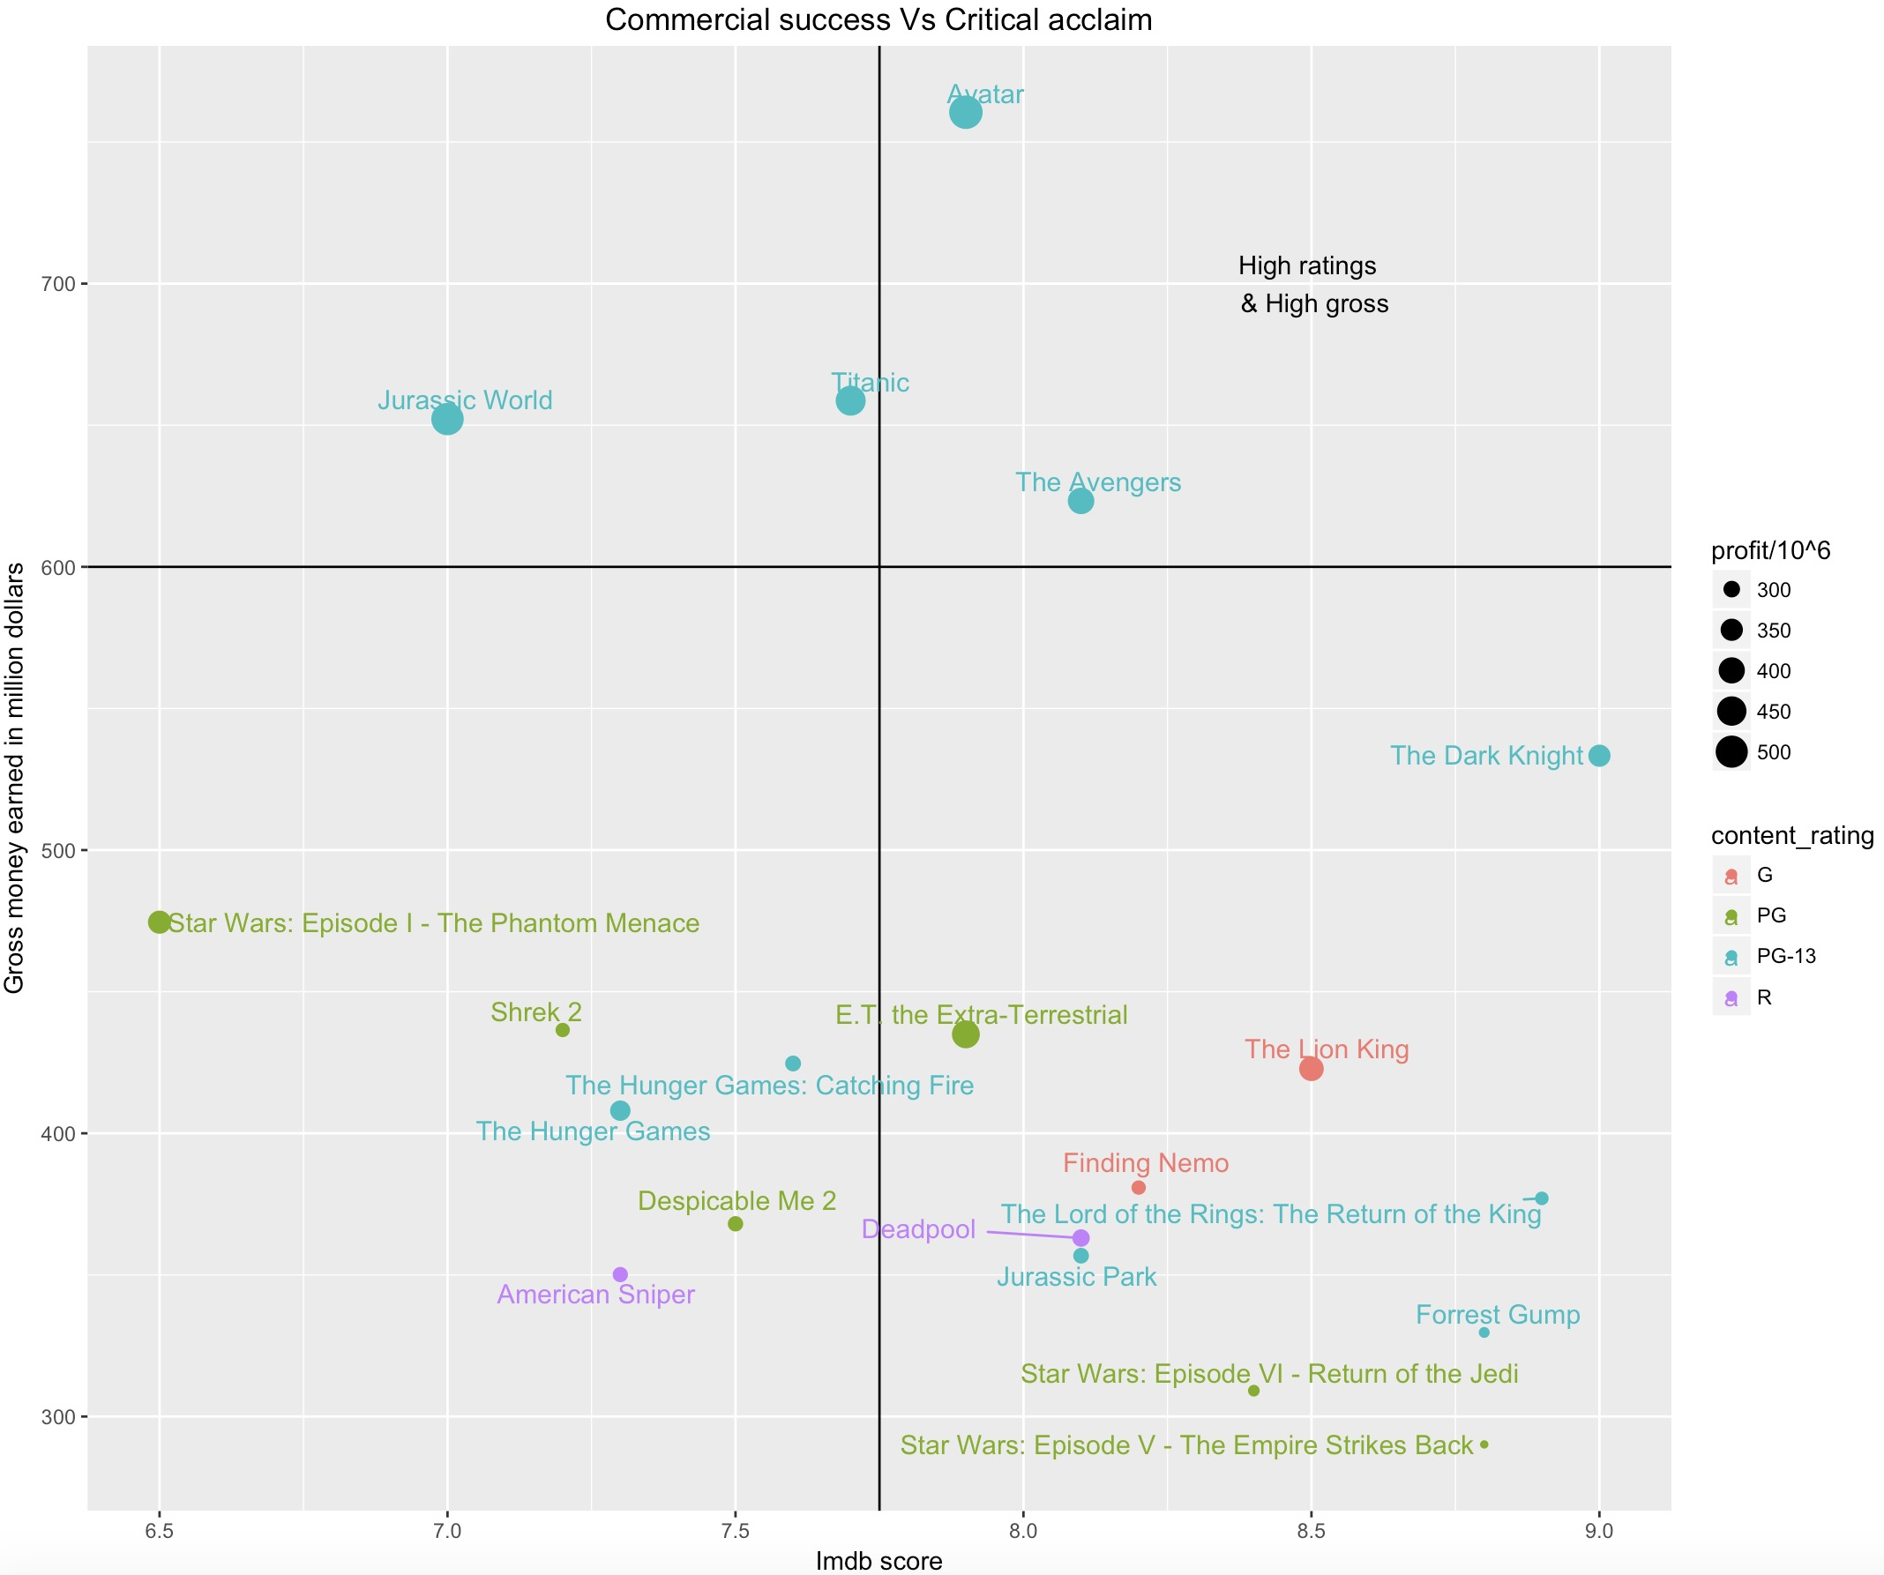
ata description:
4. Data Exploration
4.5 Commercial Success vs Critical Acclaim
This is an analysis on the Commercial Success acclaimed by the movie (Gross earnings and profit earned) vs its IMDB Score.
As expected, there is not much correlation since most critically acclaimed movies do not do much well commercially.

Slide 16
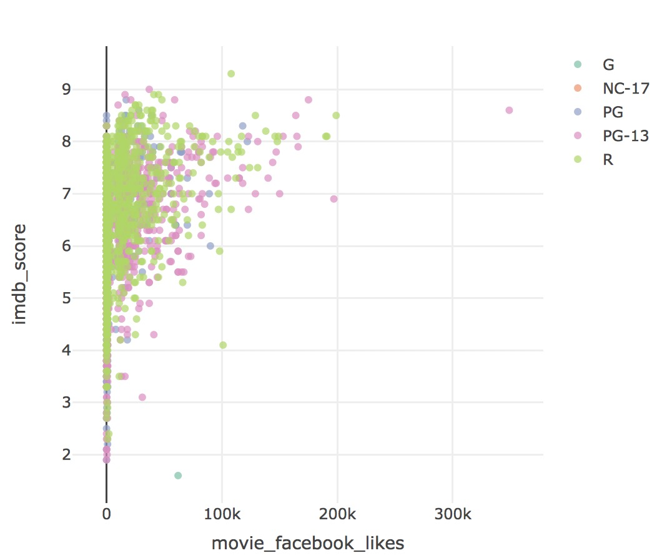
ata description:
4. Data Exploration
4.6 Relation between number of facebook likes and imdb_score
We divide this scatter plot by content-rating. Movie with extremely high Facebook likes tend to have higher imdb score. But the score for movie with low Facebook likes vary in a very wide range.

Slide 17
ata description:
5. Data pre-processing
5.1 Remove Names
Since all the names are so different for the whole dataset, there is no point to use names to predict score.
Same with plot keywords, they are too diverse to be used in the prediction.
And movie link is also a redundant variable.
5.2 Remove Linear Dependent Variables
For the purpose of data exploration, we added two variables based on existing variables: profit and return_on_investment_perc. In order to avoid multicollinearity, we removed these two added variables.

Slide 18
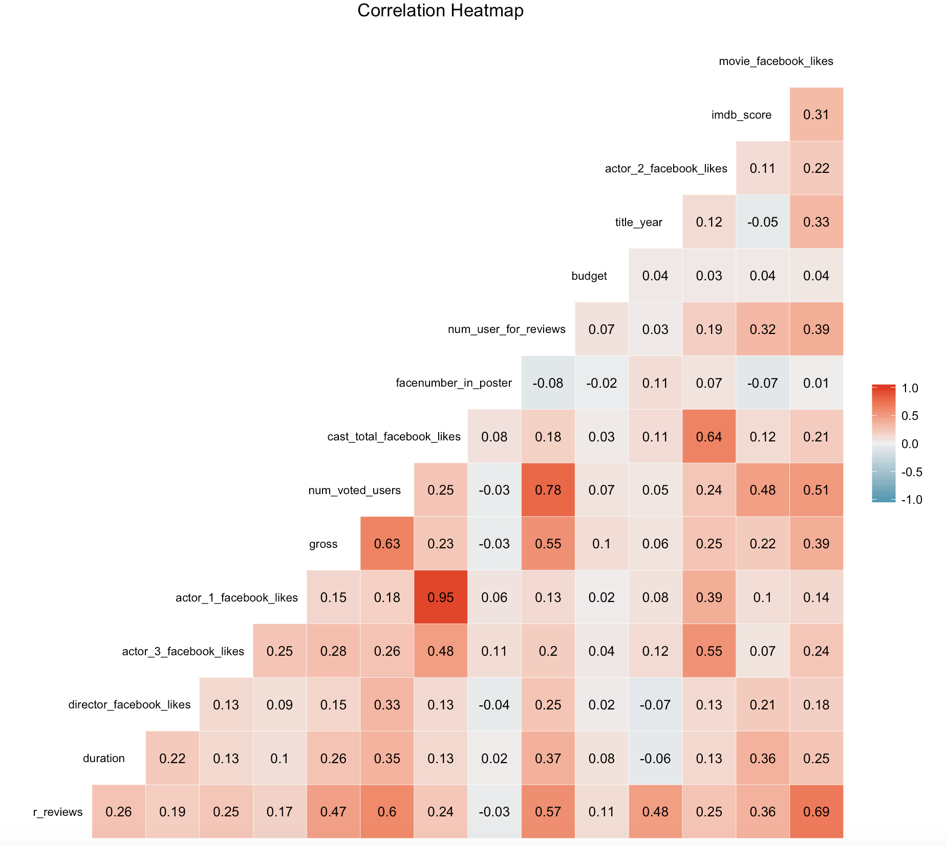
ata description:
5. Data pre-processing
5.3 Remove Highly Correlated Variable
The correlation heatmap of dataset
Based on the heatmap, we can see some high correlations (greater than 0.7) between predictors.
According to the highest correlation value 0.95, we find actor_1_facebook_likes is highly correlated with the cast_total_facebook_likes, and both actor2 and actor3 are also somehow correlated to the total. So we want to modify them into two variables: actor_1_facebook_likes and other_actors_facebook_likes.
There are high correlations among num_voted_users, num_user_for_reviews and num_critic_for_reviews. We want to keep num_voted_users and take the ratio of num_user_for_reviews and num_critic_for_reviews.

Slide 19
ata description:
5. Data pre-processing
5.4 Bin Response Variable
Our goal is to build a model, which can help us predict if a movie is good or bad. So we don’t really want an exact score to be predicted, we only want to know how good or how bad is the movie. Therefore, we bin the score into 4 buckets: less than 4, 4~6, 6~8 and 8~10, which represents bad, OK, good and excellent respectively.
5.5 Organize the Dataset
We want to reorder the columns to make the dataset easier to be understood. And we also renamed the columns to make the names shorter.
5.6 Split Dataset
Here we split data into training, validation and test sets with the ratio of 6:2:2.

Slide 20
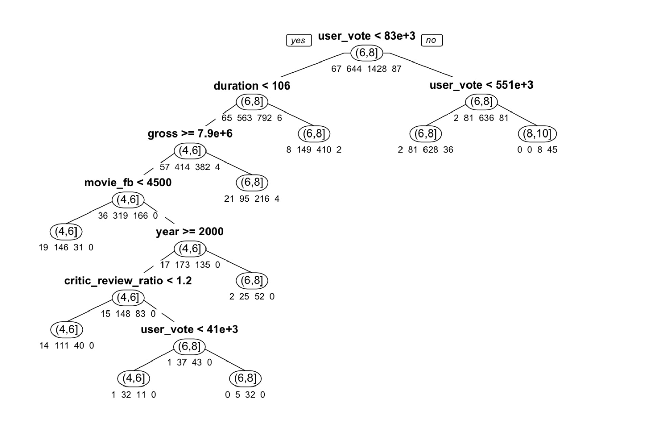
ata description:
6. Implement algorithm
6.1 Classification Tree
6.1.1 Full-Grown Tree

Slide 21
ata description:
6. Implement algorithm
6.1 Classification Tree
6.1.1 Full-Grown Tree (Classification rule & Explanation)
Classification rules:
(1). If (user_vote >= 551000) then class = (8,10].
(2). If (83000 <= user_vote < 551000) then class = (6,8].
(3). If (user_vote < 83000) and (duration >= 106) then class = (6,8].
(4). If (user_vote < 83000) and (duration < 106) and (gross < 7900000) then class = (6,8].
(5). If (user_vote < 83000) and (duration < 106) and (gross >= 7900000) and (movie_fb < 4500) then class = (4,6].
(6). If (user_vote < 83000) and (duration < 106) and (gross >= 7900000) and (movie_fb >= 4500) and (year < 2000) then class = (6,8].
(7). If (user_vote < 83000) and (duration < 106) and (gross >= 7900000) and (movie_fb >= 4500) and (year >= 2000) and (critic_review_ratio < 1.2) then class = (4,6].
(8). If (user_vote < 41000) and (duration < 106) and (gross >= 7900000) and (movie_fb >= 4500) and (year >= 2000) and (critic_review_ratio >= 1.2) then class = (4,6].
(9). If (41000 <= user_vote < 83000) and (duration < 106) and (gross >= 7900000) and (movie_fb >= 4500) and (year >= 2000) and (critic_review_ratio >= 1.2) then class = (6,8].
From these rules, we can conclude that movies with a lot of votes in imdb website tend to have a higher score, which really makes sense because popular movies will have a lot of fans to vote high scores for them.
On the contrary, if a movie has fewer votes, it can still be a good movie if its duration is longer (rule #3).
It is surprise to see that movies make less profit are good, but ok if they make more profit (rule #4).

Slide 22
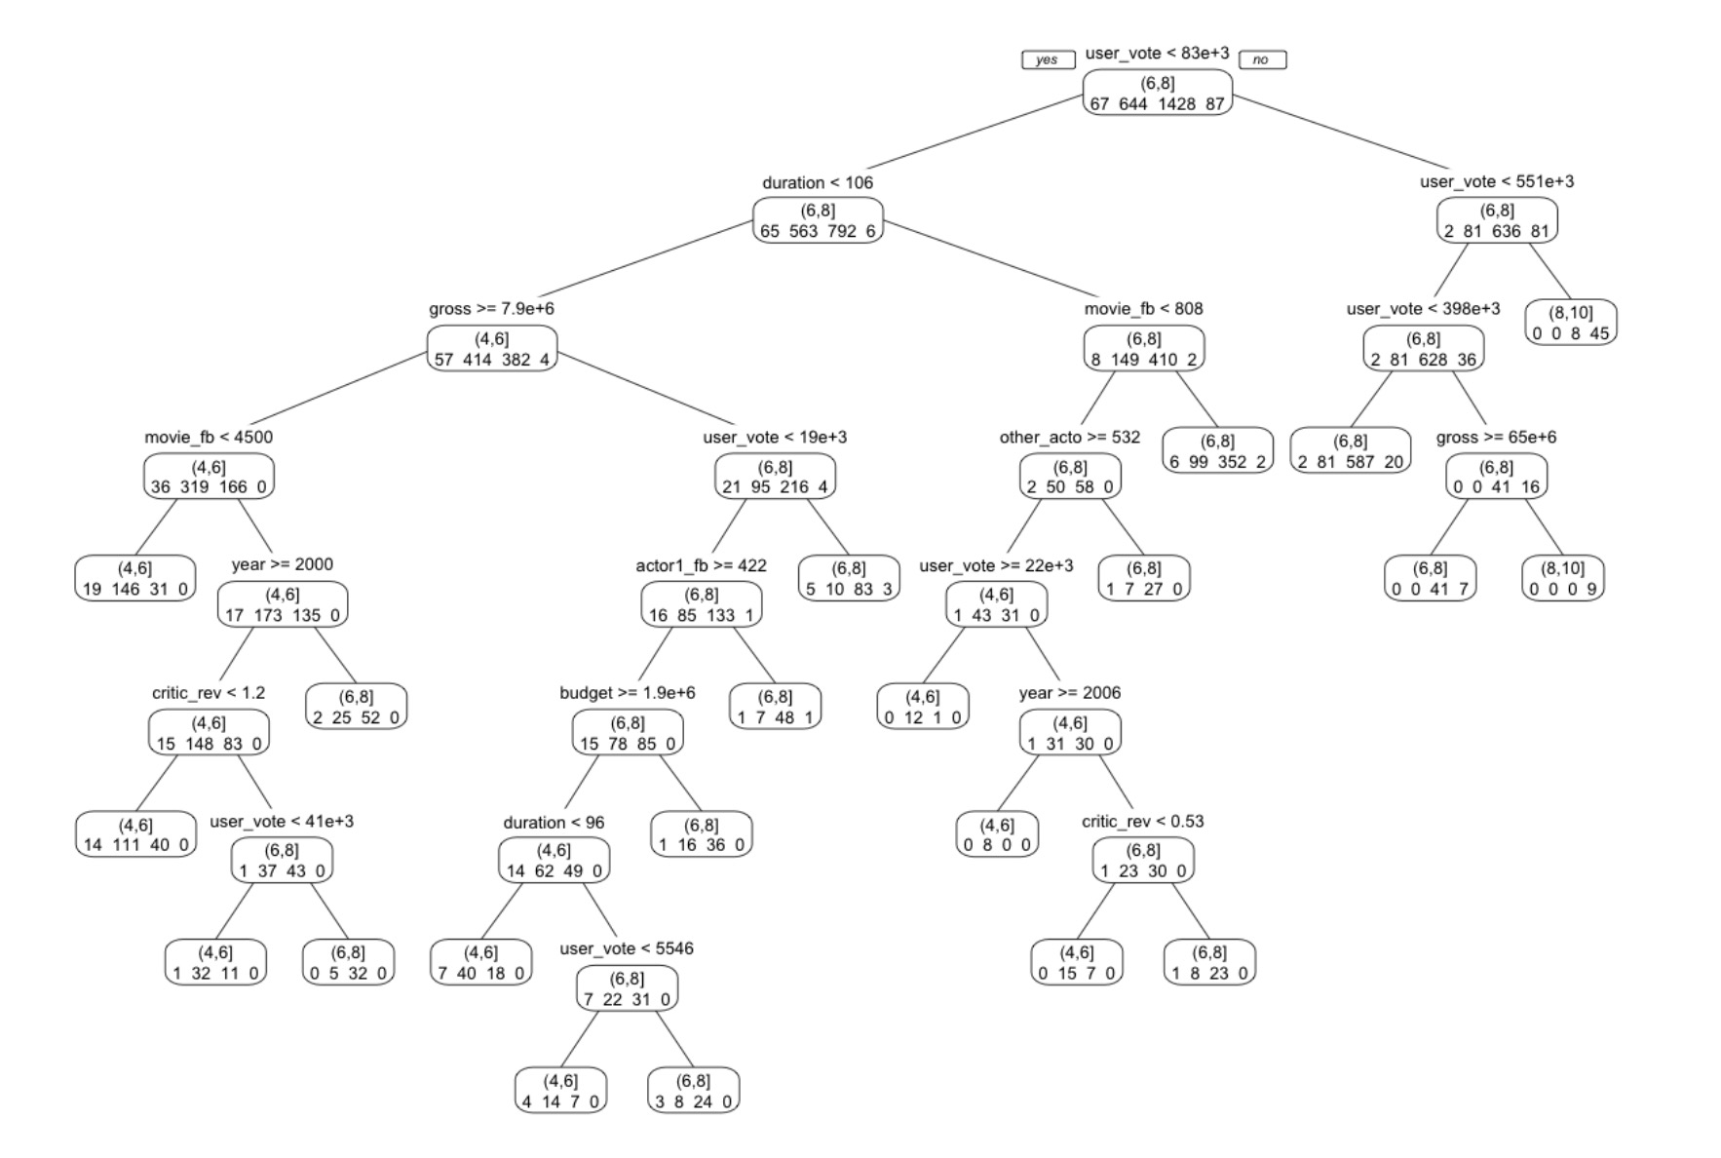
ata description:
6. Implement algorithm
6.1 Classification Tree
6.1.2 Best-pruned Tree (pruned the tree based on the cross-validation error)
After we apply the model, we get:
- Accuracy is 0.7803 for training set.
- Accuracy is 0.7129 for validation set.
- Accuracy is 0.7241 for test set.

Slide 23
ata description:
6. Implement algorithm
6.2 K-Nearest Neighbors
6.2.1 Data Pre-processing: First, we need to prepare our data for applying knn purpose. Dummy variables are required for categorical variables. We use a copy of our data, so we can still use our original data in the future.
6.2.2 Find the best k: We will set k as 1 to 20, and build 20 different models. We calculated each model’s classification accuracy, and find the best k according to the highest accuracy. After the calculation we found when k = 9, we get the highest accuracy: 0.7142857
6.2.3 Apply model on test set: Test set accuracy: 0.7456258

Slide 24
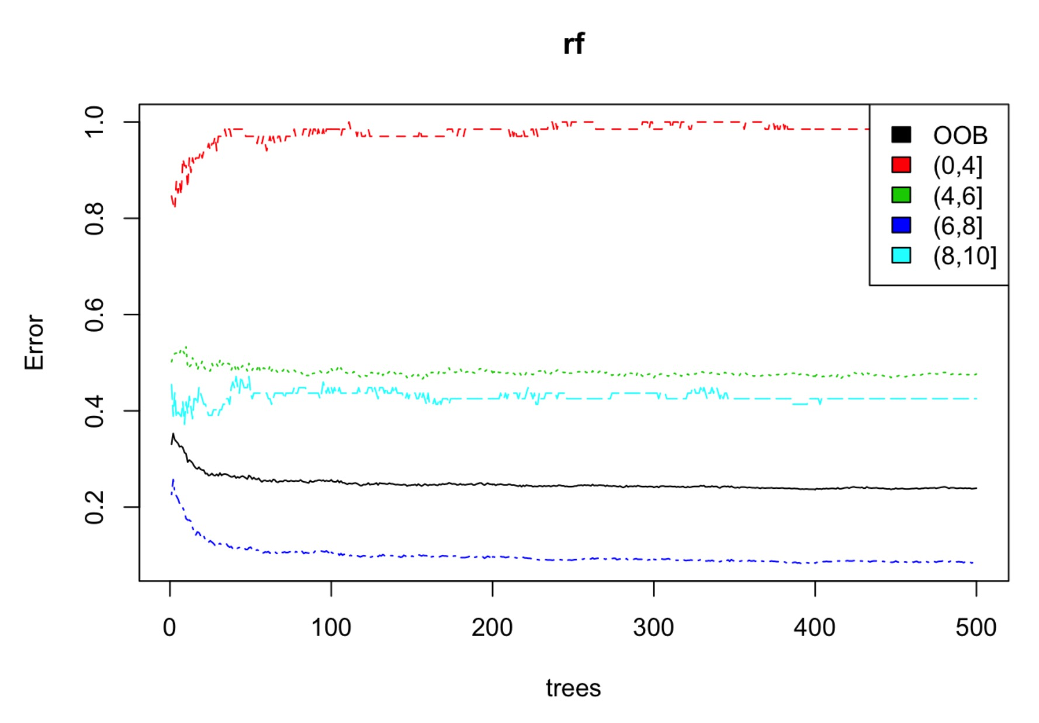
ata description:
6. Implement algorithm
6.3 Random Forest
6.3.1 Build the Model
The black line shows the overall error rate which falls below 30%.
The red, green, blue and aqua lines show the error rate for bad, ok, good and excellent movies respectively.
We can see that right now we’re much more successful predicting good movies. We cannot predict bad movies very well.

Slide 25
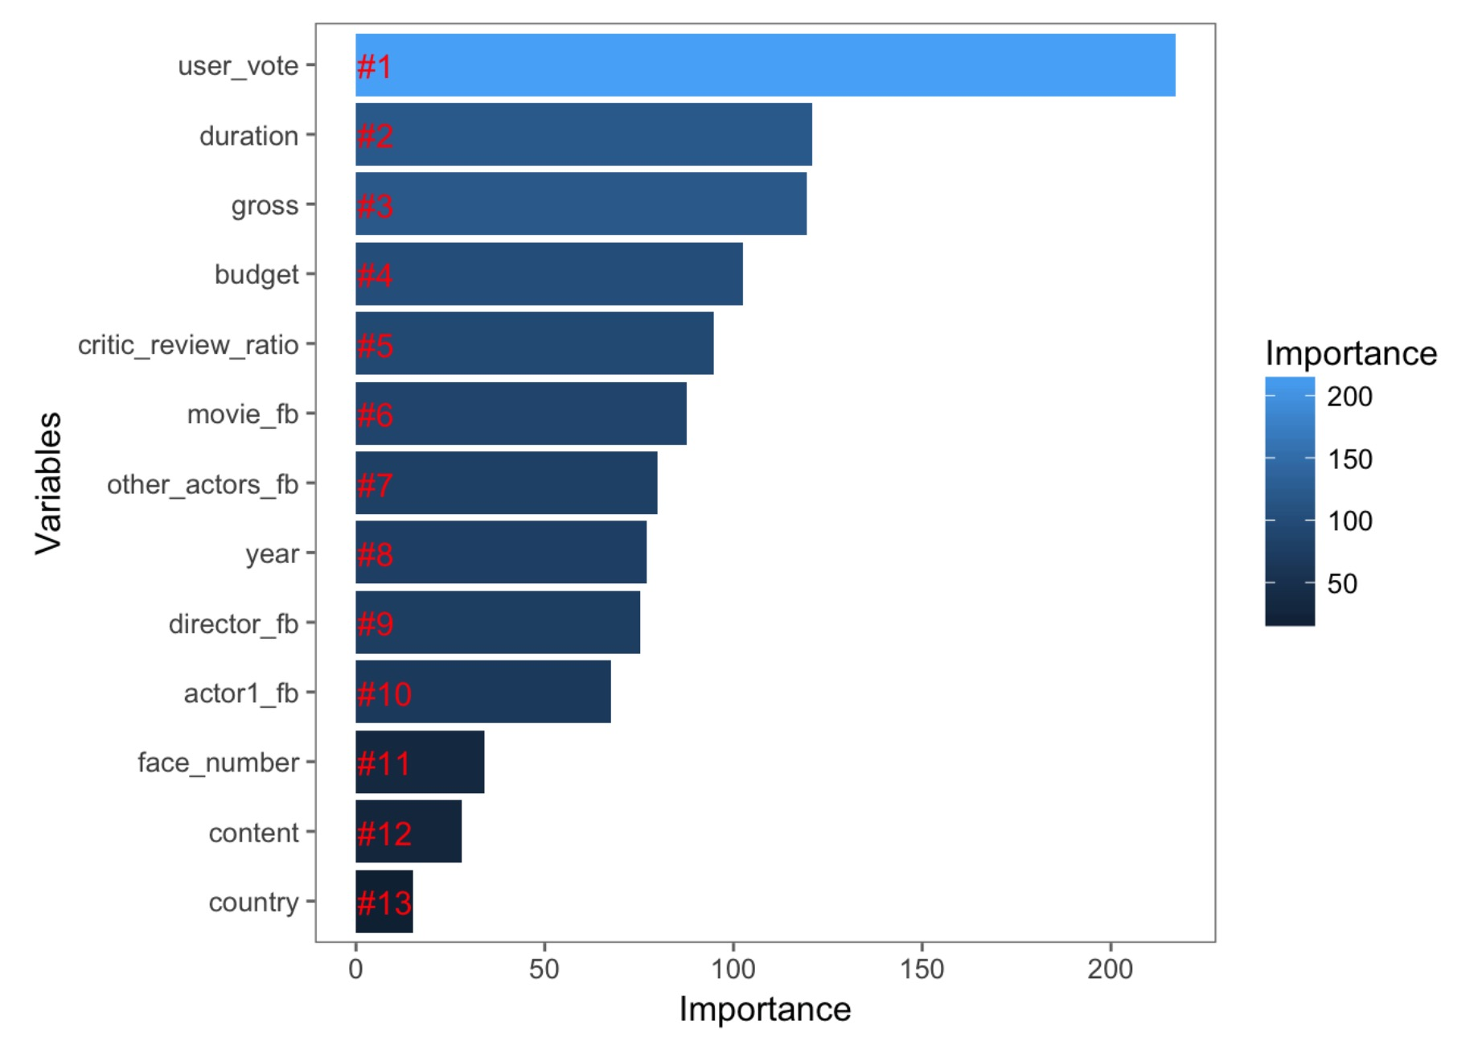
ata description:
6. Implement algorithm
6.3 Random Forest
Let’s look at relative variable importance by plotting the mean decrease in Gini calculated across all trees.
From the plot, we see User_vote is a very important variable, while face_number, content and country are not so important.
After we apply the model, we get:
- Accuracy is 0.7642 for validation set.
- Accuracy is 0.7658 for test set.

Slide 26
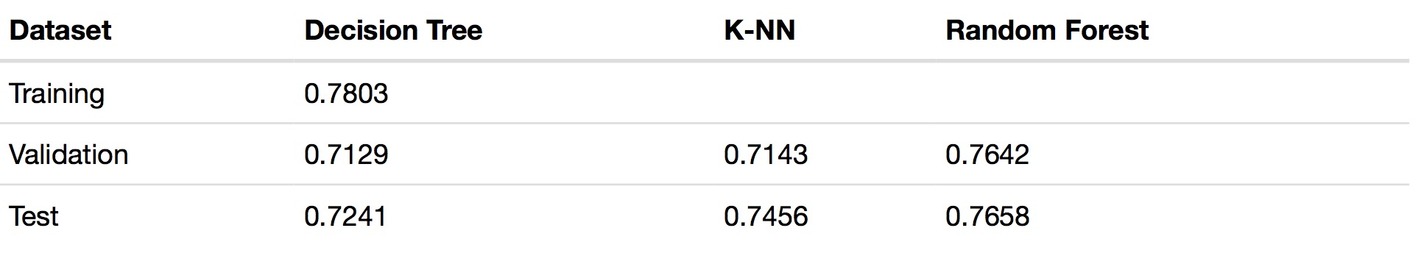
ata description:
7. Conclusion
Accuracy table for different models:
For Decision tree model, we have a higher accuracy for training data because the tree was built based on the training data.
Based on the overall performance, we find the best model is random forest, which gives a high accuracy around 0.76.

