Slide 1

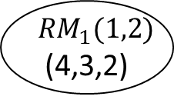

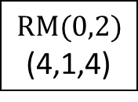

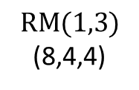
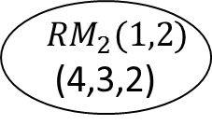
$$RM(0,2)$$
(4,1,4)
1
$$s_{0}$$
$$RM(1,3)$$
(8,4,4)
3
2
$${RM}_{1}(1,2)$$
(4,3,2)
4
$${s_{1}s}_{2}s_{3}$$
5
$${RM}_{2}(1,2)$$
(4,3,2)
$${s_{1}s}_{2}s_{3}$$

