Slide 1
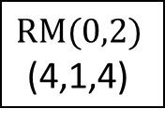
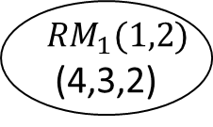
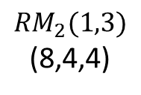

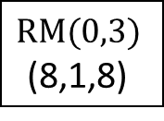
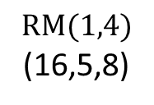
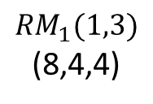
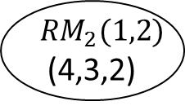


$$RM(0,3)$$
(8,1,8)
$$RM(0,2)$$
(4,1,4)
2
3
1
$${RM}_{1}(1,3)$$
(8,4,4)
4
5
$${RM}_{1}(1,2)$$
(4,3,2)
8
6
$$RM(1,4)$$
(16,5,8)
7
$${RM}_{2}(1,2)$$
(4,3,2)
9
$$RM(0,2)$$
(4,1,4)
15
10
10
$${RM}_{2}(1,3)$$
(8,4,4)
12
11
$${RM}_{1}(1,2)$$
(4,3,2)
13
14
$${RM}_{2}(1,2)$$
(4,3,2)

