Slide 1
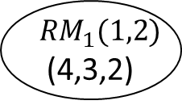
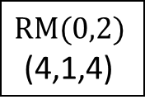
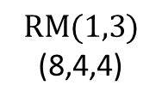

$$RM(0,2)$$
(4,1,4)
$$RM(1,3)$$
(8,4,4)
$${RM}_{1}(1,2)$$
(4,3,2)
$${RM}_{2}(1,2)$$
(4,3,2)

Slide 2


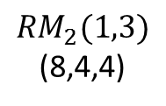

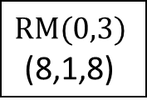
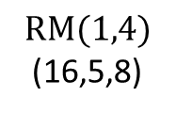
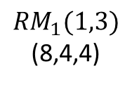

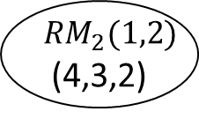

$$RM(0,3)$$
(8,1,8)
$$RM(0,2)$$
(4,1,4)
$${RM}_{1}(1,3)$$
(8,4,4)
$${RM}_{1}(1,2)$$
(4,3,2)
$$RM(1,4)$$
(16,5,8)
$${RM}_{2}(1,2)$$
(4,3,2)
$$RM(0,2)$$
(4,1,4)
$${RM}_{2}(1,3)$$
(8,4,4)
$${RM}_{1}(1,2)$$
(4,3,2)
$${RM}_{2}(1,2)$$
(4,3,2)

Slide 3

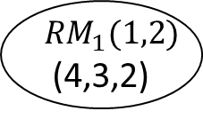
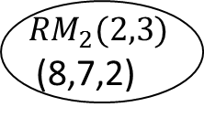

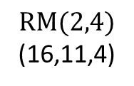
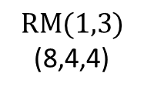
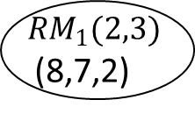
$$RM(0,2)$$
(4,1,4)
$$RM(1,3)$$
(8,4,4)
$${RM}_{1}(1,2)$$
(4,3,2)
$$RM(2,4)$$
(16,11,4)
$${RM}_{1}(2,3)$$
(8,7,2)
$${RM}_{2}(1,2)$$
(4,3,2)
$${RM}_{2}(2,3)$$
(8,7,2)

Slide 4
























$$RM(0,3)$$
(8,1,8)
$$RM(0,2)$$
(4,1,4)
$$RM(1,4)$$
(16,5,8)
$${RM}_{1}(1,2)$$
(4,3,2)
$${RM}_{1}(1,3)$$
(8,4,4)
$${RM}_{2}(1,2)$$
(4,3,2)
$${RM}_{2}(1,3)$$
(8,4,4)
$$RM(0,2)$$
(4,1,4)
$$RM(2,5)$$
(32,16,8)
$${RM}_{1}(1,2)$$
(4,3,2)
$${RM}_{2}(1,2)$$
(4,3,2)
$$RM(0,2)$$
(4,1,4)
$${RM}_{1}(1,2)$$
(4,3,2)
$$RM(1,3)$$
(8,4,4)
$$RM(2,4)$$
(16,11,4)
$${RM}_{2}(1,2)$$
(4,3,2)
$${RM}_{1}(2,3)$$
(8,7,2)
$${RM}_{2}(2,3)$$
(8,7,2)
$$RM(0,2)$$
(4,1,4)
$${RM}_{1}(1,2)$$
(4,3,2)
$$RM(1,3)$$
(8,4,4)
$$RM(2,4)$$
(16,11,4)
$${RM}_{2}(1,2)$$
(4,3,2)
$${RM}_{1}(2,3)$$
(8,7,2)
$${RM}_{2}(2,3)$$
(8,7,2)

