Slide 1
Zebra Crossing Detector Based on LSD and Geometric Features
Hanzhou Liu

Slide 2
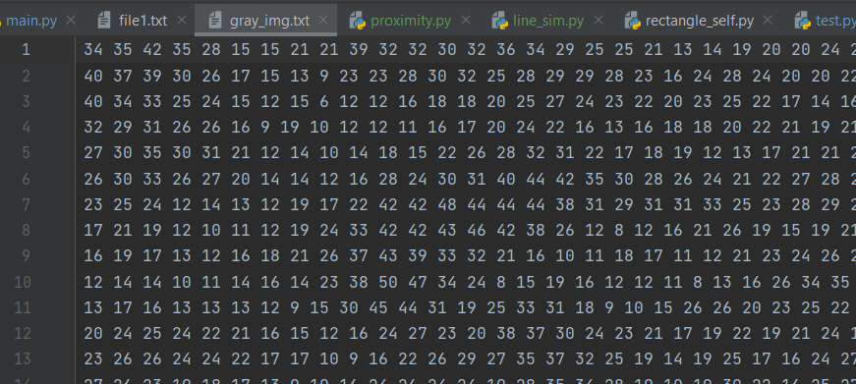
Part One
Image Preprocessing
Resize the image to 300*400
Convert the image to a grayscale image.

Slide 3
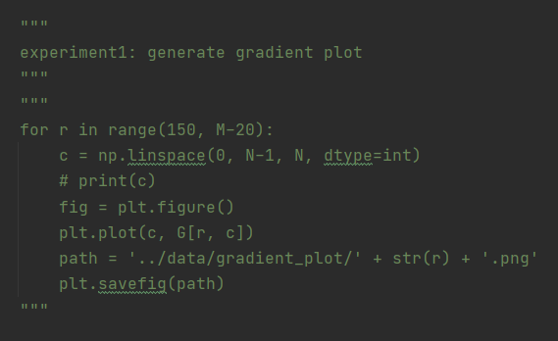
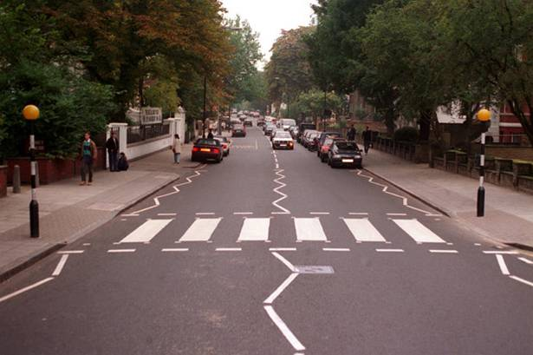
Part Two
LSD Algorithm
Compute gradient at each pixel

Slide 4
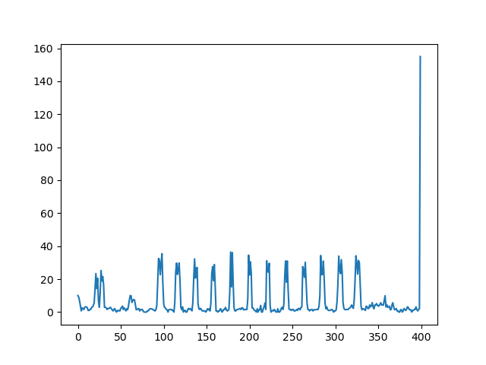
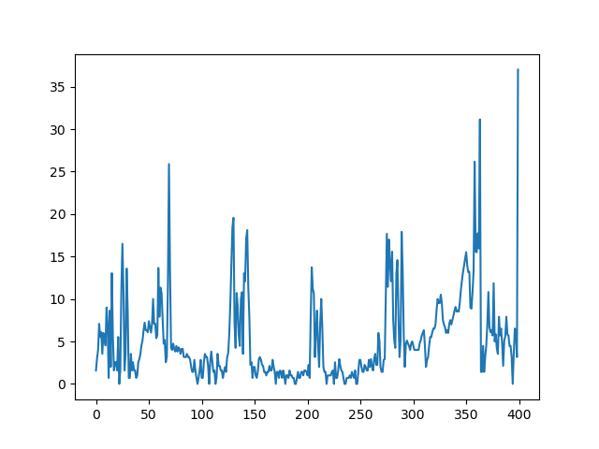
Part Two
LSD Algorithm
Experiment1: Generate Gradient Plot at each row.

Slide 5
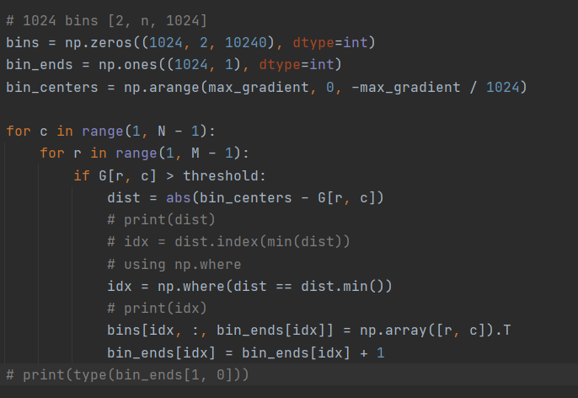
Part Two
LSD Algorithm
Pseudo-Sort Gradients by Using a 3-D Array

Slide 6
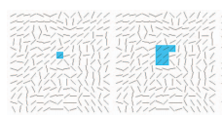
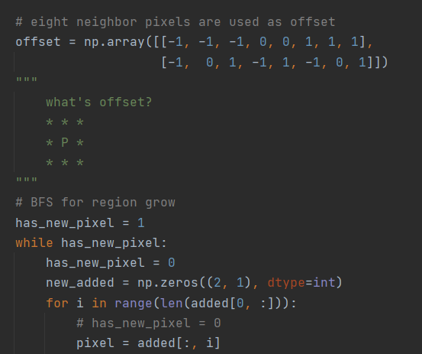
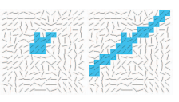
Part Two
LSD Algorithm
Region Grow Algorithm

Slide 7
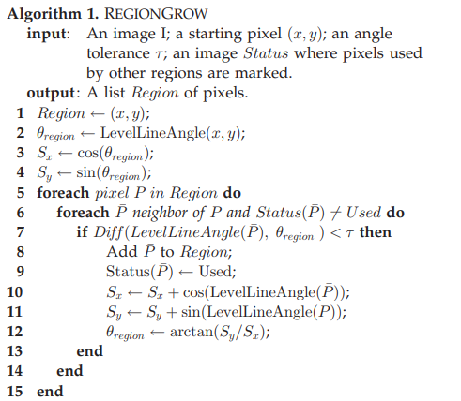
Part Two
LSD Algorithm
Region Grow Algorithm

Slide 8
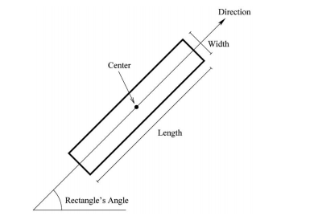
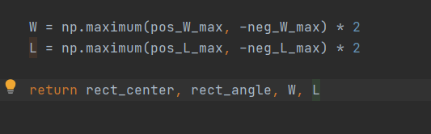
Part Two
LSD Algorithm
Region Grow Algorithm
Important parameters of a rectangle region:

Slide 9
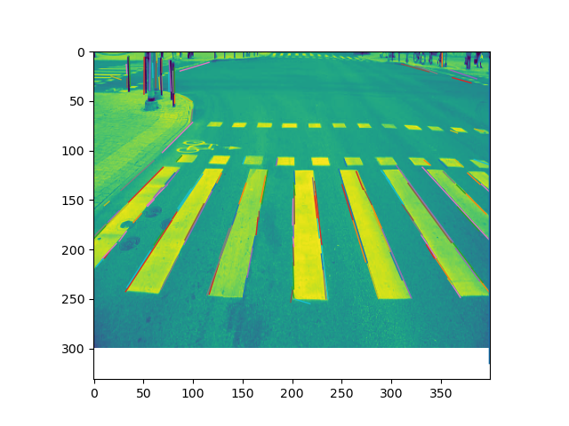
Part Two
LSD Algorithm
Visualization One

Slide 10
Part Three
Group Lines
Combine line segments close to a line
Rules: 1., 2., 3., …
Also consider the polarity of each line segment

Slide 11
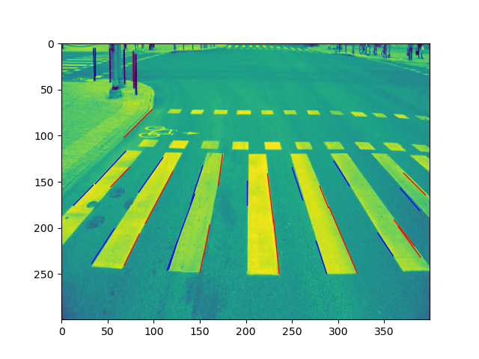
Part Three
Group Lines
Visualization Two

Slide 12
Part Four
Match Line Segments
Visualization Three

Slide 13
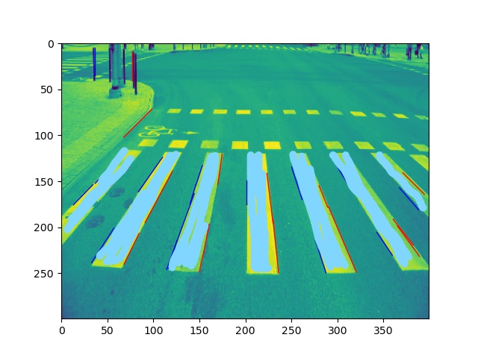
Part Five
Generate Stripes
Visualization Four

Slide 14
TRANSITION SLIDE

Slide 15
“Quote, statistic call out, or closing slide to go here”

