Slide 1
project
ADVANCE OOP

Slide 2
Group Members
Hanzla Mahmmod
Haris Hamayun
Ammad Ali
Talha Usmani

Slide 3
QuizX
Technologies Used
Front End : HTML , CSS JAVA Script (JSP)
Back End : Java Servlet , MySQL (Database)
Tools Used :
Eclipse

Slide 4
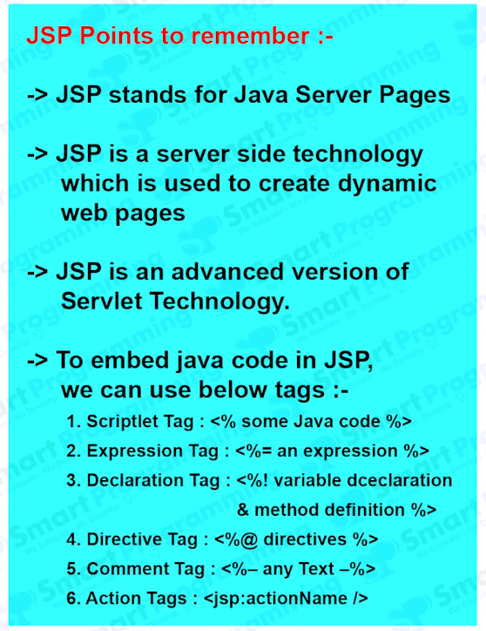

Slide 5
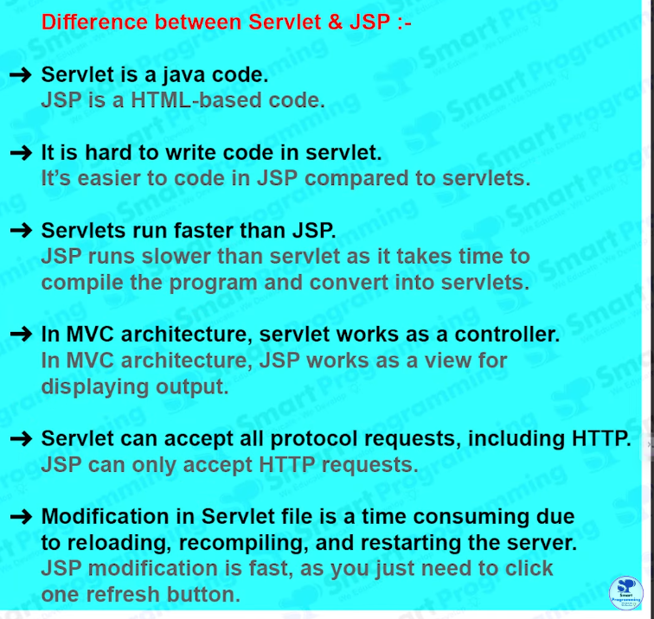

Slide 6

Home Page

Slide 7
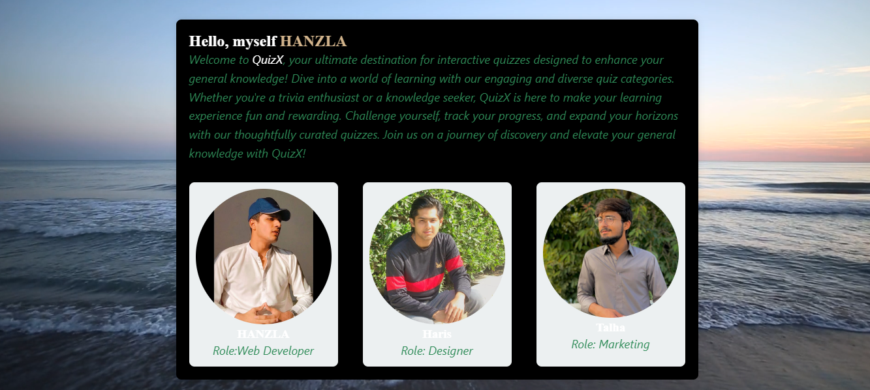
About Page

Slide 8
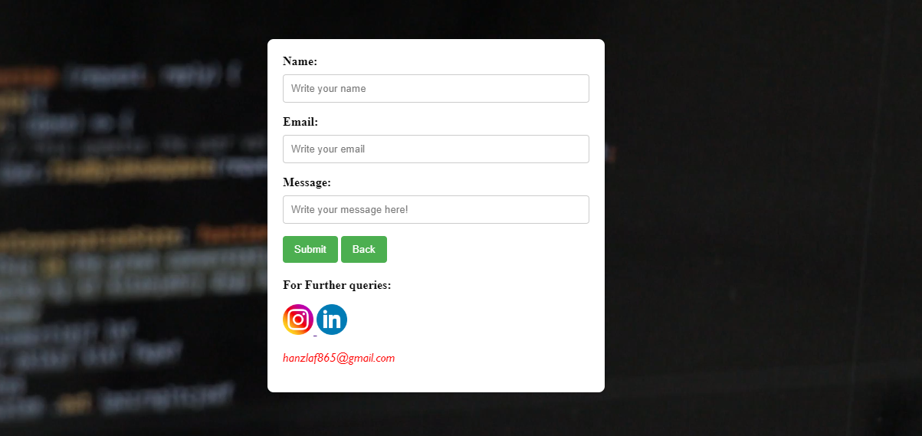
Contact Page

Slide 9
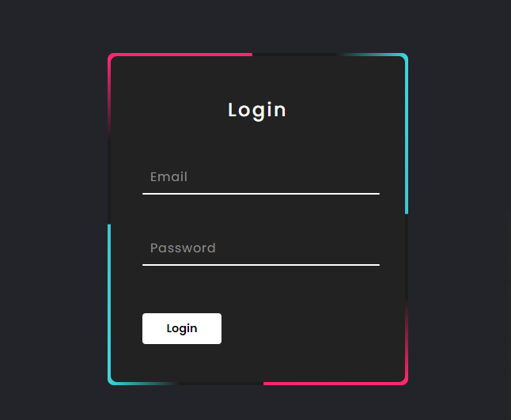
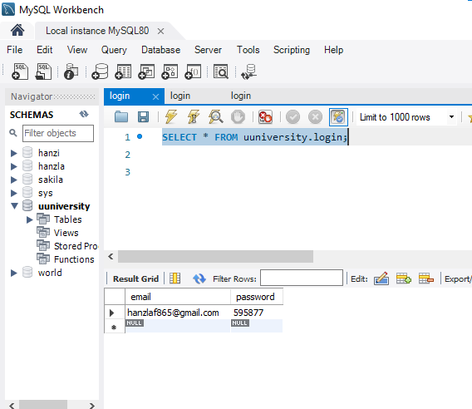
Login Page

Slide 10
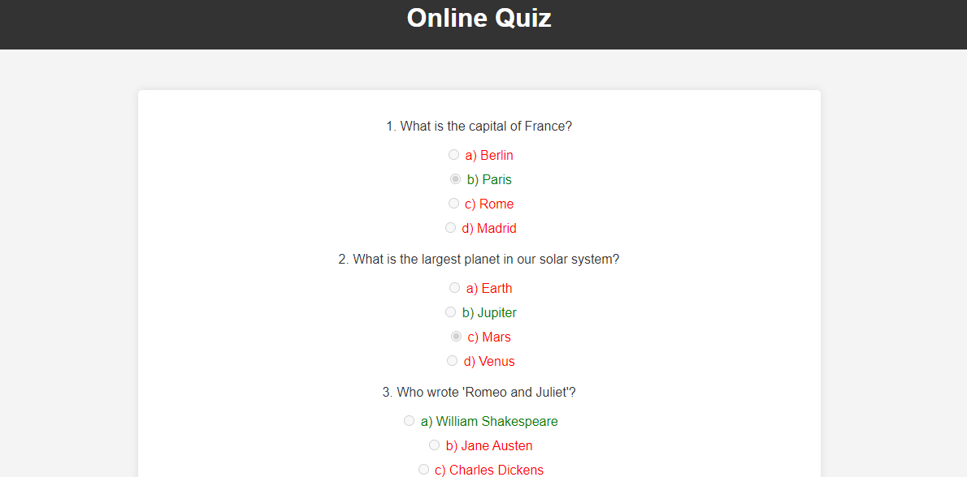

Slide 11


