Slide 1
Training Dataset
Time-dependent models:
Transformer, LSTM, GRU
Training Labels
Data Processing & Wrangling
Feature Extraction & Engineering
Feature Scaling
Time-independent models:
CNN, FC-NN
Model Evaluation & Tuning
Neural Network based
Data Preprocessing
XGBoost
Testing Dataset
Conventional ML based
5-class Prediction
Modeling

Slide 2
Time axis
5-class prediction
14
one-hot encoding
14
Sniffer location
Softmax
17x14 seq input
1x5
1
Staying time
1
Day1, 2, or 3
Fully Connected
1
Distance
Transformer encoder
1x14
CNN
# of layers = 3
Conv1d, 29to1ch
PReLU
Conv1d, 24to12ch
BatchNorm
17x14 seq
stacking
Conv1d, 32to24ch
1x3 Conv
# of layers = 2
Bi-LSTM
Conv1d, 48to32ch
48x14 seq

Slide 3
Time axis
14
14
Sniffer location
LSB
1
0
0
0
0
0
1
0
0
0
0
0
…
…
…
…
…
0
0
0
1
MSB
0
1
0
0
Location:
1
14
…
2
13

Slide 4
Time axis
5-class prediction
14
one-hot encoding
Time axis
14
Sniffer location
Softmax
17x14 seq input
1x5
14
1
Staying time
14
Sniffer location
1
Day1, 2, or 3
Fully Connected
1
Distance
Transformer encoder
1x14
CNN
LSB
1
0
0
0
# of layers = 3
Conv1d, 29to1ch
PReLU
0
0
1
0
0
0
0
0
…
…
…
…
…
Conv1d, 24to12ch
BatchNorm
17x14 seq
stacking
0
0
0
1
Conv1d, 32to24ch
1x3 Conv
MSB
0
1
0
0
# of layers = 2
Bi-LSTM
Conv1d, 48to32ch
Location:
1
14
…
2
13
48x14 seq

Slide 5
5-class prediction
Softmax
1x5
Hidden Layer3
1x16
PReLU
Hidden Layer2
1x32
Fully-Connected
Hidden Layer1
1x14
Sniffer location
1
0
1
…
0
1
Location:
1
2
3
13
14

Slide 6
Model Framework 1
Framework 2
Time axis
5-class prediction
5-class prediction
14
one-hot encoding
Softmax
14
Sniffer location
Softmax
17x14 seq input
1x5
1x5
1
Staying time
1
Day1, 2, or 3
Fully Connected
Fully Connected
1
Distance
Transformer encoder
1x14
CNN
1x16
Fully Connected
# of layers = 3
Conv1d, 29to1ch
1x32
Conv1d, 24to12ch
Fully Connected
17x14 seq
1x14
stacking
Conv1d, 32to24ch
Sniffer location
# of layers = 2
Bi-LSTM
Conv1d, 48to32ch
1
0
1
…
0
1
48x14 seq
Location:
1
2
3
13
14

Slide 7
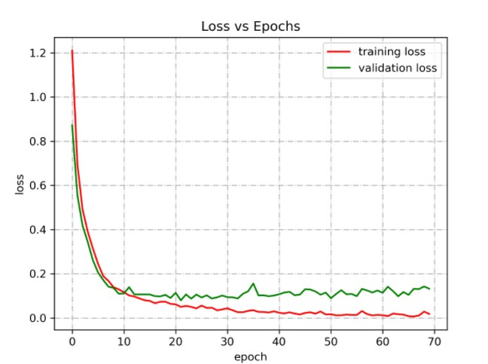
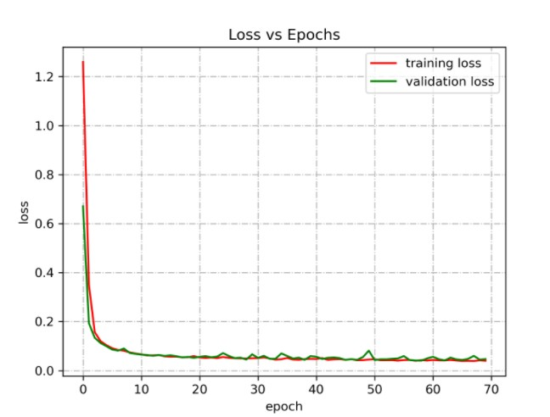


Framework 1
Framework 2
$≅$0.08
$≅$0.04

