Slide 1
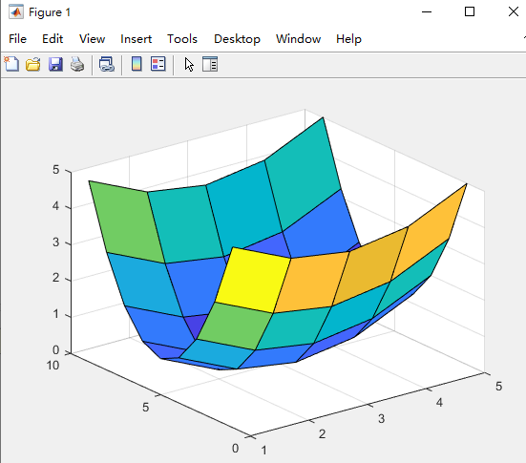
Plot f(x,y)
x =[-2:2] % value x range
y =[-4:4] % value y range
[xm ym] = meshgrid(x,y) % meshgrid: 2-D and 3-D grids
fxy = (xm.^2)/4 + ((ym.^2)/4) % Your Function fxy =f(x,y)
surf(fxy) % surf : Surface plot

