Slide 1
MATLAB- Simulink
Kun-Yen Chiu

Slide 2
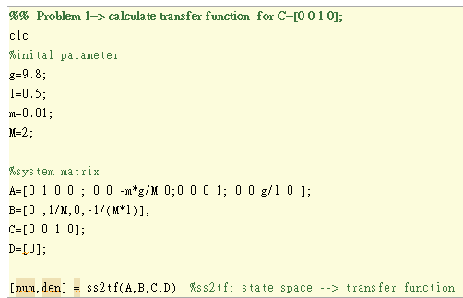
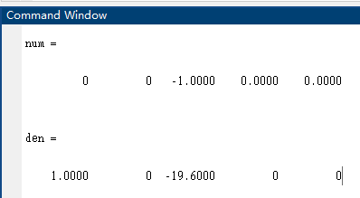
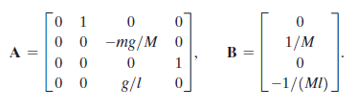
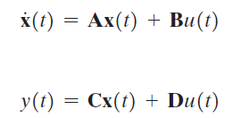
Example 3.3 Inverted pendulum control
Step 1. Used MATLAB to transfer the transfer function from state space
System matrix:

Slide 3
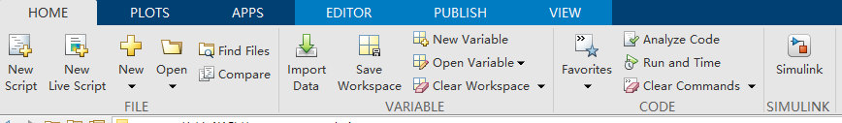
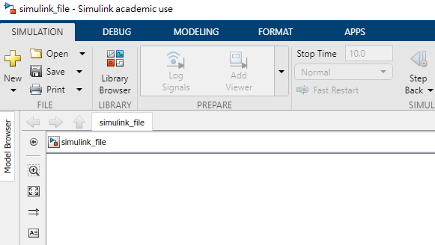
Step 2. Open Simulink
Home →Simulink →Blank Model (create new model)→save it!!
Once you save the model,
you can search the function blocks from library Browser
You will need the following function blocks:
Signal Builder Add
Constant
Product
Gain
Step
Transfer Fcn
Scope (see output result)

Slide 4
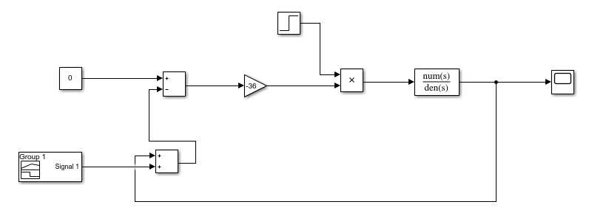
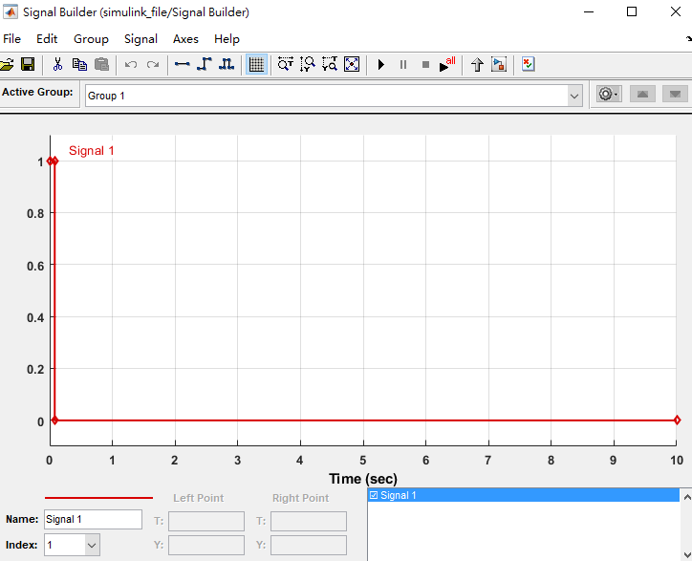
Step 3. Create Block Diagram
num = [0 0 -1 0 0]
den = [1 0 -19.6 0 0]
C =[0 0 1 0]
+-
After designing the block diagram,
Press Run and click the scope to see the result
K value (ex: -36)
++
For Signal Builder
You can set
for t= 0~0.1
y=1
else
y=0
to simulate initial condition

Slide 5
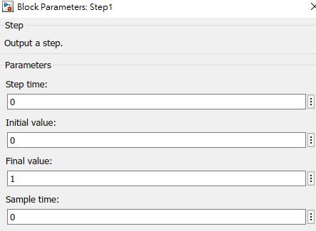
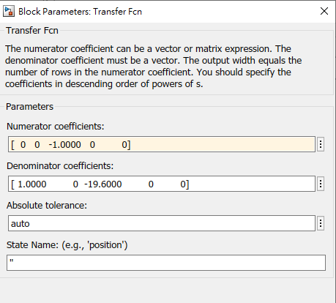
Step 3) Cont.
C =[0 0 1 0]
num = [0 0 -1 0 0]
den = [1 0 -19.6 0 0]

Slide 6
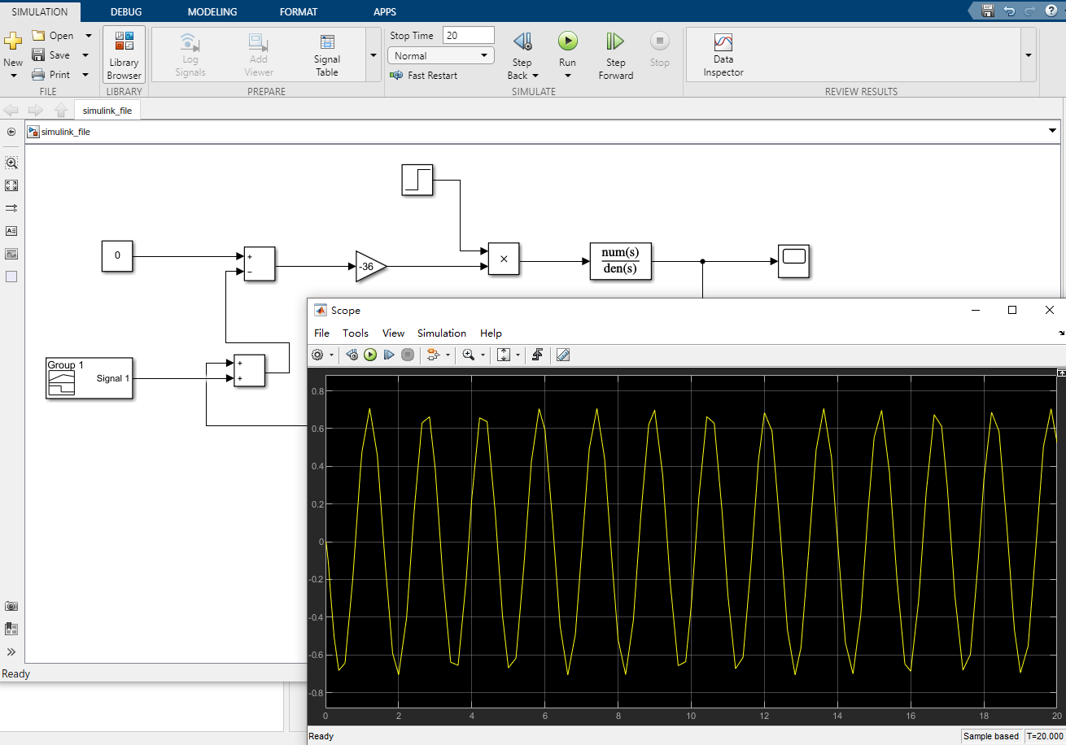
Output Result
Change the time if you want

Slide 7
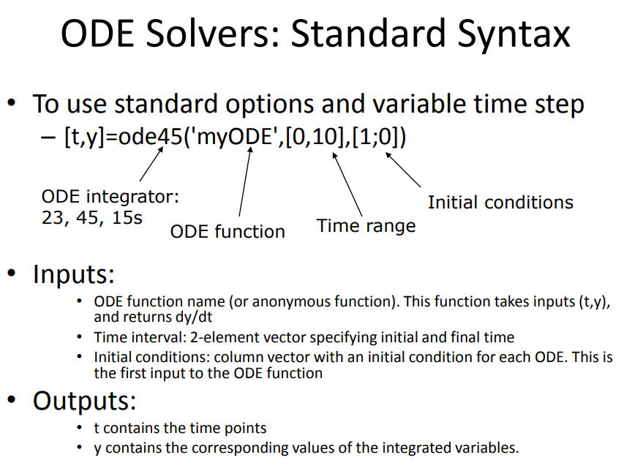
Problem 2: ODE45 Reference
More info:
https://www.mathworks.com/help/matlab/ref/ode45.html

Slide 8
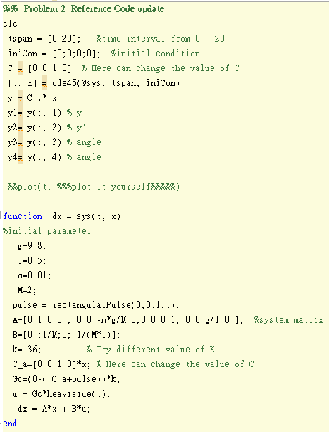
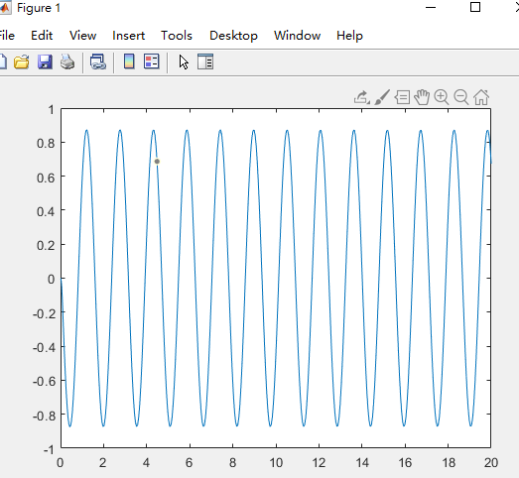
Problem 2 reference code update

Slide 9
HW4
Problem 1
Screenshot the transfer function for each C
Choose three K values for each C (total 9 result)
Problem 2
Choose three K values for each C (total 9 result)
In Your report don’t just show your result, please explain !!
**Analyze the different values of K for each C
( [0,0,1,0],[0,0,1,1] and [0,1,1,1] )

