Slide 1
Project

Slide 2
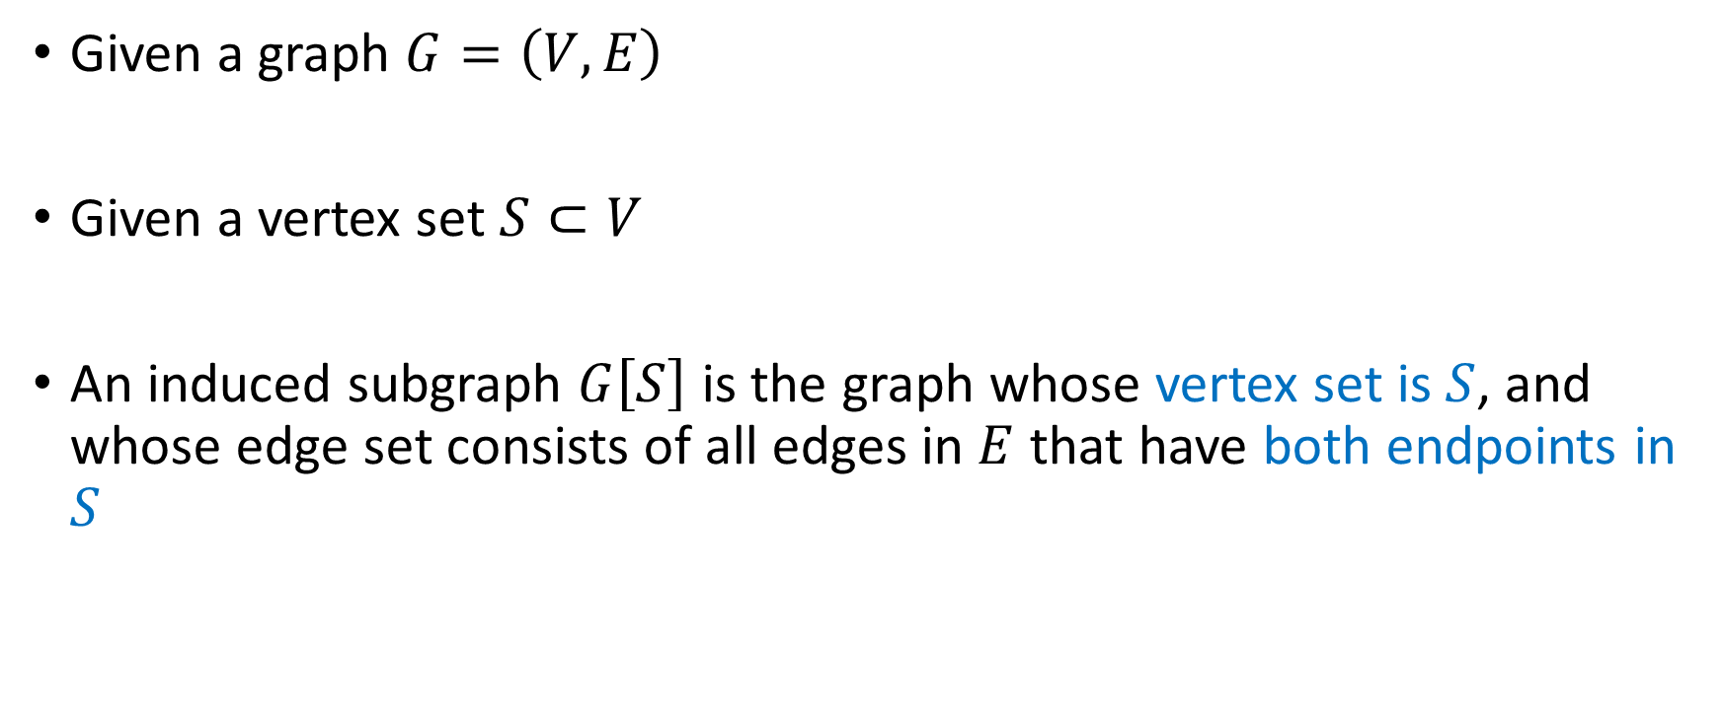
Induced subgraph
Given a graph $G=\left(V,E\right)$
Given a vertex set $S⊂V$
An induced subgraph $G\left[S\right]$ is the graph whose vertex set is $S$, and whose edge set consists of all edges in $E$ that have both endpoints in $S$

Slide 3


Induced subgraph
0
$$V=\{0,1,2,3,4\}$$
0
$$S=\{0,2,3,4\}$$
4
1
4
3
2
3
2

Slide 4

Complete graph
Given a graph $G=\left(V,E\right)$
If $G$ is a complete graph, then every pair of vertices has an edge connect them
$\left(u,v\right)∈E, ∀u,v∈V , u≠v$
0
4
1
3
2

Slide 5

Clique
Given a graph $G=(V,E)$
A clique is a subset of $V$, whose induced subgraph is a complete graph
$S=\{0,3,4\}$ is a clique
0
0
4
1
4
3
2
3

Slide 6
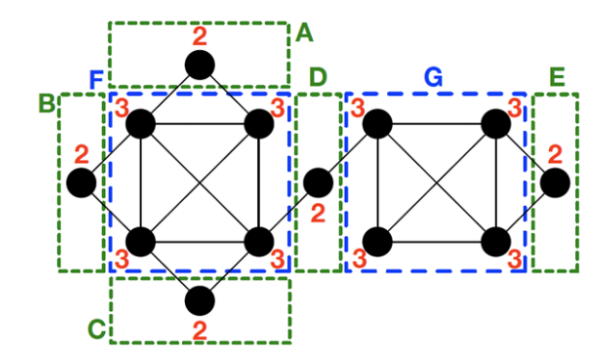

K-core
A k-core of a graph $G$ is a maximal connected subgraph of $G$ in which all vertices have degree a least k.
A vertex has coreness c if it belongs to a c-core but not to any (c+1)-core

Slide 7
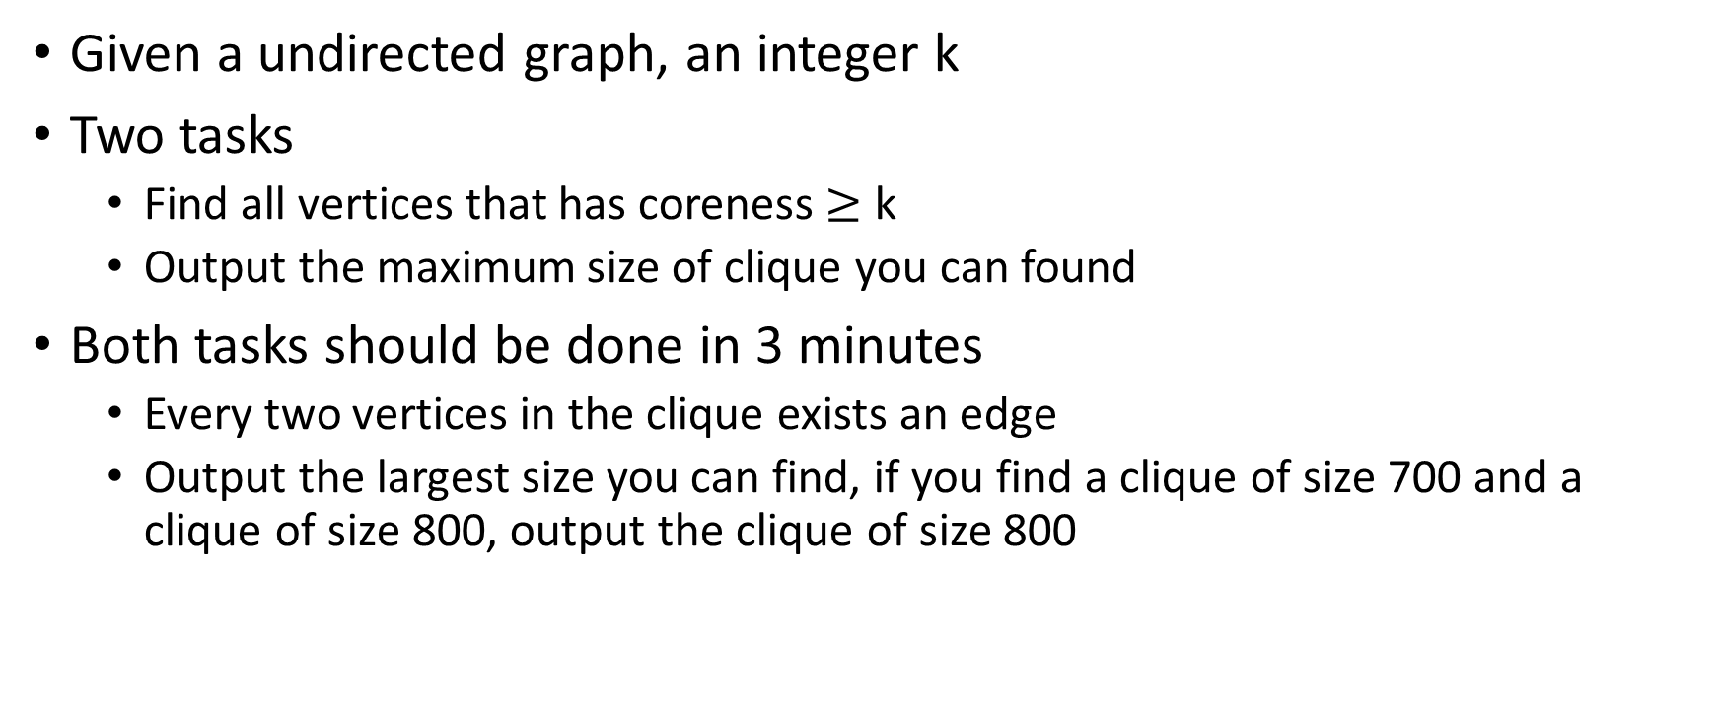
Project
Given a undirected graph, an integer k
Two tasks
Find all vertices that has coreness $≥$ k
Output the maximum size of clique you can found
Both tasks should be done in 3 minutes
Every two vertices in the clique exists an edge
Output the largest size you can find, if you find a clique of size 700 and a clique of size 800, output the clique of size 800

Slide 8
Requirements
Implement with C/C++, with your own makefile
Strictly follow the input/output formats
Do not copy/paste others’ codes
You can refer to the codes on GitHub or anywhere else
But you need to write your own code

Slide 9
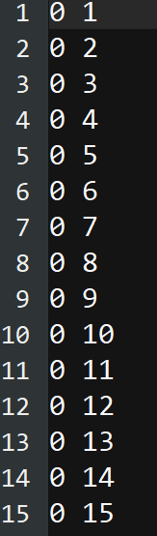
Input file format
Each line consists of two integers u and v, means there exist an edge between u and v
u and v are separated by a space

Slide 10
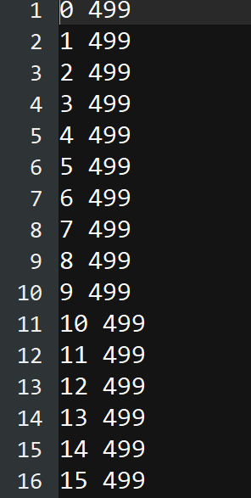
Output file format – k-core
In each line, you should output two integers
They are the vertex IDs and their coreness
[Vertex ID] [coreness]
Output vertex IDs in ascending order

Slide 11
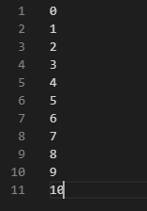
Output file format -- clique
Your program should be interrupted after 3 minutes 10 seconds after the interruption, a kill signal will be sent
Output the largest clique you can find
Each line is a vertex ID
Output vertex IDs in ascending order

Slide 12
Testing environment
CPU: i7-8700k
RAM: 64GB DDR4
DISK: 1TB
Gcc version: 4.8.5 (C++ 11)
If you need other version of compiler, please let us know the reason

Slide 13
Testing
Please provide makefile
Name of output executable file should be “clique_find”
Your code should take two arguments: input file name and k
TA will test your code as follow
./clique_find [input_file_name] k
Output file name should be
kcore.txt, for k-core problem
clique.txt, for maximum clique problem

Slide 14
Testcases
We have two testcases
Public testcase
82167 vertices, ID from 0 - 82166
2072442 edges
Private testcase
82167 vertices, ID from 0 - 82166
2091140 edges

Slide 15
Scoring
We have public and private test cases. You also need to submit the project report
Public (45%)
K-core (18%)
Clique (27%)
Private (45%)
K-core (18%)
Clique (27%)
Report (10%)

Slide 16
Scoring – k-core
To get the score of k-core problem, you need to output the correct vertex IDs and their coreness

Slide 17
Scoring -- clique
For both the public and private test cases of the clique problem, the scores are given based on the clique size you found
Size = 1500 : 60
Size > 1400 : 54
Size >= 800 : 42
Size >= 500 : 36
Otherwise : 0

Slide 18
Scoring -- example
Output correct coreness on both test cases, find clique size = 1400 on the public test case and clique size = 800 on the private test case, and write report properly
(40 + 54)*0.45 + (40 + 42)*0.45+10 = 89.2
Output correct coreness on public test case, but fail in the private test. Find clique size = 1433 on both test cases
(40 + 54 )*0.45 + ( 0 + 54 )*0.45 + 10 = 76.6

Slide 19
Report
Your report should contain
How you implement your code
Challenge you encounter in this project
Reference that give you idea (github/paper…)
No more than 3 pages

Slide 20


Submission
Submit your
Code
Makefile
Report
Submit a zip file with filename “[student_id]_project”

Slide 21



Submission
After “make”, a executable file “find_clique” should be created
After execute, kcore.txt and clique.txt should be created

Slide 22
Note
You are allowed to use STL
But do not use existing functions/libraries that directly compute coreness/find cliques

Slide 23
Warning
Do not copy code from this website when you implement k-core
https://www.geeksforgeeks.org/find-k-cores-graph/
It’s wrong

Slide 24
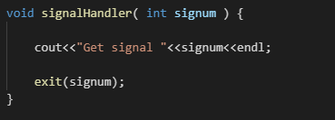
Appendix – how to handle interrupt signal
You need to include <signal.h>
Define a function signal handler

Slide 25
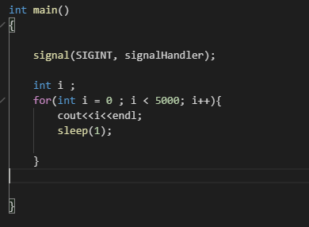
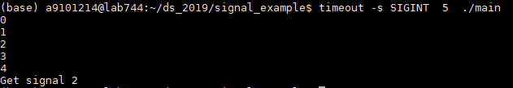
Appendix – how to handle interrupt signal
In the main function, specify the signal to handle
Run with timeout

Slide 26
Appendix
Some method you may use to find maximum clique
Branch and bound
https://en.wikipedia.org/wiki/Branch_and_bound
Graph coloring
https://www.geeksforgeeks.org/graph-coloring-set-2-greedy-algorithm/

Slide 27
Appendix – how to find k-core
Iteratively delete low degree vertices
4
5
0
7
2
6
1
3
1-core

Slide 28
Appendix – how to find k-core
Iteratively delete low degree vertices
4
5
0
7
2
6
1
3
2-core

Slide 29
Appendix – how to find k-core
Iteratively delete low degree vertices
4
5
0
7
2
6
1
3
3-core

Slide 30
Appendix – how to find clique
A simple method: brute force
For example
V = {0,1,2,3,4}
Try every possible combination
{0},{1},{2},{3},{4}
{0,1},{0,2},{0,3},{0,4}…
{0,1,2},{0,1,3}, … ,{0,3,4}…
{0,1,2,3,4}
Check which is the maximum size clique
0
4
1
3
2

Slide 31
Appendix – how to find clique
Is brute force practical?
In this project, test case contain 82167 vertices
Trying out all combinations is impossible

Slide 32
Update: bonus test case
A bonus test case will be given
Scoring depends on the size of clique you find
The scores you get are based on the ranking of the clique size
Top 10%: 10
Top 50%: 5
Top 70%: 2

Slide 33
Update: bonus test case
Timeout: 30 seconds (30 seconds for INTERRUPT, 35 seconds for KILL)
TA will run your program for 5 times
We average your top-3 best results as the your final result

Slide 34
Update: bonus test case
You need to submit another version of codes for your bonus points
Argument of the program is
File name of input graph
Number of vertices in the graph
You need to provide the makefile
After make, executable file name should also be “clique_find”
You program will be tested as follow
./clique_find [input file name] [number of vertices]

