Slide 1
10810EECS204001 Data Structures Homework 1
2019/10/3 10:10
~
2019/10/17 23:59

Slide 2
HW1
The input is a string of infix expression
You need to implement three functions
Convert infix to postfix
Convert infix to prefix
Evaluate the value of the given infix expression

Slide 3

HW1
Input consist of operand and operator
Operand is integer
$1≤$Operand $≤9$
Operator $∈\{+,−,∗,/$,$(,)\}$
$/:$ integer division, for example, 5/2 = 2

Slide 4
Convert infix to postfix
Given an infix expression, output its postfix expression
Input:1+2
Output:12+
Input:1+(3*4-5)/6*7
Output:134*5-6/7*+

Slide 5
Convert infix to prefix
Given a infix expression, output its postfix expression
Input:1+2
Output:+12
Input:1+(3*4-5)/6*7
Output:+1*/-*34567

Slide 6

Evaluation
Evaluate the value of given infix expression
Input:1+2
Output:3
Input:1+(3*4-5)/6*7
Output:8
$1+\frac{(3∗4−5)}{6}∗7→1+\frac{7}{6}∗7→1+1∗7→8$ integer division

Slide 7
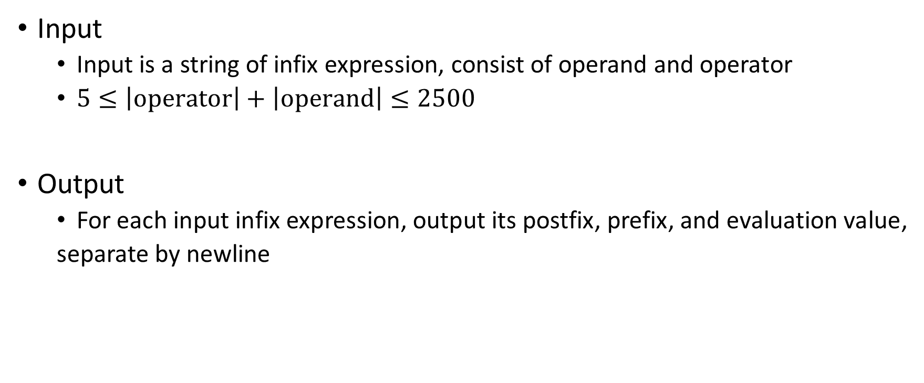
Input & output
Input
Input is a string of infix expression, consist of operand and operator
$5≤\left|operator\right|+\left|operand\right|≤2500$
Output
For each input infix expression, output its postfix, prefix, and evaluation value,
separate by newline

Slide 8
Sample input & sample output
Sample input
1+(3*4-5)/6*7
1+2
Sample output
134*5-6/7*+
+1*/-*34567
8
12+
+12
3

Slide 9
STL not allowed
<stack> <queue> are not allowed to use
Try to implement your own stack, it is very easy!

