Slide 1
10810EECS204001 Data Structures Homework 6
2019/12/28 18:00
~
2020/1/15 23:59

Slide 2
HW6
In this homework, you have to solve the minimum diameter spanning tree(MDST) problem
The graph is undirected

Slide 3
Operations
1. Add
2. Delete
3. AC
4. Diameter
5. SOSPD

Slide 4
Add
Add v1 v2 w
Add an edge between v1 and v2 and the weight is w
Ex: Add 0 1 10
If there already exists an edge, update to the new one
(delete the original one and add the new edge)
0
10
1

Slide 5
Delete
Delete v1 v2
Delete the edge between v1 and v2
Ex: Delete 0 1
0
10
1

Slide 6
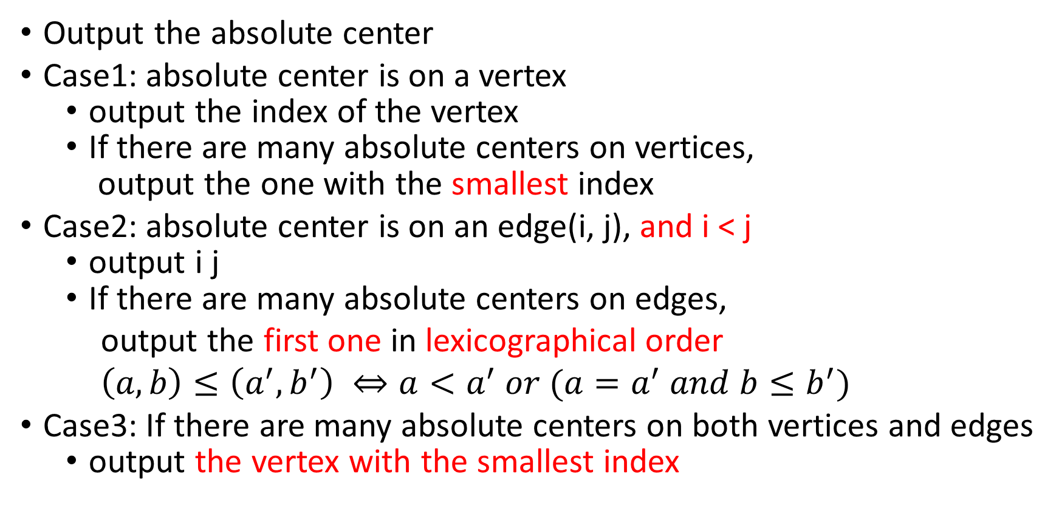
AC
Output the absolute center
Case1: absolute center is on a vertex
output the index of the vertex
If there are many absolute centers on vertices,
output the one with the smallest index
Case2: absolute center is on an edge(i, j), and i < j
output i j
If there are many absolute centers on edges,
output the first one in lexicographical order
$\left(a,b\right)≤\left(a^{′},b^{′}\right) ⇔a<a^{′} or (a=a^{′} and b≤b^{′})$
Case3: If there are many absolute centers on both vertices and edges
output the vertex with the smallest index

Slide 7
AC
If the graph is not connected,
output “Not connected graph”

Slide 8
Diameter
Output the diameter of MDST
If the graph is not connected,
output “Not connected graph”

Slide 9
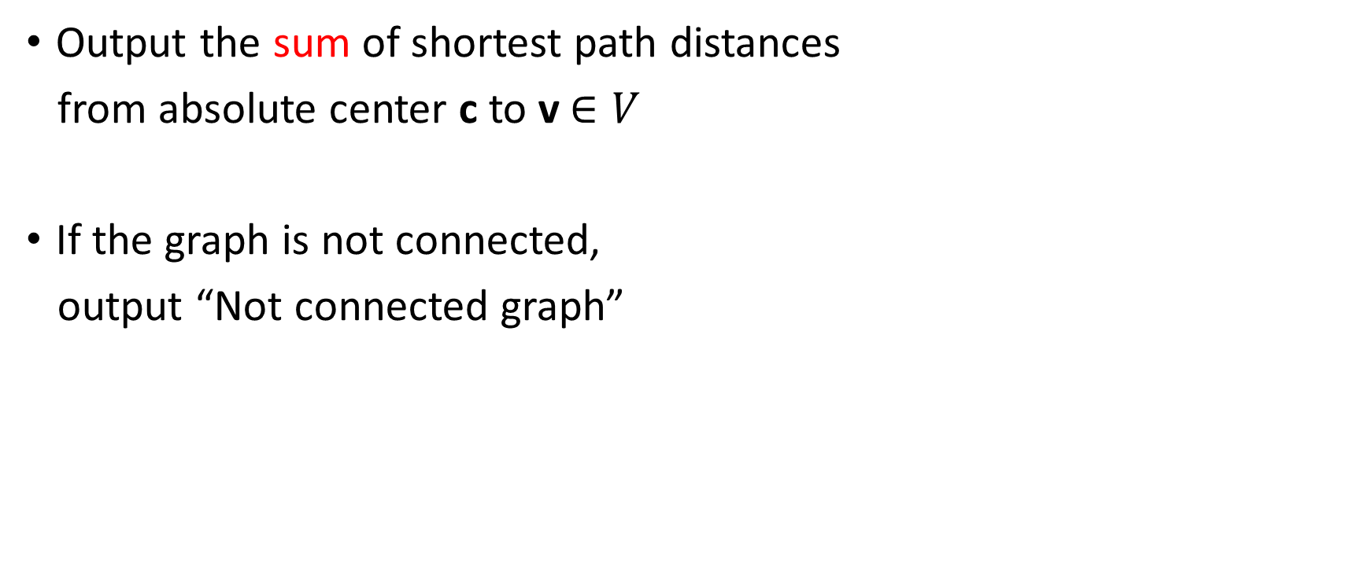
SOSPD
Output the sum of shortest path distances
from absolute center c to v$∈V$
If the graph is not connected,
output “Not connected graph”

Slide 10
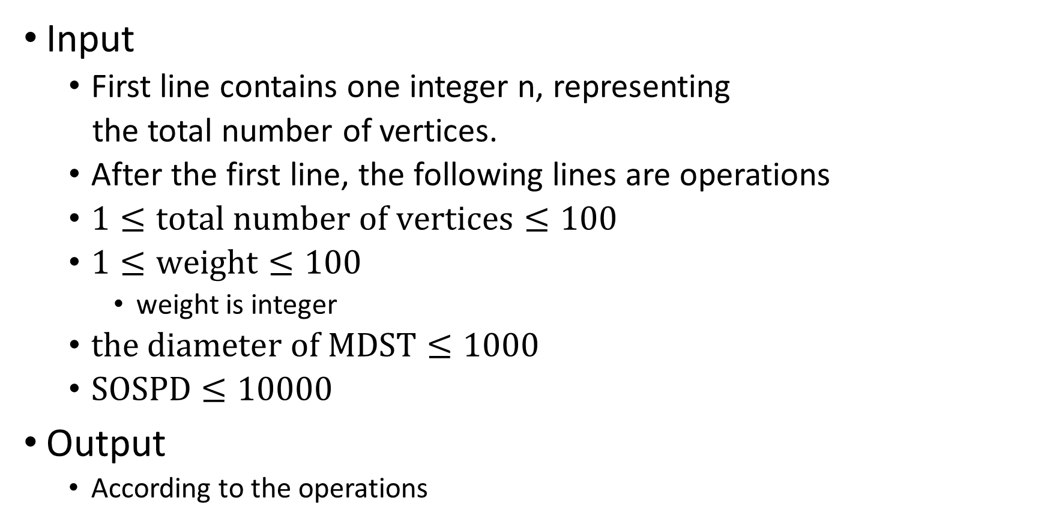
Input & Output
Input
First line contains one integer n, representing
the total number of vertices.
After the first line, the following lines are operations
$1≤total number of vertices≤100$
$1≤weight≤100$
weight is integer
$the diameter of MDST≤1000$
$SOSPD≤10000$
Output
According to the operations

Slide 11
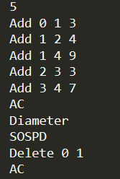

Sample Input & Sample Output
Input Output

Slide 12
The End

