Slide 1
Introduction to ML
September 27th, 2021

Slide 2
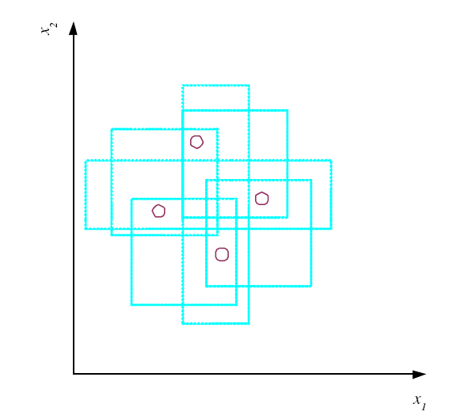
VC Dimension Vapnik-Chervonenkis
N points can be labeled in 2^{N} ways as +/–
H shatters N if there
exists h ∈ H consistent
for any of these:
VC(H ) = N
The maximum points that H can shatter is the VC dimensions (also known as capacity))
An axis-aligned rectangle
shatters 4 points only !

Slide 3
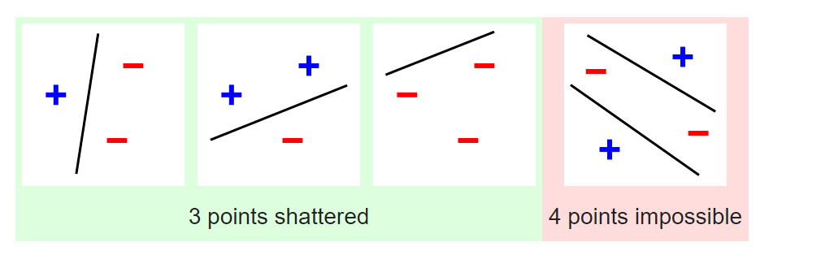
Three points shattered by a line (as a hypothesis function)
4 points not possible
We can find 4 points to be shattered by the use of rectangle making VC = 4
Does not mean all 4 points can be shattered (imagine a straight line)
VC = 4, hence if there are 5 points we can not find a consistent H that shatters with 2 dimensional inputs
Note, this is a stringent, assuming no knowledge of the data distribution
A look up table has VC dimension?

Slide 4
Multiple Classes, C_{i} i=1,...,K
Train hypotheses h_{i}(x), i =1,...,K, one to separate each class from the union of all others
2 class setup
?: reject regions where no or more than one h_{i}(x)>0.

Slide 5
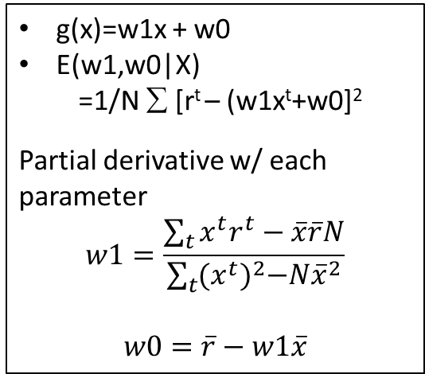
Regression
Polynomial interpolation
N point, N-1 order
interpolation (add points within the range of data-> extrapolation (predicting to the future)
Empirical error
Distance: Mean square difference
g(x)=w1x + w0
E(w1,w0|X)
=1/N ∑ [r^{t} – (w1x^{t}+w0]²
Partial derivative w/ each parameter
$$w1=\frac{\sum_{t}{x^{t}r^{t}−\overline{x}\overline{r}N}}{\sum_{t}{{(x^{t})}^{2}−N{\overline{x}}^{2}}}$$
$$w0=\overline{r}−w1\overline{x}$$
Higher order smaller error
But does it make sense? (6th order)

Slide 6
Model Selection & Generalization
Learning is an ill-posed problem; data is not sufficient to find a unique solution
Every sample is boolean (d-dimension 2^d possible input function)
Every output is Boolean (input-output pair of hypotheses function left 2^(2^d))
Each data sample we kills half (the rest are consistent – different function gives the same answer))
With N samples there remains 2(2^d-N)
Impossible for a UNIQUE answer, we usually only see a fraction of data samples

Slide 7
inductive bias, assumptions about H
For example rectangle function, rectangle with largest margin (every ‘choice’ made is a bias)
Increase complexity of hypothese class, improve power but when to stop?
unavoidable
Generalization: How well a model performs on new data
The aim of machine learning is to predict unseen
Choose the model that fits the complexity of the true data distribution (hard problem!)
Overfitting: H more complex than C or f
Underfitting: H less complex than C or f

Slide 8
Triple Trade-Off in `Learning’ based approach
There is a trade-off between three factors (Dietterich, 2003):
Complexity of H, c (H),
Training set size, N,
Generalization error, E, on new data
As N increases, E decreases
As c(H) increases, first E decreases and then E increases.

Slide 9
Cross-Validation
To estimate generalization error, we need data unseen during training. We split the data (percentage is arbitrary)
Training set (50%)
Validation set (25%)
Test (publication) set (25%)
Resampling when there is few data

Slide 10
Dimensions of a Supervised Learner
Model:
Loss function:
Optimization procedure:

Slide 11
CHAPTER 3: Bayesian Decision Theory

Slide 12
Probability and Inference
Result of tossing a coin is ∈ {Heads,Tails}
Random var X ∈{1,0} -> it’s a function
Bernoulli: P {X=1} = p_{o}^{X} (1 ‒ p_{o})^{(1 ‒ X)} –a function with parameter p0
Do we know what is P₀ ?
Sample: X = {x^{t} }^{N}_{t =1}
Estimation: p_{o} = # {Heads}/#{Tosses} = ∑_{t} x^{t} / N
Probability become statistics
Once estimate, prediction of next toss:
Heads if p_{o} > ½, Tails otherwise

Slide 13
Classification
Observation → measurable input
Credit scoring: Inputs are income and savings.
Output is low-risk vs high-risk
Input: x = [x₁,x₂]^{T} ,Output: C ∈ {0,1}
Prediction:
Bernoulli rv
Condition on x1, x2
ERROR? 1 – max (P(C=1)|x1,x2), P(C=0|x1, x2))

Slide 14
Bayes’ Rule
What is C (high risk/low risk) given the two inputs
prior
likelihood
posterior
evidence
Total probability theorem

Slide 15
Bayes’ Rule: K>2 Classes
Make a ‘classification’ decision by looking at the posterior distribution

Slide 16
Losses and Risks
Actions: α_{i}
This concept is important in cases when ‘loss’ associated to each action may not be the same
Finance, medical, …so on
Loss of α_{i} when the state is C_{k} : λ_{ik}
Expected risk (Duda and Hart, 1973)
You can/should design this
Minimizing risk by picking that action i

Slide 17
Losses and Risks: 0/1 Loss
A clear yes/no loss
Correct: no loss
Incorrect : 1loss
All class except that correct one
For minimum risk, choose the most probable class

Slide 18
Losses and Risks: Reject
Additional action when in doubt
Probability sums to 1
Risk needs to be minimized

Slide 19
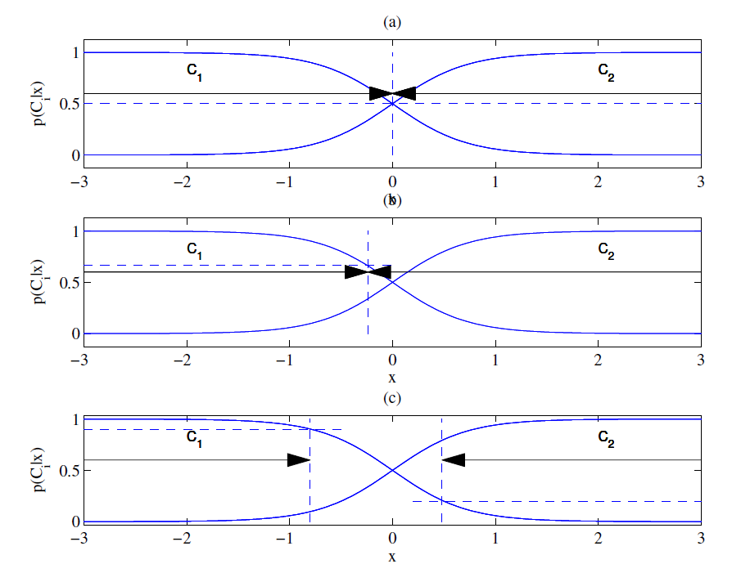
Different Losses and Reject
Equal losses
Unequal losses
With reject

Slide 20
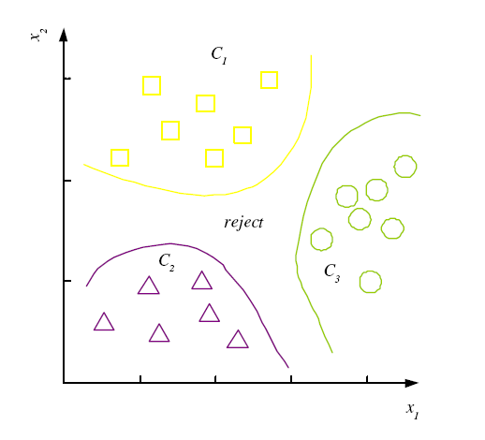
Discriminant Functions
Re-think above as implementing a set of discriminant functions
Pick one such function among the largest
All three are the same
K decision regions R₁,...,R_{K}

Slide 21
K=2 Classes
Dichotomizer (K=2) vs Polychotomizer (K>2)
g(x) = g₁(x) – g₂(x)
Log odds:

Slide 22
Utility Theory
Prob of state k given exidence x: P (S_{k}|x)
Utility of α_{i} when state is k: U_{ik}
Expected utility:

Slide 23
Association Rules
Association rule: X → Y
People who buy/click/visit/enjoy X are also likely to buy/click/visit/enjoy Y.
Dependency, it’s not cause and effect but good enough for making a business decision
A rule implies association, not necessarily causation.

Slide 24
Association measures
Joint probability,
Make this large (increase the basis)
Significance of the rule
Support (X → Y):
Confidence (X → Y):
Lift (X → Y):
conditional probability
Should be large and larger than P(Y)
Strength of the rule
Interest of the association rule X->Y

Slide 25
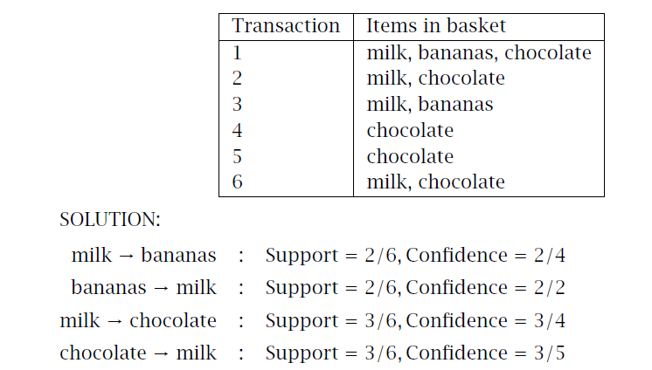
Example
High support
High confidence

Slide 26
Apriori algorithm (Agrawal et al., 1996)
For (X,Y,Z), a 3-item set, to be frequent (have enough support), (X,Y), (X,Z), and (Y,Z) should be frequent.
If (X,Y) is not frequent, none of its supersets can be frequent.
Once we find the frequent k-item sets, we convert them to rules: X, Y → Z, ...
and X → Y, Z, ...

