Slide 1
Introduction to Machine Learning 機器學習導論
李祈均 (Jeremy)
Department of Electrical Engineering
National Tsing Hua University
cclee@ee.nthu.edu.tw

Slide 2
Course logistics
What is this class?
An introduction to machine learning (ML)
A “quick-and-dirty” gentle intro to ML concept and techniques
Understand the basics/intuition not the detail derivation
A stronger focus on hands-on
English offering
Main course: mostly in English
TA session: possibly in dual-channel (with English as main)
Invited lecture: in Chinese
TA:
吳亞澤: crowpeter@gapp.nthu.edu.tw
Shreya Upadhyay: ShreyaUpadhyay10@gmail.com
許柏謙: billy73480@gmail.com

Slide 3
Course logistics
Textbook
Introduction to Machine Learning, Fourth Edition, Ethem Alpaydin
Materials
Closely follow textbook slides
All information is posted on eeclass.nthu.edu.tw
Date
M34, W2
No more extra selection
Space limited for exams and Nvidia Hands-on sessions

Slide 4
Covid19 Situation
The first week completely online via teams
If the situation back to what is supposed to be:
I will record lectures in Delta 217
Will have ‘limited’ & ‘fixed’ spaces if you are interested in coming into the classroom
TA session will be the same
Exams will be given in in-person setting
Otherwise:
We will stay online, including everything online (Classes, TA session, hw, exams, and so on)

Slide 5
Course outline
Section 1
Introduction to Machine Learning
Supervised Learning
Bayesian Decision Theory
Parametric Model
Multivariate Methods
Section 2
Clustering/Dimension reduction
Decision tree
Linear Discrimination
Support Vector Machine

Slide 6
Course Outline
Section 3
Multilayer Perceptron
Deep learning
Design and Analysis of Machine Learning Experiment
Invited Lectures
Nvidia DLI: Fundamentals of Deep Learning (2 weeks)
Talk by Prof. 陳鴻文 (清大跨院、光電所教授)

Slide 7
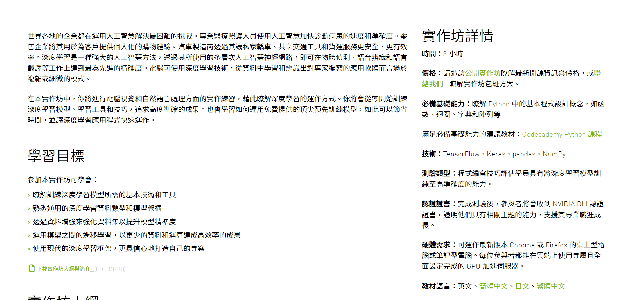
Invited Lectures
Nvidia DLI Fundamental of deep learning
Hands on lectures with Nvidia DLI Certificate
Need a laptop
12/20 – 12/29 By Nvidia 李正匡博士

Slide 8
Grading
Zero tolerance on any forms of cheating (automatic F)
3 Homework (13% each)
1 homework each section
Includes written and programming
TA session will be helpful
1 Midterm (20%)
Covers section 1-2
Closed book
1 Final (35%)
Covers all section 1-3
Closed book
Nvidia Hand-on exercise (6%)
Certificate

Slide 9
Next lecture
We will start the introduction to ML
I will send out the Teams link again..

