Slide 1
CHAPTER 1: Introduction to Machine Learning

Slide 2
Source: Big Data
Widespread use of personal computers and wireless communication leads to “big data”
We are both producers and consumers of data
Data collected is not purely random, it often has a structure, e.g., customer behavior
We need “big theory” to extract that complex structure from data for
(a) Understanding the process
(b) Making predictions for the future
Cheaper computational power (e.g., GPUs) enabling computing

Slide 3
Why “Learn” ?
Machine learning is programming computers to optimize a performance criterion using example data or past experience.
There is no need to “learn” to calculate payroll
Learning is used when:
Human expertise does not exist (navigating on Mars),
Humans are unable to explain their expertise (speech recognition)
Solution changes in time (routing on a computer network)
Solution needs to be adapted to particular cases (user biometrics)

Slide 4
What We Talk About When We Talk About “Learning”
Learning general models from a data of particular examples to ‘inductive’ generalize reasoning
Data is cheap and abundant (data warehouses, data marts); knowledge is expensive and scarce.
Example in retail: Customer transactions to consumer behavior:
People who bought “Blink” also bought “Outliers” (www.amazon.com)
Build a model that is a good and useful approximation to the data to make judgement
Customer behaviors to items preferences?

Slide 5
Applications
Retail: Market basket analysis, Customer relationship management (CRM)
Finance: Credit scoring, fraud detection
Manufacturing: Control, robotics, troubleshooting
Medicine: Medical diagnosis
Telecommunications: Spam filters, intrusion detection
Bioinformatics: Motifs, alignment
Web mining: Search engines
...

Slide 6
What is Machine Learning?
Optimize a performance criterion using example data or past experience.
Role of Statistics: Inference from a sample
Probability -> Statistics
Role of Computer science: Efficient algorithms to
Solve the optimization problem
Representing and evaluating the model for inference

Slide 7
Types of ML
Association
Supervised Learning
Classification
Regression
Unsupervised Learning
Reinforcement Learning

Slide 8
Learning Associations
Think in terms of conditional probability
Basket analysis:
P(Y | X ) probability that somebody who buys X also buys Y where X and Y are products/services.
Example: P(chips | beer) = 0.7

Slide 9
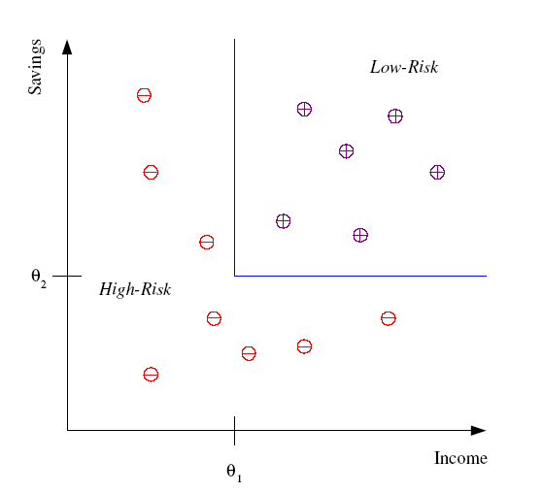
Classification – put things in categories
Example: Credit scoring
Differentiating between low-risk and high-risk customers from their income and savings
Discriminant:
IF income > θ₁ AND savings > θ₂
THEN low-risk
ELSE high-risk

Slide 10
Classification: Many Applications
aka Pattern recognition
Think in terms of input, output
Face recognition:
Why complex: Pose, lighting, occlusion (glasses, beard), make-up, hair style
Character recognition
Why complex: Different handwriting styles.
Speech recognition:
Why complex: Temporal dependency, language, variability
Medical diagnosis: From symptoms to illnesses
Biometrics: Recognition/authentication using physical and/or behavioral characteristics: Face, iris, signature, etc
Outlier/novelty detection: Detecting faults

Slide 11








Face Recognition
Training examples of a person
Test images
ORL dataset,
AT&T Laboratories, Cambridge UK

Slide 12
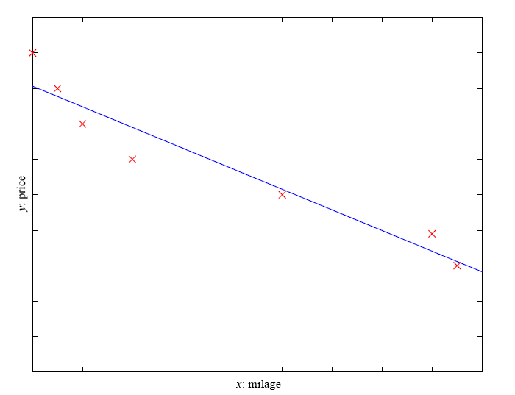
Regression
Example: Price of a used car
x : car attributes
y : price
y = g(x|θ )
g(), model (fixed)
θ, parameters (modifiable->learned)
y = wx+w₀

Slide 13
Regression Applications
Navigating a car: Angle of the steering
Kinematics of a robot arm
(x,y)
α₁= g₁(x,y)
α₂= g₂(x,y)
α₂
α₁
Response surface design

Slide 14
Supervised Learning: Uses
Database is given with labels (answers) for each sample (know what is correct)
Prediction of future cases: Use the rule to predict the output for future inputs
Knowledge extraction: The rule is easy to understand
Compression: The rule is simpler than the data it explains
Outlier detection: Exceptions that are not covered by the rule, e.g., fraud

Slide 15
Unsupervised Learning
Learning “what normally happens” – no pre-defined answers
No output (nothing to predict, recognition, don’t really care what is ‘correct’)
Clustering: Grouping similar instances with a metric
Example applications
Customer segmentation in CRM
Image compression: Color quantization
Bioinformatics: Learning motifs

Slide 16
Reinforcement Learning
Learning a policy: A sequence of outputs
Learn what to do (learn actions)
No supervised output but delayed reward
Reward guide the action learning
Credit assignment problem
Game playing
Robot in a maze
Multiple agents, partial observability, ...

Slide 17
Related Topics of ML
High-performance computing:
Parallel processing, GPUs
Data privacy and security: Sanitization/anonymization of personal data
privacy-preserving ML
Model interpretability and trust:
The importance of testing
Bias in training data, fairness of decisions
Adversarial examples
We do not want black-box but explainable models

Slide 18
Data Science
A new field composed of
Machine learning (theoretical, mathematical component)
High-performance computation (engineering component); both hardware and software aspects
Ethical/legal aspects of data collection, analysis, and data-driven decision making (social component)

Slide 19

EE? CS? Signal Processing? Machine Learning?

Slide 20
Next lecture
Jump into supervised learning

