Slide 1
Modeling Local Dependence in Natural Language with Multi-Channel Recurrent Neural Networks
Chang Xu, Weiran Huang, Hongwei Wang, Gang Wang and Tie-Yan Liu
Nankai University, Tsinghua University, Shanghai Jiao Tong University, Microsoft Research Asia
Presented by: Chang Xu

Slide 2


Content
Motivation
Background of Modeling Natural Sentences
Challenges in Capturing Semantic Structure Information
Our Method: Multi-Channel Recurrent Neural Networks
Capturing Rich Patterns with Multiple Channels
Aggregating Patterns by an Attention Module
Experimental Results
Analysis
Case Study and Visualization
Performance on Long Sentences
Impact of Model Size
Conclusion

Slide 3
Modeling Natural Sentences
Structure Information is Essential
Natural languages exhibit strong local structures in terms of semantics such as phrases.
E.g. We must find the missing document at all costs.
Phrase structures are important for understanding the meaning of sentences
Conventional Recurrent Neural Networks
Usually treat each token in a sentence uniformly and equally
May miss the rich semantic structure information of a sentence.

Slide 4
Challenges in Capturing Semantic Structure Information
Requiring Flexibility
There are diverse word dependence patterns
Flexible and learnable structure modeling method is preferred than predefined connections or fixed topology.
Hard to Parameterize
The local structures and word dependence patterns in sentences are discrete symbols rather than regular learnable model parameters.
It is non-trivial to capture and parameterize them.

Slide 5
Content
Motivation
Background of Modeling Natural Sentences
Challenges in Capturing Semantic Structure Information
Our Method: Multi-Channel Recurrent Neural Networks
Capturing Rich Patterns with Multiple Channels
Aggregating Patterns by an Attention Module
Experimental Results
Analysis
Case Study and Visualization
Performance on Long Sentences
Impact of Model Size
Conclusion

Slide 6
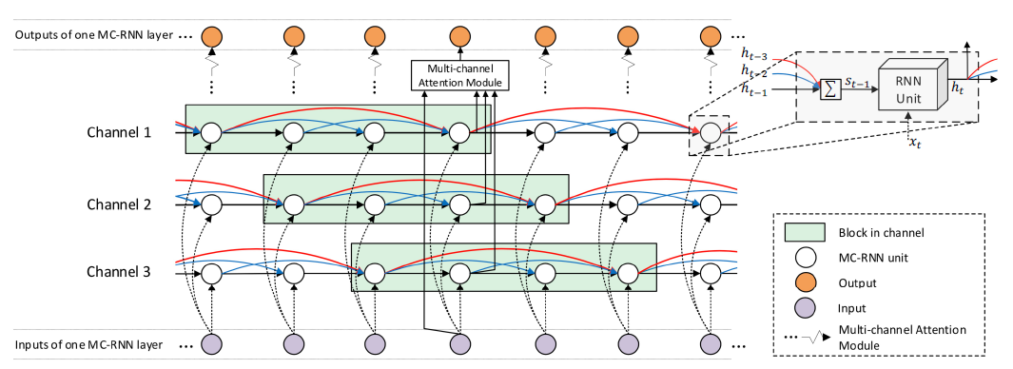
Multi-Channel Recurrent Neural Networks (MC-RNN)
Illustration of the structure of one-layer MC-RNN with 3 channels.

Slide 7
Each channel in the MC-RNN layer contains several blocks
Local connections are built in each block
Solid lines with the same color (red/blue/black) share the same parameter matrices
Channels can be computed in parallel.

Slide 8
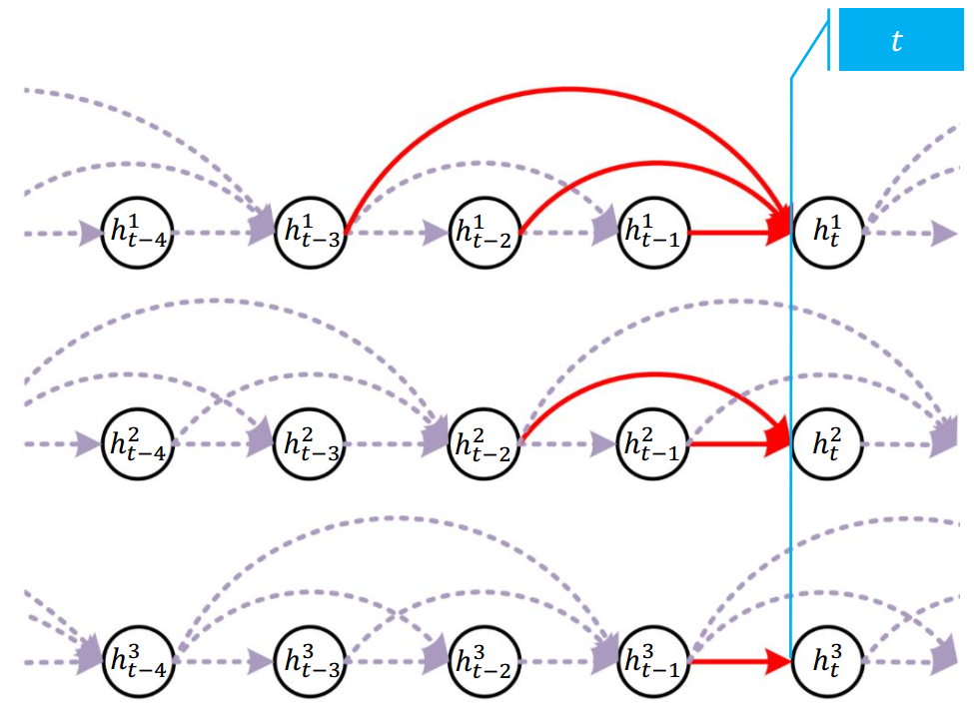
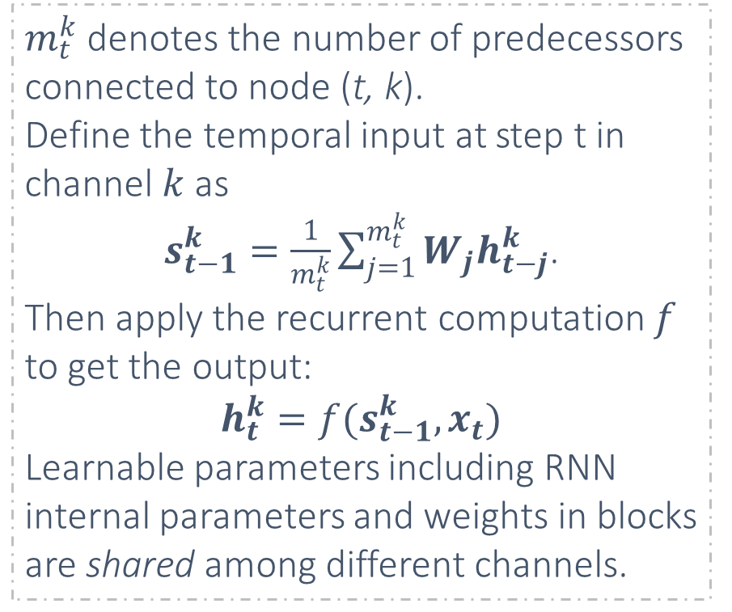
Capturing Rich Patterns with Multiple Channels
$m_{t}^{k}$ denotes the number of predecessors connected to node (t, k).
Define the temporal input at step t in channel $k$ as
$s_{t−1}^{k}=\frac{1}{m_{t}^{k}}\sum_{j=1}^{m_{t}^{k}}{W_{j}h_{t−j}^{k}}$.
Then apply the recurrent computation $f$ to get the output:
$$h_{t}^{k}=f(s_{t−1}^{k},x_{t})$$
Learnable parameters including RNN internal parameters and weights in blocks are shared among different channels.
Channel 1
Channel 2
Channel 3
The indegree $m_{t}^{2}$ of Channle2 at time t in this figure is 2

Slide 9
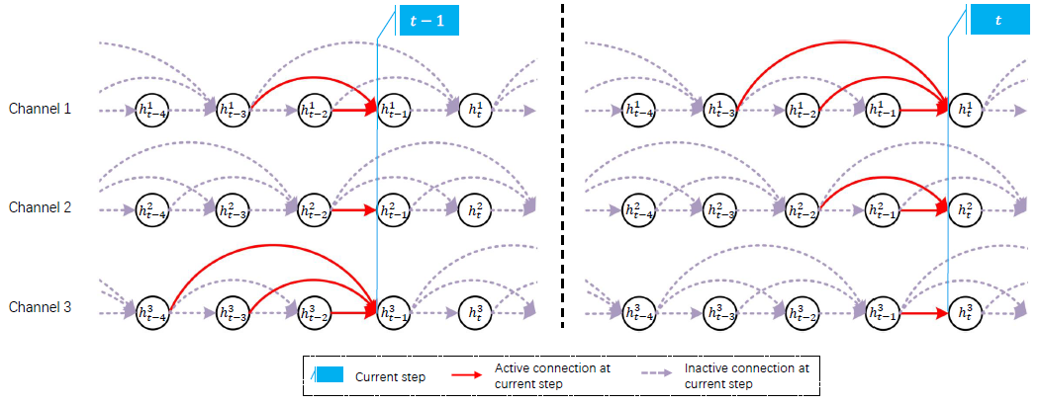
The inputs of each recurrent unit include
not only its immediate predecessor
but also from the historical units within a certain distance.
MC-RNN can capture a strong dependence between words in a phrase, and make compact representations for the phrased
Different Connection Mechanism for Different Channels
Set the blocks of neighboring channels has one step staggered with each other in a progressive way
All possible local structures or dependency patterns whose length is no more than the block size can be enumerated
At time step t, the red lines in channel 1, 2, 3 represent 4-word/ 3-word/ 2-word dependence patterns respectively

Slide 10
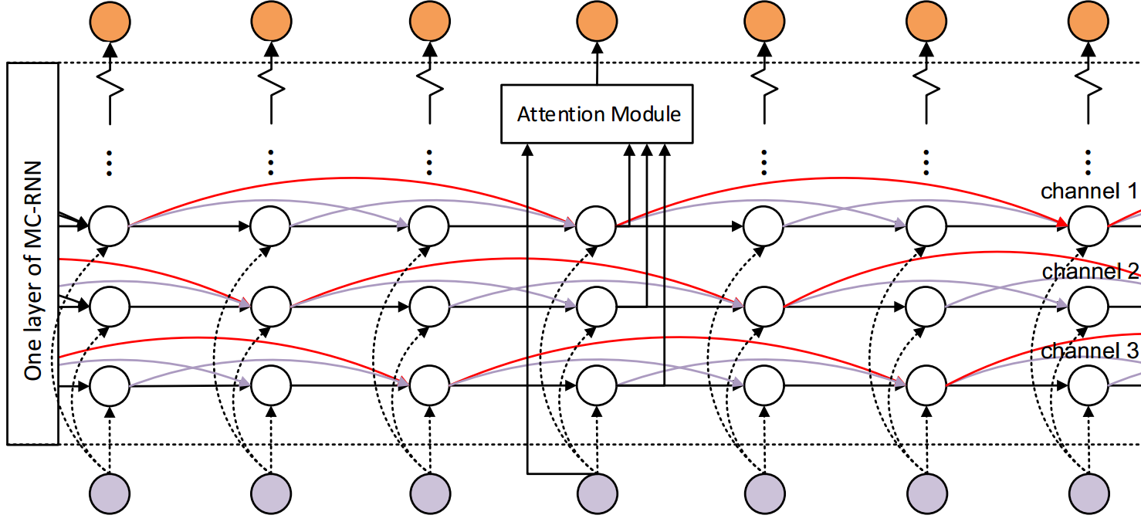
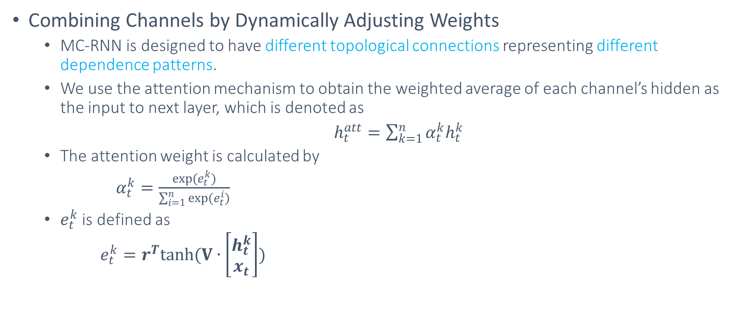
Aggregating Patterns by an Attention Module
Combining Channels by Dynamically Adjusting Weights
MC-RNN is designed to have different topological connections representing different dependence patterns.
We use the attention mechanism to obtain the weighted average of each channel’s hidden as the input to next layer, which is denoted as
$h_{t}^{att}=\sum_{k=1}^{n}{α_{t}^{k}h_{t}^{k}}$
The attention weight is calculated by
$α_{t}^{k}=\frac{exp(e_{t}^{k})}{\sum_{i=1}^{n}{exp(e_{t}^{i})}}$
$e_{t}^{k}$ is defined as
$e_{t}^{k}=r^{T}tanh(V∙\left[\begin{matrix}h_{t}^{k} \\ x_{t}\end{matrix}\right])$

Slide 11
Content
Motivation
Background of Modeling Natural Sentences
Challenges in Capturing Semantic Structure Information
Our Method: Multi-Channel Recurrent Neural Networks
Capturing Rich Patterns with Multiple Channels
Aggregating Patterns by an Attention Module
Experimental Results
Analysis
Case Study and Visualization
Performance on Long Sentences
Impact of Model Size
Conclusion

Slide 12
Experimental Results
Methods | Params | BLEU
Actor-critic | - | 28.53
NPMT-LM | - | 29.16
HM-RNN | 25M | 30.60
HO-RNN | 30M | 31.29
Baseline-RNN | 25M | 31.03
MC-RNN-2 | 28M | 31.98
MC-RNN-3 | 29M | 32.23
MC-RNN-4 | 31M | 32.09
Machine Translation
2-layer encoder, 2-layer decoder
256-d bpe embedding, 256-d hidden size
Beam search with width 5
Test on IWLST 2014 De-En task
Compared with
Baseline-RNN: the most widely used sequence to sequence framework RNNSearch (Bahdanau, Cho, and Bengio 2015)
HO-RNN: changed the topological structure of RNN (Soltani and Jiang 2016)
HM-RNN: modifies the recurrent computations (Chung, Ahn, and Bengio 2017)
Actor-critic: an approach to training neural networks to generate sequences using reinforcement learning (Bahdanau et al. 2017)
NPMT-LM: a neural phrasebased machine translation system that models phrase structures in the target language (Huang et al. 2018)

Slide 13
Experimental Results
Abstractive Summarization
The task is to generate the headline of the given article
The dataset we use is Gigaword corpus (Graff et al. 2003):
3.8M training article-headline pairs, 190k for validation and 2000 for test
MC-RNN follows the settings of Baseline-RNN:
Using LSTM as the recurrent unit
encoder and the decoder have 4 layers
Embedding size: 256
Hidden size: 256
Methods | Params | RG-1 | RG-2 | RG-L
HM-RNN | 35M | 34.68 | 16.11 | 32.22
HO-RNN | 46M | 35.86 | 16.99 | 33.38
Baseline-RNN | 36M | 34.65 | 16.13 | 32.24
MC-RNN-2 | 38M | 36.21 | 17.30 | 33.60
MC-RNN-3 | 40M | 36.55 | 17.58 | 33.72
MC-RNN-4 | 42M | 36.50 | 17.44 | 33.68

Slide 14
Experimental Results
Language Modeling
Evaluate on Penn Treebank corpus which contains about 1 million words
Evaluation metric: perplexity
The network structure follow the state-of-the-art model AWD-LSTM (Merity, Keskar, and Socher 2018)
1150 units in the hidden layer
400-d word embedding
DropConnect is used on the hidden-to-hidden weight matrices
Methods | Validation | Test
Variational LSTM + augmented loss (Inan, Khosravi, and Socher 2017) | 71.1 | 68.5
Variational RHN (Zilly et al. 2016) | 67.9 | 65.4
NAS Cell (Zoph and Le 2017) | - | 62.4
Skip Connection LSTM(Melis, Dyer, and Blunsom 2018) | 60.9 | 58.3
AWD-LSTM w/o finetune (baseline) (Merity, Keskar, and Socher 2018) | 60.7 | 58.8
MC-RNN | 59.2 | 56.9

Slide 15
Content
Motivation
Background of Modeling Natural Sentences
Challenges in Capturing Semantic Structure Information
Our Method: Multi-Channel Recurrent Neural Networks
Capturing Rich Patterns with Multiple Channels
Aggregating Patterns by an Attention Module
Experimental Results
Analysis
Case Study and Visualization
Performance on Long Sentences
Impact of Model Size
Conclusion

Slide 16
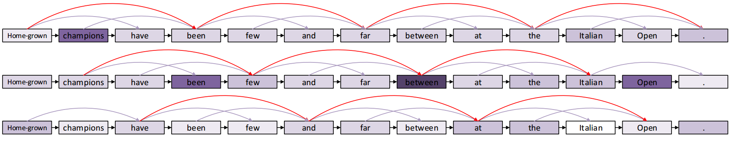
Case Studies and Visualization
Visualization of attention scores of the sentence “ Home-grown champions have been few and far between at the Italian Open.”
Local dependence patterns and local structures are captured, such as:
”home-grown champions”
”champions have been”
”few and far between”
”Italian Open”

Slide 17
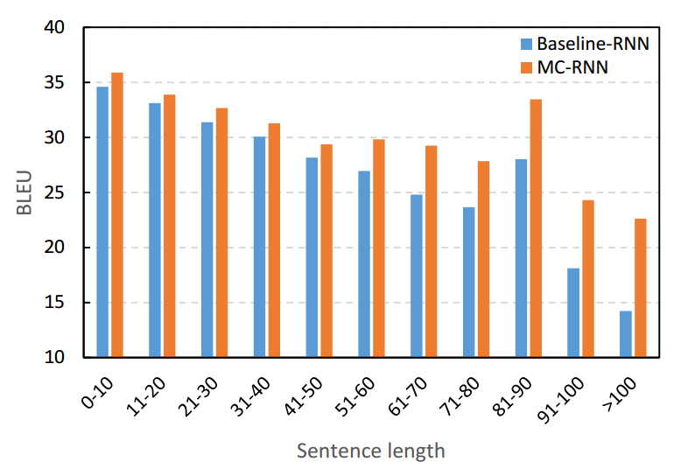
Performance on Long Sentences
Conducted on IWSLT-14 De-En translation task
Long sentences are more difficult to handle than short ones
Both our method and the baseline-RNN model perform worse as the lengths of the sentences increase, indicating
Our model brings much more improvement on long sentences
when the sentence length is greater than 61, our model outperforms baselines by a larger margin
MC-RNN enables short-cut connections across timestep and directly passes error signal through blocks

Slide 18
Impact of Model Size and Time Cost
We tried several runs for Baseline-RNN
Baseline-RNN-large: increase the size of the hidden state from 256 to 286
Baseline-RNNdeep: Increase the number of layers from 2 to 3
No significant improvement of performance on Baseline-RNN
Better performance of our MC-RNN is caused by model design rather than larger model size
Owing to parallel computation, MC-RNN can achieve almost the same time cost as the conventional RNN
Methods | Params | BLEU
Baseline-RNN | 25M | 31.03
Baseline-RNN-large | 29M | 30.93
Baseline-RNN-deep | 29M | 30.98
MC-RNN-2 | 28M | 31.98
MC-RNN-3 | 29M | 32.23
MC-RNN-4 | 31M | 32.09

Slide 19
Impact of Model Size and Time Cost
We tried several runs for Baseline-RNN
Baseline-RNN-large: increase the size of the hidden state from 256 to 286
Baseline-RNNdeep: Increase the number of layers from 2 to 3
No significant improvement of performance on Baseline-RNN
Better performance of our MC-RNN is caused by model design rather than larger model size
Owing to parallel computation, MC-RNN can achieve almost the same time cost as the conventional RNN
Methods | Params | BLEU
Baseline-RNN | 25M | 31.03
Baseline-RNN-large | 29M | 30.93
Baseline-RNN-deep | 29M | 30.98
MC-RNN-2 | 28M | 31.98
MC-RNN-3 | 29M | 32.23
MC-RNN-4 | 31M | 32.09

Slide 20
Content
Motivation
Background of Modeling Natural Sentences
Challenges in Capturing Semantic Structure Information
Our Method: Multi-Channel Recurrent Neural Networks
Capturing Rich Patterns with Multiple Channels
Aggregating Patterns by an Attention Module
Experimental Results
Analysis
Case Study and Visualization
Performance on Long Sentences
Impact of Model Size
Conclusion

Slide 21
Conclusions
We proposed a new RNN model with multichannel multi-block structure to better capture and utilize local patterns in sequential data for language-related tasks
Experiments on machine translation, abstractive summarization, and language modeling validated the effectiveness of the proposed model
Achieved new state-of-the-art results on Gigaword on text summarization and Penn Treebank on language modeling

Slide 22
Thanks!

