Slide 1
Pre-course: Constitutive Modelling of Soft Tissues Lecture 3 Strain Energy Functions
Namshad Thekkethil
School of Mathematics and Statistics

Slide 2
Overview
Summary of balance equations
Constitutive Equations – Strain Energy Function
Objectivity
Isotropy
Stress and Strain Tensors
Linear Elasticity
Nonlinear Elasticity

Slide 3

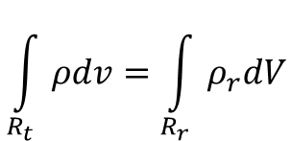







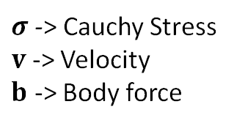
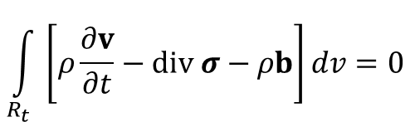
Summary of Balance Equations
$$\int_{R_{t}}{ρdv}=\int_{R_{r}}{ρ_{r}dV}$$
$$R_{r}$$
$$χ\left(X,t\right)$$
Mass balance:
$$x$$
$$X$$
$$F$$
$$R_{t}$$
$$\int_{R_{t}}{\left[ρ\frac{∂v}{∂t}−div σ−ρb\right]dv}=0$$
Linear Momentum balance:
$σ$ -> Cauchy Stress
$v$ -> Velocity
$b$ -> Body force
Angular Momentum balance:
$$σ=σ^{T}$$
Unknowns:
$$ρ,v \left(3 components\right),σ (9 components)$$
$$ρ,v \left(3 components\right),σ (6 components)$$
$$σ=σ^{T}$$
13 Unknowns
10 Unknowns
1+3 = 4 Equations

Slide 4
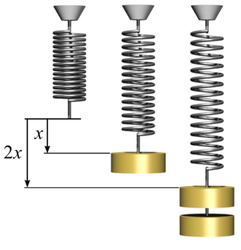



Constitutive Equations
Stress-strain relationship
$$σ=f\left(x,v,F,L,…\right)$$
Homogeneous Elastic material:
$$σ=g\left(F\right)$$
No pre-stress:
$$g\left(I\right)=0$$
Hyperelastic or Green elastic materials: Stress-strain relationship from strain energy function

Slide 5
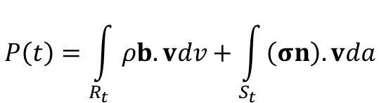
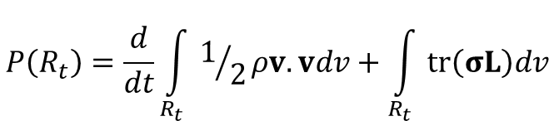
Energy Balance Equation
$$Total rate of working=Rate of work due to body force+Rate of work due to surface force$$
$$P\left(t\right)=\int_{R_{t}}{ρb.vdv}+\int_{S_{t}}{\left(σn\right).vda}$$
Simplification, See slide no. 22
$$P\left(R_{t}\right)=\frac{d}{dt}\int_{R_{t}}{1/2ρv.vdv}+\int_{R_{t}}{tr\left(σL\right)dv}$$
Energy balance:
Rate of
Kinetic energy
Rate of stored
Elastic energy

Slide 6

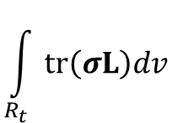
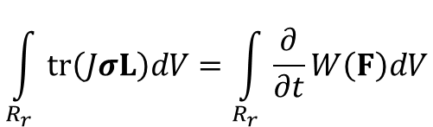

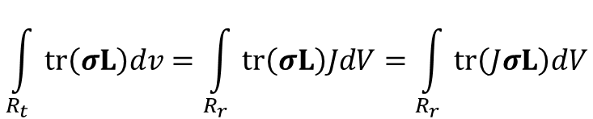

The rate of change of the total stored elastic energy…
For hyperelastic material, we have
Rate of Stored elastic energy per
unit reference volume
$$\int_{R_{t}}{tr\left(σL\right)dv}$$
$$\int_{R_{t}}{tr\left(σL\right)dv}=\int_{R_{r}}{tr\left(σL\right)JdV}=\int_{R_{r}}{tr\left(JσL\right)dV}$$
Rate of stored
Elastic energy
$$dv=JdV$$
$W:$Stored elastic energy (strain energy) per unit reference volume
$$tr\left(JσL\right)=\frac{∂}{∂t}W\left(F\right)$$
$$\int_{R_{r}}{tr\left(JσL\right)dV}=\int_{R_{r}}{\frac{∂}{∂t}W\left(F\right)dV}$$
Constitutive equations
Expression for $W$

Slide 7
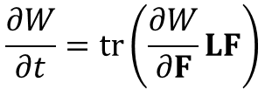

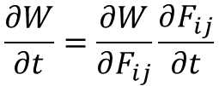
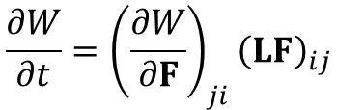




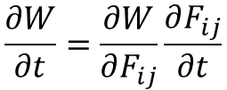

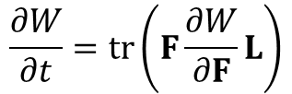
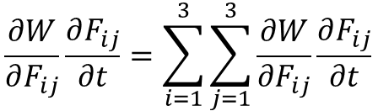

The rate of change of the total stored elastic energy…
Since $W(F)$ is only a function of $F$, we have
Index notation
$$\frac{∂W}{∂F_{ij}}\frac{∂F_{ij}}{∂t}=\sum_{i=1}^{3}{\sum_{j=1}^{3}{\frac{∂W}{∂F_{ij}}\frac{∂F_{ij}}{∂t}}}$$
$$\frac{∂W}{∂t}=\frac{∂W}{∂F_{ij}}\frac{∂F_{ij}}{∂t}$$
Derivative of scalar
w.r.t tensor
$$\frac{∂F}{∂t}=\dot{F}=LF$$
$$\frac{∂F_{ij}}{∂t}={\left(LF\right)}_{ij}$$
$$\frac{∂W}{∂F_{ij}}={\left(\frac{∂W}{∂F}\right)}_{ji}$$
$$L_{ij}=\frac{∂v_{i}}{∂x_{j}}$$
$$\frac{∂W}{∂t}=\frac{∂W}{∂F_{ij}}\frac{∂F_{ij}}{∂t}$$
$$\frac{∂W}{∂t}={\left(\frac{∂W}{∂F}\right)}_{ji}{\left(LF\right)}_{ij}$$
$$\frac{∂W}{∂t}=tr\left(\frac{∂W}{∂F}LF\right)$$
$$\frac{∂W}{∂t}=tr\left(F\frac{∂W}{∂F}L\right)$$
Trace
$$tr\left(ABC\right)=tr\left(CAB\right)$$
$$tr\left(AB\right)=A_{ji}B_{ij}$$

Slide 8


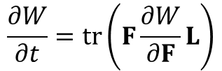
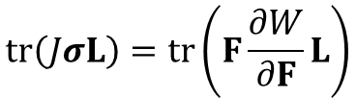

The rate of change of the total stored elastic energy
$$tr\left(JσL\right)=\frac{∂}{∂t}W\left(F\right)$$
$$tr\left(JσL\right)=tr\left(F\frac{∂W}{∂F}L\right)$$
$$\frac{∂W}{∂t}=tr\left(F\frac{∂W}{∂F}L\right)$$
$$Jσ=F\frac{∂W}{∂F}$$
$$σ=J^{−1}F\frac{∂W}{∂F}$$

Slide 9
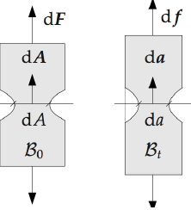










Stress tensor
Cauchy stress tensor as a function of F
$$σ=g\left(F\right)=J^{−1}F\frac{∂W}{∂F}$$
Reference
Configuration
Nominal/Engineering stress
$$S_{ij}=\frac{∂W}{∂F_{ji}}$$
$$S=\frac{∂W}{∂F}$$
$$First PK stress P$$
First Piola Kirchhoff’s stress
$$P=S^{T}$$
Current/ deformed
Configuration
Stress in the reference configuration
Force per unit reference area
$S$ is not symmetric, but $FS$ is symmetric
$$Cauchy stress σ$$
$$S=JF^{−1}σ=h\left(F\right)$$
$${\left(FS\right)}^{T}=FS$$
$$σ=J^{−1}FS$$

Slide 10






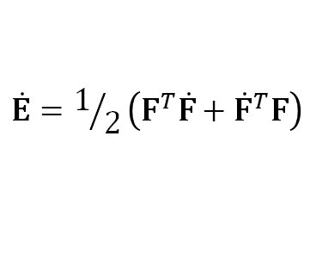
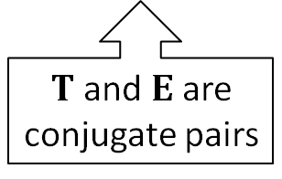
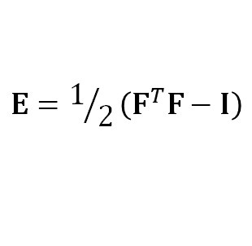


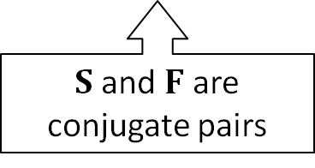

Conjugate stress and strain tensors
Rate of total elastic stored energy per unit reference volume
$$tr\left(JσL\right)$$
$$tr\left(JσL\right)=tr\left(FSL\right)=tr\left(SLF\right)$$
$$tr\left(JσL\right)=tr\left(S\dot{F}\right)$$
$S$ and $F$ are conjugate pairs
$$σ=J^{−1}FS$$
$$L=\dot{F}F^{−1}$$
We define
$$E=1/2\left(F^{T}F−I\right)$$
$$\dot{E}=1/2\left(F^{T}\dot{F}+{\dot{F}}^{T}F\right)$$
Green strain
tensor
$$tr\left(S\dot{F}\right)=tr\left(SF^{−T}F^{T}\dot{F}\right)$$
$$tr\left(S\dot{F}\right)=tr\left(TF^{T}\dot{F}\right)$$
$$tr\left(S\dot{F}\right)=tr\left(T\dot{E}\right)$$
$$T=SF^{−T}$$
$T$ and $E$ are conjugate pairs
$$dx.dx−dX.dX=dX.\left(F^{T}F−I\right)dX$$
2nd Piola
Kirchoff’s stress tensor
More conjugate stress/strain pairs: See slide no. 23

Slide 11














Objectivity
Principle of material frame-indifference.
$W$ is indifferent to observer transformations (translations and rotations)
$$R_{r}$$
$$R_{t}$$
$$χ\left(X,t\right)$$
$$R_{t^{′}}$$
Rotate
$$F$$
$$Q$$
$$x′$$
$$X$$
$$x$$
$$W\left(F\right)$$
$$W\left(QF\right)$$
Objectivity
$$W_{t^{′}}=W_{t}$$
$$χ′\left(X,t\right)$$
$$F^{′}=\frac{∂χ′\left(X,t\right)}{∂X}=\frac{∂χ′\left(X,t\right) }{∂χ\left(X,t\right)}\frac{∂χ\left(X,t\right)}{∂X}=QF$$
$$W\left(QF\right)=W\left(F\right)$$

Slide 12






Isotropy…
Isotropy -> Material Properties same in all directions
Anisotropy -> Material Properties not necessarily same in all directions
$$F$$
$$δ$$
Example:
Isotropic
$$F$$
$$δ$$
$$F_{2}>F_{1}$$
$$δ$$
$$δ$$
Anisotropic
$$F_{1}$$

Slide 13


















Isotropy
$$R_{r}$$
$$R_{t}$$
$$W\left(F\right)$$
$$χ\left(X,t\right)$$
$$F$$
$$F=\frac{∂χ\left(X,t\right)}{∂X}$$
$$X$$
$$F^{′}=\frac{∂χ\left(X^{′},t\right)}{∂X}=\frac{∂χ\left(X^{′},t\right)}{∂X′}\frac{∂χ′\left(X,t\right)}{∂X}$$
$$χ′\left(X,t\right)$$
$$P$$
$$F′$$
$$R_{t^{′}}$$
$$W\left(FP\right)$$
$$F^{′}=FP$$
Isotropic
$$W_{t^{′}}=W_{t}$$
$$P=\frac{∂χ\left(X,t\right)}{∂X}$$
$$X′$$
$$χ\left(X′,t\right)$$
$$W\left(FP\right)=W\left(F\right)$$
$$R_{r^{′}}$$

Slide 14
Types of deformation
Linear Elastic
-> Small deformation
Stress
Strain
-> Large deformation
Nonlinear Elastic
Stress
Strain

Slide 15














Linear Elasticity
Displacement:
$$u=x−X$$
$$F=Grad x=I+H$$
$$H=Grad u$$
Linear Elasticity -> Small deformation
$$ε≡\sqrt{H.H}=\sqrt{H_{ij}^{2}}≪1$$
Polar decomposition,
Objectivity & Isotropy
$$σ_{ij}=c_{ijkh}e_{kh}$$
$$σ=\frac{∂g}{∂U}e+𝒪\left(ε^{2}\right)$$
$$σ=ce$$
$$c_{ijkh}=\frac{∂g_{ij}}{∂U_{kh}}\left(I\right)$$
$$F=RU$$
$$ε≪1$$
$$c=\frac{∂g}{∂U}\left(I\right)=\frac{∂^{2}W}{∂U∂U}\left(I\right)$$
See derivation in slide no. 24-26
Elasticity tensor
(4th Order)
$$W=\frac{1}{2}\left[λ{\left(tr e\right)}^{2}+2μe∙e\right]$$
$$σ=λ\left(tr e\right)I+2μe$$
Hook’s law
$λ,μ$ -> Lame’ moduli

Slide 16






















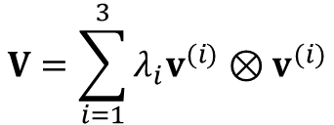


Nonlinear Elasticity
For isotropic materials
$$E_{2}$$
$$λ_{1}$$
$$λ_{2}$$
$$v^{(1)}$$
$$W\left(F\right)=W\left(FQ\right)$$
$$W\left(F\right)=W\left(V\right)$$
Objectivity
$$v^{(2)}$$
$$F=VR$$
$$V=\sum_{i=1}^{3}{λ_{i}v^{(i)}⊗v^{(i)}}$$
$λ_{1},λ_{2},λ_{3}$ -> Eigen values (principal stretches) of $V$
$$φ$$
$v^{(1)},v^{(2)},v^{(3)}$-> Eigen vectors of $V$
$$φ$$
$$E_{1}$$
$$γ=\tan{φ}$$
$$W\left(V\right)=W′\left(λ_{1},λ_{2},λ_{3}\right)$$
$i_{1},i_{2},i_{3}$ -> principal invariants of $V$
$$W′\left(λ_{1},λ_{2},λ_{3}\right)=W′′\left(i_{1},i_{2},i_{3}\right)$$
$$i_{1}=λ_{1}+λ_{2}+λ_{3}$$
$$i_{2}=λ_{2}λ_{3}+λ_{3}λ_{1}+λ_{1}λ_{2}$$
$$i_{3}=λ_{1}λ_{2}λ_{3}$$
$$W′\left(λ_{1},λ_{2},λ_{3}\right)=W′′′\left(I_{1},I_{2},I_{3}\right)$$
$$I_{1}=λ_{1}^{2}+λ_{2}^{2}+λ_{3}^{2}$$
$$I_{2}=λ_{2}^{2}λ_{3}^{2}+λ_{3}^{2}λ_{1}^{2}+λ_{1}^{2}λ_{2}^{2}$$
$$I_{3}=λ_{1}^{2}λ_{2}^{2}λ_{3}^{2}$$
$$I_{1},I_{2},I_{3} \text{−> }\text{principal} \text{invariants} \text{of} C=F^{T}F$$

Slide 17
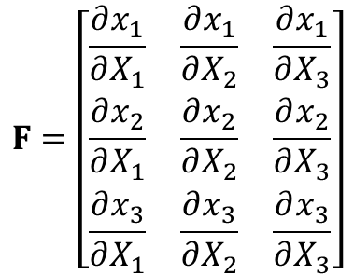
















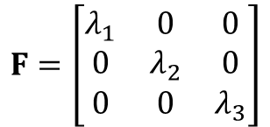
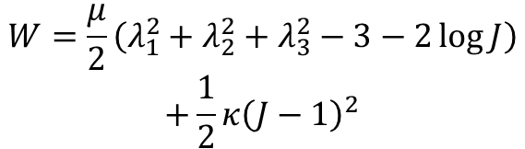

W as a function of the principal stretches
Simple elongation of a circular cylinder
$$λ_{1}=λ=\frac{l}{L}=\frac{{dx}_{1}}{{dX}_{1}}$$
$$λ_{2}=\frac{{dx}_{2}}{{dX}_{2}}$$
$$λ_{3}=\frac{{dx}_{3}}{{dX}_{3}}$$
$$F=\left[\begin{matrix}\frac{∂x_{1}}{∂X_{1}} & \frac{∂x_{1}}{∂X_{2}} & \frac{∂x_{1}}{∂X_{3}} \\ \frac{∂x_{2}}{∂X_{1}} & \frac{∂x_{2}}{∂X_{2}} & \frac{∂x_{2}}{∂X_{3}} \\ \frac{∂x_{3}}{∂X_{1}} & \frac{∂x_{3}}{∂X_{2}} & \frac{∂x_{3}}{∂X_{3}}\end{matrix}\right]$$
$$W=\frac{μ}{2}\left(λ_{1}^{2}+λ_{2}^{2}+λ_{3}^{2}−3−2\log{J}\right)$$
$$+\frac{1}{2}κ{\left(J−1\right)}^{2}$$
$$E_{1}$$
$$F=\left[\begin{matrix}λ_{1} & 0 & 0 \\ 0 & λ_{2} & 0 \\ 0 & 0 & λ_{3}\end{matrix}\right]$$
$$E_{3}$$
$μ,κ$ -> Material properties, always $>0$
$$L$$
$$l$$
$$E_{2}$$
$$J=\det{F}=λ_{1}λ_{2}λ_{3}$$
$${Jσ}_{i}=λ_{i}\frac{∂W}{∂λ_{i}}=μ\left(λ_{i}^{2}−1\right)+κJ\left(J−1\right)$$
$$λ_{1}=λ$$
See derivation in slide no. 27-28
$$Jσ=μ\left(λ^{2}−1\right)+κJ\left(J−1\right)$$
$$σ_{1}=σ$$
$$λ_{2}=λ_{3}$$
$$0=μ\left(λ_{2}^{2}−1\right)+κJ\left(J−1\right)$$
$$σ_{2}=σ_{3}=0$$

Slide 18




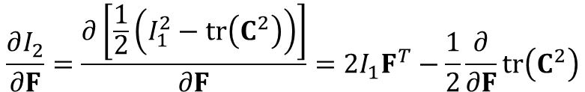




W as a function of the principal invariants I₁, I₂, and I₃…
$$I_{1}=tr\left(C\right)$$
$$\overline{W}\left(I_{1},I_{2},I_{3}\right)$$
$$I_{2}=\frac{1}{2}\left[I_{1}^{2}−tr\left(C^{2}\right)\right]$$
$$C=F^{T}F$$
$$I_{3}=\det{C}$$
Nominal stress
$$S=\frac{∂\overline{W}}{∂I_{1}}\frac{∂I_{1}}{∂F}+\frac{∂\overline{W}}{∂I_{2}}\frac{∂I_{2}}{∂F}+\frac{∂\overline{W}}{∂I_{3}}\frac{∂I_{3}}{∂F}$$
$$\frac{∂I_{2}}{∂F}=\frac{∂\left[\frac{1}{2}\left(I_{1}^{2}−tr\left(C^{2}\right)\right)\right]}{∂F}=2I_{1}F^{T}−\frac{1}{2}\frac{∂}{∂F}tr\left(C^{2}\right)$$
$$\frac{∂I_{1}}{∂F}=2F^{T}$$
$$\frac{∂I_{3}}{∂F}=\frac{∂}{∂F}{\left(\det{F}\right)}^{2}=2I_{3}F^{−1}$$
See derivation in slide no. 29

Slide 19




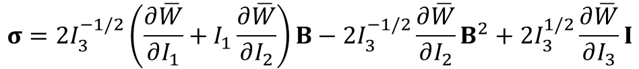


W as a function of the principal invariants I₁, I₂, and I₃
$$I_{1}=tr\left(C\right)$$
$$\overline{W}\left(I_{1},I_{2},I_{3}\right)$$
$$I_{2}=\frac{1}{2}\left[I_{1}^{2}−tr\left(C^{2}\right)\right]$$
$$C=F^{T}F$$
$$I_{1}\left(F\right),I_{2}\left(F\right),I_{3}\left(F\right)$$
$$I_{3}=\det{C}={\left(\det{F}\right)}^{2}$$
$$S=\frac{∂\overline{W}}{∂I_{1}}\frac{∂I_{1}}{∂F}+\frac{∂\overline{W}}{∂I_{2}}\frac{∂I_{2}}{∂F}+\frac{∂\overline{W}}{∂I_{3}}\frac{∂I_{3}}{∂F}$$
$$S=2\frac{∂\overline{W}}{∂I_{1}}F^{T}+2\frac{∂\overline{W}}{∂I_{2}}\left(2I_{1}F^{T}−2F^{T}FF^{T}\right)+2I_{3}\frac{∂\overline{W}}{∂I_{3}}F^{−1}$$
Nominal stress
Cauchy stress
$$σ=2I_{3}^{−1/2}\left(\frac{∂\overline{W}}{∂I_{1}}+I_{1}\frac{∂\overline{W}}{∂I_{2}}\right)B−2I_{3}^{−1/2}\frac{∂\overline{W}}{∂I_{2}}B^{2}+2I_{3}^{1/2}\frac{∂\overline{W}}{∂I_{3}}I$$
$$σ=J^{−1}FS$$
$$B={FF}^{T}$$

Slide 20
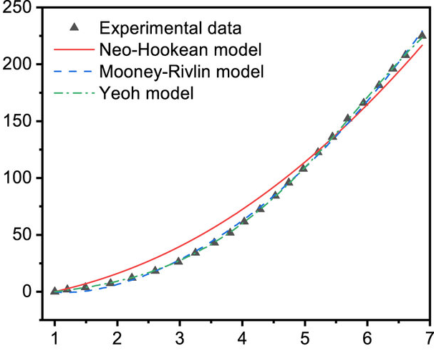




W as a function of the principal invariants I₁, I₂, and I₃
neo-Hookean
$$W=\frac{1}{2}μ\left(I_{1}−3\right)$$
$$μ>0$$
Stress
Mooney-Rivlin
$$W=\frac{1}{2}μ_{1}\left(I_{1}−3\right)−\frac{1}{2}μ_{2}\left(I_{2}−3\right)$$
$$μ_{1}≥0,μ_{2}≤0,μ_{1}−μ_{2}=μ>0$$
Strain
Dong, X., & Duan, Z. (2022). Comparative study on the sealing performance of packer rubber based on elastic and hyperelastic analyses using various constitutive models. Materials Research Express, 9(7), 075301.

Slide 21
Extra Notes

Slide 22
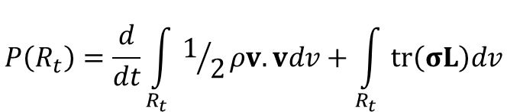

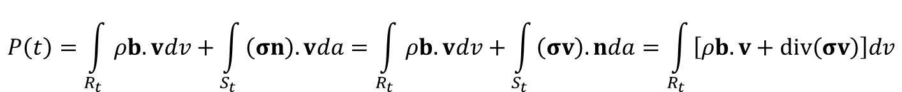


Energy Balance Equation
$$P\left(t\right)=\int_{R_{t}}{ρb.vdv}+\int_{S_{t}}{\left(σn\right).vda}=\int_{R_{t}}{ρb.vdv}+\int_{S_{t}}{\left(σv\right).nda}=\int_{R_{t}}{\left[ρb.v+div\left(σv\right)\right]dv}$$
($σ$is symmetric)
(Divergence theorem)
$$=\int_{R_{t}}{\left[ρb.v+div\left(σ\right).v+tr \left(σL\right)\right]dv}=\int_{R_{t}}{\left[\left(ρb+div\left(σ\right)\right).v+tr \left(σD\right)\right]dv}=\int_{R_{t}}{\left[ρ\dot{v}.v+tr \left(σD\right)\right]dv}$$
(${\left(σ_{ij}v_{j}\right)}_{,i}=σ_{ij,i}v_{j}+σ_{ij}v_{j,i}=σ_{ij,i}v_{j}+σ_{ij}L_{ji}$)
($σ_{ij}L_{ji}=σ_{ij}\left(D_{ji}+W_{ji}\right)=σ_{ij}D_{ji}$)
Using momentum balance
$$P\left(R_{t}\right)=\frac{d}{dt}\int_{R_{t}}{1/2ρv.vdv}+\int_{R_{t}}{tr\left(σL\right)dv}$$

Slide 23




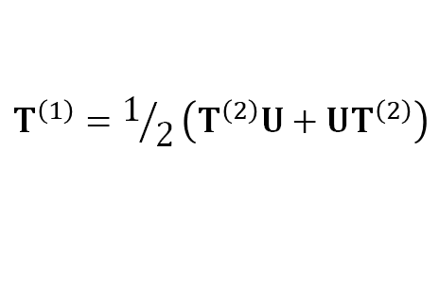
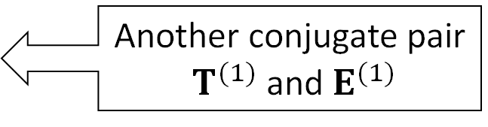

Conjugate stress and strain tensors
Stored energy rate
$$\frac{∂W}{∂t}=tr\left(T^{\left(2\right)}{\dot{E}}^{(2)}\right)=tr\left[1/2\left(T^{\left(2\right)}U+UT^{\left(2\right)}\right){\dot{E}}^{(1)}\right]$$
Another conjugate pair
$T^{(1)}$ and $E^{(1)}$
$$T^{\left(1\right)}=1/2\left(T^{\left(2\right)}U+UT^{\left(2\right)}\right)$$
$$tr\left(T^{\left(2\right)}{\dot{E}}^{(2)}\right)=tr\left[T^{\left(1\right)}{\dot{E}}^{(1)}\right]$$
$$\frac{∂W}{∂t}=Jtr\left(σD\right)=tr\left(S\dot{F}\right)=tr\left(T^{\left(2\right)}{\dot{E}}^{(2)}\right)=tr\left(T^{\left(1\right)}{\dot{E}}^{(1)}\right)$$
In general
$$\frac{∂W}{∂t}=tr\left(T^{\left(m\right)}{\dot{E}}^{(m)}\right)$$
$$E^{(m)}=\frac{U^{m}−I}{m}$$
$W^{(m)}$ as a function of the general strain tensor $E^{(m)}$
$$T^{(m)}=\frac{∂W}{∂E^{(m)}}$$
$$W^{(m)}\left(E^{(m)}\right)=W^{(1)}\left(E^{(1)}\right)=W^{(2)}\left(E^{(2)}\right)$$

Slide 24












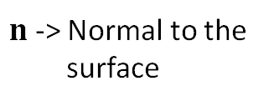




Objectivity
Principle of material frame-indifference.
$W$ is indifferent to observer transformations (translations and rotations)
$$R_{0}$$
$$R_{t}$$
$$χ\left(X,t\right)$$
$$R_{t^{′}}$$
Rotate
$$F$$
$$Q$$
$$x′$$
$$X$$
$$x$$
$$σ^{′}=g\left(F′\right)$$
$$n^{′}=Qn$$
$$W\left(F\right)$$
$$σ=g\left(F\right)$$
$$W\left(QF\right)$$
$n$ -> Normal to the
surface
$$χ′\left(X,t\right)$$
$$F^{′}$$
Traction vector on $R_{t}$:
$$t^{′}=Qt$$
$$Q^{−1}=Q^{T}$$
$$σ^{′}=QσQ^{T}$$
$$t=σn$$
$$σ^{′}Qn=Qσn$$
$$σ^{′}Q=Qσ$$
Traction vector on $R_{t′}$:
$$t^{′}=σ^{′}n′=σ^{′}Qn$$
$$g\left(F′\right)=Qg\left(F\right)Q^{T}$$

Slide 25

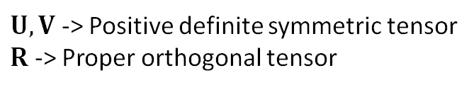








Polar decomposition
Polar decomposition theorem
$U,V$ -> Positive definite symmetric tensor
$R$ -> Proper orthogonal tensor
$$F=RU=VR$$
$$U^{2}=F^{T}F$$
$$V^{2}={FF}^{T}$$
$$R=FU^{−1}$$
Isotropy:
$$g\left(QF\right)=Qg\left(F\right)Q^{T}$$
$$g\left(RF\right)=Rg\left(F\right)R^{T}$$
$$g\left(RU\right)=Rg\left(U\right)R^{T}$$
$$g\left(F\right)=Rg\left(U\right)R^{T}$$
$$Q=R$$

Slide 26










Linear Elasticity
$$E=\frac{1}{2}\left(F^{T}F−I\right)=\frac{1}{2}\left[{\left(I+H\right)}^{T}\left(I+H\right)−I\right]=\frac{1}{2}\left[H+H^{T}+𝒪\left(ε^{2}\right)\right]$$
$$E=e+𝒪\left(ε^{2}\right)$$
Infinitesimal strain tensor
$$e=\frac{1}{2}\left(H+H^{T}\right)$$
$$U^{2}=F^{T}F={\left(I+H\right)}^{T}\left(I+H\right)=I+2e+𝒪\left(ε^{2}\right)$$
$$U=I+e+𝒪\left(ε^{2}\right)$$
$$U^{−1}=I+e+𝒪\left(ε^{2}\right)$$
$$R=FU^{−1}=\left[I+H\right]\left[I−e+𝒪\left(ε^{2}\right)\right]=I+\frac{1}{2}\left(H−H^{T}\right)+𝒪\left(ε^{2}\right)$$
$$R=I+w+𝒪\left(ε^{2}\right)$$
$$w=\frac{1}{2}\left(H−H^{T}\right)$$
$$g\left(U\right)=g\left(I+e\right)=g\left(I\right)+\frac{∂g}{∂U}\left(I\right)e+𝒪\left(ε^{2}\right)$$
$$σ=Rg\left(U\right)R^{T}=\left[I+w+𝒪\left(ε^{2}\right)\right]\left[g\left(I\right)+\frac{∂g}{∂U}e+𝒪\left(ε^{2}\right)\right]\left[I−w+𝒪\left(ε^{2}\right)\right]$$
$$σ=g\left(I\right)+wg\left(I\right)−g\left(I\right)w+\frac{∂g}{∂U}e+𝒪\left(ε^{2}\right)$$
$$σ=\frac{∂g}{∂U}e+𝒪\left(ε^{2}\right)$$
No pre-stress:
$$g\left(I\right)=0$$

Slide 27

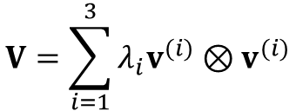


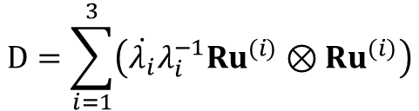
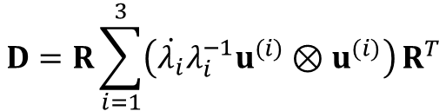
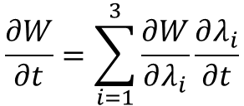

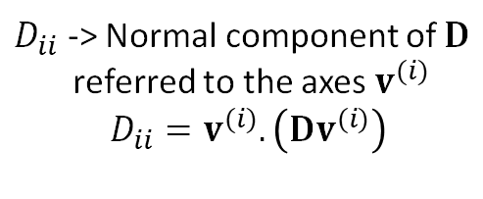
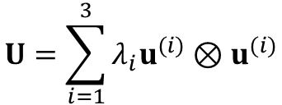
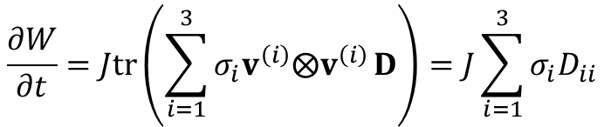
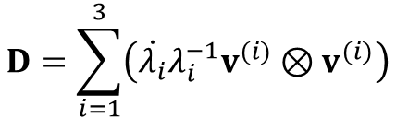

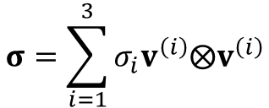


W as a function of the principal stretches…
$$\frac{∂W}{∂t}=\sum_{i=1}^{3}{\frac{∂W}{∂λ_{i}}\frac{∂λ_{i}}{∂t}}$$
$$W\left(λ_{1},λ_{2},λ_{3}\right)$$
We have
$$\frac{∂W}{∂t}=Jtr\left(σD\right)$$
$$\frac{∂W}{∂t}=Jtr\left(\sum_{i=1}^{3}{σ_{i}v^{\left(i\right)}⨂v^{\left(i\right)}}D\right)=J\sum_{i=1}^{3}{σ_{i}D_{ii}}$$
$D_{ii}$ -> Normal component of $D$
referred to the axes $v^{(i)}$
$$D_{ii}=v^{(i)}.\left(Dv^{(i)}\right)$$
$$σ=\sum_{i=1}^{3}{σ_{i}v^{\left(i\right)}⨂v^{\left(i\right)}}$$
$σ_{i}$ -> Principal stresses
$$D=\frac{1}{2}R\left(\dot{U}U^{−1}+U^{−1}\dot{U}\right)R^{T}$$
$$D=R\left(\dot{U}U^{−1}\right)R^{T}$$
$$U=\sum_{i=1}^{3}{λ_{i}u^{(i)}⊗u^{(i)}}$$
$$D=R\sum_{i=1}^{3}{\left(\dot{λ_{i}}λ_{i}^{−1}u^{(i)}⊗u^{(i)}\right)}R^{T}$$
$$D=\sum_{i=1}^{3}{\left(\dot{λ_{i}}λ_{i}^{−1}Ru^{(i)}⊗{Ru}^{(i)}\right)}$$
$$V=\sum_{i=1}^{3}{λ_{i}v^{(i)}⊗v^{(i)}}$$
$$D=\sum_{i=1}^{3}{\left(\dot{λ_{i}}λ_{i}^{−1}v^{(i)}⊗v^{(i)}\right)}$$
$$v^{(i)}=Ru^{(i)}$$
$$D_{ii}=\dot{λ_{i}}λ_{i}^{−1}$$

Slide 28


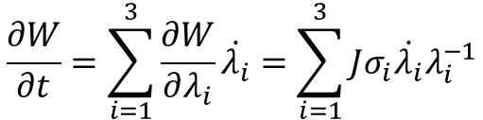
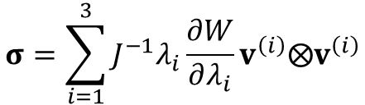
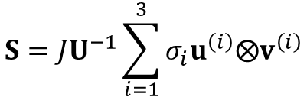


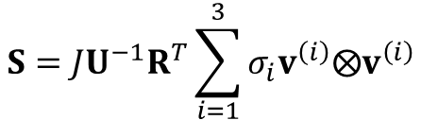




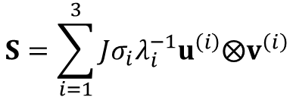
W as a function of the principal stretches
$$\frac{∂W}{∂t}=\sum_{i=1}^{3}{\frac{∂W}{∂λ_{i}}\dot{λ_{i}}}=\sum_{i=1}^{3}{Jσ_{i}\dot{λ_{i}}λ_{i}^{−1}}$$
$$σ_{i}=J^{−1}λ_{i}\frac{∂W}{∂λ_{i}}$$
$$D_{ii}=\dot{λ_{i}}λ_{i}^{−1}$$
$$\frac{∂W}{∂λ_{i}}=Jσ_{i}λ_{i}^{−1}$$
Cauchy stress
$$J=λ_{1}λ_{2}λ_{3}$$
$$σ=\sum_{i=1}^{3}{J^{−1}λ_{i}\frac{∂W}{∂λ_{i}}v^{\left(i\right)}⨂v^{\left(i\right)}}$$
Nominal stress
$$S=JU^{−1}R^{T}\sum_{i=1}^{3}{σ_{i}v^{\left(i\right)}⨂v^{\left(i\right)}}$$
$$S=JU^{−1}\sum_{i=1}^{3}{σ_{i}u^{\left(i\right)}⨂v^{\left(i\right)}}$$
$$S=\sum_{i=1}^{3}{Jσ_{i}λ_{i}^{−1}u^{\left(i\right)}⨂v^{\left(i\right)}}$$
$$S=JF^{−1}σ$$
$$F^{−1}=U^{−1}R^{T}$$
$$R^{T}v^{(i)}=u^{(i)}$$
$$U^{−1}u^{(i)}={λ_{i}^{−1}v}^{(i)}$$

Slide 29











W as a function of the principal invariants I₁, I₂, and I₃
$$\frac{∂I_{1}}{∂F}=\frac{∂tr\left(F^{T}F\right)}{∂F}$$
$$tr\left(F^{T}F\right)={\left(F^{T}\right)}_{iβ}{\left(F\right)}_{βi}$$
$$tr\left(F^{T}F\right)=F_{βi}F_{βi}=F_{βi}^{2}$$
$$\frac{∂I_{1}}{∂F}=\frac{∂tr\left(F^{T}F\right)}{∂F}$$
$${\left(\frac{∂I_{1}}{∂F}\right)}_{kα}=\frac{∂F_{βi}^{2}}{∂F_{αk}}=2F_{βi}\frac{∂F_{βi}}{{∂F}_{αk}}$$
$${\left(\frac{∂I_{1}}{∂F}\right)}_{kα}=2F_{αk}$$
$$\frac{∂I_{1}}{∂F}=2F^{T}$$
$$\frac{∂I_{2}}{∂F}=\frac{∂\left[\frac{1}{2}\left(I_{1}^{2}−tr\left(C^{2}\right)\right)\right]}{∂F}$$
$${\left[\frac{∂}{∂F}tr\left(C^{2}\right)\right]}_{kα}=\frac{∂\left(C_{βi}^{2}\right)}{∂F_{αk}}=2C_{βi}\frac{∂\left(C_{βi}\right)}{∂F_{αk}}=2C_{βi}\frac{∂\left(F_{βp}^{T}F_{pi}\right)}{∂F_{αk}}=2C_{βi}\left[F_{pβ}\frac{∂\left(F_{pi}\right)}{∂F_{αk}}F_{pi}\frac{∂\left(F_{pβ}\right)}{∂F_{αk}}\right]$$
$=2C_{βk}\left[F_{αβ}\right]+2C_{ki}\left[F_{αi}\right]=$ $4F^{T}FF^{T}$
$$\frac{∂I_{2}}{∂F}=\frac{∂\left[\frac{1}{2}\left(I_{1}^{2}−tr\left(C^{2}\right)\right)\right]}{∂F}=2I_{1}F^{T}−\frac{1}{2}\frac{∂}{∂F}tr\left(C^{2}\right)$$
$$\frac{∂I_{3}}{∂F}=\frac{∂}{∂F}{\left(\det{F}\right)}^{2}=2I_{3}F^{−1}$$

